Slide 1
Appendix A
Basic Algebra Review
Section A-5
Integer Exponents
and Scientific Notation

Slide 2
Integer Exponents and Scientific Notation
Integer Exponents
Scientific Notation
Barnett/Ziegler/Byleen College Mathematics 12e

Slide 3
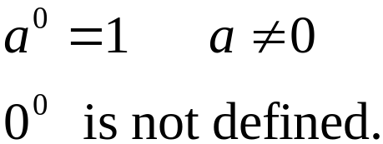
Integer Exponents
For n an integer and a a real number:
1. For n a positive integer,
2. For n = 0,
Barnett/Ziegler/Byleen College Mathematics 12e

Slide 4
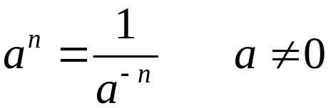
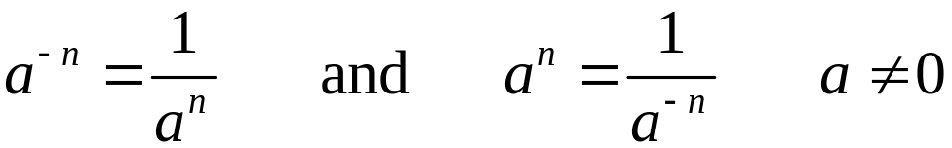
Integer Exponents
For n an integer and a a real number:
3. For n a negative integer,
If n is negative, then (–n) is positive.
Note: It can be shown that for all integers n,
Barnett/Ziegler/Byleen College Mathematics 12e

Slide 5

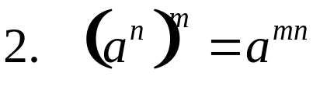

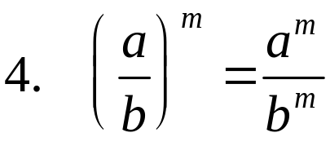
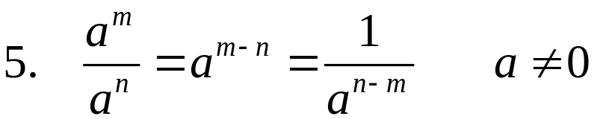
Exponents Properties
For n and m integers and a and b real numbers,
Barnett/Ziegler/Byleen College Mathematics 12e

Slide 6

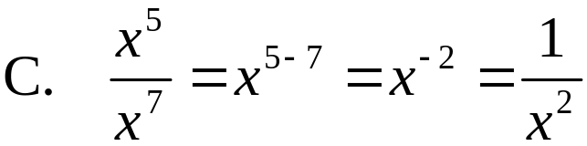
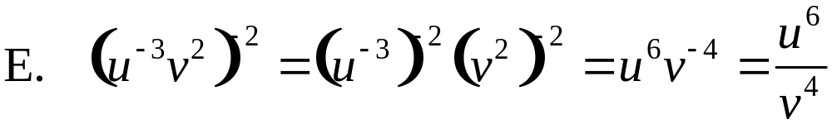
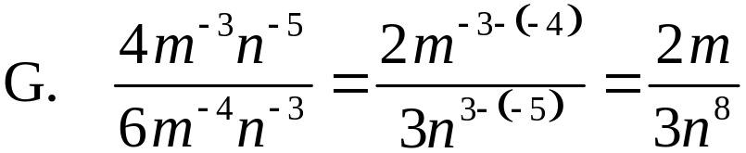
Exponents Properties
Simplify, and express the answers using positive exponents only.
Barnett/Ziegler/Byleen College Mathematics 12e

Slide 7
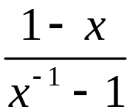
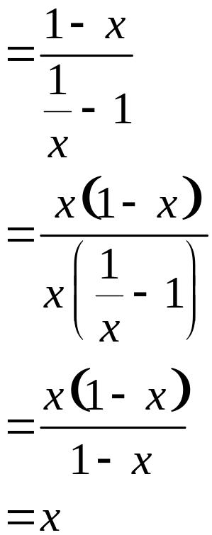
Exponents Properties
Write as a simple fraction with positive exponents.
Barnett/Ziegler/Byleen College Mathematics 12e

Slide 8




Scientific Notation
A number in the following form is said to be in scientific notation:
Write in scientific notation.
Write in standard decimal form.
Barnett/Ziegler/Byleen College Mathematics 12e

