Slide 1
Restaurant Market Research
Capstone Project
-
IBM Data Science Professional Certificate

Slide 2
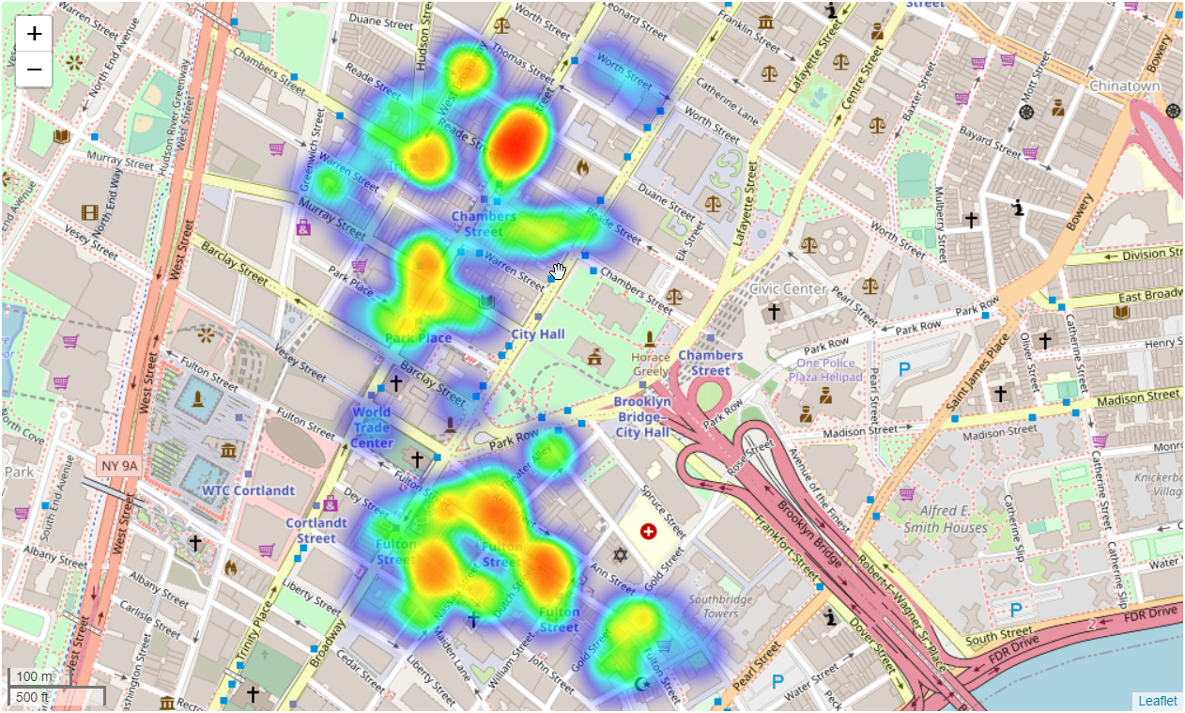
Restaurant Market Research
Using heatmaps to identify potential locations for locally novel food service ventures.

Slide 3
Example Heatmap
Area
1
Heatmap shows two distinct areas
Area
2

