Slide 1
Did covid-19 impact crime in
Los Angeles?
Group 7: Pratik Khadse, Hsuan-Ting (Tommy) Wu,
Nishkarsh Khokhar, Falak Jain, Yi-Ching (Millie) Lin

Slide 2
Agenda
Questions
Datasets and Data Cleaning Process
Data Visualization
Analytics Process
Conclusion

Slide 3
Questions
How did covid-19 impact crime in Los Angeles? What other factors could lead to this impact?
Regression
Whether Asians were more likely to become victims after covid-19 in Los Angeles?
Hypothesis

Slide 4
Answering the questions - Data driven approach
Assumption 1:
Population, Income, Unemployment Rate, Location and Covid-19 may have impact on the crime in LA.
Assumption 2:
Asians were more likely to become victims after covid-19 in Los Angeles.

Slide 5
Ideal Experiment: Question 1
Ideal Experiment: Question 2
We have two worlds: one with covid, one without covid
Our variables are unemployment rate, population, median income, location, etc
Controlling for these variables, is the crime rate different for the two worlds
We have two worlds: one with covid, one without covid
Is the proportion of crimes against Asians different for the two worlds.

Slide 6
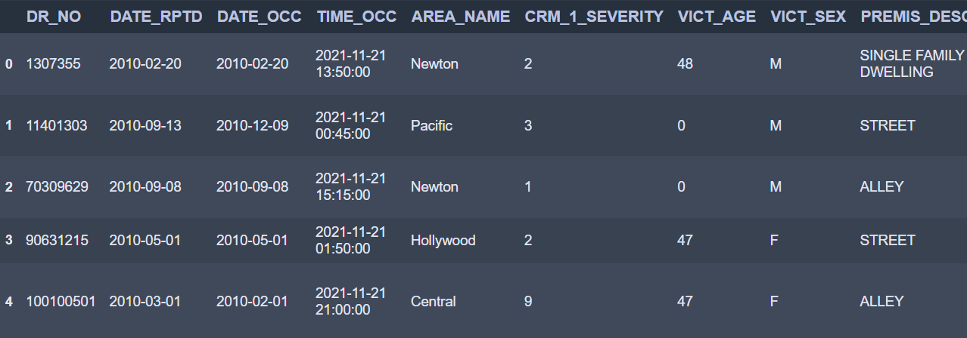
Dataset
1. Los Angeles Crime Data 2010-2021
Data source: Kaggle
This dataset reflects incidents of crime in the City of Los Angeles from 2010 - 2019 as well as from 2020-2021 in two separate data sets
This data is transcribed from original crime reports that are typed on paper and therefore there may be some inaccuracies within the data
Address fields are only provided to the nearest hundred block in order to maintain privacy

Slide 7
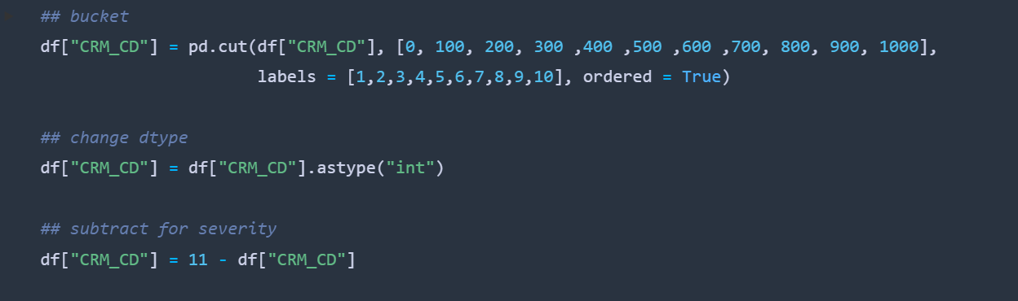
Data Cleaning
Step1. Los Angeles Crime Data 2010-2021
Removed leading zeros and converted datetime fields to datetime datatype
Segmented crimes according to severity based on crime code
Maintaining consistency between codes and descriptions

Slide 8
Data Cleaning
Step2. Zip code from longitude/latitude
The original data set consisted of coordinates
Used reverse geocoding via a Google API
Obtained zip code details for every set of coordinates
Sample address returned from Google API Call:
164 W Jefferson Blvd, Los Angeles, CA 90007, USA
Using string formatting, we extract the zip code from this address
Merged the zipcodes on the dataset in order to merge demographic data

Slide 9
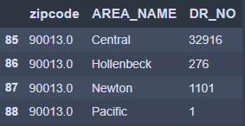
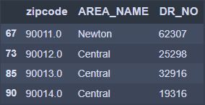
Data Cleaning
Step3. Zip Code / Area
Issue: Crimes committed in same zip codes handled by different police departments (areas)
Solution: Find area of zip code with highest number of cases and use that as the area zip code belongs to
Before
After

Slide 10
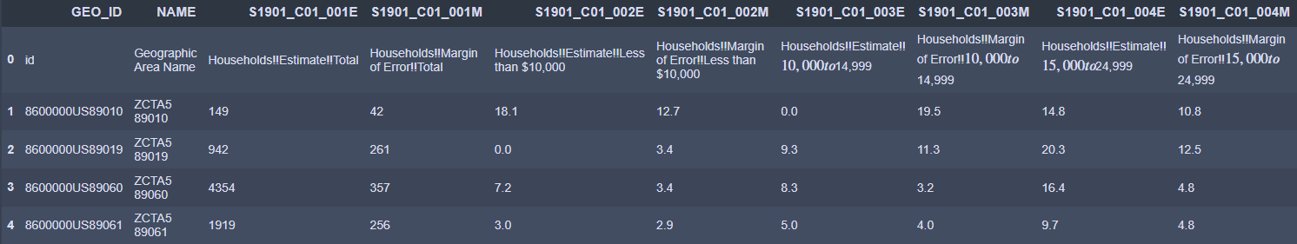
Dataset
2. US Census
Data source: United States Census Bureau
The dataset includes Unemployment rate / Median household income / Population in each ZCTA zip code in LA county
Years: 2011 - 2019, based on American Community Survey data
27 csv files total

Slide 11
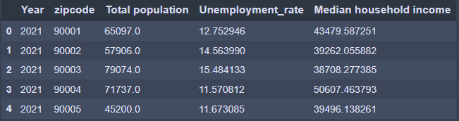
Data Cleaning
Step1. Census Data
Choose specific columns from data set:
Households!!Estimate!!Median income (dollars)
Percent!!EMPLOYMENT STATUS!!Percent Unemployed
Estimate!!SEX AND AGE!!Total population
Added year for year file
2010/2020/2021: Estimated using average percentage for each zipcode from the 9 years
Extracted zip code from original format
Combine population/unemployment rate/income into one

Slide 12
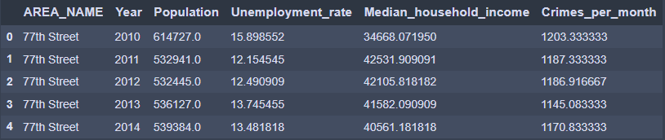
Data Cleaning
Step2. Connect crime with census data
Census data left join zip/area dataframe
Remove zip codes from census that did not have crime data
Group by area and year
Population: Sum
Unemployment rate / Income: Average
Crime: From crime dataset, find average monthly number of crimes (2021 divide by 5)
Combine into one dataframe

Slide 13
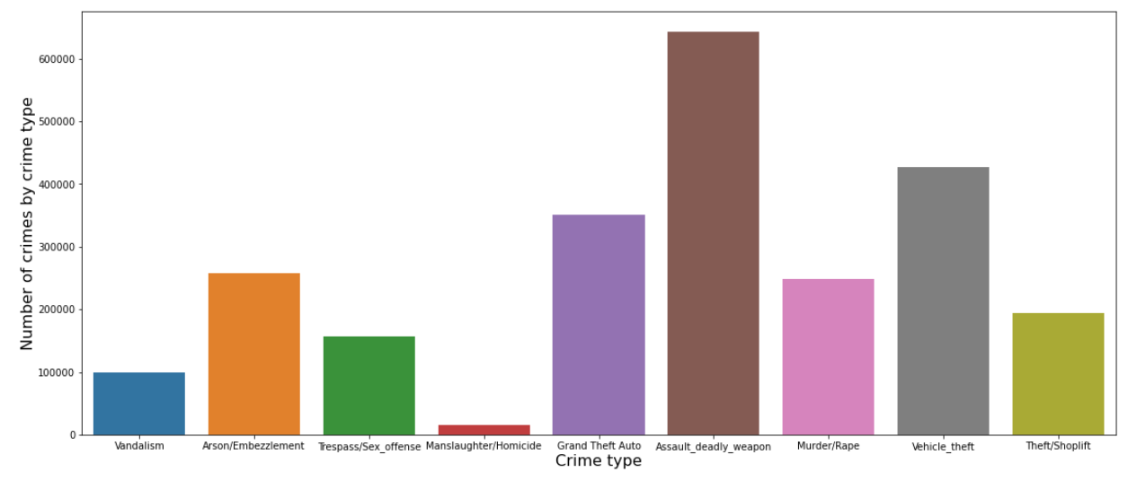
Data Visualization - Descriptive Statistics
1. Number of Crimes by Crime Type
Assault with deadly weapons are the most common crimes, followed by vehicle theft

Slide 14
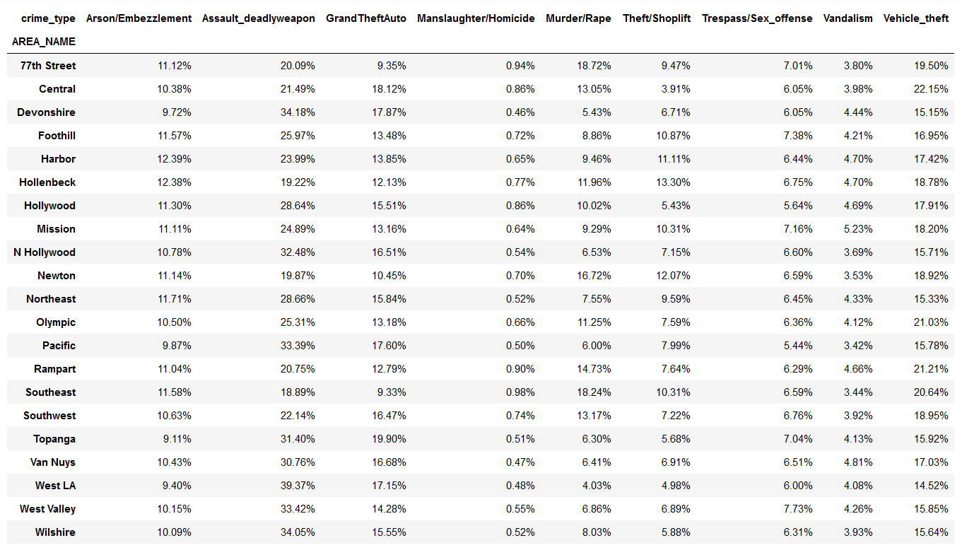
Data Visualization - Descriptive Statistics
2. Proportion of Crime by Area Name and Crime Type
For each area in LA, deadly weapon assault(red) is the most common crime type, followed by vehicle theft(orange)

Slide 15
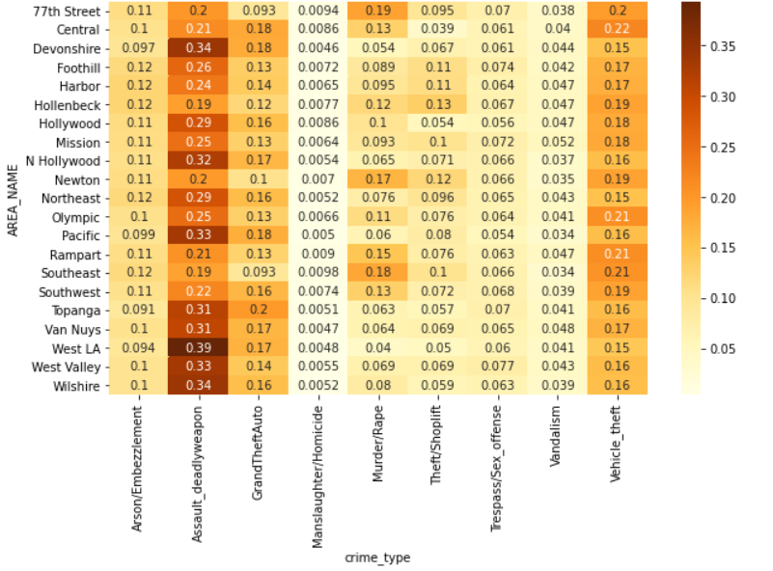
Data Visualization - Descriptive Statistics
3. Heat Map for Crime Type by Area Name
Previous slide’s information in a heatmap to highlight which areas are particularly dangerous(darker the worse)

Slide 16
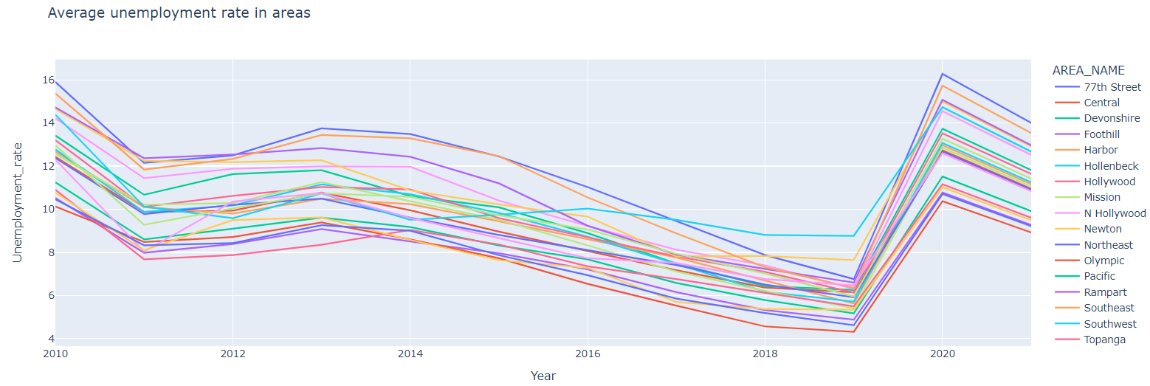
Data Visualization - Descriptive Statistics
4. Average Unemployment Rate in LA Areas
For the last 11 years, we see the unemployment rate drop on a consistent basis, until 2020 during covid where there was a significant spike in all areas, followed by a drop in 2021.

Slide 17
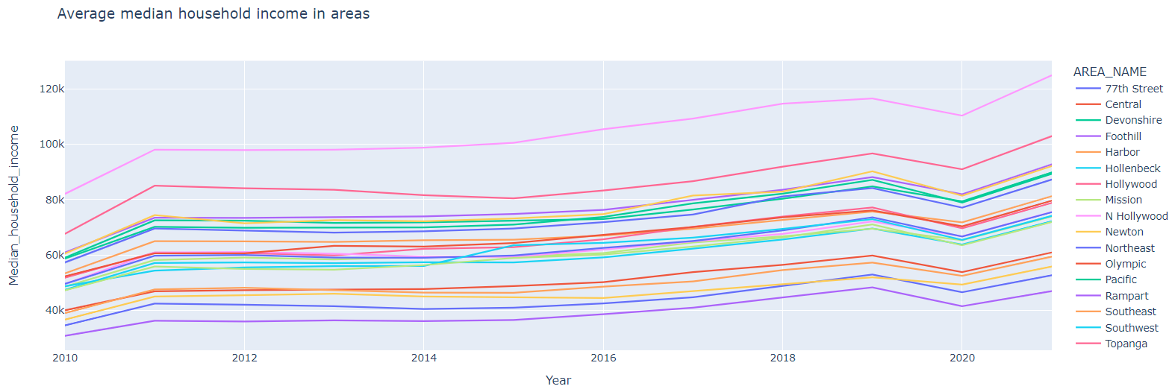
Data Visualization - Descriptive Statistics
5. Average Median Household Income in LA Areas
For the last 11 years, we see the median household income rise on a consistent basis, until 2020 during covid where there was a big drop in all areas, followed by a sharp increase in 2021.

Slide 18
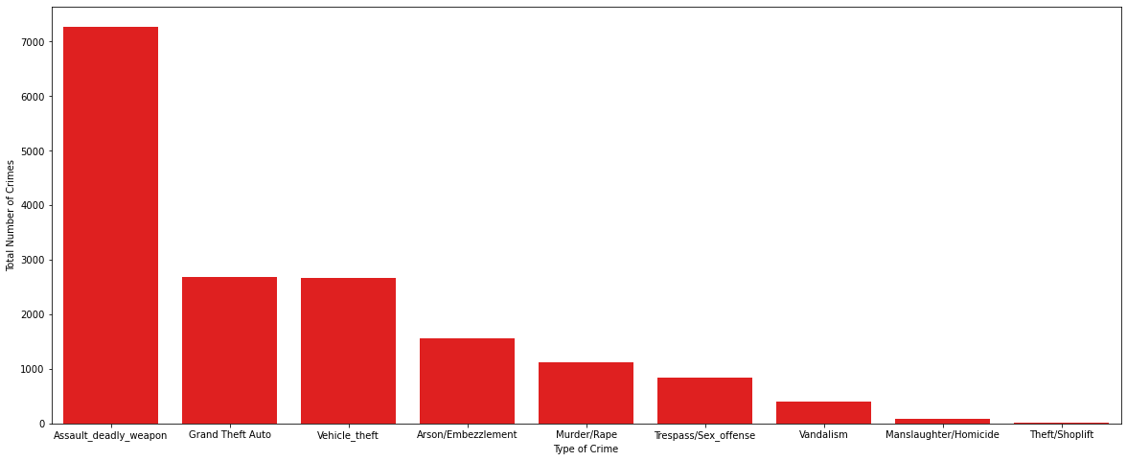
Data Visualization - Descriptive Statistics
6. Most crimes involving Asian victims are assault with deadly weapons
The chart above shows total number of crimes against Asians by crime type. Over the last 11 years, there have been more than 7000 deadly weapon assault cases against Asian community.

Slide 19
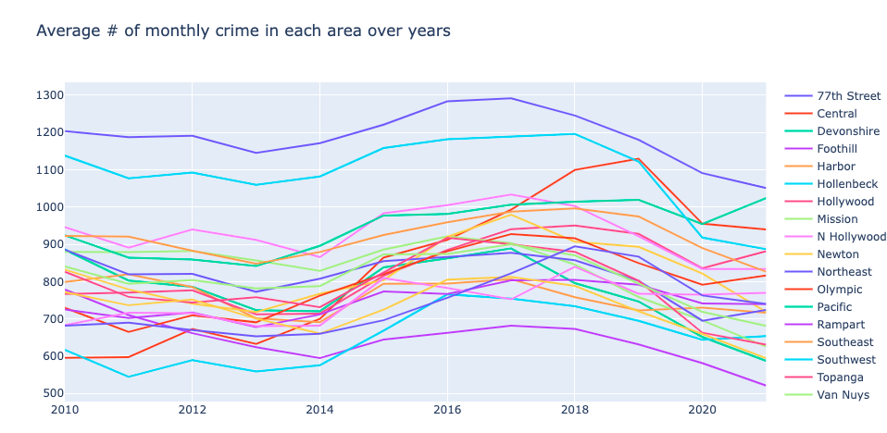
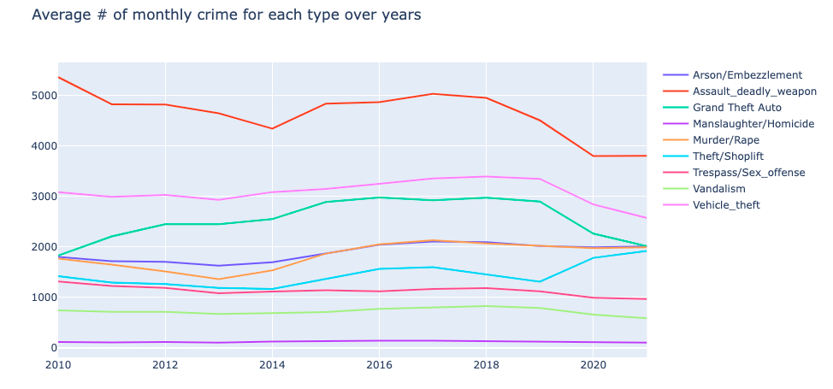
Analytics Process
Q1. How did covid-19 impact crime in Los Angeles? What other factors could lead to this impact?
Notes:
Replace monthly crime type

Slide 20
Analytics Process
Q1. How does covid-19 impact crime in Los Angeles? What other factors could lead to this impact?
Linear Regression Model:
log(Average # of monthly crimes each year in each area) =
b0 + b1*Covid + b2*log(Population) + b3*log(Unemployment Rate) + Area Dummies
log(Median household income) does not have impact on # of crime significantly and is therefore removed from the model

Slide 21
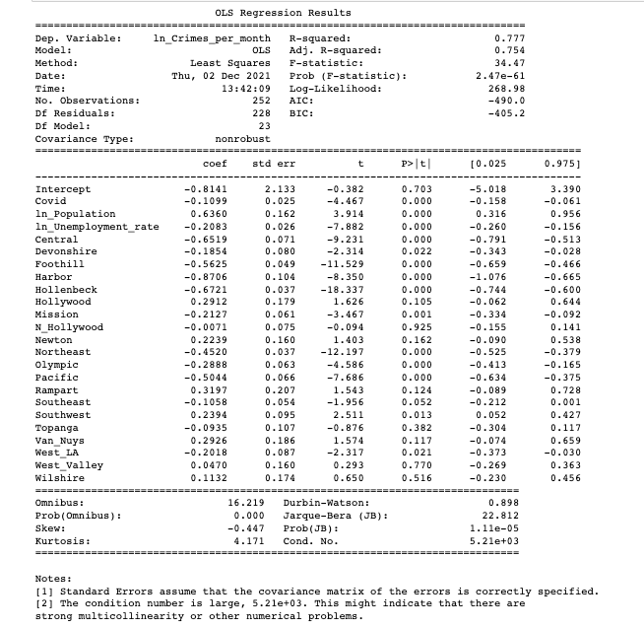
Analytics Process
Linear Regression Result:
The population and unemployment rate have an impact on the number of crime significantly.
Certain locations also significantly affect crime.
After the pandemic, the average number of monthly crimes decreases by 10.4% compared to pre-covid periods.

Slide 22
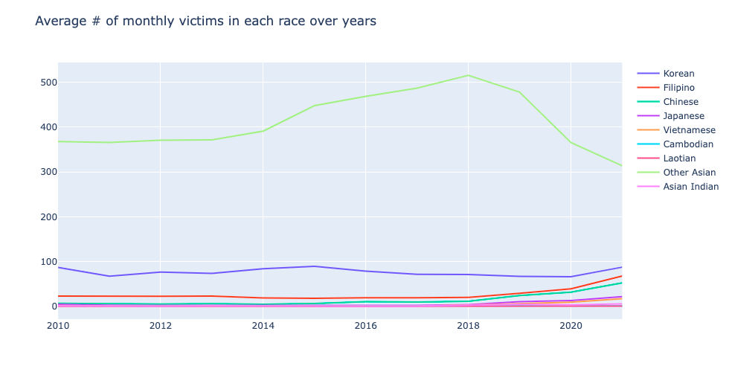
Analytics Process
Q2. Whether Asians were more likely to become victims after covid-19 in Los Angeles?

Slide 23
Analytics Process
Q2. Whether Asian are more likely to become victims after covid-19 in Los Angeles?
Two sample t hypothesis test:
Goal: To check whether the proportion of Asians victims (Chinese, Korean, Japanese, Filipino, Vietnamese, Cambodian, Laotian, Other Asian, Asian Indian) among all victims increases after covid-19 in LA.
H0: The average proportion of Asian victims among all victims before covid-19 (mu0) is the same as the average proportion after covid-19 (mu1). mu0 - mu1 = 0
Ha: The average proportion of Asian victims among all victims after covid-19 (mu1) is larger than the average proportion before covid-19 (mu0). mu0 - mu1 < 0

Slide 24
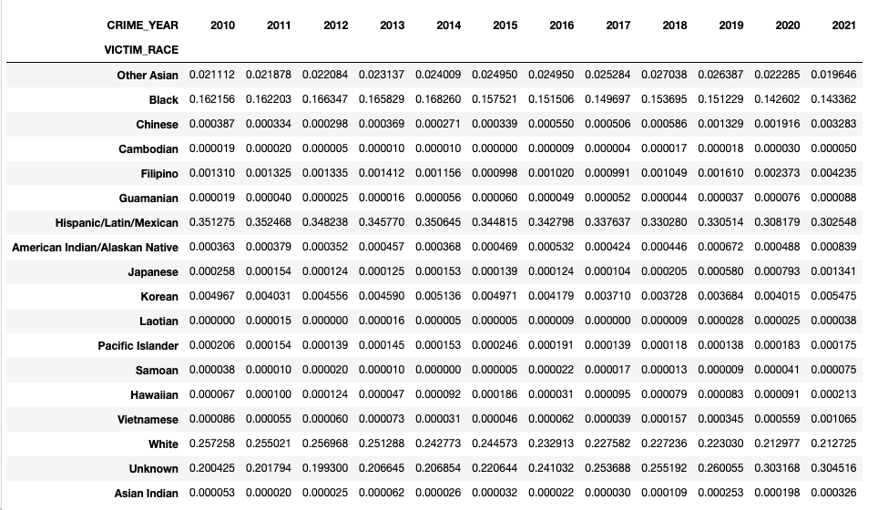
Analytics Process
Hypothesis Result:
Test Statistics = -2.54
Threshold: t(df = 9, 0.05) = −1.833
Since -2.54 < Threshold, we can reject the null hypothesis.
Inference: The average proportion of Asian victims among all victims after covid-19 is larger than the average proportion before covid-19.
The proportion of victims by race over years

Slide 25
Conclusion
Q1: How does covid-19 impact crime in Los Angeles? What other factors could lead to this impact?
The population, unemployment rate and locations have an impact on the number of crime significantly
The average monthly rate of crime decreases after the outbreak of covid-19
Q2: Whether Asian are more likely to become victims after covid-19 in Los Angeles?
Among all crimes, the proportion of the asian victims increases after the outbreak of covid-19

Slide 26
Reference
Kaggle: https://www.kaggle.com/sumaiaparveenshupti/los-angeles-crime-data-20102020?select=Crime_Data_from_2010_to_2019.csv
United States Census Bureau: https://data.census.gov/cedsci/
Household median income: https://data.census.gov/cedsci/table?q=income&g=0400000US06%248600000&tid=ACSST5Y2019.S1901&hidePreview=true
Unemployment: https://data.census.gov/cedsci/table?q=unemployment&g=0400000US06%248600000&tid=ACSST5Y2019.S2301&hidePreview=true
Population: https://data.census.gov/cedsci/table?q=demographic&g=0400000US06%248600000&tid=ACSDP5Y2019.DP05&hidePreview=true
Google API Call: https://maps.googleapis.com/maps/api/geocode/json?latlng=34.0197,-118.2749&key

Slide 27
Thanks for Listening!

Slide 28
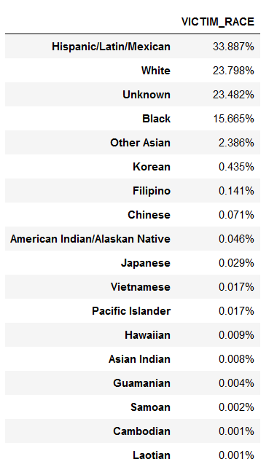
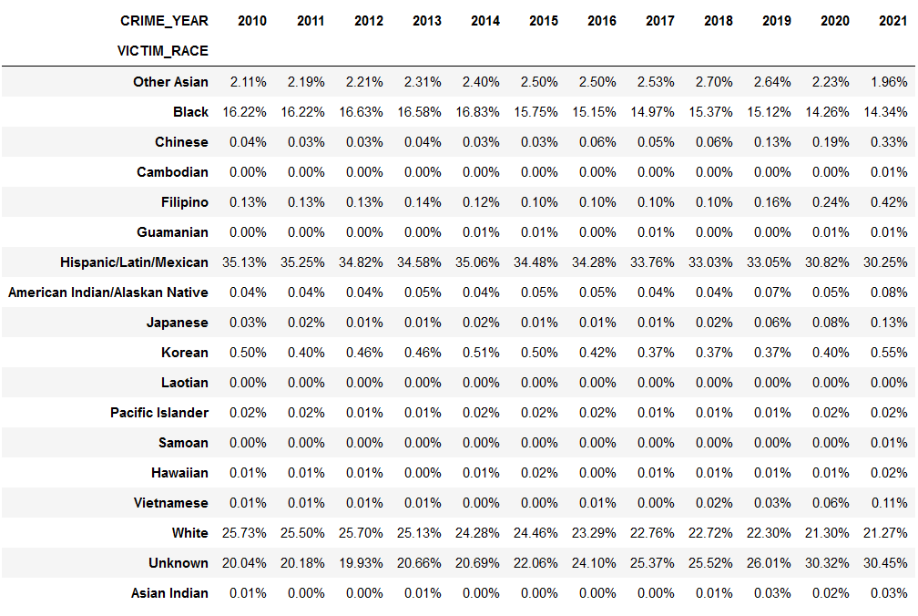
Appendix
Proportion of Victim by Race Over Years
Total for last 11 years, 34% of victims of crime in LA are Hispanic, followed by 24% White and 16% Black community. Over the years, it may seem like crimes against Black, Hispanic and White community have fallen, but do note the Unknown column. It seems that victim race records have not been kept as well as they were 10 years ago.

Slide 29
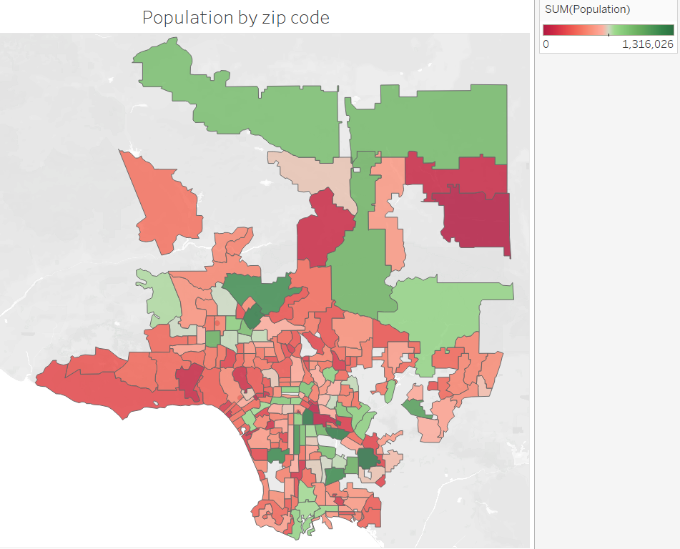
Appendix
Population Density by LA Zipcodes

