Slide 1
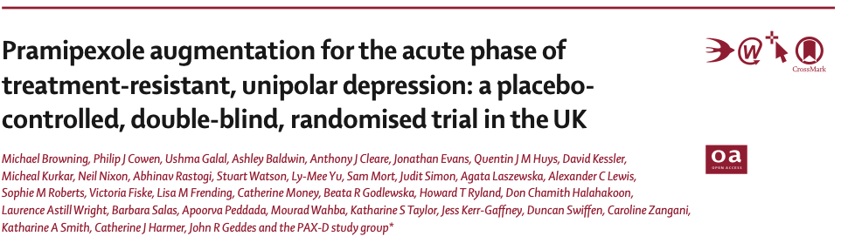
Oral Presentation
Thomas HUSSON
March 11, 2026

Slide 2
Introduction
Lancet Psychiatry 2025
Phase 3 multicentre double-blind randomised control, double-blind
9 centers in england
Population : Adults with treatment-resistant unipolar depression
Investigational drug : Pramipexole added to ongoing antidepressant treatment
Aim of the study : Test if pramipexole improves depressive symptoms better than placebo

Slide 3
What is Pramipexole ?
What is Pramipexole ?
- Selective dopamine D2/D3 agonist
- Potentially targets anhedonia and motivation
- Used here as augmentation of antidepressant treatment
Previous evidence
- Promising but limited
- Small RCTs and observational studies
- Mixed results, but overall signal in favor of efficacy
- Need for a larger placebo-controlled trial
Notes:
Selective dopamine D2/D3 receptor agonist
Distinct from standard antidepressants which target serotonin
Interest in depression :
- Pramipexole is a selective dopamine D2/D3 receptor agonist
- It is pharmacologically distinct from standard antidepressants, which mainly
target serotonin
- It is of interest in depression because it may target anhedonia, low
motivation, and reward-processing deficits
- The biological rationale is that dopaminergic signalling is involved in
reward learning and motivational drive
- In this study, pramipexole was used as an add-on treatment to ongoing
antidepressant therapy
Et pour la slide suivante :
Evidence Base for Pramipexole in Depression
- Before this trial, evidence was promising but limited
- The article cites a systematic review reporting:
- 5 completed randomized controlled trials
- 3 open-label studies
- 5 observational studies
- One prior RCT in 65 unipolar TRD patients found benefit on a continuous
depression outcome, but not clearly on response
- Another RCT suggested that 1 mg/day could be effective, while 5 mg/day had
poor tolerability
- A very small trial in unipolar depression did not show a clear between-group
difference
- Case series suggested possible benefit at higher doses, around 2.5 mg/day
- Therefore, before the current paper, the signal was interesting but not
definitive
- The current Lancet Psychiatry trial provides the strongest randomized
evidence so far in treatment-resistant unipolar depression

Slide 4
Study design
Inclusion and assessing participants
Inclusion criteria
Adults ≥18 years
DSM-5 major depressive disorder
QIDS-SR16 >10
Ongoing antidepressant treatment
Failure of ≥2 antidepressants in the current episode
Exclusion criteria
Psychosis or bipolar disorder
Impulse control difficulties
Concomitant antipsychotic treatment
Contraindication / unstable medical illness
2 weeks run-in
Randomization 1:1
Placebo
Pramipexole
Start: 0.25 mg/day
Up to 2.5 mg/day
Primary endpoint at week 12
= Change in QIDS-SR16 score
Follow-up to week 48
Efficacy – Safety - Tolerability

Slide 5
Study design
Inclusion and assessing participants
IDENTi-FICATION
Primary and seconday care services
Search in health system records
Advertising
ELIGIBI-LITY
Assessed and managed in their local secondary care service
Lack of response of ≥ 2 antidepressants for this episode, for 4 weeks
One antidepressant at time OR already augmentation strategy (≥ 2 antidepressants at the same time)

Slide 6
Study design
Inclusion and assessing participants
Inclusion criteria
Adults ≥18 years
DSM-5 major depressive disorder
QIDS-SR16 >10
Ongoing antidepressant treatment
Failure of ≥2 antidepressants in the current episode
Exclusion criteria
Psychosis or bipolar disorder
Impulse control difficulties
Concomitant antipsychotic treatment
Contraindication / unstable medical illness
2 weeks run-in
Randomization 1:1
Placebo
Pramipexole
Start: 0.25 mg/day
Up to 2.5 mg/day
Primary endpoint at week 12
= Change in QIDS-SR16 score
Follow-up to week 48
Efficacity – Safety - Tolerability

Slide 7
Study design
Randomization 1:1
METHODS
Online randomisation system
MINIMISATION after 10 patients randomized with 80% bias
center
Age < 50 vs > 50 yo
Gender
Severity (QIDS-SR16)
DOUBLE-BLIND
Open label only for central pharmacy team
At the end of the study : patients could continue pramipexole if wanted
Participants asked to guess their confidence on receiving pramipexole or placebo (0 to 4)
Notes:
Randomisation was performed centrally through an online system,
with a 1:1 allocation ratio.
The authors used a minimisation procedure
to balance the two groups on four important prognostic factors:
study site, age, sex, and baseline depression severity.
The first ten participants were randomised without minimisation
in order to avoid predictability at the beginning of the trial.
After that, the algorithm favoured, with an 80% probability,
the treatment allocation that best reduced imbalance between the groups,
while still preserving a degree of randomness.
This strategy improved baseline comparability between the groups
and strengthened internal validity,
while also maintaining good allocation concealment.

Slide 8
Study design
Inclusion and assessing participants
Inclusion criteria
Adults ≥18 years
DSM-5 major depressive disorder
QIDS-SR16 >10
Ongoing antidepressant treatment
Failure of ≥2 antidepressants in the current episode
Exclusion criteria
Psychosis or bipolar disorder
Impulse control difficulties
Concomitant antipsychotic treatment
Contraindication / unstable medical illness
2 weeks run-in
Randomization 1:1
Placebo
Pramipexole
Start: 0.25 mg/day
Up to 2.5 mg/day
Primary endpoint at week 12
= Change in QIDS-SR16 score
Follow-up to week 48
Efficacity – Safety - Tolerability

Slide 9
Study design
Placebo
Pramipexole
Start: 0.25 mg/day
Up to 2.5 mg/day
PROCE-DURES
2 weeks run-in (stability)
Dose increased each 3 days, targeting 2,5mg in 4 weeks
If side-effects : maximum dose tolerated
CHANGES
Changes of the initial antidepressant permitted > 12wks

Slide 10
Study design
Inclusion and assessing participants
Inclusion criteria
Adults ≥18 years
DSM-5 major depressive disorder
QIDS-SR16 >10
Ongoing antidepressant treatment
Failure of ≥2 antidepressants in the current episode
Exclusion criteria
Psychosis or bipolar disorder
Impulse control difficulties
Concomitant antipsychotic treatment
Contraindication / unstable medical illness
2 weeks run-in
Randomization 1:1
Placebo
Pramipexole
Start: 0.25 mg/day
Up to 2.5 mg/day
Primary endpoint at week 12
= Change in QIDS-SR16 score
Follow-up to week 48
Efficacity – Safety - Tolerability

Slide 11
Study design
Primary endpoint at week 12
= Change in QIDS-SR16 score
PRIMARY
Change from baseline in QIDS-SR16 (0 to 27) at week 12
/1wk before week 12 then /4wks after week 12 up to wk48
Well validated scale with good psychometric properties
SECON-DARIES
Change QIDS-SR16 at week 48
Response and remission in QIDS-SR16 at week 12
Clinician rated QIDS-C
Snaith Hamilton Pleasure Scale for rating anhedonia
General Anxiety Disorder Score (GAD-7)
Others questionnaires related to depression
Adverse : impulsive, mania, etc with questionnaires

Slide 12
Statistical analysis
Endpoints
Primary Endpoint : changes in the QIDS-SR score
SD of the score = 5,4 → standardized effect size of 3/5,4= 0,56
Sample Size Determination
Clinically relevant : ≥ 3 points differences on QIDS-SR
Power (β risk): 90%
Type 1 error (ɑ) : 5%
Initial drop out rate at week 12 assumed at 20% (8% finally)
→ 75 patients per group included in ITT.

Slide 13
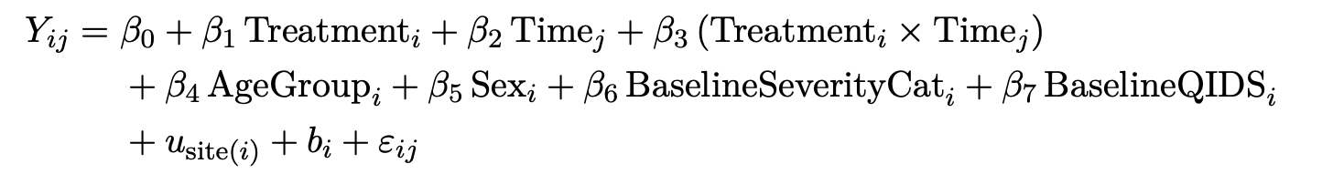
Statistical analysis
Primary endpoint : ≥ 3 points differences on QIDS-SR at week 12
Analysed using a generalised linear mixed-effects model
Fixed effects | Random effects
Treatment Time Treatment * Time Minimisation variables : Age group Gender Severity at baseline QIDS at baseline | Site random effect Participant random intercept
Interpretation :
Y_{ij} : QIDS-SR16 score for participant i at timepoint j
Treatment effect at week 12 is read from treatment*time interaction at wk12
Longitudinal model using all data

Slide 14
Statistical analysis
Other outcomes
CONTI-NUOUS
Analyzed with mixed-effects linear regression model
Reported as adjusted mean differences (obtained from mixed-effects model)
BINARY
mixed-effects logistic regression
Reported as marginal relative risks
COUNTS
Mixed-effects Poisson regression model with robust standard errors
Incidence rate ratio

Slide 15
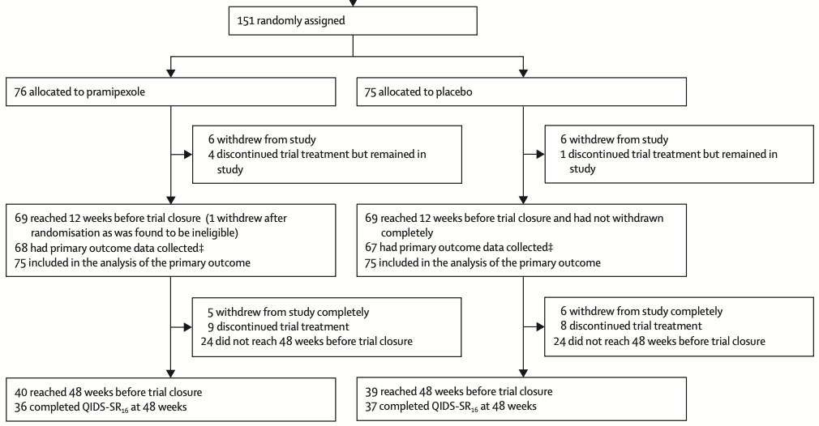
Results
75 patients per group at week 12
≈ 40 patients per group at week 48

Slide 16
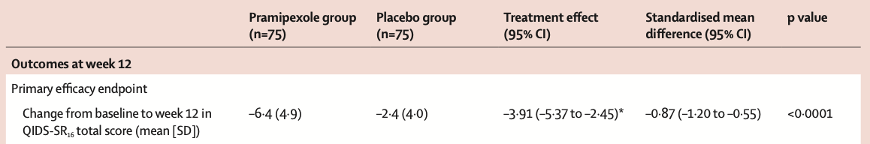
Results
Primary outcome : changes at week 12
Observed mean change : -6,4 in QIDS-SR scale
Adjusted mean change : -3,91 in QIDS-SR scale
Standardised mean change : -0,87 (= Cohen’s d)

Slide 17
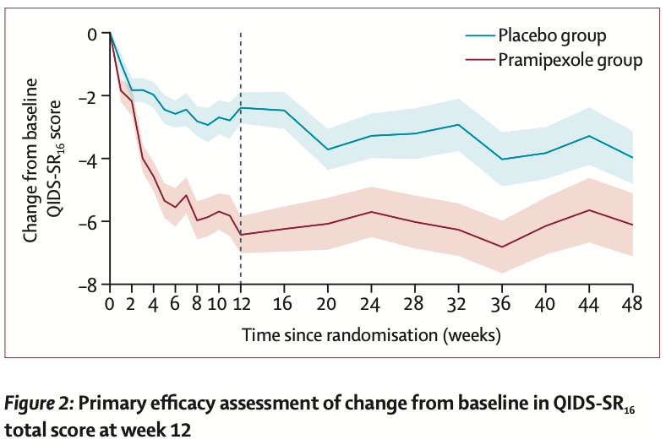
Results
Benefit maintained during time
At wk 48 : Adjusted mean difference : -2,02
Follow up incomplete

Slide 18
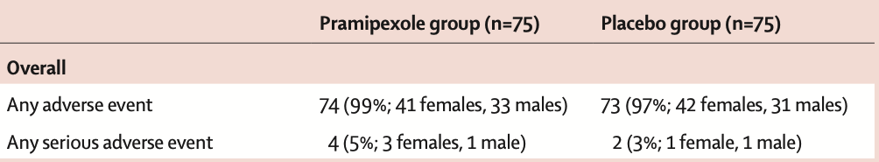
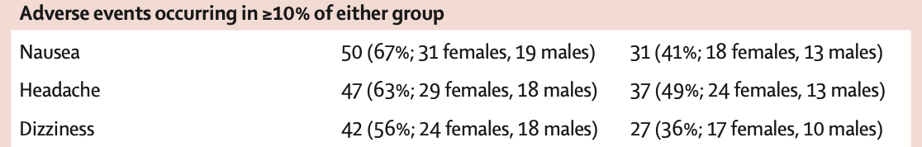
Results
Any adverse event was common in both groups
However, discontinuation due to adverse effects was more frequent with pramipexole (20% vs 5%)
But specific effects of pramipexole : nausea, headache, dizziness

Slide 19
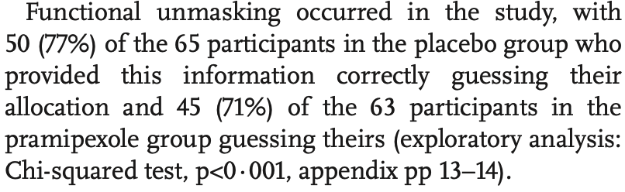
Results
Functional unblinding occurred
≈ 75% patients
± expectancy bias

Slide 20
Discussion
Strengths of the trial:
Design : multicentre, double blind, placebo
Central randomisation with minimisation
Clinically revelant population
Follow up to 48 weeks
Key limitations of the trial:
Self-rated primary outcome (expectancy bias)
Frequent functional unblinding
Moderate sample size
Missing datas for 48 weeks
Notes:
Functional unblinding likely: many participants correctly guessed treatment
allocation
- Primary outcome was self-rated, so more vulnerable to expectancy bias
- Tolerability issue: more discontinuations due to adverse effects with
pramipexole
- Recognisable adverse-effect profile may have contributed to unmasking
- Moderate sample size: limited power for rare harms and subgroup analyses
- External validity remains limited: UK sites, selected TRD population,
several psychiatric exclusions
- No ethnicity data collected
- Long-term interpretation is weaker because follow-up at 48 weeks was
incomplete for many participants and antidepressant changes were allowed
after week 12

Slide 21
Conclusion
Pramipexole was more effective than placebo at 12 weeks in treatment-resistant unipolar depression
The benefit was clinically meaningful, but tolerability and functional unblinding limit interpretation

