Slide 1
Netflix Dataset Analysis With PySpark
A local Spark pipeline for data quality checks, statistical analysis, and chart-ready results.
Input
Processing
Output
netflix_dataset.csv
Spark DataFrames + Spark SQL
CSV files and charts in tp_netflix_spark/results
PySpark mini-project | Local Spark execution
01

Slide 2
NETFLIX SPARK ANALYSIS
Pipeline Overview
9,827
25,793
43
19
movies after cleaning
movie-genre rows
original languages
distinct genres
Local CSV
>
Spark read
>
Clean + type
>
Explode genres
>
SQL aggregations
>
CSV + charts
The project runs locally with master local[*], but uses Spark's distributed execution model.
The shell script only launches the Python program; the processing logic is in PySpark.
PySpark mini-project | Local Spark execution
02

Slide 3
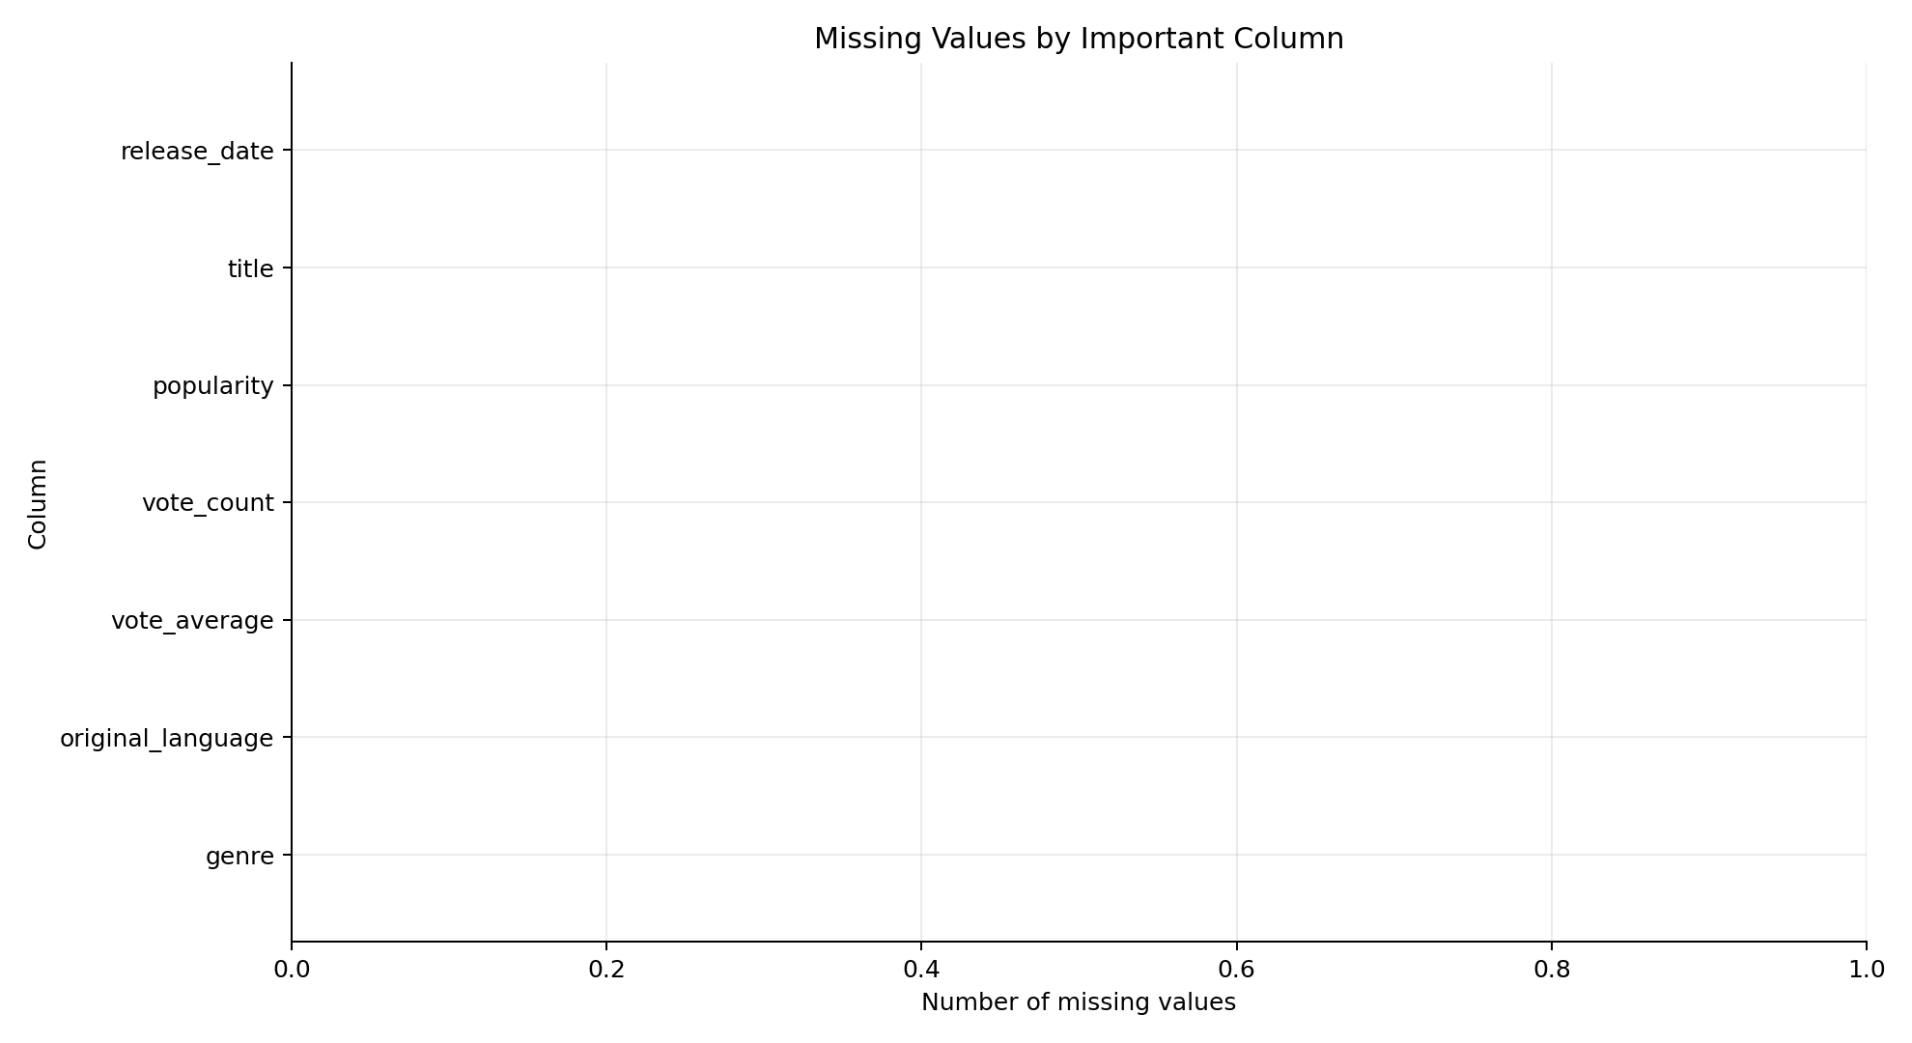
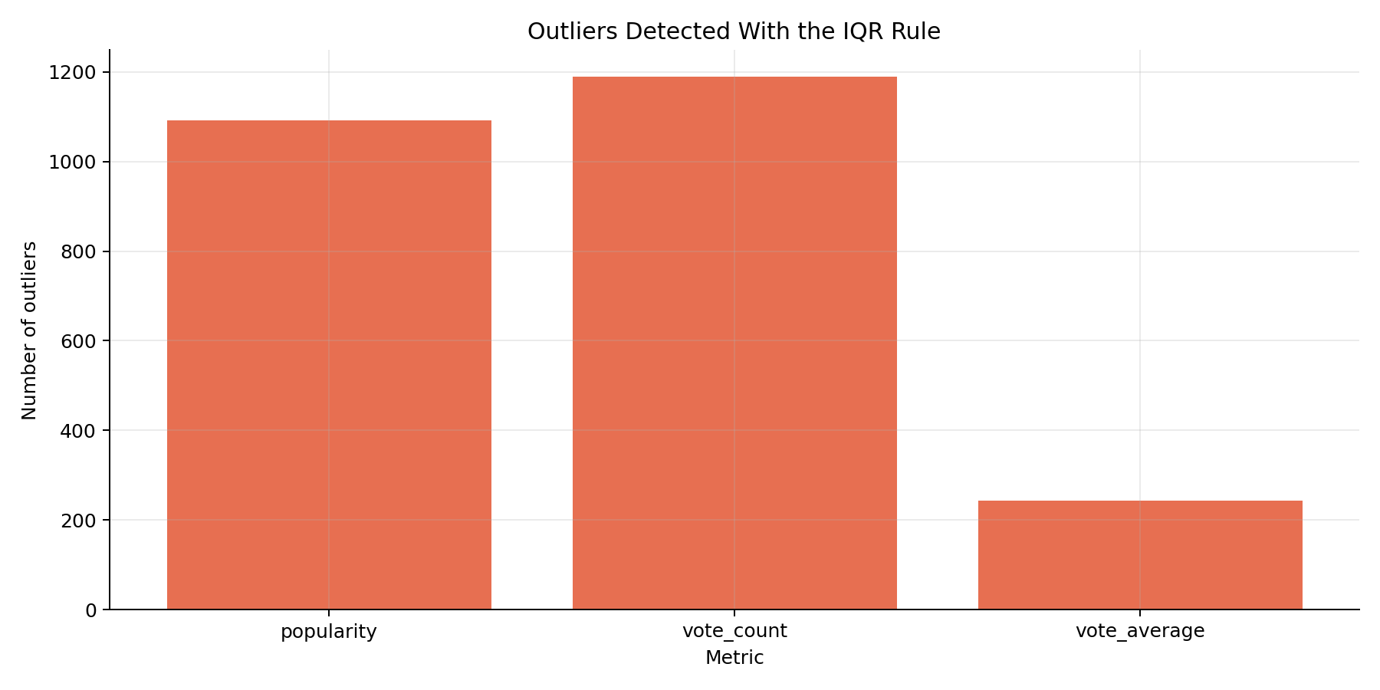
NETFLIX SPARK ANALYSIS
Data Quality: Missing Values and Outliers
Missing values are checked on columns required for the analysis.
Outliers are detected with the IQR rule: Q1 - 1.5*IQR and Q3 + 1.5*IQR.
Outliers are reported, not automatically removed, to keep the analysis transparent.
PySpark mini-project | Local Spark execution
03

Slide 4
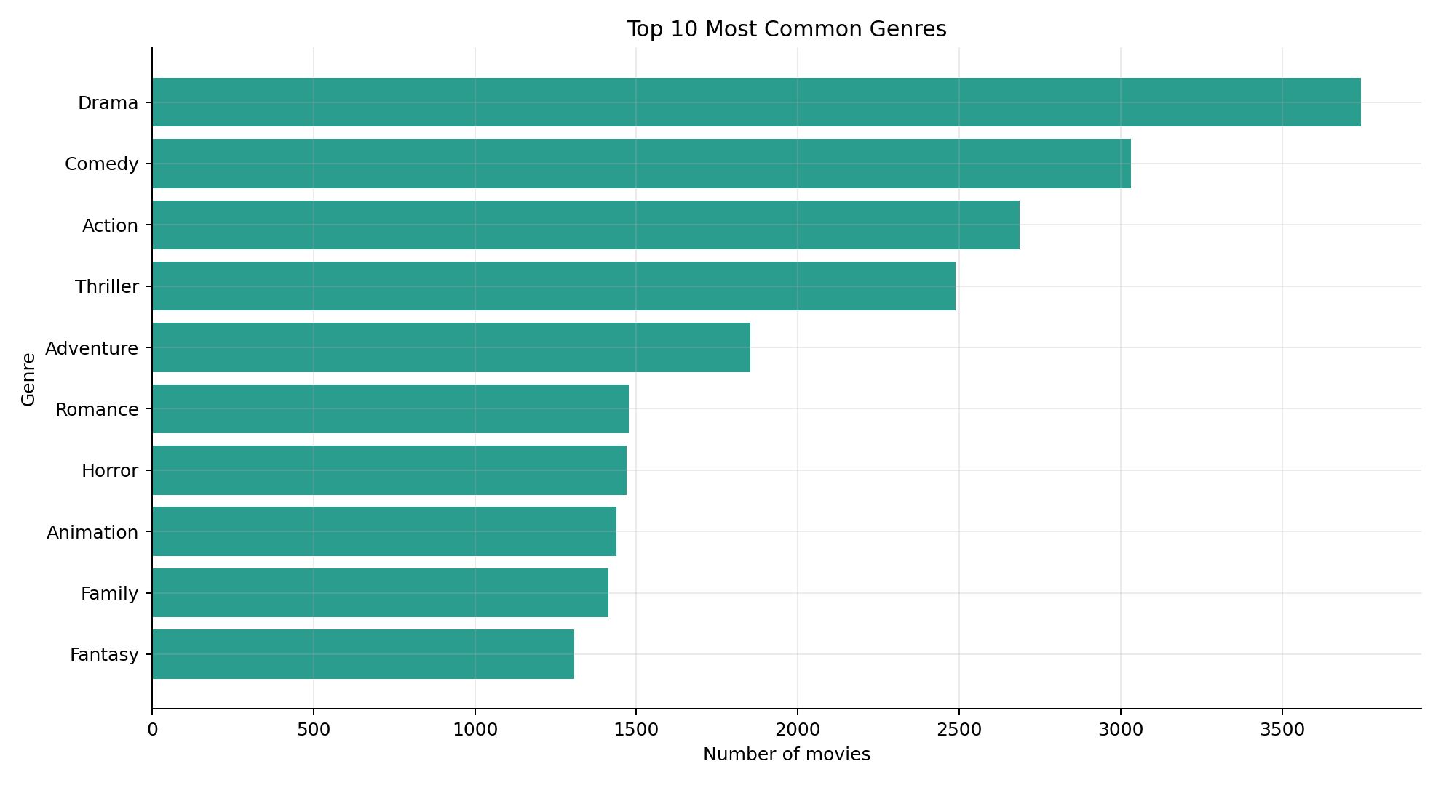
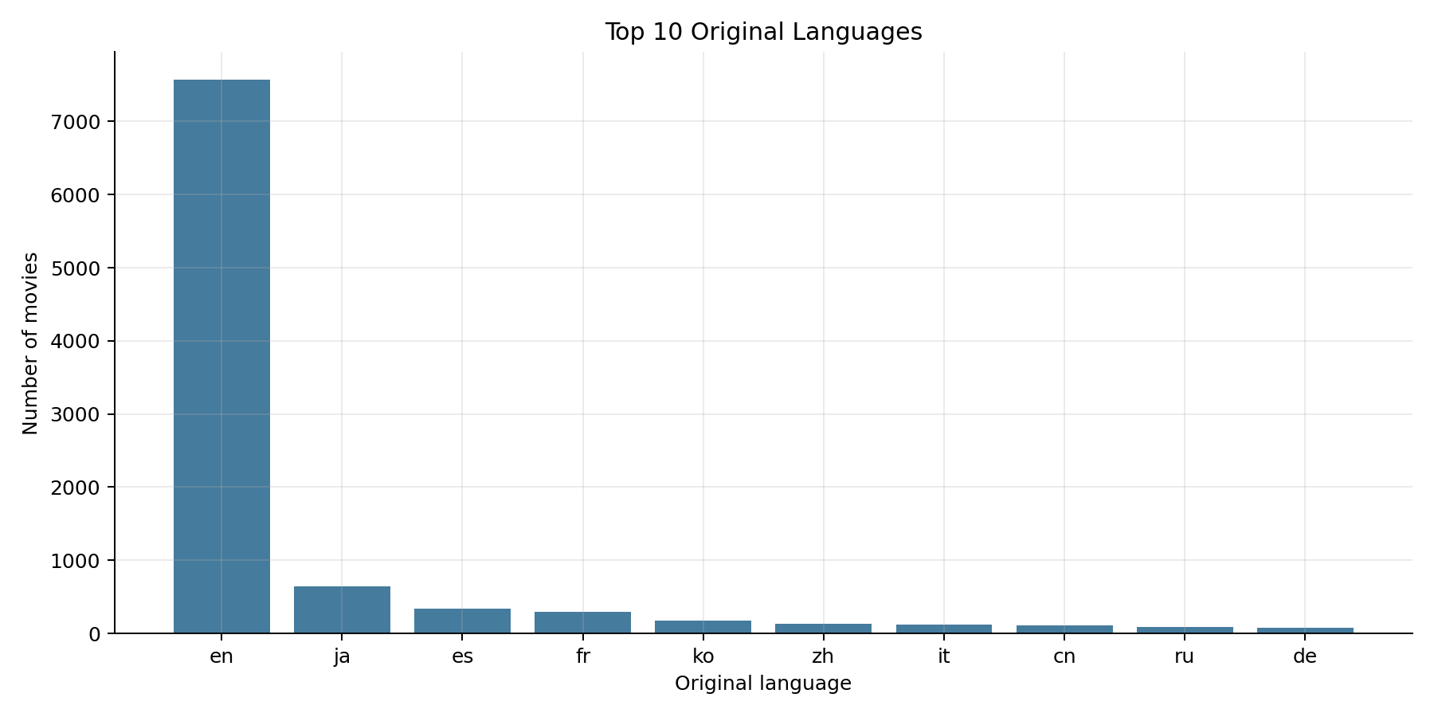
NETFLIX SPARK ANALYSIS
Genres and Languages
Drama, Comedy, Action, and Thriller dominate the catalog, while English is by far the most common original language.
PySpark mini-project | Local Spark execution
04

Slide 5
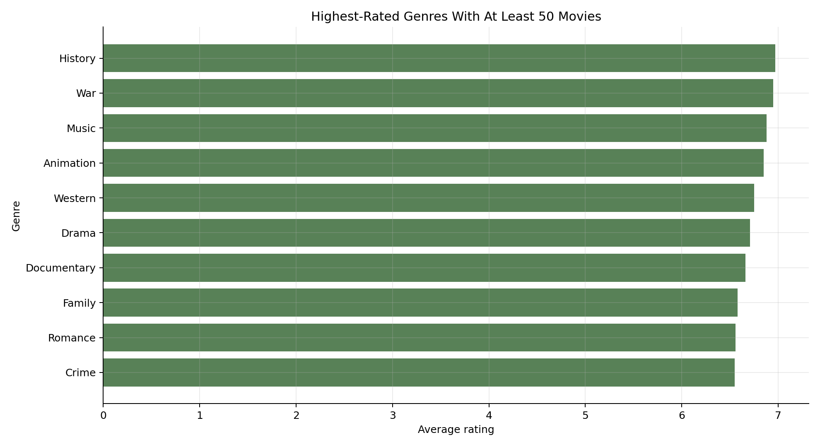
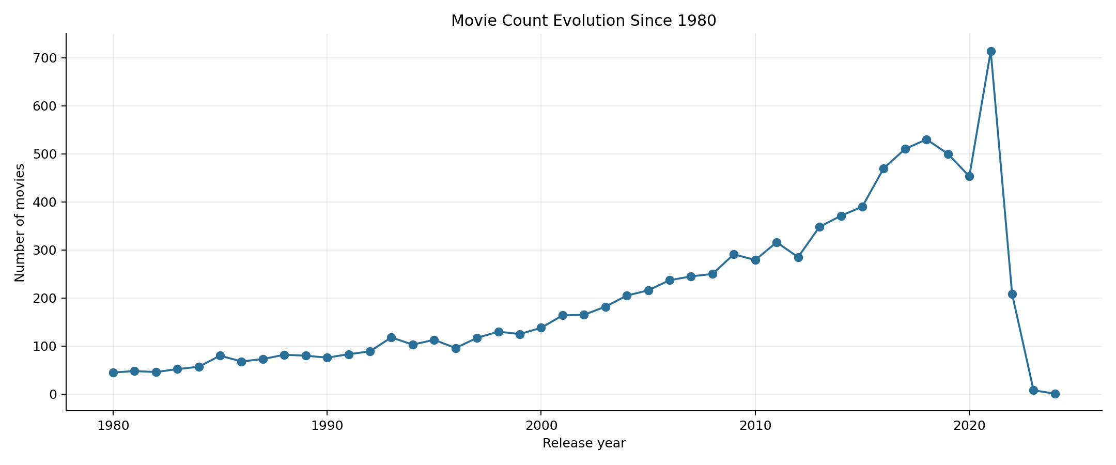
NETFLIX SPARK ANALYSIS
Release Years and Ratings
Spark SQL produces the grouped results; Matplotlib only turns those final aggregates into presentation images.
PySpark mini-project | Local Spark execution
05

Slide 6
NETFLIX SPARK ANALYSIS
What the Project Demonstrates
Spark concepts
Limits and next steps
Transformations: select, cast, dropna, split, explode
The dataset is small compared to real Big Data workloads.
Actions: count, collect on small aggregated outputs, write.csv
Execution is local, not on a real cluster.
Aggregations: groupBy, count, avg, min, max
A next step could use Spark MLlib to predict rating or popularity.
Spark SQL temporary views for readable analysis
The pipeline remains easy to scale because the logic is Spark-based.
PySpark mini-project | Local Spark execution
06

