Slide 1
Stochastic Resonance, SNN models of the visual system
Thomas Delaney
17/09/2020

Slide 2
Stochastic Resonance
When the a certain level of noise aids in the detection of signal.
Common in natural processes.
Observed in non-linear processes or processes that involve thresholding, in particular.

Slide 3
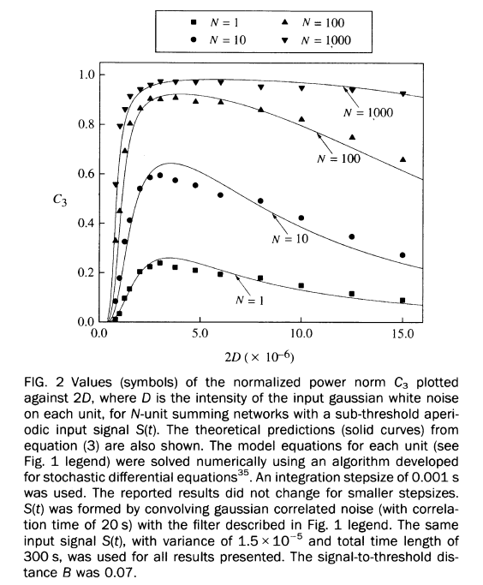
Stochastic Resonance
Collins et al. (1995) showed that a network of excitable FitzHugh–Nagumo (FHN) neurons can be optimized to a fixed level of noise.
The larger the network, the less degradation caused by an increase in noise beyond the optimum.
But, this network is excitable only. We need a network with excitation and inhibition components.

Slide 4
Stochastic Resonance in ASD: Increased noise
Simmons et al. (2009) mention increased noise accounting for ASD characteristics/deficits in vision/colour/facial representation.
Park et al. (2017) make a nice model, and they find that increased additive noise correlates positively with severity of ASD characteristics.

Slide 5
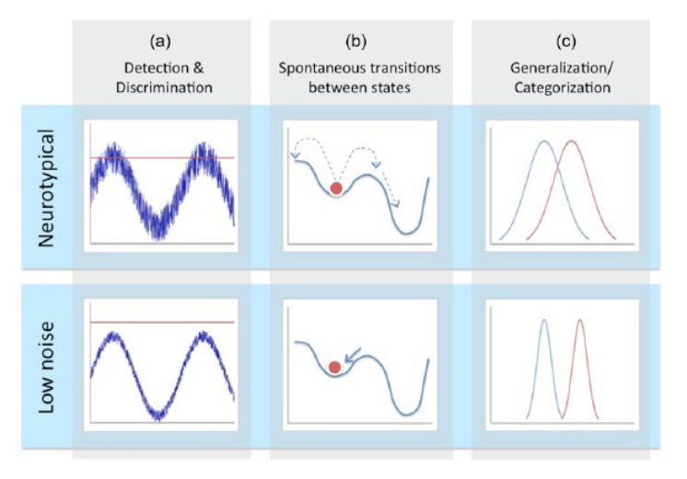
Stochastic Resonance in ASD: Decreased noise
Davis et al. (2015) argue that several ASD characteristics can be explained by decreased internal noise.
Arguments are all theoretical, but worth mentioning.

Slide 6
Increased and decreased noise?
Could an increase in internal noise at lower sensory levels induce decreased noise at higher processing levels?
Idei et al (2020), S-CTRNNPB based model shows homogeneous excitability induces reduced variance in ‘intent’.
Leads to inflexibility, clumsiness, excessive synaptic development.
Their NN model has too few layers to be biophysically realistic. Not a SNN model.

Slide 7
Spiking Neural Networks
NNs usually convery information between nodes using continuous (or piece-wise continuous) non-linear activation functions.
SNNs convey information between nodes using spike-timing and spike rates. (event based)
The activation function is usually an idealised spike generation mechanism. LIF, HH.

Slide 8
Spiking Neural Networks
STDP learning rule is the most biologically plausible, although it is usually not used.
Back-propagation of errors is difficult because neurons’ output is discontinuous.
This is usually overcome using non-biologically plausible solutions. (There are many different training methods)
It is said that backpropagation is not biologically plausible, but an academic in Bristol reckons otherwise (Rui Ponte Costa)

Slide 9
Spiking Neural Networks
We would expect SNNs to have some notion of energy efficiency.
Expect SNNs to excel at tasks that the brain excels at. (image recognition, object detection, pattern detection, etc.)

Slide 10
Convolutional SNNs
Convolutional spiking neural networks have been implemented.
Trained to achieve good accuracy on MNIST and CIFAR.
Non-biological aspects like back-prop via ‘membrane potential’
Another possibility is training a normal CNN and converting the trained CNN to a spiking CNN.
I need to read more about these networks specifically.

Slide 11
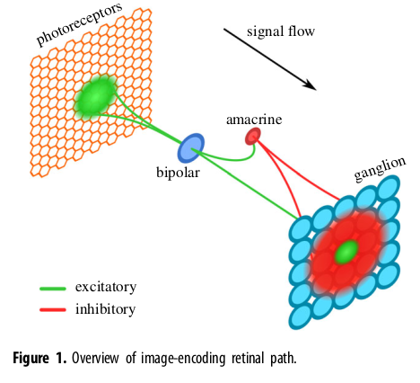
An example SNN for vision
Hopkins et al. (2018).
A model of the retina.
Has excitatory and inhibitory connections.
Trained by STDP
78% accuracy on MNIST.
More complex Conv. SNN will hopefully have E/I connections with multiple learning layers.

Slide 12
Things to do
Read about several Conv SNN.
Learn about the Deep Dream framework, and which networks will be compatible.

Slide 13
References
David R. Simmons, Ashley E. Robertson, Lawrie S. McKay, Erin Toal, Phil McAleer, Frank E. Pollick, Vision in autism spectrum disorders. Vision Research 49, 2705–2739, (2009)
J. J. Collins, Carson C. Chow. Thomas T. Imhoff, Stochastic resonance without tuning. Nature 376, 236-238, (1995)
Woon Ju Park, Kimberly B. Schauder, Ruyuan Zhang, Loisa Bennetto, Duje Tadin, High internal noise and poor external noise filtering characterize perception in autism spectrum disorder. Scientific Reports 7, 17584, (2017)
Davis G, Plaisted-Grant K., Low endogenous neural noise in autism. Autism 19(3), 351-362, (2015)
Idei H, Murata S, Yamashita Y, Ogata T., Homogeneous Intrinsic Neuronal Excitability Induces Overfitting to Sensory Noise: A Robot Model of Neurodevelopmental Disorder. Front Psychiatry 11:762, (2020)
Amirhossein Tavanaei, Masoud Ghodrati, Saeed Reza Kheradpisheh, Timothée Masquelier, Anthony Maida, Deep learning in spiking neural networks. Neural Networks 111, 47–63, (2019)
Michael Hopkins, Garibaldi Pineda-Garcı́a, Petrut, A. Bogdan, Steve B. Furber, Spiking neural networks for computer vision. Interface Focus 8, 20180007

