Slide 1
Progress update 22/10/2020
Thomas Delaney

Slide 2
Recent Activities
Learned about the Pynn interface.
Build a small spiking network inspired by Hopkins’s network.
Used it for binary classification.
Experimented with E/I balance

Slide 3
Pynn interface
A python/cython based interface with simulators (Nest, Brian, NEURON) for creating spiking neural networks.
Flexible enough to allow custom callbacks.
This allows for variable rate Poisson spiking neurons, and recording changes in weights between spiking layers.
Hopkins used an extended version specifically designed for SpiNNaker hardware.

Slide 4
Idea: Bright/Dark Classification using SNN
Two ‘Source’ layers of on/off neurons, spiking according to Poisson distributions.
Target layer of integrate and fire neurons.
Excitatory Feed-forward connections between source layers and target layer.
Inhibitory lateral connections within target layers.

Slide 5
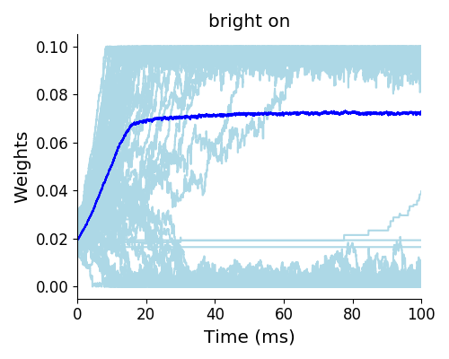
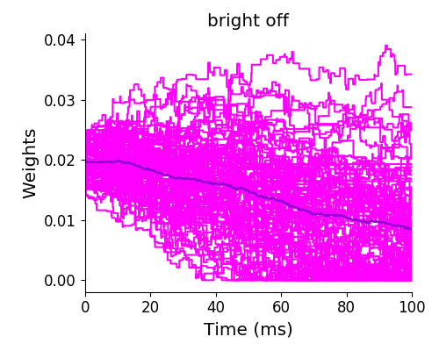
Idea: Bright/Dark Classification using SNN
Training:
The ‘stimulus’ modulates the firing rate of the source layers.
For training with a bright stimulus, the ‘on’ layer fires frequently, the ‘off’ layer fires less frequently.
Present the ‘stimulus’ for long enough for the networks to evolve (100s).
Network is defined by the connections, and their strengths.

Slide 6
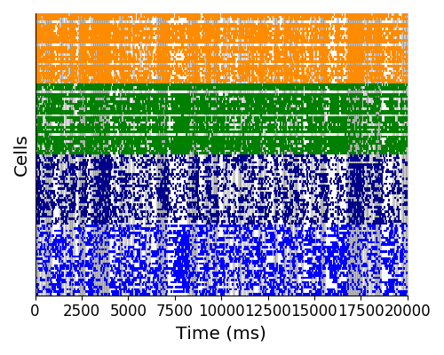
Idea: Bright/Dark Classification using SNN
Classification
Construct on/off source layers.
Connect to two different target layers, one using ‘bright’ trained network, other using ‘dark’ trained network.
Present stimuli at random.
The network with the higher firing rate corresponds to the classification.

Slide 7
Classification Performance
The classification performance is influenced by the presentation duration.
Presentation Duration (ms) | Accuracy
25 | .5
50 | .6
100 | .7
200 | .84

Slide 8
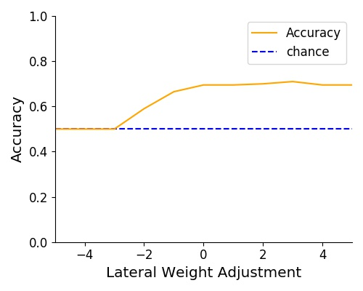
Changing E/I ratio
Added a multiple of the mean lateral weight to all lateral weights.
Reducing the lateral weight caused a great increase in firing rate, associated with a reduction in accuracy.

Slide 9
Weaknesses
Classification performance is heavily influenced by stimulus presentation duration.
Saturating synapses.
‘Accuracy’ measurement not perfect
Very high firing rates are possible for the target layer

Slide 10
Potential extensions
Pair many ‘source’ and ‘target’ layers to create an SNN analogue to the Neocognitron
Implement this network using ‘neural mass models’?
Use stimuli similar to those used in Nagai et al (2015) in order to investigate local/global processing bias.

Slide 11
References
Davison Andrew, Brüderle Daniel, Eppler Jochen, Kremkow Jens, Muller Eilif, Pecevski Dejan, Perrinet Laurent, Yger Pierre, PyNN: a common interface for neuronal network simulators, Frontiers in Neuroinformatics 2, (2009)
Michael Hopkins, Garibaldi Pineda-Garcı́a, Petrut, A. Bogdan, Steve B. Furber, Spiking neural networks for computer vision. Interface Focus 8, 20180007
Yukie Nagai, Takakazu Moriwaki, Minoru Asada, Influence of Excitation/Inhibition Imbalance on Local Processing Bias in Autism Spectrum Disorder. Proceedings of the 37th Annual Meeting of the Cognitive Science Society, 1685-1690, (2015)

Slide 12
The End

