Slide 1
Progress update - 05/11/2020
Thomas Delaney

Slide 2
ICDL/Epigenetics Robotics
“Understanding Variation in Affective Experience using Physiology” – Karen Quigley: interesting methods, similar physiology for different subjective states
“A Novel Predictive-Coding-Inspired Variational RNN Model for Online Prediction and Recognition” - Xavier Hinaut: 3 timescales of learning, application of Active inference
“Moody learners” : growing-when-required network, idea of quantifying mood
“End-To-End Pixel-Based Deep Active Inference for Body Perception and Action” - Cansu Sancaktar: combines Deep CNN with active inference and robot application
“Bayesian Optimization for Developmental Robotics with Meta-Learning by Parameters Bounds Reduction” - Maxime Petit: using past experiences to reduce the search space of optimal params, robotic application

Slide 3
ICDL/Epigenetics Robotics
“Goal-Directed Planning for Habituated Agents by Active Inference Using a Variational RNN” - Takazumi Matsumoto: similar to the other variational RNN,

Slide 4
Auditory Hypersensitivity
Read both Matsuzaki’s papers, from 2012 and 2014. Compared MEG recordings from populations of ASD with hypersensitivity, ASD without hypersensitivity, and TD children.
2012:
  Those with hypersensitivity showed delayed M50/M100 peak latencies. (Implies increased processing time.)
  M50 dipole moments were statistically larger. Implies greater activity.
  Peak latencies correlated with severity of hypersensitivty.
2014:
  M50 dipole moments increased in ASD with hypersensitivity.
  Prolonged response duration.
  Response duration correlated with severity of hypersensitivty.
Assert that hypersensitivity is associated with decreased inhibitory processing.

Slide 5
Visual Hypersensitivity
We could implement a similar set up for visual processing.
We could use a grid setup to assign receptive fields to nearby cells.
Have a separate population of inhibitory cells.
Manipulate the parameters of these cells to suppress activity.
Then we would expect the network representation to have light spilling out from bright areas to darker areas.

Slide 6
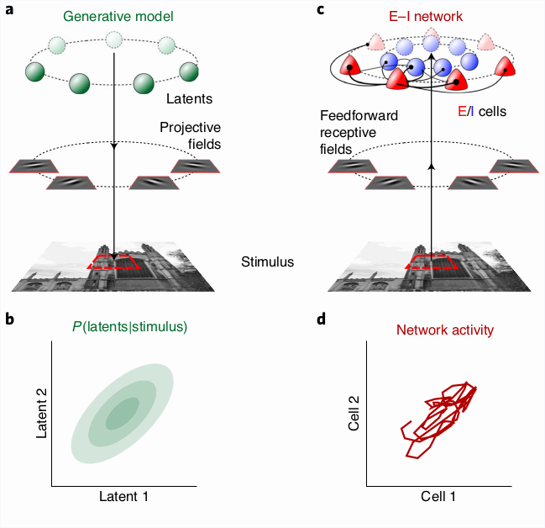
Network simulation of visual cortex rate response
Read Echeveste et al. 2020, as suggested by Alexis.
“Cortical-like dynamics in recurrent circuits optimized for sampling-based probabilistic inference”
Generative model assuming that all natural images are combinations of Gaussian distributions (GSM).
The network has excitatory and inhibitory populations.
The neurons are designated defined receptive fields.
Optimised network displays biological properties: stimulus modulated noise variability, increased inhibition at stimulus onset, gamma oscillations.
Could inspire a similar SNN.

Slide 7
References
Junko Matsuzaki et al, Differential responses of primary auditory cortex in autistic spectrum disorder with auditory hypersensitivity, NeuroReport 2012, 23:113–118, (2012)
Junko Matsuzaki et al, Progressively Increased M50 Responses to Repeated Sounds in Autism Spectrum Disorder with Auditory Hypersensitivity: A Magnetoencephalographic Study, PLOS ONE 9(7), (2014)
Rodrigo Echeveste et al, Cortical-like dynamics in recurrent circuits optimized for sampling-based probabilistic inference, Nature Neuroscience 23, 1138-1149, (2020)

