Slide 1
Individual meeting -
03/12/2020
Thomas Delaney

Slide 2
A potential network for the Hallucination machine
“STDP-based spiking deep convolutional neural networks for object recognition”
Saeed Reza Kheradpisheh, Mohammad Ganjtabesh, Simon J. Thorpe, Timothée Masquelier.
University of Tehran, Iran and Université Toulouse 3, France.
Neural Networks 9, 2018

Slide 3
Spiking deep convolutional neural network
Used STDP to train a spiking neural network with multiple convolutional and pooling layers.
The input was images.
The images were first passed through a ‘Difference of Gaussians’ layer to convert the images to spike trains.
These spike trains are the input to the SDCNN.
The remainder of the spiking network consists of paired convolutional and pooling layers.
They add an SVM after the final ‘global’ pooling layer, for classification purposes. But the training is unsupervised.

Slide 4
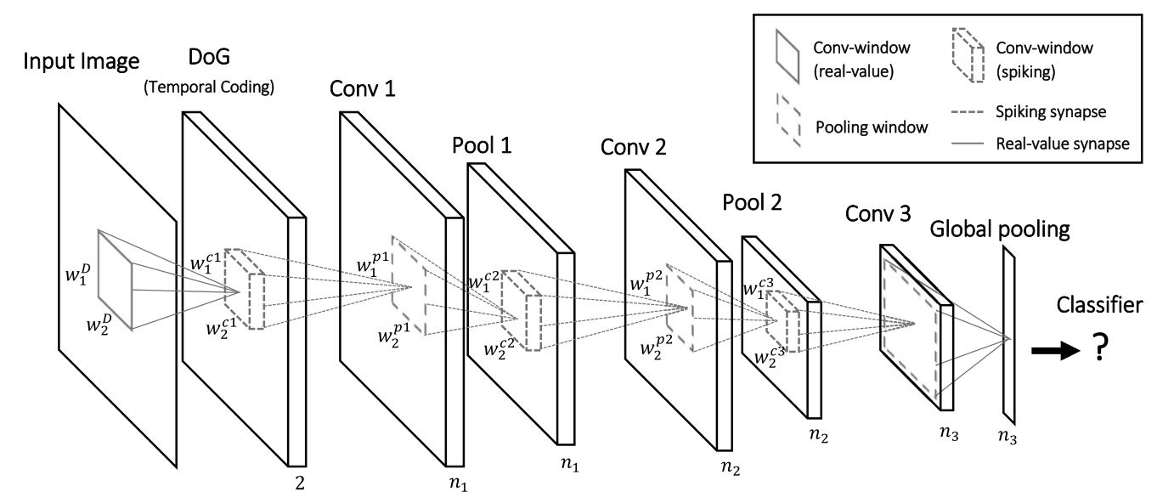
Spiking deep convolutional neural network

Slide 5
STDP learning
In the DoG layer, the areas of highest contrast are detected.
Those areas correspond to spike trains with the lowest latency (the quickest spikes)
The neurons in each convolutional layer are non-leaky integrate and fire neurons.
When a neuron reaches its threshold it spikes and inhibits spiking in neurons from other neuronal maps.
Each neuron is only allowed to spike once.
Learning only occurs in convolutional layers

Slide 6
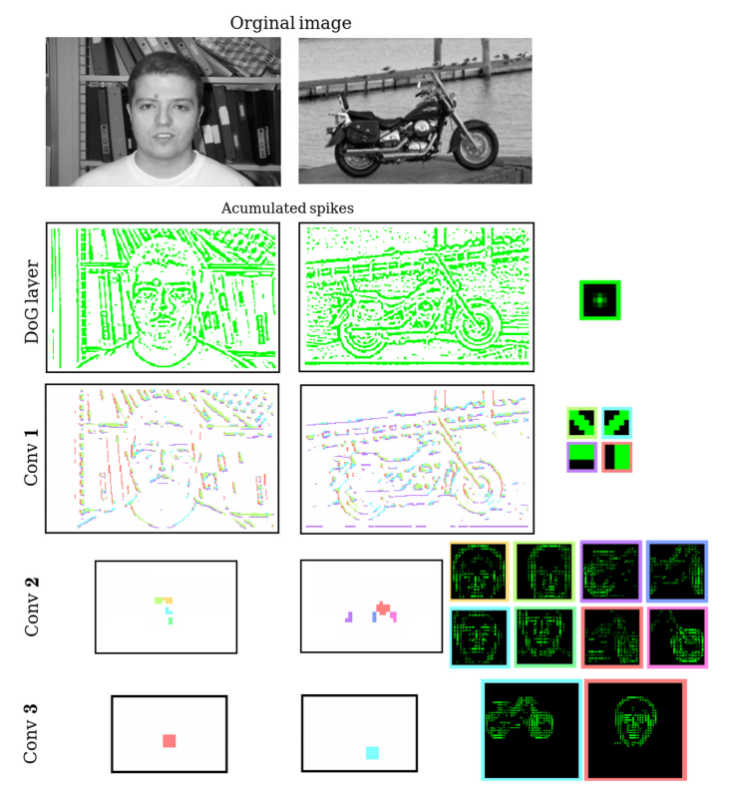
Layer representations
Lower layer detects edges at different orientations.
Highest layer detects representations of classes.
Similar to increasing complexity in representations in visual areas Retina → V1 → … → IT.

Slide 7
Why is this useful?
The network outperforms all other SNNs in MNIST classification.
It also outperforms DCNN on small datasets. A NN attempting to replicate neural behaviour should be able to learn from few examples.
The network represents images using an efficient code (few spikes). This imitates biological networks.
The neurons in the deeper layers are highly informative about the stimulus. Mirrors the deeper layers of the visual system.
It seems like the Deep Dream method of image manipulation could be implemented in this network. (This is used in the Hallucination machine.)

Slide 8
Problems/Room to improve
There is no way to change the excitation/inhibition balance.
The images used to train the network are from quite simple object recognition databases. Not natural images.
The neurons are only allowed to spike one time. This is not biological.

Slide 9
References
Saeed Reza Kheradpisheh, Mohammad Ganjtabesh, Simon J. Thorpe, Timothée Masquelier. “STDP-based spiking deep convolutional neural networks for object recognition”. Neural Networks 99, 56–67, (2018)
Keisuke Suzuki, Warrick Roseboom, David J. Schwartzman, Anil K. Seth, “A Deep-Dream Virtual Reality Platform for Studying Altered Perceptual Phenomenology”. Scientific Reports 7, 15982, (2017)

Slide 10
The End

