Slide 1
FDR Wireless switch and controller
Triet Nguyen
Khoi Le
Thomas Jung

Slide 2

ARDUINO
Open source electronic platform
Not only limited to only Windows like other microcontroller systems.
Simple and clear programming environment
Easy to use for beginners and flexible for advanced users.
Inexpensive
TN

Slide 3

Types of Arduino Boards
Arduino Uno
Arduino Due
Arduino Mega
Arduino Leonardo
Arduino Nano
TN

Slide 4

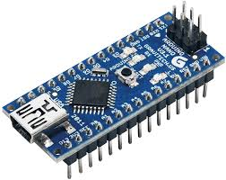
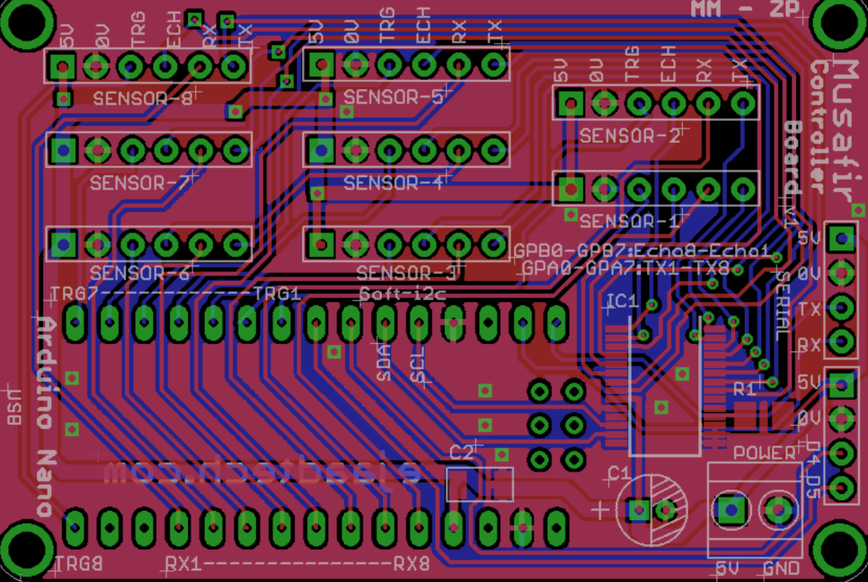
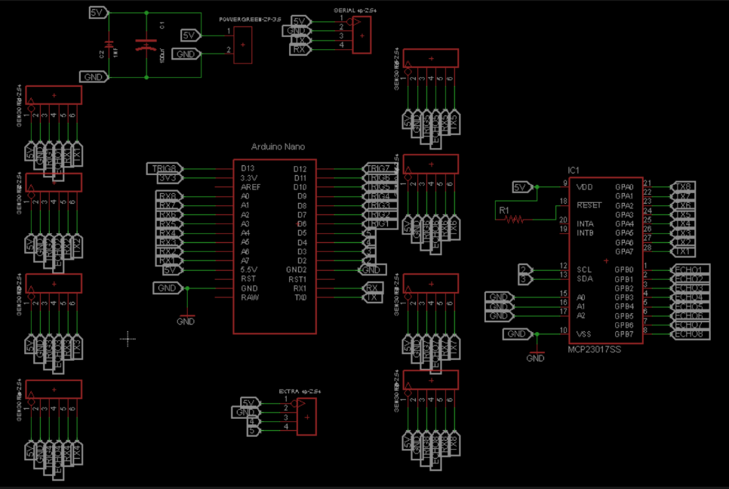
Arduino Nano
14 digital pins on the Nano can be used as an input or output, The Nano has 8 analog inputs, each of which provide 10 bits of resolution.
KL

Slide 5
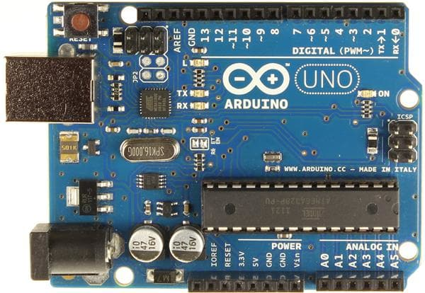
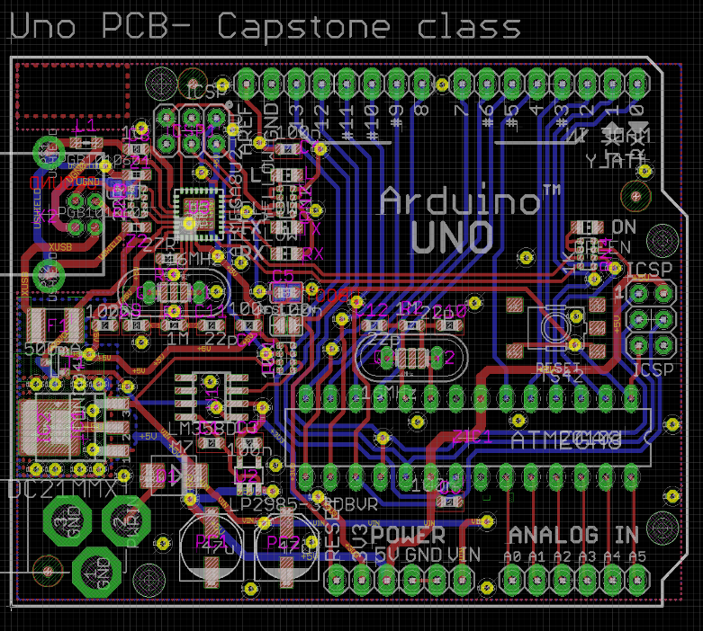
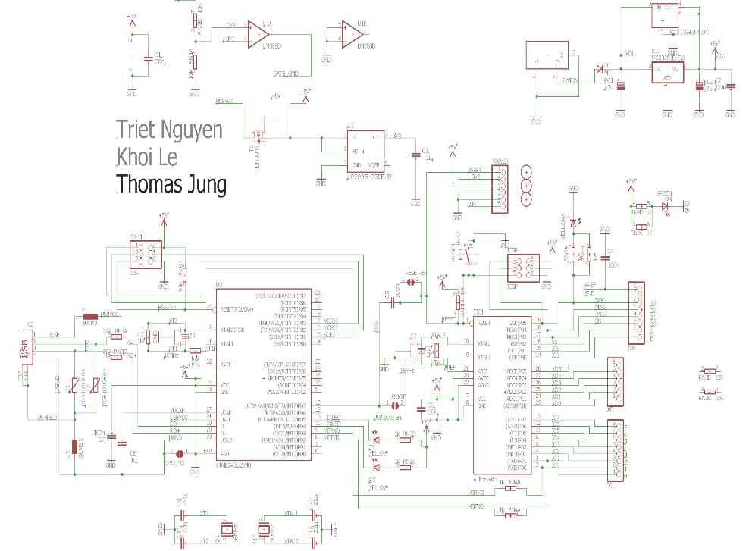
Arduino Uno
It has 14 digital input/output pins, 6 analog inputs, a 16 MHz quartz crystal, a USB connection, a power jack, an ICSP header and a reset button.
KL

Slide 6
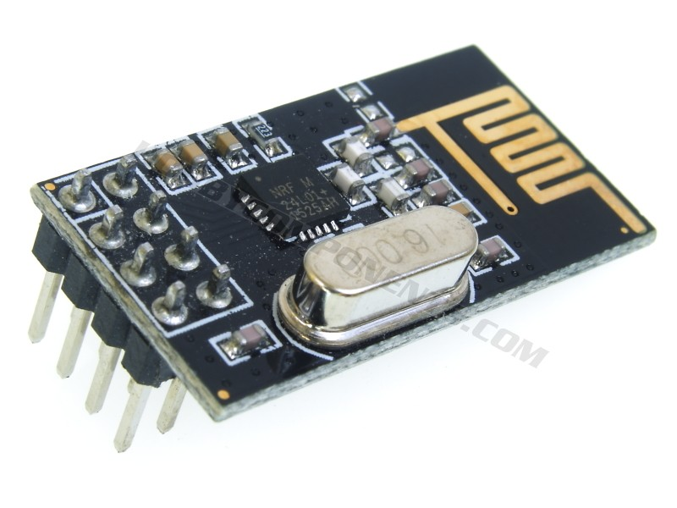
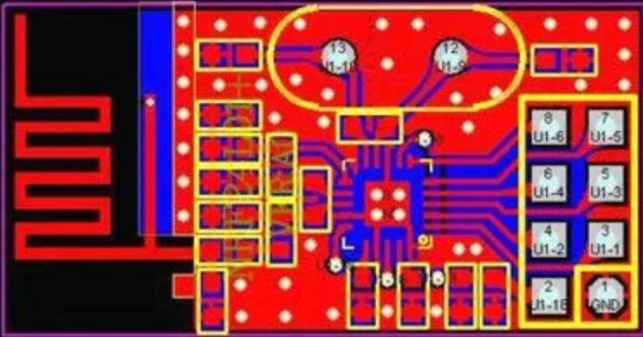
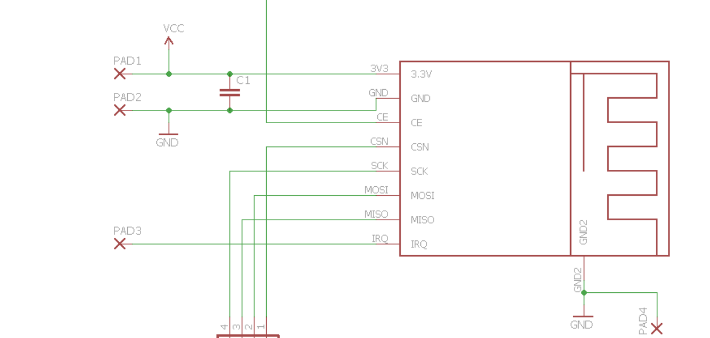
NRF24L01 (Antenna)
It uses the 2.4 GHz band and it can operate with baud rates from 250 kbps up to 2 Mbps.
KL

Slide 7
Block diagram
Receiver
Transmitter
NANO
Antenna
UNO
Antenna
Switch
LED
TN

Slide 8
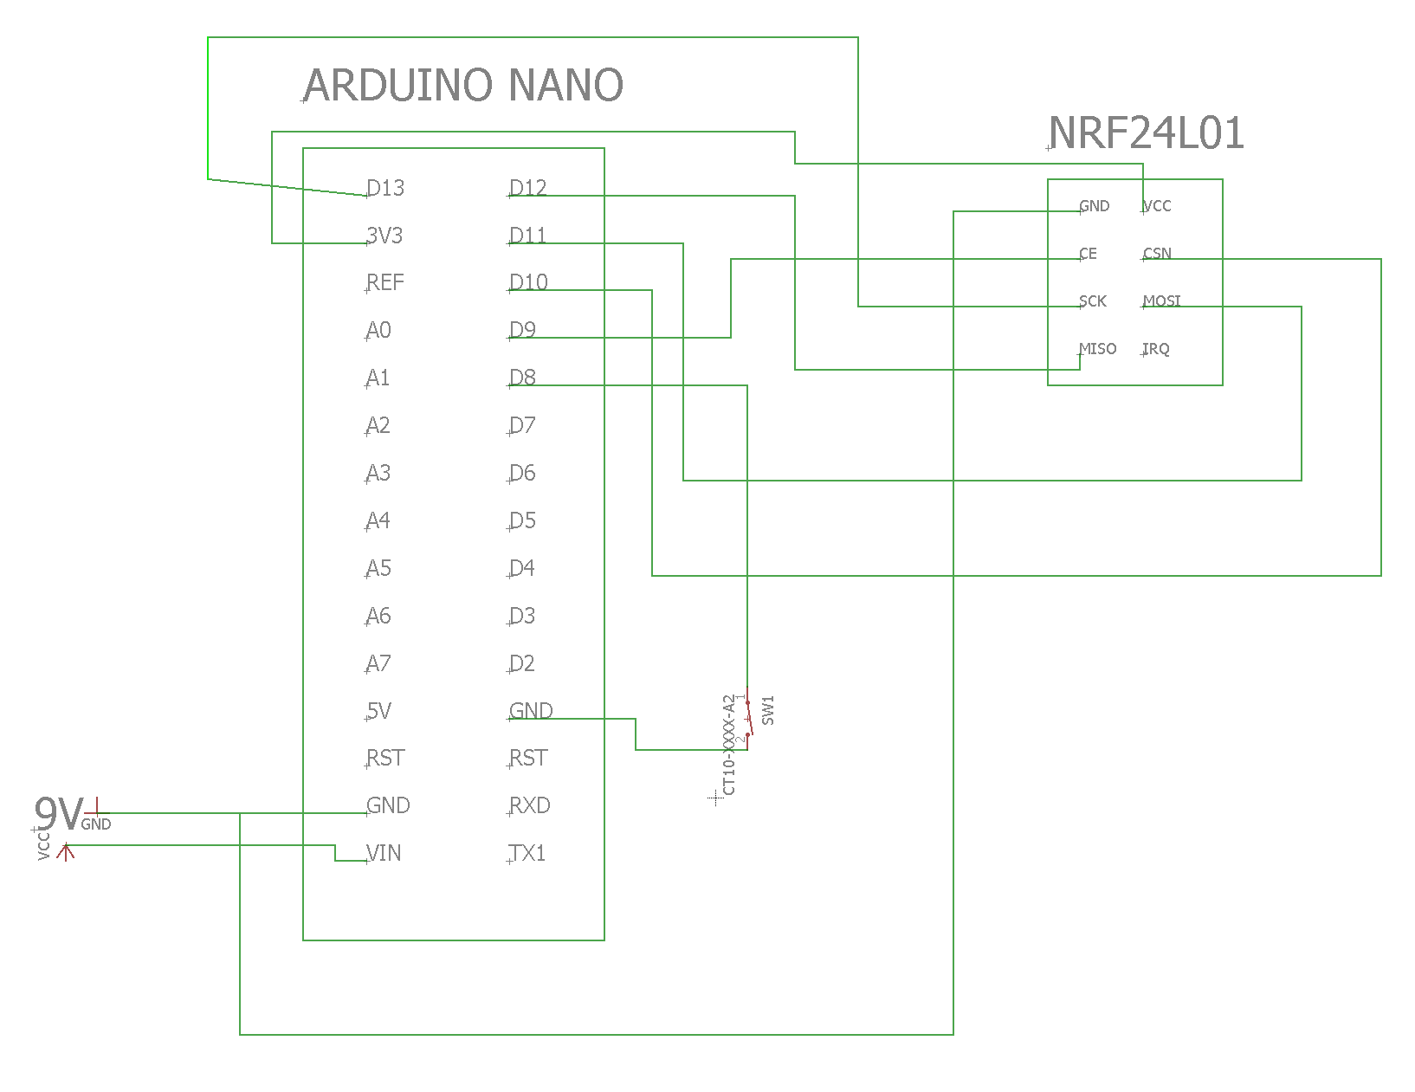
Transmitter schematic
TN

Slide 9
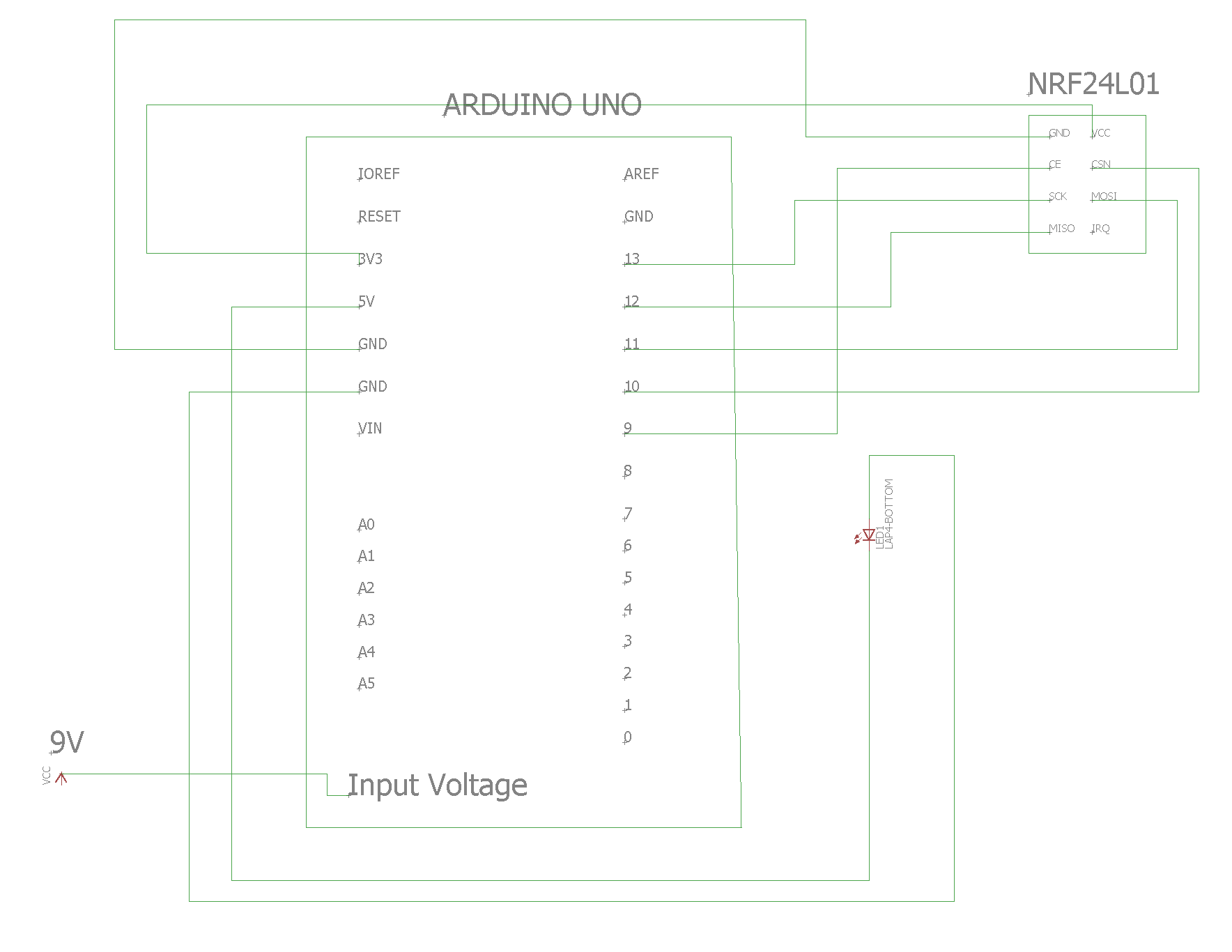
Receiver schematic
TN

Slide 10
Parts’ information
Component Name | Part Quantity | Cost per unit | Distributor | URL /Link
UNO Project Starter kit | 1 | $34.99 | Amazon | https://www.amazon.com/gp/product/B01D8KOZF4/ref=ox_sc_act_title_1?smid=A2WWHQ25ENKVJ1&psc=1
2.4GHz RF transceiver | 10 | $11.98 | Amazon | https://www.amazon.com/gp/product/B00O9O868G/ref=ox_sc_act_title_2?smid=A1N6DLY3NQK2VM&psc=1
NANO board | 3 | $13.86 | Amazon | https://www.amazon.com/gp/product/B0713XK923/ref=ox_sc_act_title_3?smid=A2WWHQ25ENKVJ1&psc=1
TN

Slide 11
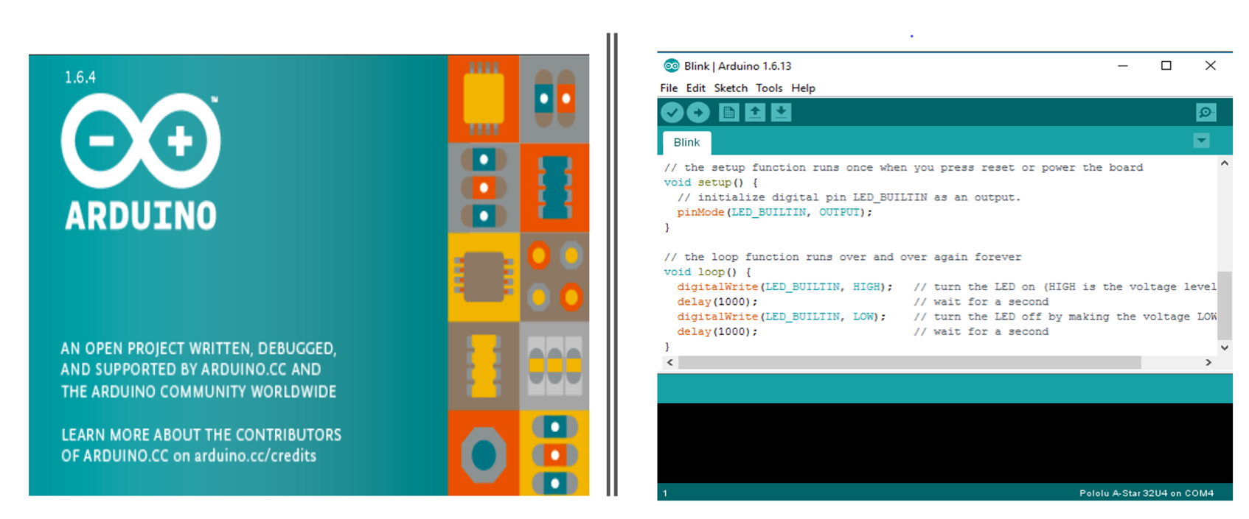
Chosen IDE
TJ

Slide 12
About Arduino Programming
Arduino has its own IDE that holds the sketch, which is a set of instructions that tells the board what functions it needs to perform.
Every Arduino sketch has two main parts to the program:
1.) void setup() – Sets things up that have to be done once and then don’t happen again.
2.) void loop() – Contains the instructions that get repeated over and over until the board is turned off.
TJ

Slide 13
Software Requirements
Arduino IDE is supported by the Arduino company for working with all types of Arduino made by their company
No additional software is required to be downloaded
Needed Libraries can be imported in many ways
TJ

Slide 14
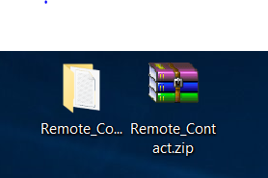
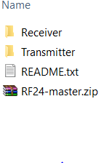
Software
TJ

Slide 15
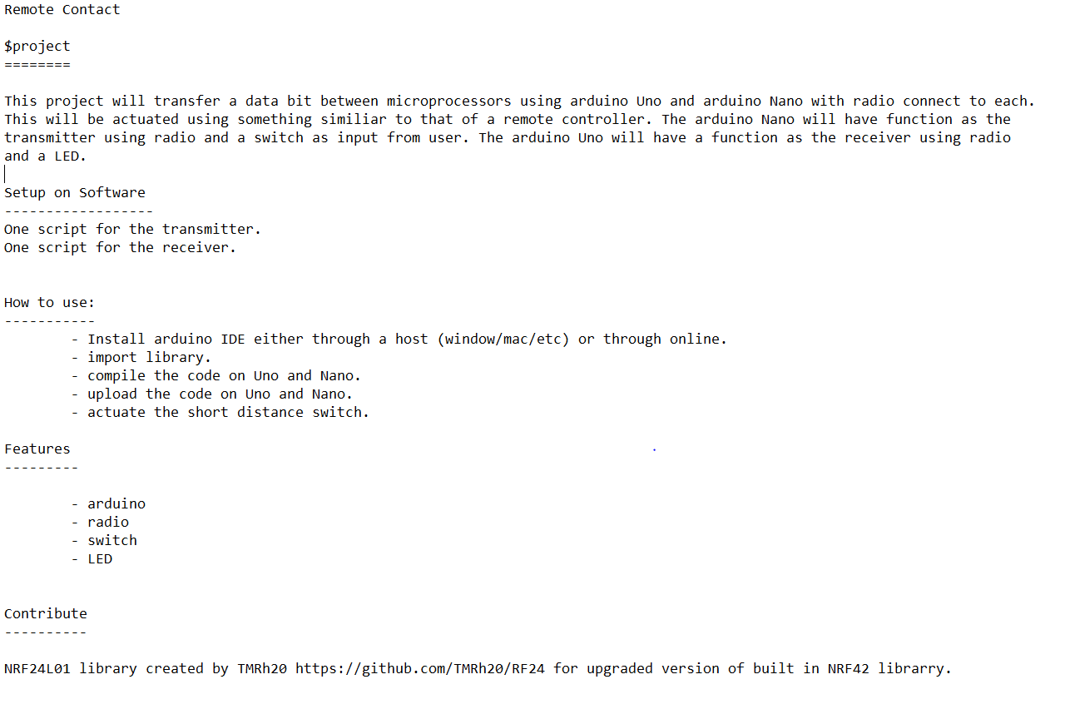
README
TJ

Slide 16
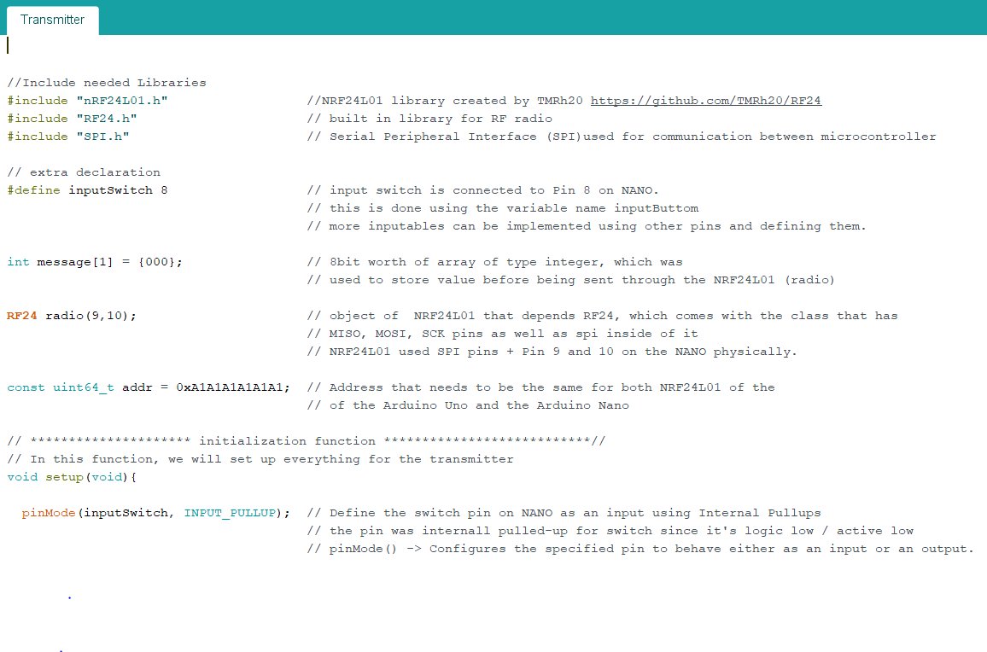
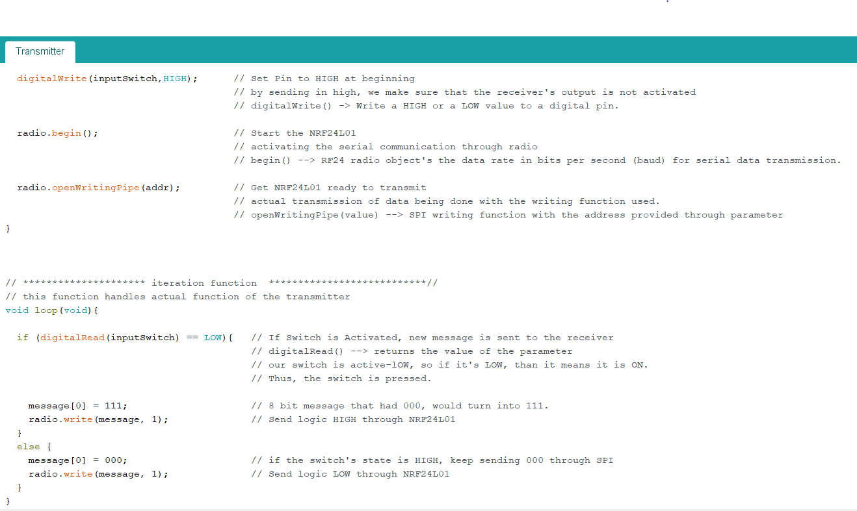
Transmitter
TJ

Slide 17
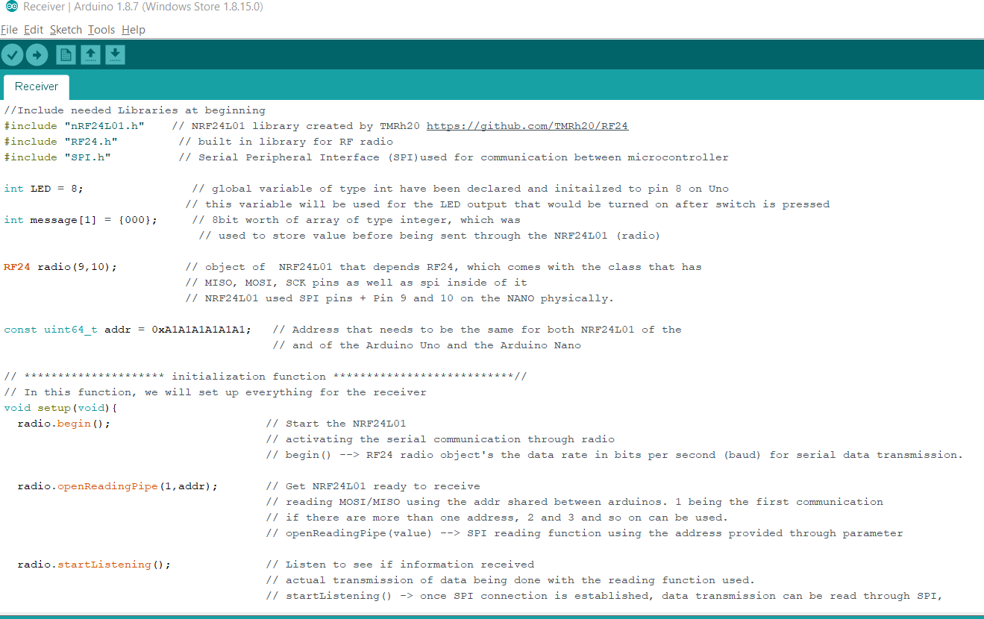
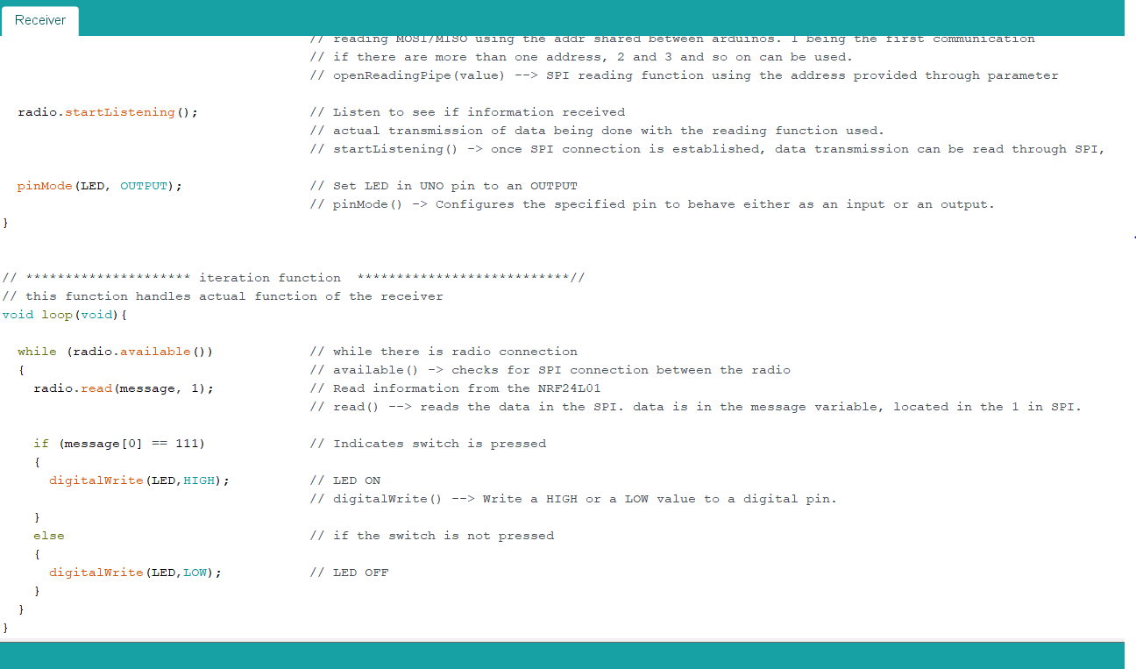
Receiver
TJ

Slide 18
Working Hardware

Slide 19

QUESTIONS???

