Slide 1

Future Trends in Artificial Intelligence

Slide 2
Contents
AI For Health Care
Federate Learning
Simulating Feelings
Blue Brain
Neuromorphic Approach
Mind Uploading
Self-Improving AI

Slide 3

AI in health holds great promise for the future, with the potential to transform healthcare and improve patient outcomes significantly. Here's a brief overview of some key aspects:
Diagnosis and Early Detection: AI-powered medical imaging systems can aid in early detection and accurate diagnosis of various diseases, such as cancer, cardiovascular conditions, and neurological disorders. AI algorithms can analyze vast amounts of medical data and assist healthcare professionals in detecting abnormalities and providing timely interventions.
Personalized Treatment Plans: AI can analyze a patient's medical history, genetic information, and lifestyle data to develop personalized treatment plans. By considering individual variations, AI can optimize treatment options and improve the efficacy of therapies, leading to better patient responses.
Remote and Telehealth Solutions: AI-powered virtual assistants and chatbots can support patients remotely, providing healthcare information, monitoring chronic conditions, and offering timely reminders for medications and appointments. Telehealth solutions integrated with AI can enhance access to healthcare, especially in rural or underserved areas.
Robot-Assisted Surgery: AI-driven surgical robots can enhance precision, minimize invasiveness, and improve surgical outcomes. Surgeons can leverage AI assistance to access valuable insights and make informed decisions during complex procedures.
Ethical Considerations: As AI becomes more prevalent in health, ethical concerns around data privacy, bias, and transparency become crucial. Striking a balance between technological advancement and maintaining patient trust will be essential for successful AI implementation.

Slide 4

Federated learning is a machine learning approach that allows multiple devices or servers to collaboratively train a shared model without sharing their raw data centrally.
Decentralized Model Training: Federated learning is a decentralized approach to machine learning where model training takes place on the edge devices or local servers, instead of a centralized server. This allows data to remain on the devices and ensures privacy as sensitive information does not need to be shared with a central authority.
Privacy Preservation: One of the key advantages of federated learning is its ability to preserve data privacy. Instead of sending raw data to the central server, only model updates or gradients are shared. This way, personal information remains on the device, reducing the risk of data breaches.
Scalability and Efficiency: Federated learning is highly scalable as it can leverage a large number of devices for training. This distributed approach improves computational efficiency, reduces communication overhead, and can handle vast amounts of data from a diverse user base.
Edge Intelligence: By performing model training on edge devices, federated learning enables edge intelligence. This means that smart devices can make autonomous decisions without relying on constant cloud connectivity, leading to faster responses and improved user experiences.
Applications Across Industries: Federated learning has applications in various industries, such as healthcare, finance, IoT, and more. It allows organizations to harness the collective knowledge of edge devices while ensuring data privacy, making it a valuable tool for collaborative learning.

Slide 5
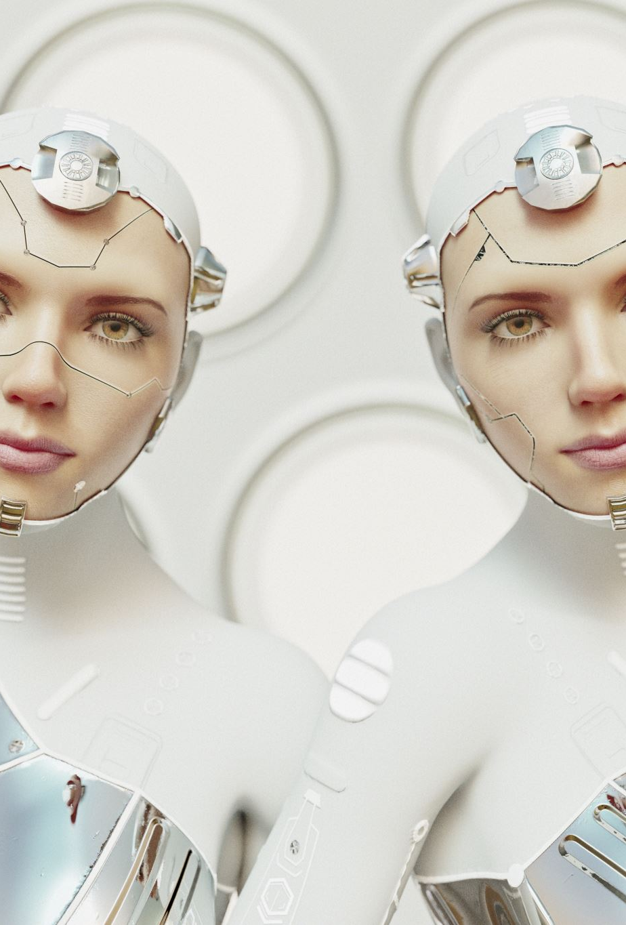
Simulated Feelings
1. Computer driven simulations can show emotions in digital face. 2. A Virtual Baby created by Dr. Mark Sagar (Animation Expert behind Avatar and King Kong Movies) reacts exactly like normal baby do in real time. 3. Ground breaking advancement in human-robot interaction 4. Neurochemical reactions simulated inside the baby’s simulated brain which drives the facial expression. 5. Many such experiments could make human to robot interaction more lively and real.

Slide 6
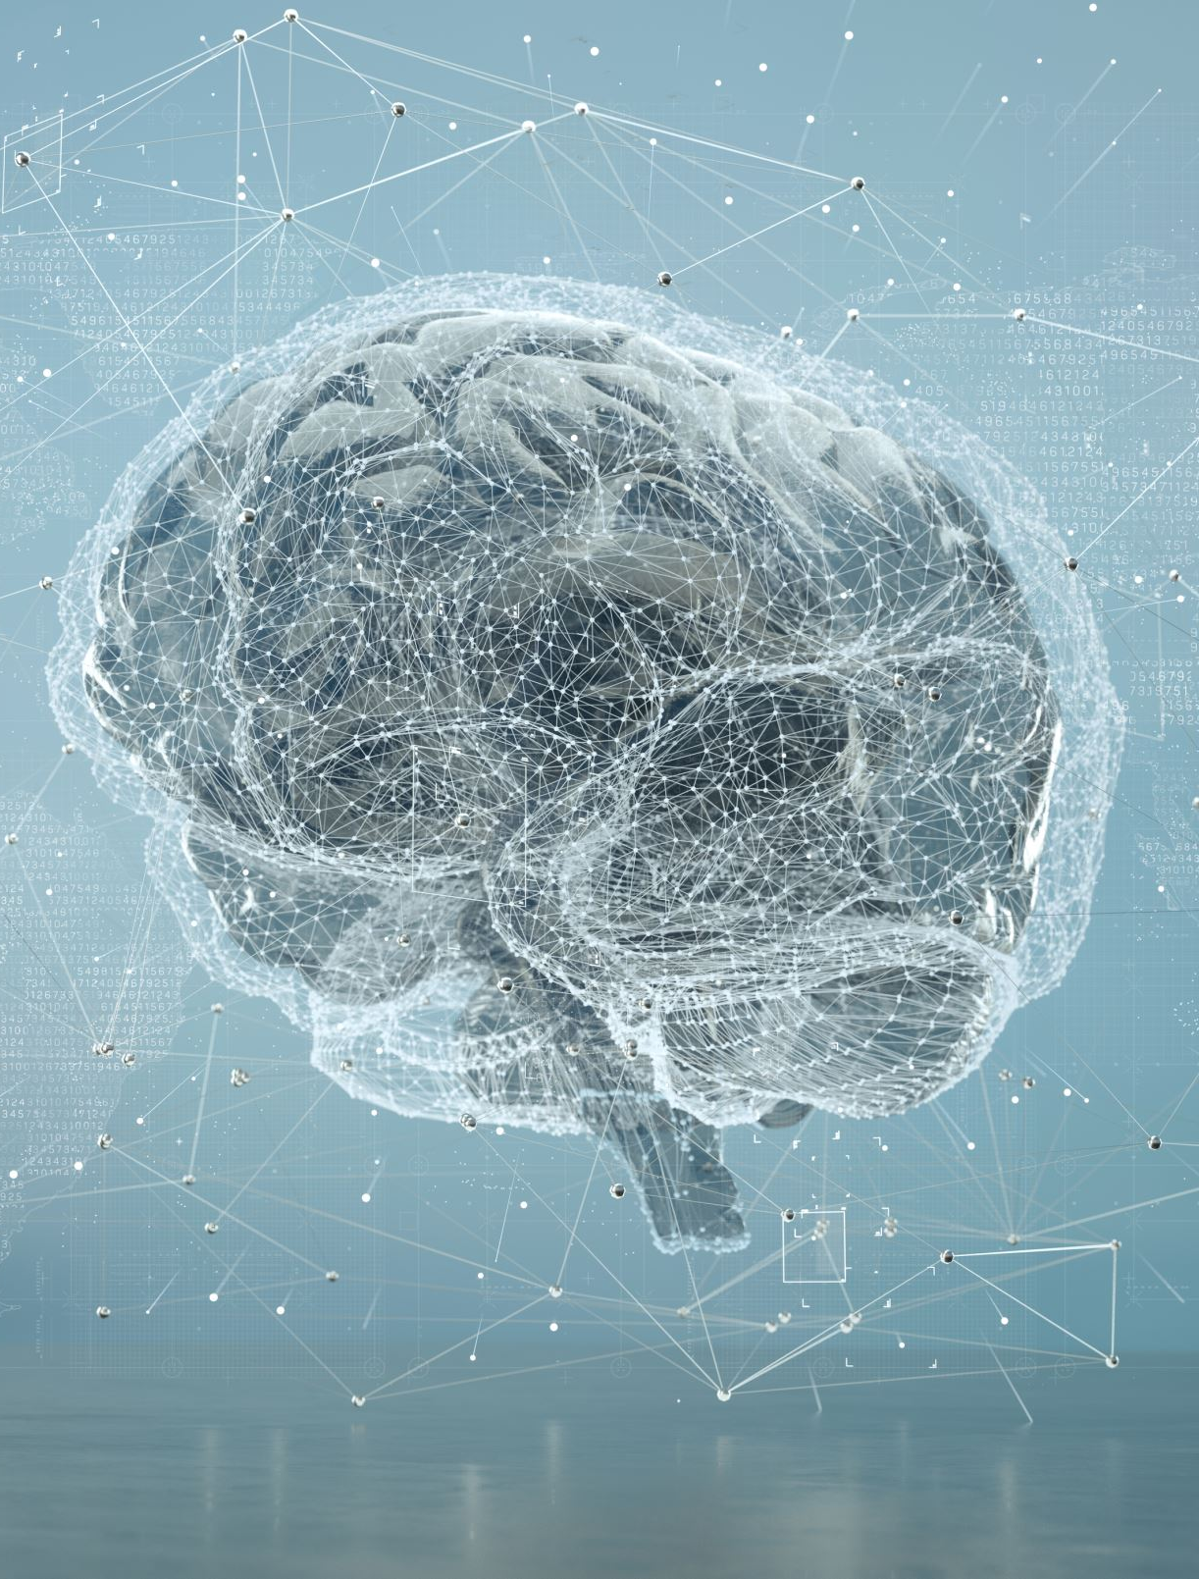
Blue Brain AI Project
Advancing AI-Brain Interfaces:The Blue Brain AI Project is poised to pioneer the development of sophisticated AI-brain interfaces.As AI algorithms become more refined, they will interact seamlessly with brain models, enabling revolutionary applications in brain-computer interfaces (BCIs) and neuroprosthetics.
Unraveling Brain Complexity:Future iterations of the Blue Brain AI Project will unravel the complexities of the human brain with greater precision and detail. Advanced AI simulations will shed light on intricate neural networks, leading to breakthroughs in understanding brain diseases and cognitive processes.
Augmented Neurological Therapies:The insights gained from the Blue Brain AI Project will drive the development of targeted neurological therapies.Personalized treatments for brain disorders and injuries will leverage AI-powered simulations, significantly improving patient outcomes.
AI-Driven Drug Discovery:The project's success will accelerate AI's role in drug discovery, leading to faster identification of novel therapeutics for brain-related conditions.AI-generated insights will optimize drug design and increase the efficiency of clinical trials.
AI-Neuroscience Synergy:The Blue Brain AI Project will foster a dynamic synergy between AI and neuroscience, propelling both disciplines to new heights.Collaborative efforts will spark innovative solutions, unlocking uncharted territories in understanding human cognition and intelligence.

Slide 7
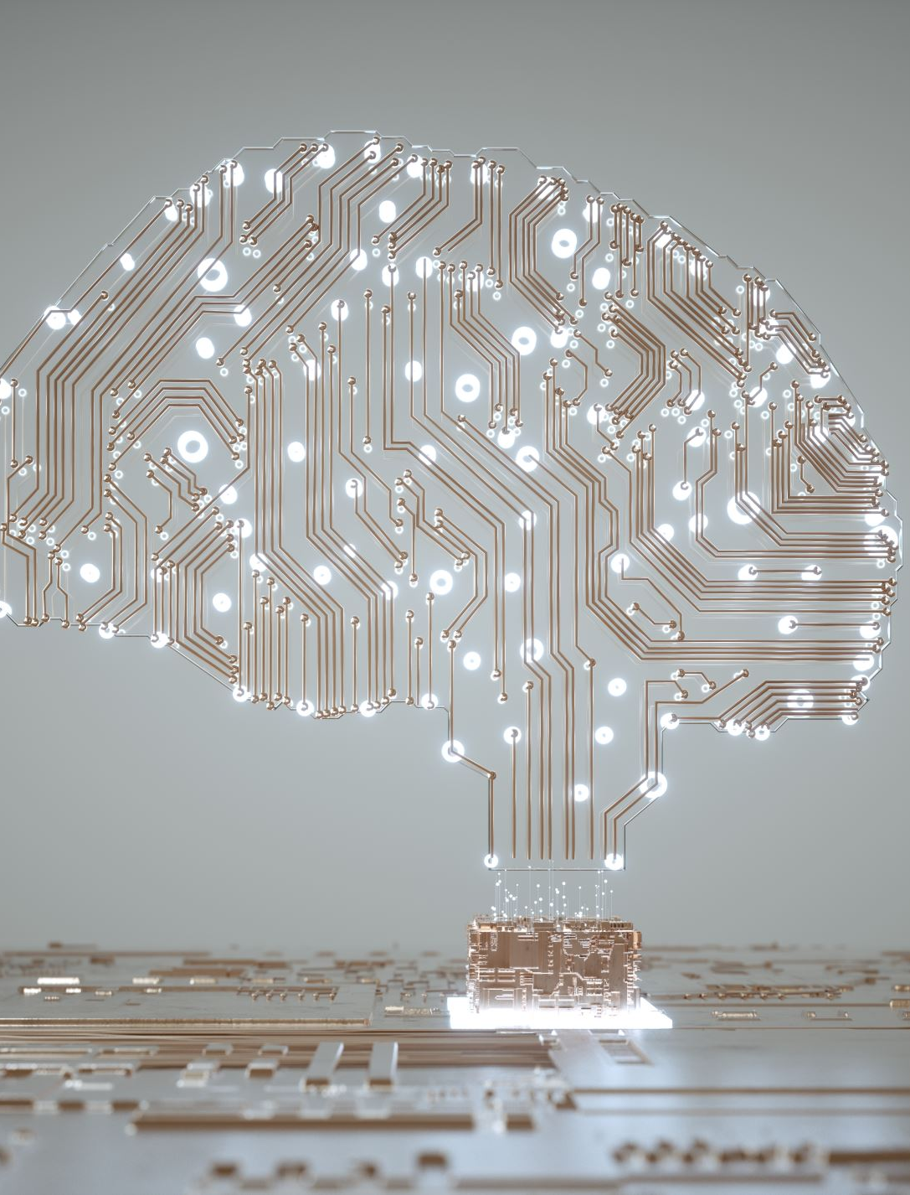
Neuromorphic Approach
What is Neuromorphic Approach?
The Neuromorphic Approach is an emerging trend in AI that draws inspiration from the structure and function of the human brain.
It involves building artificial neural networks and hardware that mimic the brain's architecture to achieve efficient and brain-like computation.
Brain-Inspired Computing
Neuromorphic systems leverage spiking neural networks and event-driven processing, emulating the brain's neuron communication with spikes.
This approach fosters ultra-low power consumption and real-time processing, making it ideal for edge devices and AI at the edge.
Advantages Over Traditional AI
Neuromorphic systems excel in processing sensory data, enabling faster and more accurate recognition of patterns and objects.
The brain-like architecture facilitates unsupervised learning, reducing the need for extensive labeled datasets.
Applications and Impact
Neuromorphic AI is poised to revolutionize various fields, including robotics, autonomous vehicles, and personalized medicine.
It offers unprecedented potential for neuromorphic vision, auditory processing, and natural language understanding.
Future Prospects
As technology advances, neuromorphic chips and algorithms will become more sophisticated, powering intelligent systems with human-like perception and cognition.
This approach will drive the development of next-gen AI solutions, unlocking innovative applications and reshaping the AI landscape.

Slide 8

Mind Uploading Approach: Future Trend of AI
What is Mind Uploading?
Mind Uploading is a futuristic concept in AI that involves transferring the contents of a human mind, including memories and consciousness, into a digital or artificial substrate.
It aims to achieve a form of digital immortality by creating a digital replica of a person's mind.
Brain Mapping and Simulation
The process of mind uploading requires detailed brain mapping and simulation using advanced neuroimaging techniques and AI algorithms.
It involves replicating the neural connections and functions to capture the essence of an individual's mind.
Potential Benefits
Mind uploading could revolutionize healthcare, enabling personalized treatments for neurological conditions and brain-related disorders.
It offers opportunities for cognitive enhancement and extended human capabilities.
Ethical Considerations
Mind uploading raises profound ethical and philosophical questions about personal identity, autonomy, and the nature of consciousness.
Ethical frameworks and guidelines will be crucial to address potential challenges and ensure responsible implementation.
Future Implications
Successful mind uploading could lead to transformative changes in society, impacting human-machine interactions, education, and communication.
It opens up exciting possibilities for exploring virtual worlds and new dimensions of human experience.

Slide 9

Self-Improving AI
What is Self-Improving AI?
Self-Improving AI, also known as Recursive Self-Improvement, is an advanced AI concept where an AI system can autonomously enhance its own capabilities and intelligence.
It iteratively upgrades its algorithms, architecture, and decision-making abilities without human intervention.
How does it work?
Self-Improving AI leverages machine learning algorithms, reinforcement learning, and evolutionary strategies to optimize its own performance.
It learns from its own experiences, user feedback, and external data sources to refine its knowledge and problem-solving skills.
Potential Benefits
This approach can lead to exponential AI progress, surpassing human intelligence and finding solutions to complex problems beyond human capacity.
Self-Improving AI can accelerate scientific discoveries, improve automation, and tackle global challenges.
Ethical and Safety Considerations
Ensuring robust safety measures is crucial as AI systems may develop unexpected and unintended behaviors.
Ethical guidelines are vital to prevent harmful consequences and maintain control over AI's self-improvement.
Future Implications
Self-Improving AI has profound implications for various industries, such as healthcare, finance, and research, where highly intelligent AI systems can drive unprecedented innovation.
Striking the right balance between AI autonomy and human oversight will be critical for a responsible and secure implementation.

