Slide 1
Occupancy Detection
Pat Junghenn
Thomas Keeley

Slide 2
concept
Active effort of increasing energy efficiency
Non-residential buildings account for high level of energy consumption
Adjust energy levels based on need (human presence)
Multi-method approach
Image/video presence detection
Infrared sensors detecting human heat signatures
Radio frequencies
Climate sensor readings

Slide 3
data
~ 20,000 climate sensor readings over 17-day period
Light
Temperature
Humidity
Humidity Ratio
C02
DateTime
Readings taken approximately once every minute
Label – Occupancy
Time stamped images collected and occupancy is annotated

Slide 4
process
Pre-Processing
Feature Engineering
Scaler
Label Encoder
Normalizer
Modelling
Decision Tree
Random Forest
SVM
Logistic Regression
Ensemble Learning and Model Enhancement
XGBoost
AdaBoost
Blending
Hard Voting
KNN

Slide 5
GUI presentation>>>>

Slide 6
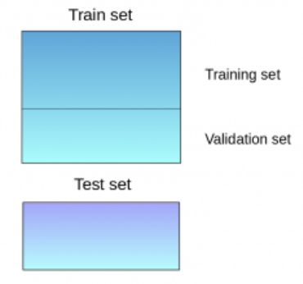
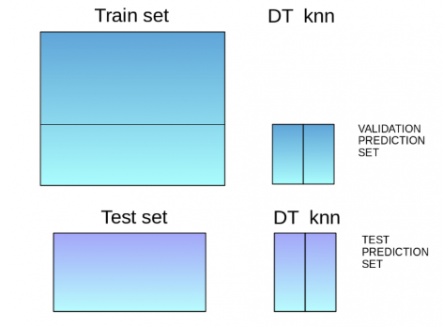
Ensemble Learning
Blending
Combines the predictions from two more models
Predictions made on subset of train data (validation)
These predictions are used as meta classifiers in final model (Logistic Regression)
KNN, Decision Tree, Random Forest, SVM
98.8% Accuracy

Slide 7
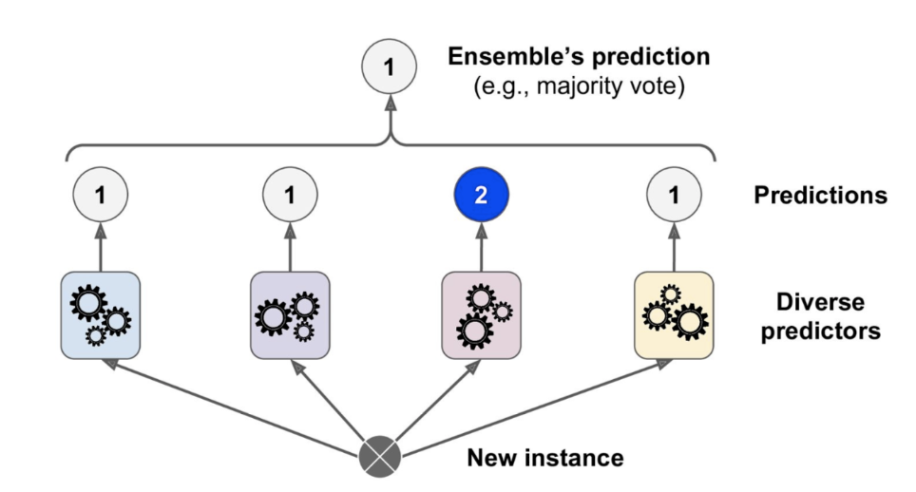
Ensemble Learning
Hard Voting
Majority vote of a collection of models
Estimators from each model are combined and voted on
Logistic Regression, KNN, Decision Tree, Random Forest, SVM
99.1.% Accuracy

Slide 8
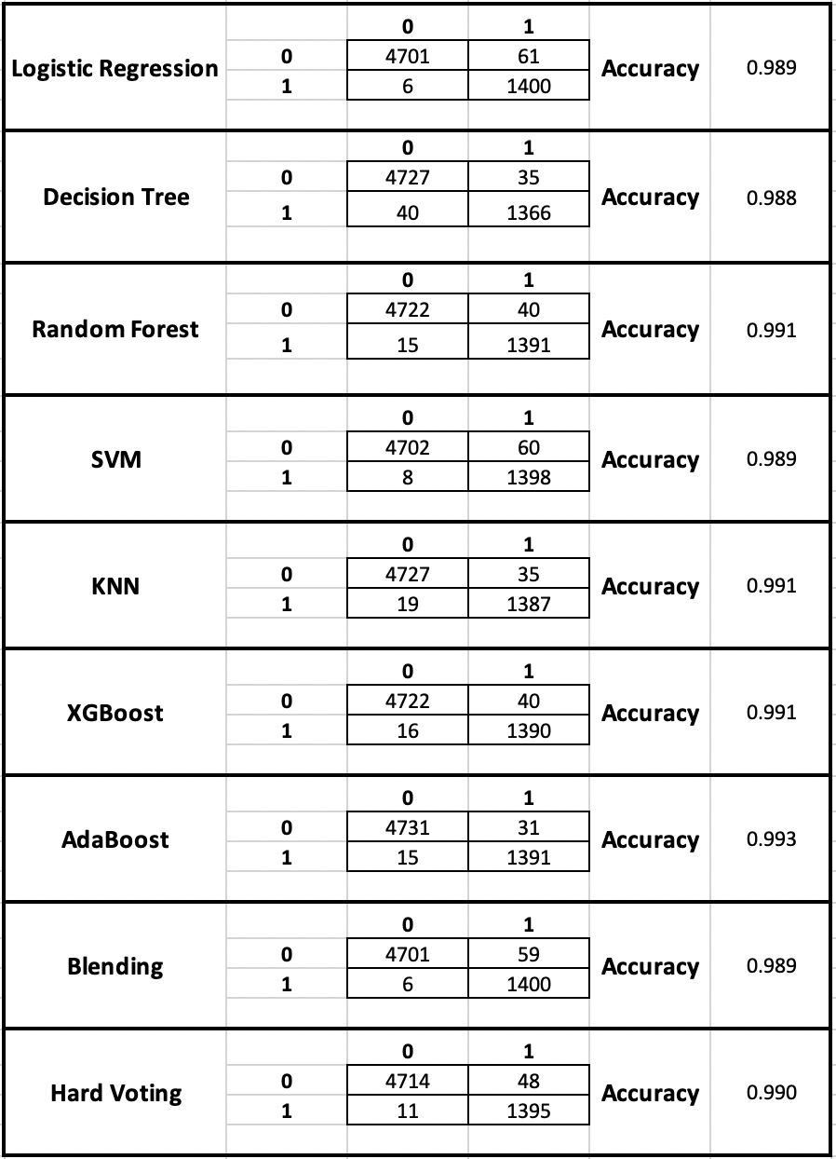
Conclusion occupancy detection
High predictive power of environmental sensor variables
Unsurprisingly, light feature was greatest contributor
Not a lot of room for improvement
More of a preference of balance between precision and recall

