Slide 1
PROJECT
TEACHER: MARIA ZAMBRANO VERGARA

Slide 2
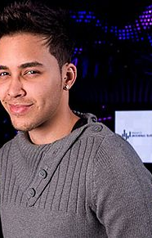
PRINCE ROYCE

Slide 3
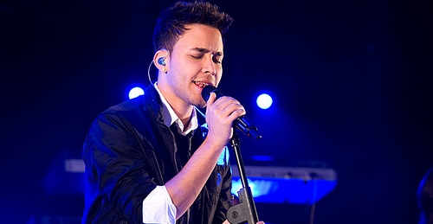
BACKGROUND INFORMATION
BIRTH NAME: Geoffrey Royce Rojas
BORN: May 11, 1989 (age 28) The Bronx, New York, U.S
GENRES: Latin pop, bachata, R&B
OCCUPATION(S): singwer, songwriter.
YEARS ACTIVE: 2009- present
INSTRUMENTS: Vocals, guitar

Slide 4

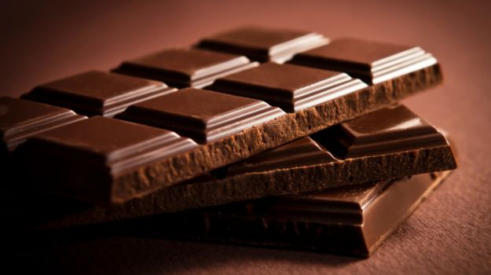
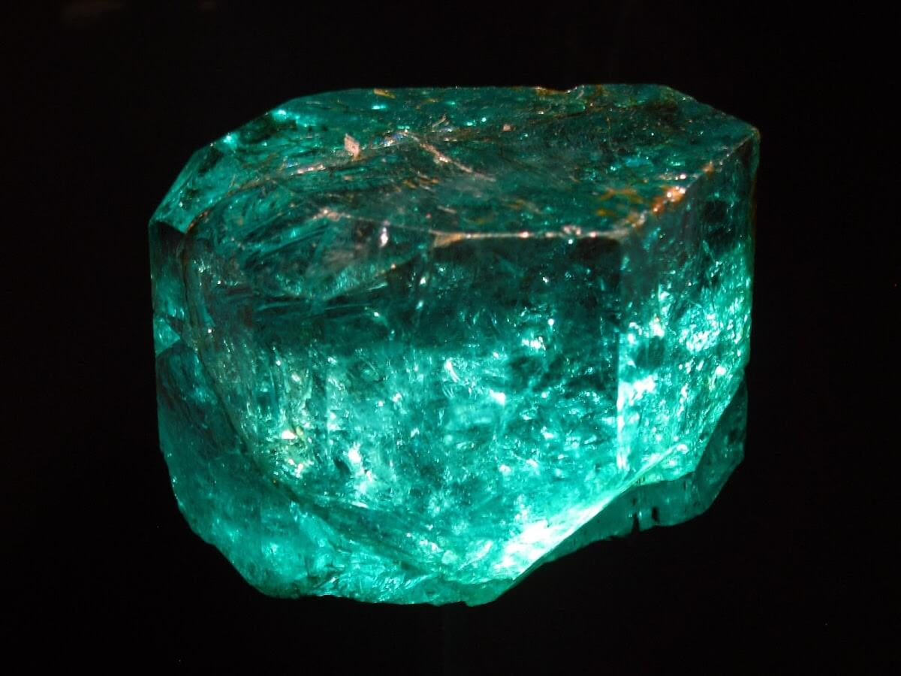
EXTRA INFORMATION
FAVORITE FOOD: Sancocho
SWEET FAVORITE: Chocolate
FAVORITE COLOR: Green
SIGN OF THE ZODIAC: Taurus
JEWEL: Emerald

Slide 5
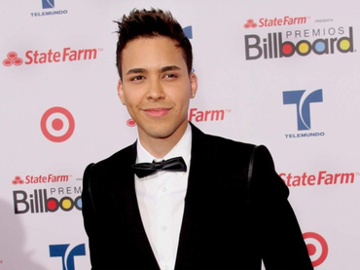
PART OF HIS CAREER
From an early age she became interested in music and during her adolescence began writing poetry in English and Spanish and making her first musical compositions. At 19, together with her friend Sughey Aráuz, she met Andres Hidalgo who became his manager . Some time later, Hidalgo introduced him to the pianist and producer Sergio George, who, when he heard three tracks of his musical model, hired him for his record label.

Slide 6
MY OPINION
Recognized artist and an excellent composer, very popular.
Despite having a rather rough appearance is very sensitive.
His music catches and entertains the public, in a very short time his projects became popular making him gain fame and acceptance of the public.
Many people call him a vain and ambitious thing that he has denied and that is in the eyes of many.
This is an excellent human being.

