Slide 1
I DIDN'T DO THE HOMEWORK
No hice la tarea

Slide 2

It was a joke I'm sorry

Slide 3
PROJECT
TEACHER: MARIA ZAMBRANO VERGARA

Slide 4
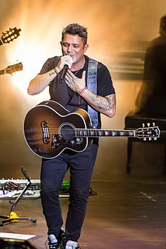
ALEJANDRO SANZ

Slide 5
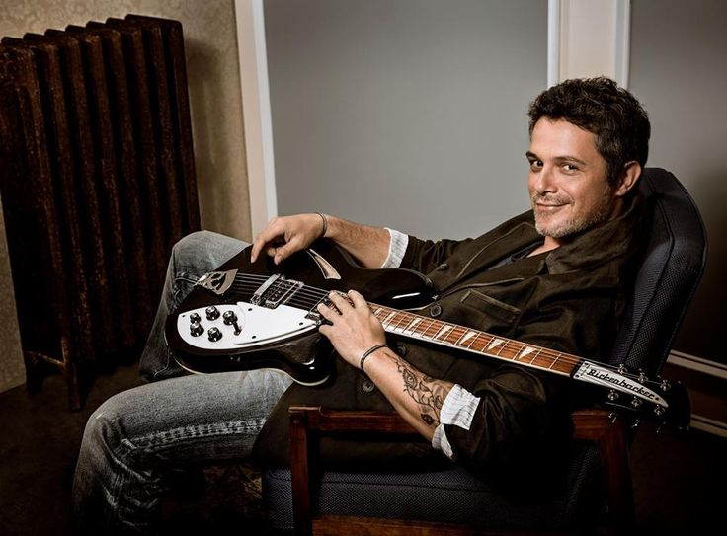
Background information
BIRTH NAME: Alejandro Sánchez Pizarro
BORN: 18 December 1968 (age 48)
Madrid, Spain
GENRES: Latin pop
OCCUPATION(S): singwer, songwriter
YEARS ACTIVE: 1989- present
INSTRUMENTS: Vocals, guitar and piano

Slide 6


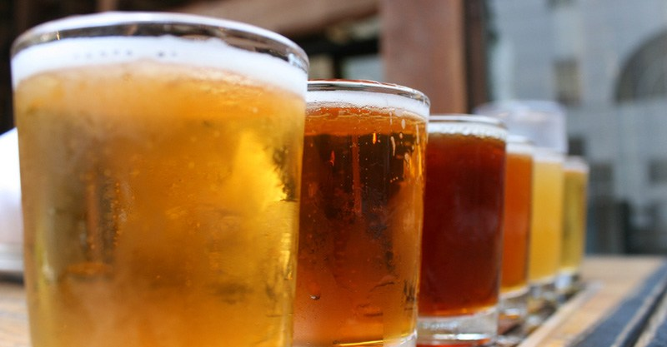
EXTRA INFORMATION
SIGN OF THE ZODIAC: Sagittarius
HAIR: Brown
EYES: Brown
SPORT: Tennis
FAVORITE COLOR: Predilection for black
FAVORITE GARMENT: sporty, loves to wear informal
FAVORITE FOOD: Salad, seafood
FAVORITE DRINK: Isotonic drink at concerts

Slide 7
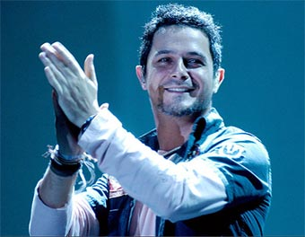
PART OF HIS CAREER
His career began at the end of 1988, when recording the album Los chulos are pa 'to take care of them at the age of 20, under the pseudonym of Alexander the Great. This disc of Techno-Flamenco style, contained 10 subjects and was produced by Miguel Angel Arenas. On the cover, Alexander the Great appears dressed in a bullfighter's vest with chorreras. This album was thanks to the family Gallofré, since Alexander went of small with Gallophés to sing to his house.

Slide 8
MY OPINION
A humble Spanish artist of heart, who began his career at a very young age sure of his self and what he could demonstrate to the world.
His talent was the key that opened the doors to an endless number of opportunities for him and his family
Curious since very small and very imperative.
An admiration of improvement and effort is what today has it in a highly recognized position.
Encourage you to listen to this great artist and his music in general

