Slide 1

Compiler Construction for the JVM
Tom Lee
me@tomlee.co
Senior Consultant
Shine Technologies
http://www.shinetech.com

Slide 2
Overview
Who am I?
Why target the JVM?
Compiler Construction 101
“Hello World”
Scala's Parser Combinators
“Hello World” in AST form
Representing ASTs in Scala
Compiling ASTs with BCEL
A Small Proof of Concept

Slide 3
Who am I?
Senior Consultant for Shine Technologies
  http://www.shinetech.com
Hobbyist compiler enthusiast
Open source contributor
  (C)Python
    try/except/finally syntax in 2.5
    Compilation of ASTs within Python in 2.6
    Beginnings of AST optimizer in 2.7 / 3.0 ...
      … but got distracted by real life :(
  … and others

Slide 4

Why target the JVM?
Third-party libraries
Highly tuned*
  *For long-running processes
Memory management
Enterprise friendly
  Whatever that means :)

Slide 5
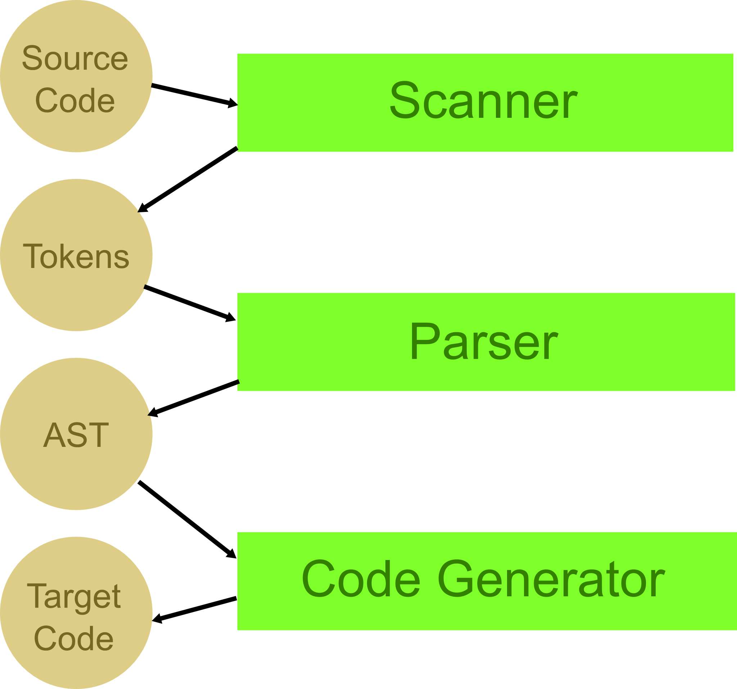
Compiler Construction 101

Slide 6
“Hello World”
puts(“Hello World”);

Slide 7
“Hello World” (cont.)
puts(“Hello World”);

Slide 8
“Hello World” (cont.)
putsStmt → “puts” “(“ str “)” “;”
str → STR
STR → regex(“[^”]*”)

Slide 9
“Hello World” (cont.)
call → name “(“ str “)” “;”
name → ID
str → STR
ID → regex([a-zA-Z_][a-zA-Z_0-9]*)
STR → regex(“[^”]*”)

Slide 10
“Hello World” (cont.)
stmt → expr “;”
expr → str | call
call → name “(“ args? “)”
args → expr (“,” expr)*
str → STR
name → ID
STR → regex(“[^”]*”)
ID → regex([a-zA-Z_][a-zA-Z_0-9]*)
By deriving these grammars, we make it easy
to reproduce them in Scala. How?

Slide 11
Scala's Parser Combinators
DSL for describing parsers in Scala
Act upon parse results
  e.g. construct AST
AST → Abstract Syntax Tree
  Logical representation of your program

Slide 12
Scala's Parser Combinators (cont.)
Grammar
expr → str | call
call → name “(“ args? “)” “;”
...
Scala
def expr = str | call
def call = name ~ (“(“ ~> args? <~ “)”) “;”
...

Slide 13
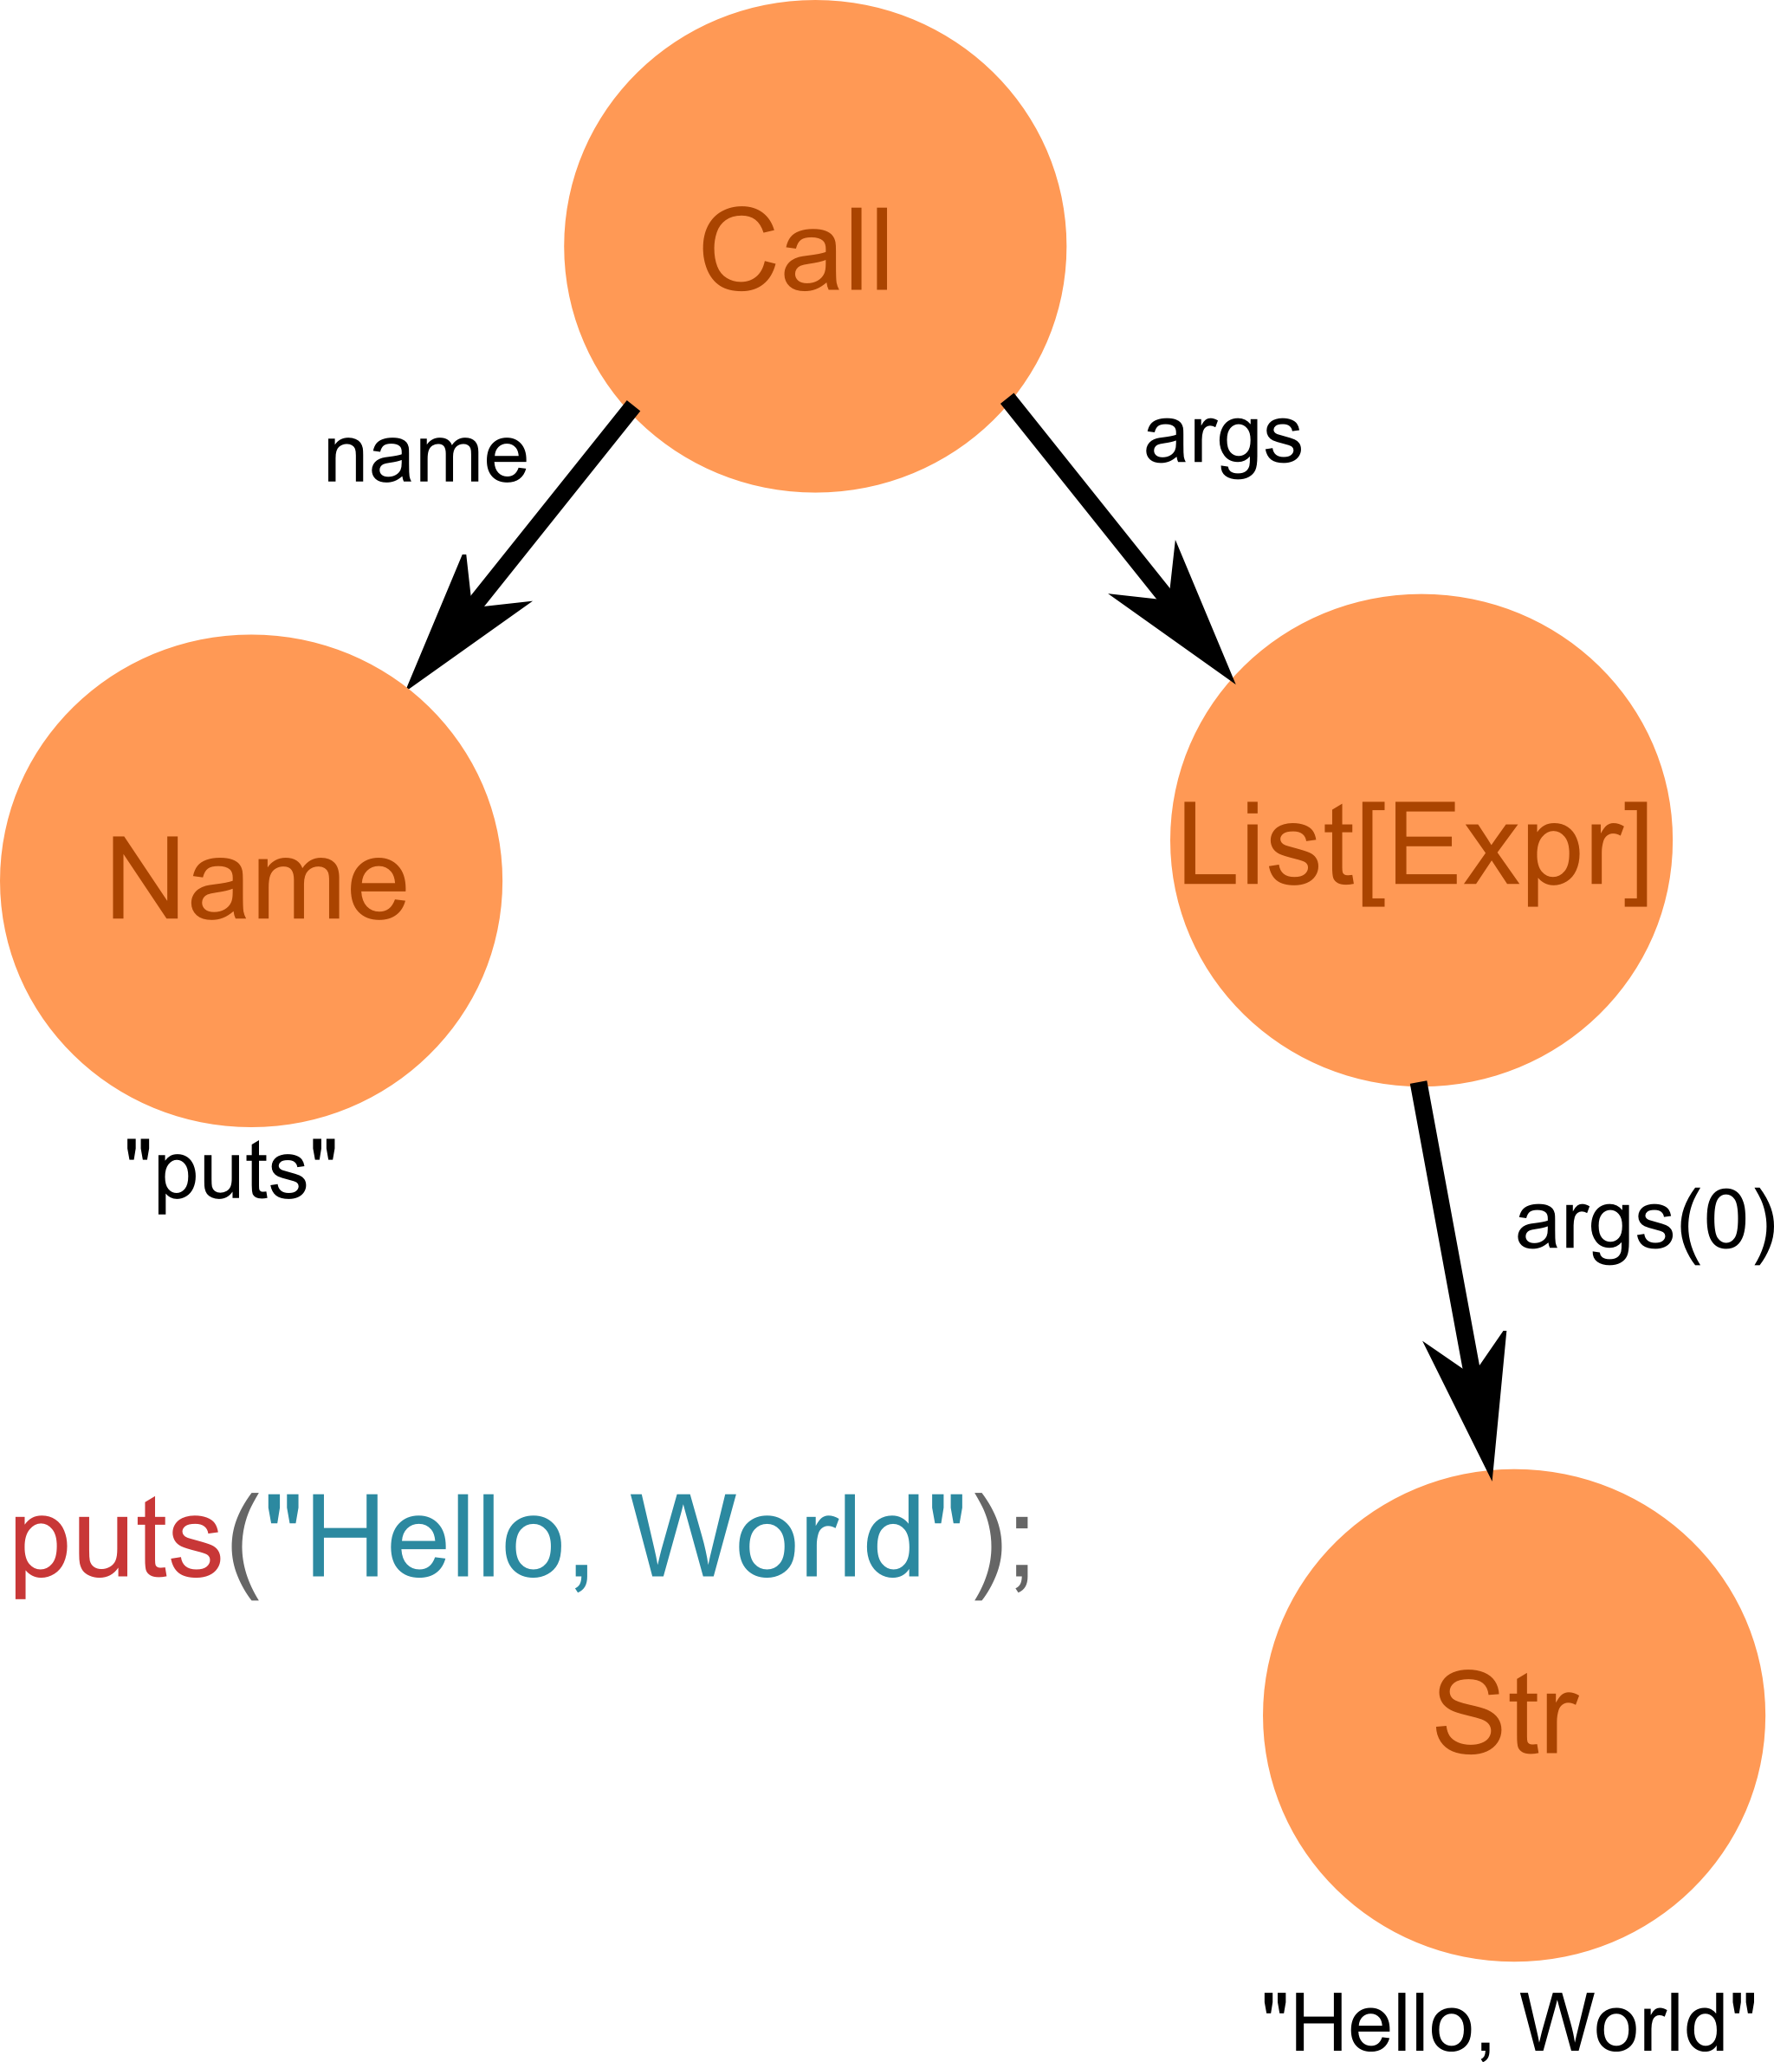
“Hello World” in AST form

Slide 14
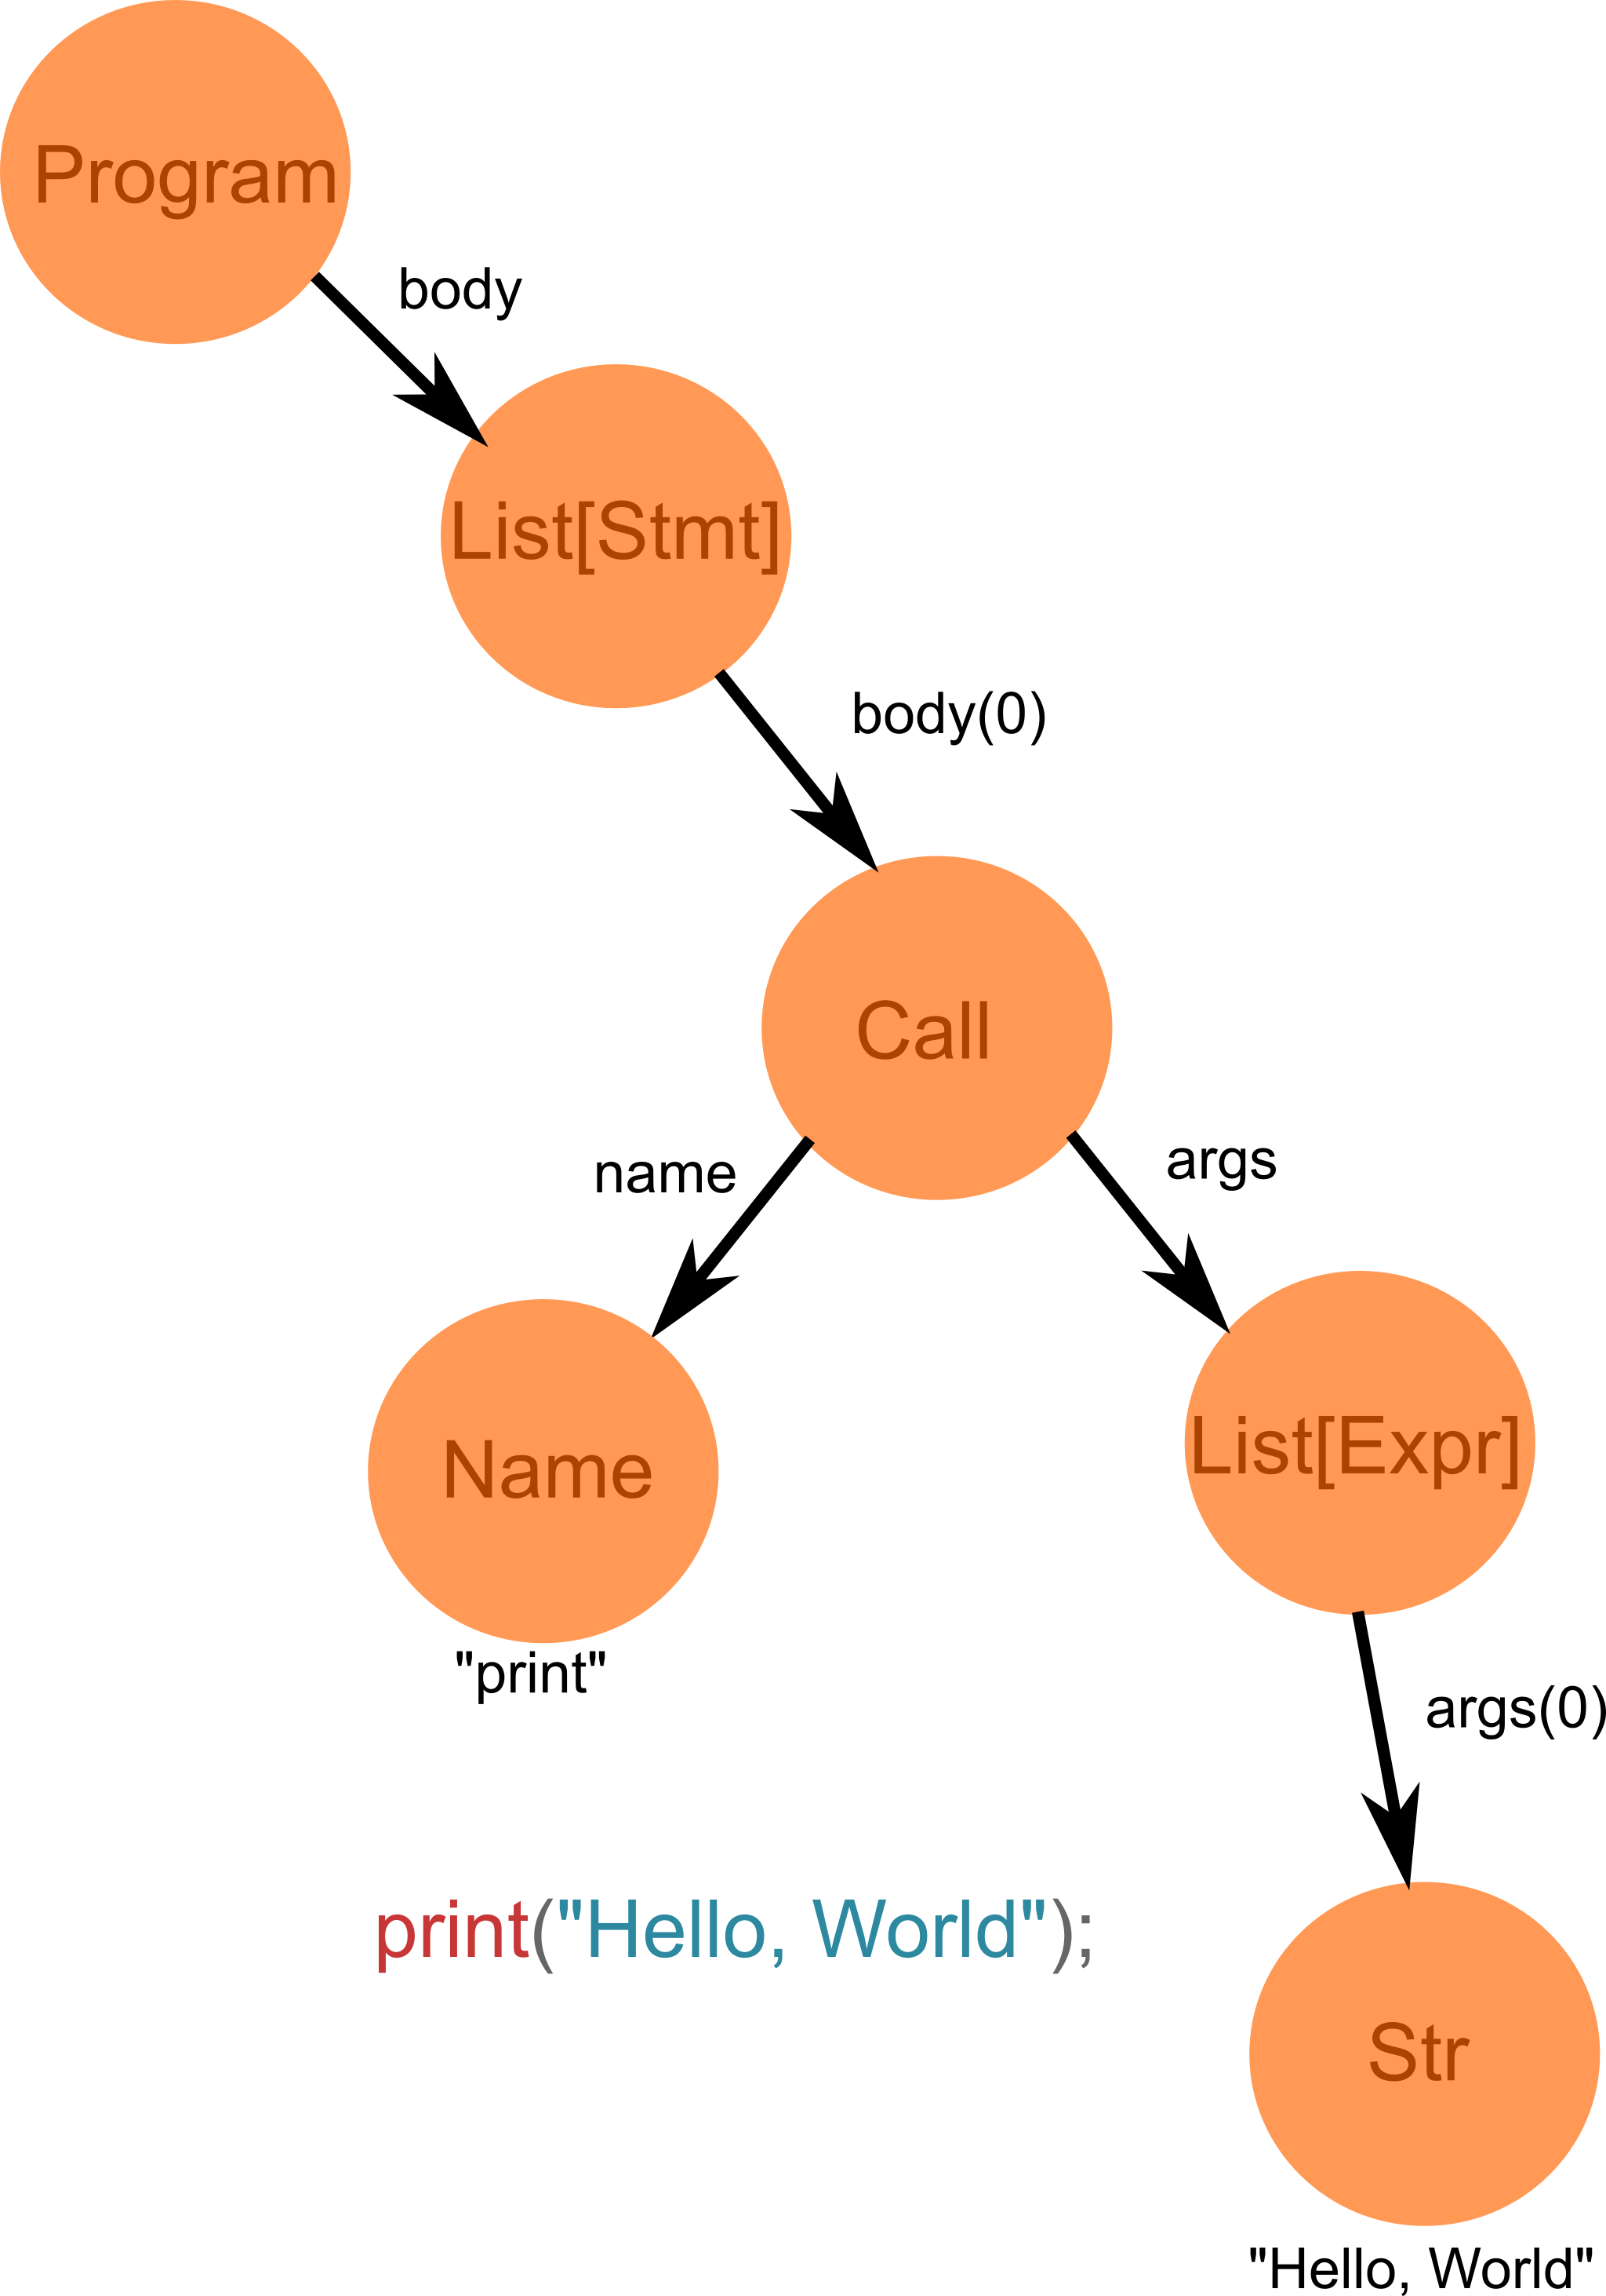
“Hello World” in AST form (cont.)
o_O
For the sake of simplicity,
we'll pretend all our programs
consist of a single expression...

Slide 15
Representing ASTs in Scala
Trait for AST nodes
Trait for expressions
Trait for statements
Case classes for everything else

Slide 16
Representing ASTs in Scala (cont.)
trait AST {}
// trait Stmt extends AST {}
trait Expr extends AST {}
case class Call(name : Name, args : List[Expr]) extends Expr
case class Name(id : String) extends Expr
case class Str(value : String) extends Expr

Slide 17
Compiling ASTs with BCEL
Generate builtins
  e.g. the “puts” function.
Visit each AST node
Generate logically equivalent bytecode
????
  Or: Beware of the verifier.
Profit!

Slide 18
A Small Proof of Concept
Compiles our “language” to JVM bytecode

Slide 19
Summary
Write a grammar
Convert it to its parser combinator equivalent
Act upon parse results to construct an AST
Generate logically equivalent JVM bytecode

