Slide 1

Database Handling with PHP
Idg2003: Back-end web development 1
Lecture 6
Luvin Ragoo (luvin.m.ragoo@ntnu.no)
Notes:
Intro to PHP

Slide 2

MySQL
Probably the most popular: well over 10 million installations.
Developed in the mid-1990s, it is now mature technology.
It is free to use like PHP, yet it is extremely powerful and exceptionally fast.
It is highly scalable, which means it can grow with your website.

Slide 3

MySQL: Basics
Database: is a structured collection of records stored in a computer system.
is organised in such a way that it can be quickly searched,
and information can be rapidly retrieved.
orders
addresses
customers
products

Slide 4
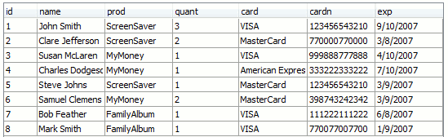
MySQL: Basics
A (relational) database consists of one or more tables.
Table: is a collection of related data held in a structured format within a database.
column
row

Slide 5



MySQL: Basics
A database management system (DBMS) is system software for creating and managing databases.
The DBMS provides users and programmers with a systematic way to create, retrieve, update and manage data.

Slide 6
MySQL: Basics
Structured Query Language (SQL): is a language designed for accessing and manipulating relational databases.
SELECT prod FROM orders
WHERE name="John Smith";

Slide 7
Accessing MySQL
There are three ways which you can interact with MySQL:
Command line,
via an interface, such as phpMyAdmin,
through a programming language like PHP.

Slide 8
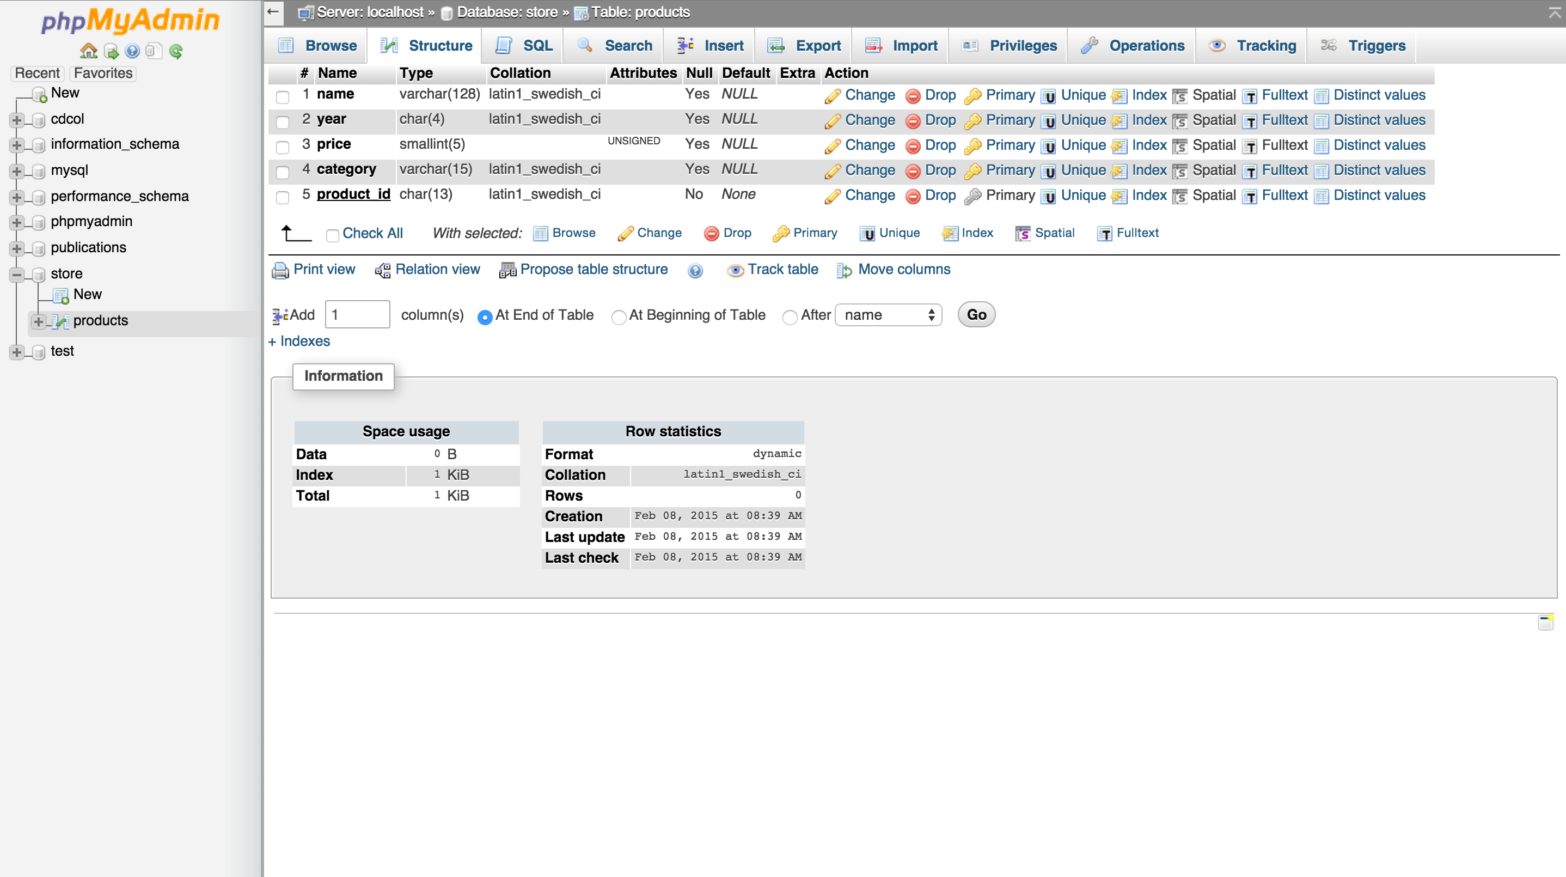
Accessing MySQL via phpMyAdmin
phpMyAdmin is a free software tool written in PHP, intended to handle the administration of MySQL over the Web.
It provides a visual interface to prepare and execute MySQL commands.
http://www.phpmyadmin.net/

Slide 9
Accessing MySQL via phpMyAdmin
phpMyAdmin is a free software tool written in PHP, intended to handle the administration of MySQL over the Web.
It provides a visual interface to prepare and execute MySQL commands.
http://www.phpmyadmin.net/

Slide 10
MySQL Commands
Command | Meaning
ALTER | Alter a database or table
BACKUP | Backup a table
\c | Cancel an input
CREATE | Create a database
DELETE | Delete a row from table
DESCRIBE | Describes columns of a table
DROP | Delete a database or table
EXIT | Exit
GRANT | Change user privileges
HELP | Display help
Command | Meaning
INSERT | Insert data
LOCK | Lock tables
QUIT | Same as exit
RENAME | Rename a table
SHOW | List details about an object
SOURCE | Execute a file
STATUS | Display the current status
TRUNCATE | Empty a table
UNLOCK | Unlock tables
UPDATE | Update an existing record
USE | Use a database

Slide 11
MySQL and PHP: The Process
Connect to MySQL.
Select the database to use.
Build query string.
Perform the query.
Retrieve the results and output them to a web page.
Repeat Steps 3-5 until all desired data has been retrieved.
Disconnect from MySQL.

Slide 12
MySQL and PHP: Example DB
CREATE USER ‘idg2003'@'localhost' IDENTIFIED BY idg2003 ';
CREATE DATABASE idg2003 _db;
GRANT ALL ON idg2003_db.* TO idg2003 '@'localhost';

Slide 13
MySQL and PHP: Example DB
USE idg2003_db;
CREATE TABLE books (
isbn smallint(6) PRIMARY KEY,
title varchar(100),
publisher varchar(50),
pages tinyint(4),
abstract text(1000)
);

Slide 14
MySQL and PHP: Example DB
INSERT INTO books(isbn, title, publisher, pages, abstract) VALUES('1234', 'Book 1', 'ACM', '22-50', 'an abstract’);
INSERT INTO books(isbn, title, publisher, pages, abstract) VALUES('1235', 'Book 2', 'ACM', '40-50', 'another abstract');

Slide 15
MySQL Commands: Scope of this course
PHPMyAdmin :
Create/Delete Databases
Create/Modify/Delete Tables
PHP :
Create Entries in Tables
Read Data from Tables
Update Existing Entries
Delete Entries from Tables

Slide 16
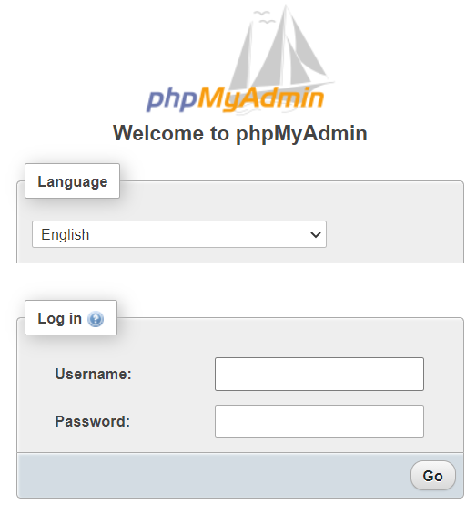
Connecting to PHPMyAdmin
Go to http://localhost/phpmyadmin/
By Default : -
Username : root
Password : root

Slide 17
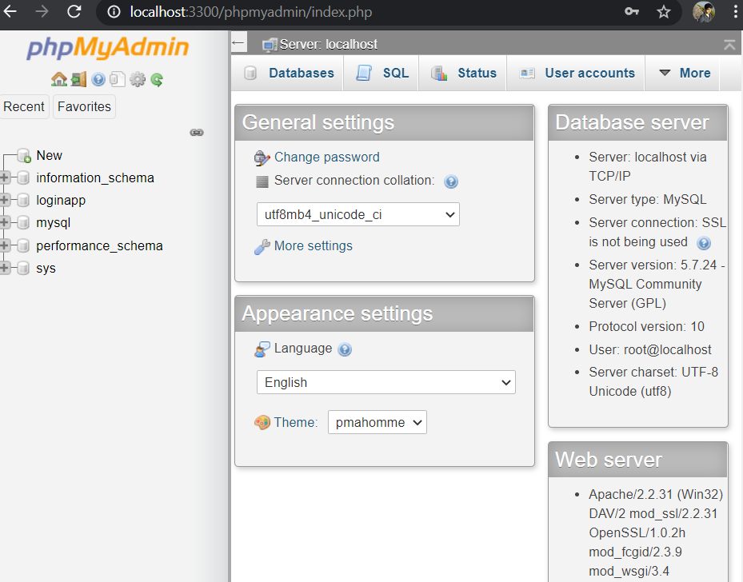
PHPMyAdmin : Interface

Slide 18
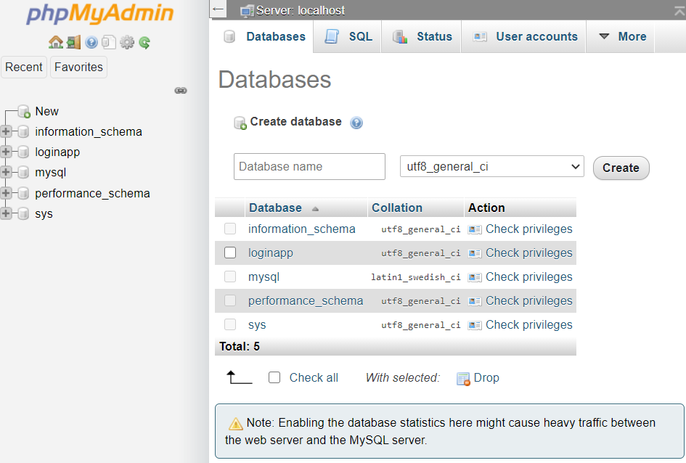
PHPMyAdmin : Creating a Database
Navigate to Database Tab > Insert a name for your Database > Click Create

Slide 19
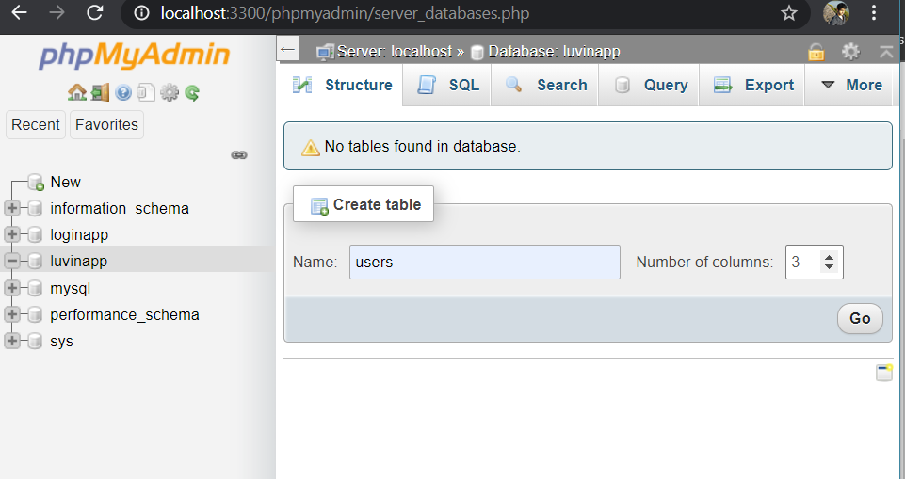
PHPMyAdmin : Creating a Table
Insert Name > select number of colums > click Go

Slide 20
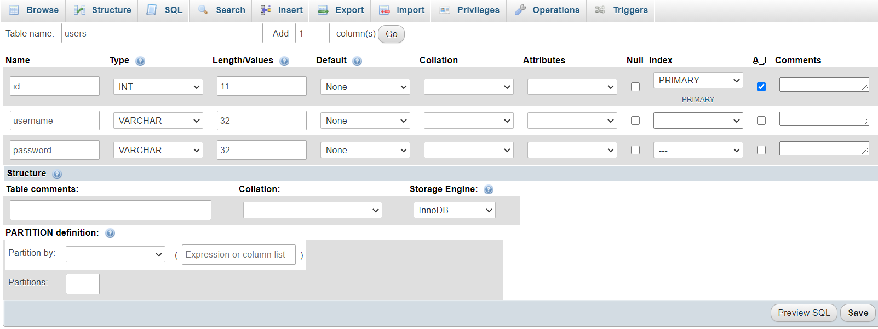
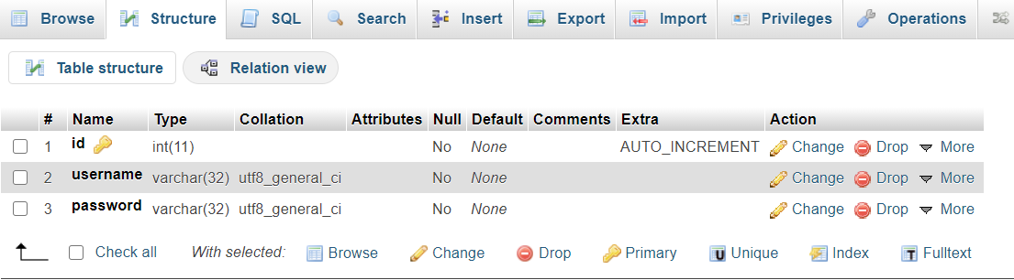
PHPMyAdmin : Creating a Table
Name the column and define data type.
Index : PRIMARY defines the main column by which a row will be identified
A_I stands for Auto Increment

Slide 21
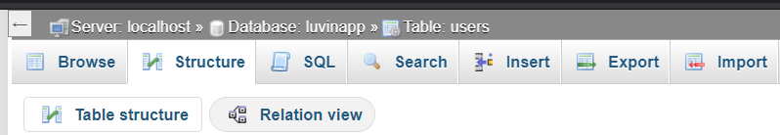
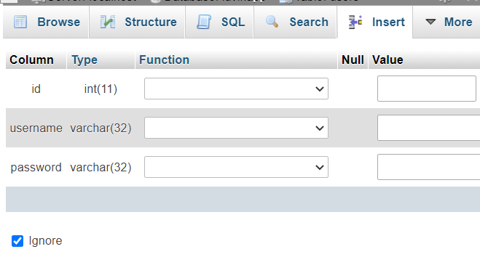
PHPMyAdmin : Adding/Removing Entries
Navigate to Insert Tab
Input Data into Value fields of the respective Columns > Click Go
Note that id column does not need a value, since
it is set to Auto Increment with every new entry

Slide 22
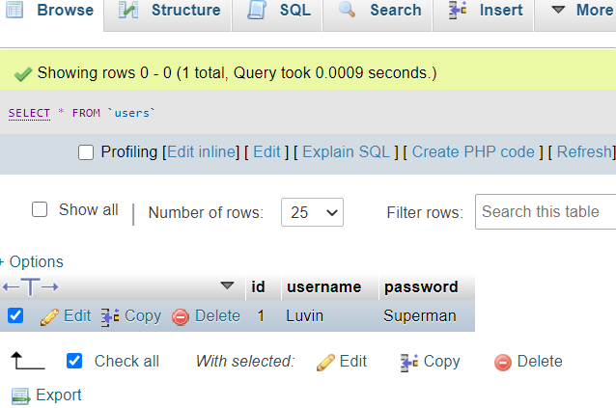
PHPMyAdmin : Adding/Removing Entries
In the Browse tab > Select the entry to Delete > Click Delete

Slide 23
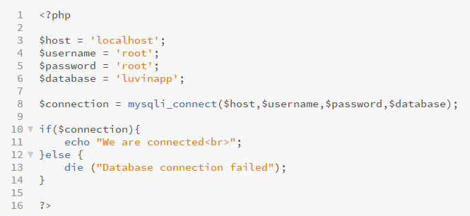
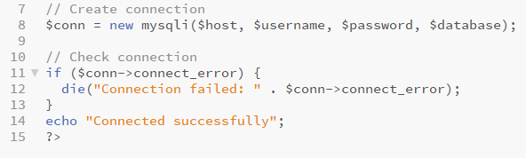
Accessing MySQL Database from PHP : Connecting to Database
Alternatively, can also use object-oriented approach :
https://www.php.net/manual/en/book.mysqli.php

Slide 24
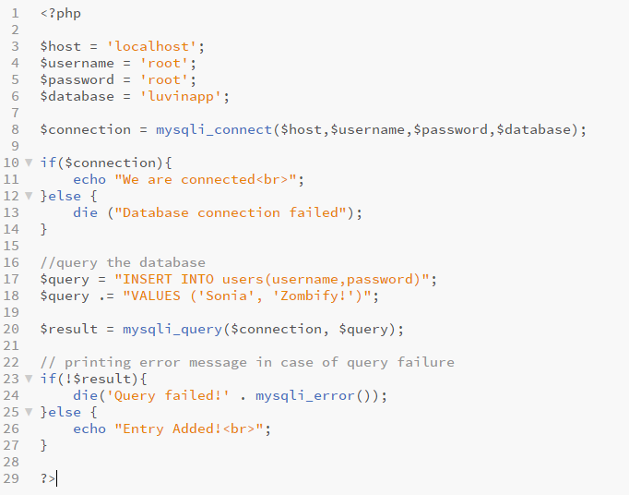
Accessing MySQL Database from PHP : Creating an Entry

Slide 25
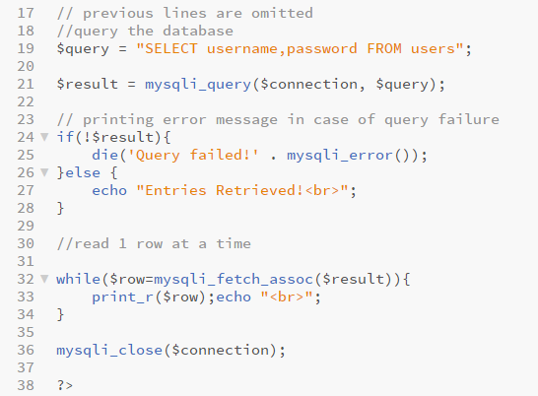
Accessing MySQL Database from PHP : Reading From Table
Alternatively :
Would select all columns from the table ‘users’.

Slide 26
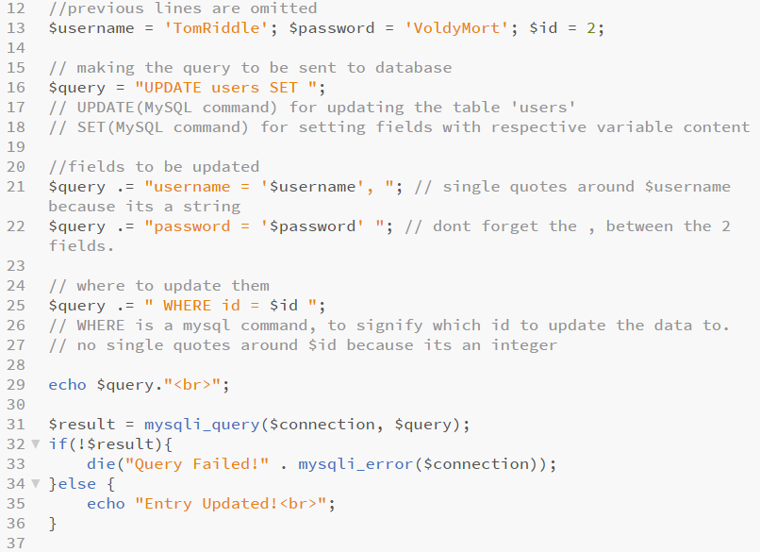
Accessing MySQL Database from PHP : Update Entry
Query sent to $connection would look like this :

Slide 27
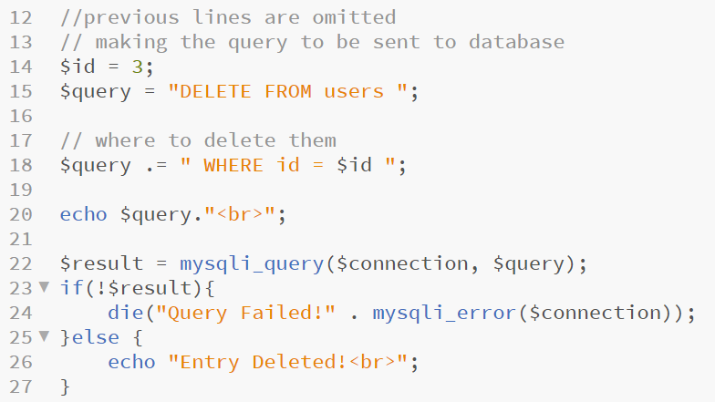
Accessing MySQL Database from PHP : Delete Entry

Slide 28
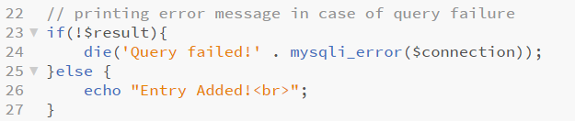
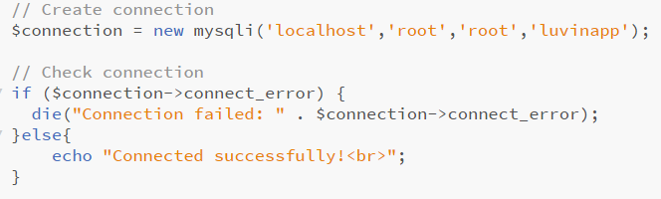
MySQL and PHP: Error Reporting
mysqli_error() function can give some information about why a database error occurred.
Alternatively, if the connection was created as an object of mysqli, then the connect_error() method can be accessed from the object as follows

Slide 29
MySQL and PHP + Forms Handling
Finally, MySQL database processes can be further enhanced with forms handling, to make your website super dynamic. Consider the LoginApp Example.

