Slide 1
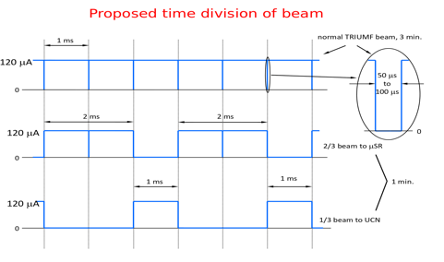
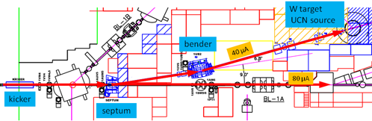
Kicker Control System
Need to direct a fraction of 1V beam buckets to 1U instead of 1A.
Ramp up beam during 50us ion source blanking notch.

Slide 2
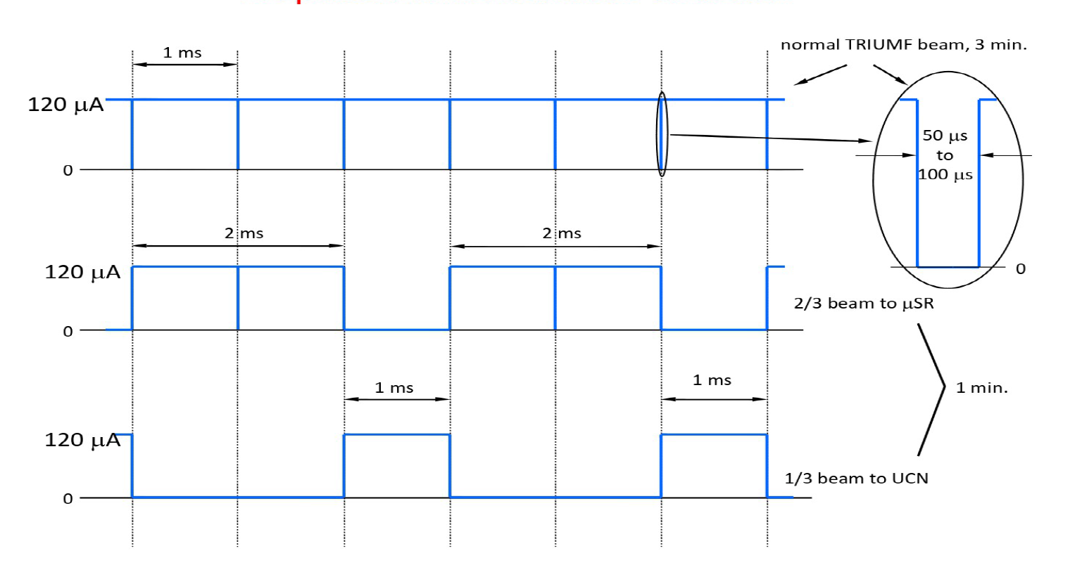
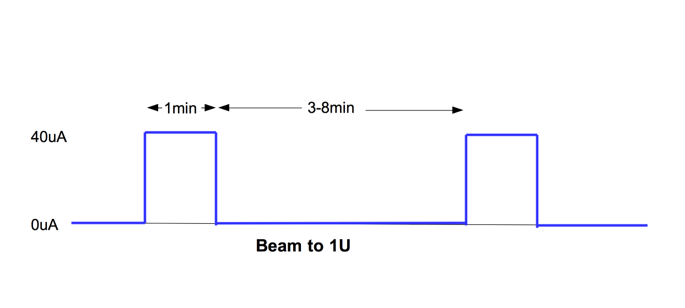
Kicker Operating Modes
For regular operation, kicker will have short and long timescale structure
  Short: kick a fraction of the 1ms buckets to 1U; at full power would be third of buckets to 1U = 40uA.
  Long: put 40uA on UCN target for 1 minute, then analyze UCNs for 3-8 minutes. Repeat.
For commissioning we will probably want a different mode where the long structure is a single 1s or 1minute beam-ON period.
Rod asked: how precise does long period need to be?
  Answer: not so precise for minute periods: 1min +- 1s is fine. But for commissioning 1s +- 1s is probably not fine.
BL1V
BL1V
BL1A
BL1U
short
BL1U
long

Slide 3
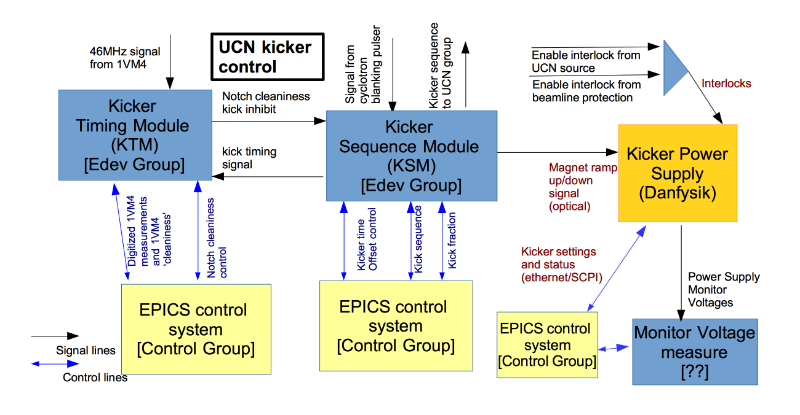
Possible Kicker Control
KSM: does actual sequencing of magnet ramp up/down.
KTM: measures the beam at kicker, make sure that our kicks are aligned with blanking notches.

Slide 4
Possible Kicker Control
Staging: think we only need KSM + EPICS control for first tests.

Slide 5
KSM Work Breakdown
Use existing hardware for KSM module
KSM firmware provided by SciTech dept
KSM EPICS control provided by controls group
T. Lindner
DAQ group
For UCN
April 25, 2016

Slide 6
Requirements for KSM
Need reasonable remote control for EPICS
Need 2-4 logic input and 4-6 logic outputs (1 optical)
KSM
In 1 Signal from cyclotron blank pulser (TTL)
In 2 Enable (TTL)
Out 1/2 Magnet ramp up/down (TTL/NIM; one output convert to optical)
Out 3/4 Adjusted kick time (TTL/NIM, two copies of same signal)
Out 5/6 Long sequence timing signal (TTL/NIM, two copies of same signal)
Out 12 Constant logic high (TTL): to bypass KSM enable
EPICs control (VME registers)

Slide 7
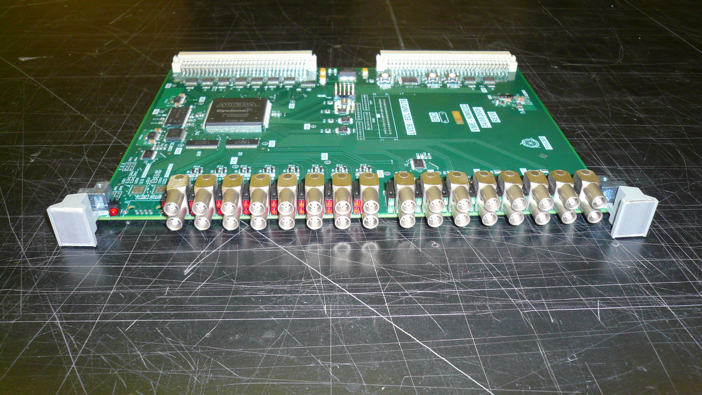
Options for KSM Module
(using existing hardware)
PPG or IO-32 VME module (made by edev group)
  Control through VME registers
ARM-based CAMAC controller (Konstantin + Kevin + Rolf Keitel I think)
  Control from ARM to Cyclone-IV FPGA
Cyclone V SoC evaluation card
  Control from ARM to FPGA side of Cyclone V.
IO-32 VME board

