Slide 1
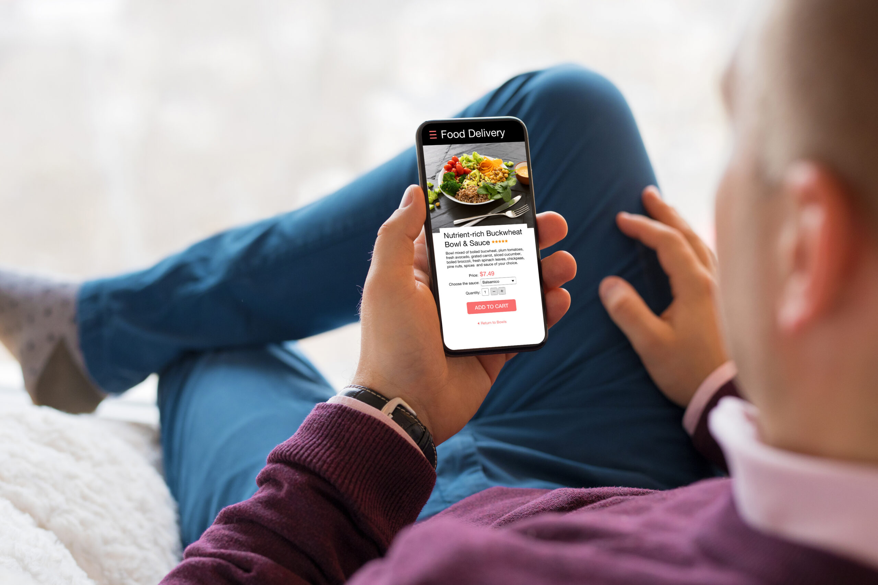
FITBITE
FB
Healthy meals. Smarter days.
Digital Business Project
Designing a Profitable and Feasible E-Business
Example concept: a digitally operated healthy-meal delivery business in Bangkok.
Prepared as a classroom business proposal

Slide 2
1. Project Objective
The project evaluates an e-business as a real business, not only as a creative idea.
Create customer value
Generate sustainable profit
Remain feasible
Use digital technologies to solve a clear customer problem and make the buying experience convenient.
Show how the business attracts customers, generates revenue, controls costs, and remains financially viable.
Demonstrate that the market, technology, operations, finances, and legal/ethical requirements are achievable.
Key principle
A good e-business is an idea that customers want, can be implemented realistically, and can generate sustainable profit.
Illustrative business proposal — assumptions are for classroom/project purposes

Slide 3
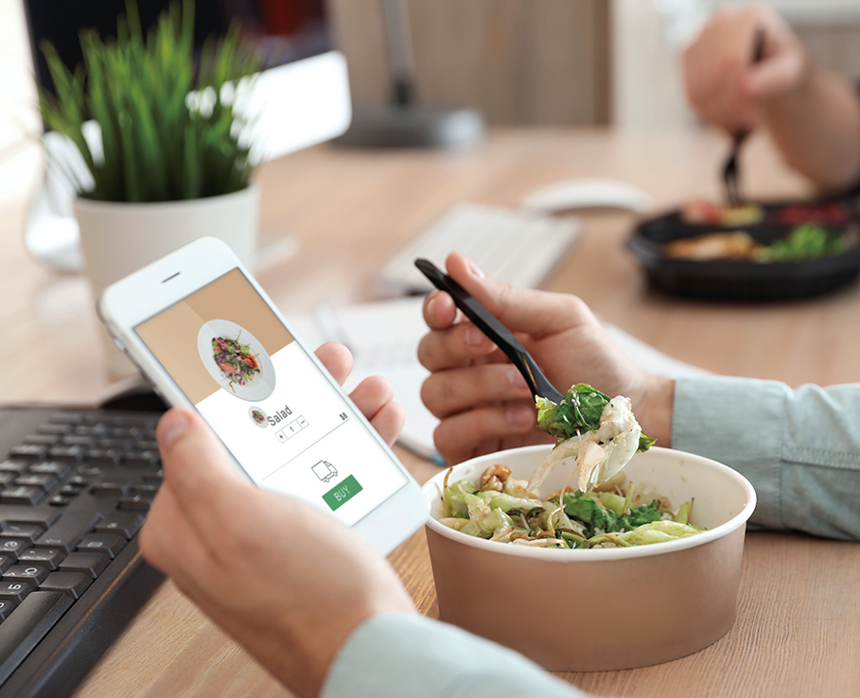
2. Business Concept: FitBite
A mobile-first healthy meal delivery service designed for busy urban customers.
The problem
Busy students and young professionals often want healthier meals but have limited time to plan, cook, or compare options.
Existing delivery choices can be convenient, but healthy choices may be expensive, difficult to track, or inconsistent.
FitBite simplifies the decision: choose a goal, select a meal, pay digitally, and receive a portion-controlled meal.
The solution
Fresh, affordable meal bowls with clear calorie/protein information.
One-time orders and flexible weekly packs.
Digital ordering through a mobile-friendly website and LINE.
Personalized recommendations based on lifestyle goals.
Illustrative business proposal — assumptions are for classroom/project purposes

Slide 4
3. Value Proposition & Differentiation
Why should customers choose FitBite instead of existing alternatives?
Affordable
Personalized
Convenient
Transparent
Target average price of about ฿199 per meal—below many premium macro-tracked options.
Customers choose goals such as balanced, high-protein, or lighter meals.
Mobile ordering, digital payment, scheduled delivery, and LINE customer support.
Every menu item displays calories, protein, ingredients, and allergens.
Competitive advantage
FitBite positions itself between ordinary food delivery and premium meal-prep subscriptions: healthier than convenience food, but more accessible and flexible than high-end plans.
Illustrative business proposal — assumptions are for classroom/project purposes

Slide 5
4. Target Market
Primary market: digitally active urban consumers in Bangkok.
18–35
Bangkok
฿199
Mobile-first
Daily
Primary age range
Initial service area
Target average meal
Buying behavior
Digital engagement
Demographics: university students, early-career professionals, office workers, and fitness-oriented consumers.
Lifestyle: busy schedules, health/fitness interests, convenience seeking, frequent food delivery.
Purchasing behavior: comfortable with mobile ordering, QR/PromptPay/card payments, promotions, and reviews.
Digital habits: Instagram, TikTok, Facebook, LINE, Google search, and food-delivery platforms.
Needs: affordable healthy food, predictable portions, convenience, variety, nutrition transparency, and reliable delivery.
Illustrative business proposal — assumptions are for classroom/project purposes

Slide 6
5. E-Business Model
FitBite uses a B2C direct-to-consumer model with optional subscription packs.
1
2
3
4
5
6
Discover
Order
Pay
Prepare
Deliver
Retain
TikTok / Instagram / Google
Website / LINE
PromptPay / card / e-wallet
Central kitchen
Scheduled rider delivery
Reviews / loyalty / packs
Digital infrastructure
E-commerce website: product catalogue, nutrition information, cart, checkout, delivery scheduling.
Social media: Instagram + TikTok for discovery; Facebook for broader reach; LINE for retention and customer service.
Payment: PromptPay/QR, credit/debit cards, and selected e-wallets.
Fulfillment: central kitchen → quality check → sealed packaging → scheduled delivery.
Customer service: LINE chat, social DMs, FAQ, and post-purchase support.
Illustrative business proposal — assumptions are for classroom/project purposes

Slide 7
6. Products & Pricing
Pricing is designed to balance affordability, perceived value, and contribution margin.
Product / plan | Customer price | Estimated variable cost | Contribution
Single Balanced Bowl | ฿199 | ฿110 | ฿89
High-Protein Bowl | ฿229 | ฿125 | ฿104
5-Meal Pack | ฿950 | ฿550 | ฿400
20-Meal Monthly Pack | ฿3,600 | ฿2,200 | ฿1,400
Pricing strategy
Penetration-oriented introductory pricing, then protect margin through meal packs and repeat purchases.
Promotions
First-order voucher, referral credit, student bundle, and limited-time social media codes.
Expected profit per sale
At ฿199 average price and ฿110 variable cost, contribution is approximately ฿89 before fixed costs.
Illustrative business proposal — assumptions are for classroom/project purposes

Slide 8
7. Revenue Model
The business earns primarily from meal sales and repeat/pack purchases.
70%
25%
5%
Direct meal sales
Weekly/monthly packs
Corporate / group orders
Revenue logic
Primary revenue: customers purchase individual meals directly through the FitBite digital storefront.
Recurring revenue: 5-meal and 20-meal packs increase order frequency and customer retention.
Secondary revenue: office wellness orders, gym partnerships, and small corporate meal packages.
Future option: premium personalization service or nutrition coaching partnership, without making the core model dependent on it.
Illustrative business proposal — assumptions are for classroom/project purposes

Slide 9
8. Cost Structure
Major costs are separated into variable costs per meal and monthly fixed operating costs.
Variable cost per meal | Estimate
Ingredients / food materials | ฿75
Packaging | ฿12
Delivery allocation | ฿18
Payment processing / transaction | ฿5
Total variable cost | ฿110
Monthly fixed cost | Estimate
Kitchen / production space | ฿30,000
Labor / operations | ฿35,000
Digital advertising | ฿20,000
Website / software | ฿5,000
Admin / utilities / contingency | ฿10,000
Total fixed cost | ฿100,000
Cost-control priorities
Use standardized recipes and portion sizes to control ingredient waste.
Batch purchasing and menu engineering can lower food cost.
Schedule delivery windows to reduce failed deliveries and rider cost.
Track advertising cost per acquired customer and stop low-performing campaigns.
Illustrative business proposal — assumptions are for classroom/project purposes

Slide 10
9. Monthly Profitability Projection
Illustrative base case: 1,500 meals sold per month.
฿298,500
฿165,000
฿100,000
฿33,500
Monthly revenue
Variable costs
Fixed costs
Estimated profit
Calculation
Expected Revenue − Total Costs = Expected Profit
฿298,500 − (฿165,000 + ฿100,000) = ฿33,500
Annualized base case
If the base case is sustained: annual revenue ≈ ฿3,582,000; annual operating profit ≈ ฿402,000.
Illustrative business proposal — assumptions are for classroom/project purposes

Slide 11
10. Break-Even Analysis
How many meals must FitBite sell before it begins making a profit?
1,124
฿223,676
฿89
Break-even meals / month
Break-even sales / month
Contribution / meal
Formula
Break-Even Point = Fixed Costs ÷ (Selling Price − Variable Cost per Unit)
= ฿100,000 ÷ (฿199 − ฿110) = 100,000 ÷ ฿89 ≈ 1,124 meals
Feasibility meaning
The business needs roughly 1,124 meals per month to cover fixed and variable costs. A 1,500-meal target provides a buffer above break-even.
Illustrative business proposal — assumptions are for classroom/project purposes

Slide 12
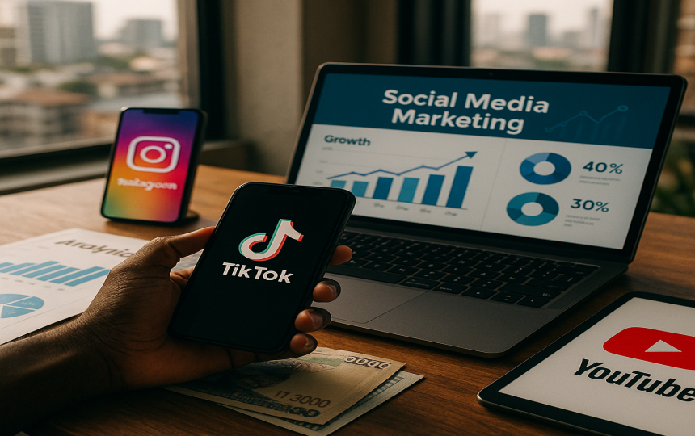
11. Digital Marketing Strategy
Prioritize channels where the target market discovers food, lifestyle ideas, and promotions.
Instagram: high-quality meal photos, Reels, customer stories, nutrition tips, and weekly menus.
TikTok: short videos showing meal preparation, price/value comparisons, challenges, and creator collaborations.
LINE: order reminders, loyalty rewards, customer service, personalized offers, and retention.
SEO / Google: capture high-intent searches such as healthy meal delivery in Bangkok.
Influencers: micro-influencers in fitness, university, lifestyle, and office-worker communities.
Paid advertising: retarget website visitors and test different offers using a controlled monthly budget.
Reviews and referrals: encourage verified customers to share feedback and give referral credits.
Priority funnel
Discover → Trust → Trial → Repeat → Refer
Image source: Slab.ng social media marketing illustration; used here as a visual example of digital marketing channels.

Slide 13
12. Competitor Analysis
The comparison uses publicly visible Bangkok healthy-food offerings; prices/features can change and should be rechecked before launch.
Factor | FitBite | Homie Clean Food | Protein Chef BKK
Positioning | Affordable + personalized | Clean food + meal programs | Premium macro-tracked meals
Example price | ฿199 target | From ~฿150/meal | From ~฿290/meal
Digital ordering | Website + LINE | Website + digital checkout | Website + scheduled delivery
Nutrition transparency | Calories + protein | Macro-balanced | Detailed macros
Flexibility | One-time + packs | Weekly programs | One-time + scheduled
Key advantage | Accessible personalization | Established clean-food positioning | Premium macro tracking
FitBite competitive gap
Win on affordability + flexible personalization + simple digital experience rather than trying to be the most premium option.
Competitor references: Homie Clean Food and Protein Chef BKK public websites, accessed August 2026.

Slide 14
13. Feasibility Analysis
A strong concept must be feasible across five dimensions.
Market feasibility
Technical feasibility
Operational feasibility
Demand is plausible because the target market values convenience, delivery, health, and mobile purchasing. Validate through a small pilot.
A website, payment gateway, LINE account, analytics, and delivery integrations are accessible without building complex proprietary technology.
A small central kitchen, standardized recipes, packaging, scheduled delivery windows, and quality checks can support a pilot launch.
Financial feasibility
Legal / ethical feasibility
At the base-case assumptions, 1,500 meals/month generates about ฿33,500 operating profit before tax/financing. Break-even is about 1,124 meals/month.
Comply with food-safety requirements, labeling, consumer protection, payment security, privacy/data protection, and truthful nutrition/allergen communication.
Pilot-first approach
Start with one Bangkok service zone, a limited menu, and 100–200 pilot customers. Use actual order, repeat-purchase, delivery, and food-cost data before scaling.
Illustrative business proposal — assumptions are for classroom/project purposes

Slide 15
14. Risk Analysis
Identify what could go wrong and how management would reduce the impact.
Risk | Potential effect | Mitigation
Low customer demand | Sales below break-even | Pilot launch, customer interviews, A/B testing, targeted promotions
Food-cost inflation | Lower contribution margin | Supplier alternatives, menu engineering, portion control
Delivery delays | Poor reviews / refunds | Delivery windows, backup riders, zone-based scheduling
Strong competition | Customer switching | Differentiate on personalization, value, retention
Food safety / quality issue | Reputation + legal exposure | Strict SOPs, hygiene controls, traceability, staff training
Data/privacy incident | Loss of trust + compliance risk | Minimize data, secure access, clear privacy practices
Illustrative business proposal — assumptions are for classroom/project purposes

Slide 16
15. Implementation Roadmap
A phased launch reduces financial and operational risk.
Phase 1
Validate
Weeks 1–2
Customer interviews, landing page, menu test, competitor price check
Phase 2
Pilot
Weeks 3–6
100–200 customers, limited delivery zone, collect feedback
Phase 3
Optimize
Months 2–3
Improve recipes, packaging, delivery, ads, retention
Phase 4
Scale
Months 4–12
Expand zones, partnerships, corporate packs, automation
Core launch metrics
Orders/month • contribution margin • customer acquisition cost • repeat purchase rate • average order value • on-time delivery • rating/refund rate
Illustrative business proposal — assumptions are for classroom/project purposes

Slide 17
16. Final Business Recommendation
Should FitBite be launched?
YES — but launch as a controlled pilot first.
The target customer has a clear problem: healthy eating is difficult to maintain when time and convenience matter.
The digital model is technically realistic because customers can discover, order, pay, communicate, and review through existing platforms.
The base-case financial model is positive at 1,500 meals/month, with an estimated operating profit of about ฿33,500 per month.
The break-even level of approximately 1,124 meals/month gives a measurable sales target for management.
The biggest uncertainty is not technology—it is whether enough customers will buy repeatedly at the required price.
Therefore, FitBite should validate demand with a small pilot before investing heavily in kitchen capacity or large-scale advertising.
Decision rule
Scale only when customer retention, unit economics, food quality, and delivery reliability are consistently proven.
Illustrative business proposal — assumptions are for classroom/project purposes

Slide 18
17. Required Deliverables Checklist
The completed proposal should address every required component.
✓
Business name, logo, and tagline
✓
Break-even analysis
✓
Business concept and customer problem
✓
Digital marketing strategy
✓
Target market
✓
Competitor analysis
✓
E-business model
✓
Feasibility analysis
✓
Products/services and pricing
✓
Risk analysis
✓
Revenue model
✓
Final recommendation
✓
Cost and profitability analysis
Illustrative business proposal — assumptions are for classroom/project purposes

Slide 19
18. Presentation Questions to Prepare
Be ready to defend the business logic, not only the idea.
1.
Who will buy your product or service?
6.
What are the major costs?
2.
Why will they buy it?
7.
When will you break even?
3.
How will you reach them?
8.
Why is the business feasible?
4.
How will the business make money?
9.
What could cause the business to fail?
5.
How much profit can you realistically make?
10.
How will you prevent or manage those risks?
Illustrative business proposal — assumptions are for classroom/project purposes

Slide 20
FITBITE
Healthy meals. Smarter days.
A good e-business is not simply creative.
It is wanted by customers, feasible to operate, financially viable, and sustainable over time.
Thank you
Questions & discussion

