Slide 1
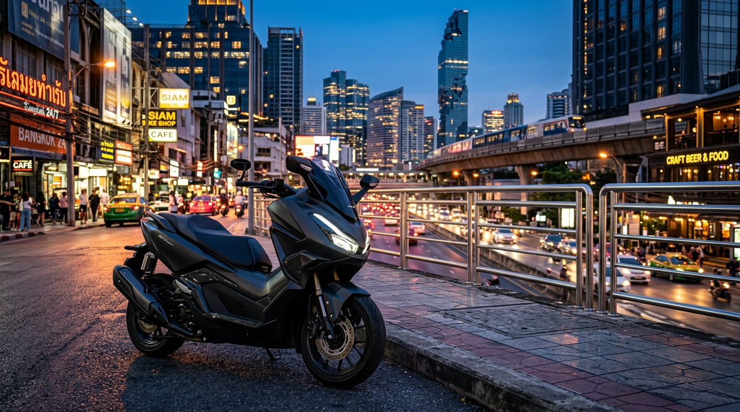
🛵 BKK MOTORBIKE RENTAL
Smart. Seamless.
Keyless Mobility.
A mobile-first, IoT-enabled motorbike rental platform designed to eliminate traditional rental friction across Greater Bangkok.
• Initial Fleet: 20 Bikes (10 Standard / 10 Premium)
• Key Edge: Contactless IoT Unlock & Zero Passport Hold
• Target: Students, Expats, Tourists & Commuters
BKK Motorbike Rental | Digital Business Project | Bangkok, Thailand

Slide 2
BKK MOTORBIKE RENTAL
1. Project Objective
Evaluating an e-business through value creation, profitability, and operational feasibility.
Create Customer Value
• Solve shop dependency: 100% online booking in under 2 minutes.
• Zero passport holding: digital KYC verifies identity safely.
• Transparent pricing: no surprise insurance or hidden fees.
• Smart keyless access: unlock motorbike directly via smartphone.
Generate Sustainable Profit
• High contribution margins: 63% to 68% across all tiers.
• Balanced revenue mix: monthly contracts + daily tourists.
• Lean fixed overhead: ฿168,000/month across 20-bike fleet.
• Break-even target: 75% fleet utilization (15 active bikes).
Operational Feasibility
• Market demand: high congestion near BTS/MRT & university hubs.
• Proven tech stack: lightweight PWA + 4G cellular IoT locks.
• Central operations: Sathorn maintenance depot with regular SOPs.
• Full legal compliance: Thailand PDPA & DLT driver rules.
Core Guiding Principle
• A great digital business solves real user pain points, operates reliably in the physical world, and generates resilient, repeatable profit.
BKK Motorbike Rental | Digital Business Project | Bangkok, Thailand

Slide 3
BKK MOTORBIKE RENTAL
2. Business Concept: BKK Motorbike Rental
A mobile-first, IoT-enabled motorbike rental platform for Greater Bangkok.
The Traditional Rental Problem
• Manual & Inconvenient: Must visit physical rental shops in heavy traffic.
• Opaque & Hidden Fees: Arbitrary damage claims and unlisted charges.
• Passport Anxiety: Shops routinely hold original passports as collateral.
• Paper Contract Delays: Slow paperwork, manual errors, and deposit friction.
• Zero Fleet Visibility: Cannot verify real-time availability or bike condition.
The BKK Motorbike Rental Solution
• Instant Online Booking: Search, compare, and reserve in under 2 minutes.
• Guaranteed Price Transparency: Clear rates with optional zero-deductible waiver.
• Digital KYC: Automated encrypted passport verification—no physical holding.
• Keyless Smart IoT: Unlock the vehicle instantly via mobile digital key.
• Automated Operations: GPS telematics, scheduled servicing, instant deposit refund.
Core Experience Flow
• Search Catalog Online ➔ Digital KYC Upload ➔ PromptPay QR Payment ➔ Smart Key IoT Unlock ➔ GPS Safe Ride ➔ Instant Deposit Release
BKK Motorbike Rental | Digital Business Project | Bangkok, Thailand

Slide 4
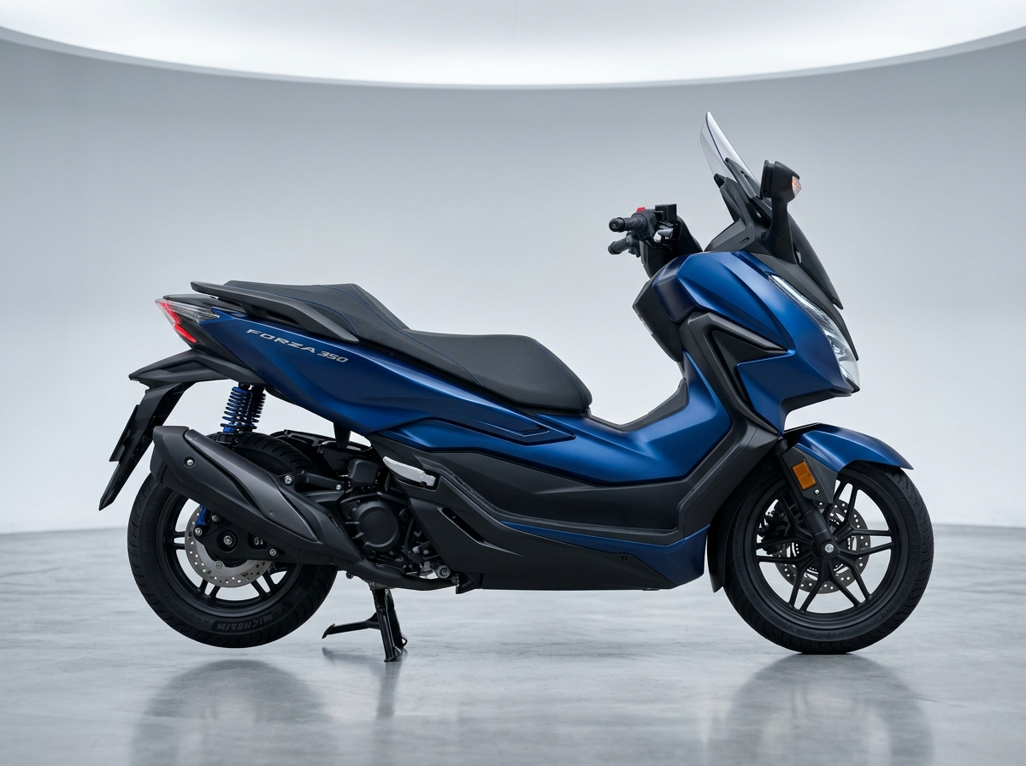
BKK MOTORBIKE RENTAL
3. Value Proposition & Differentiation
Why customers choose BKK Motorbike Rental over traditional street shops.
Affordable & Flexible
• Competitive rates: ฿300/day Std, ฿450/day Premium.
• Up to 40% duration discount on 30-day packages.
• Special student offers & ฿500 referral credits.
Personalized Choice
• Standard: Agile Honda Click 160 & Scoopy-i.
• Premium: Luxury Honda Forza 350 & Vespa Sprint.
• Custom add-ons: Full-face helmets, damage waivers.
Frictionless Convenience
• Instant booking via PWA mobile web app.
• Keyless Smart IoT unlock with haptic feedback.
• 5 Bangkok hubs or flat ฿200 doorstep delivery.
Total Transparency
• Zero hidden fees; clear digital rental agreements.
• No passport holding: encrypted digital KYC.
• Automated prompt deposit refund upon return.
Key Competitive Edge
A smart digital rental experience combining keyless IoT access, PromptPay payments, and GPS fleet telematics.
BKK Motorbike Rental | Digital Business Project | Bangkok, Thailand

Slide 5
BKK MOTORBIKE RENTAL
4. Target Market & Personas
Targeting digitally active urban residents, students, expats, and travelers (Age 18–40).
18 – 40
Target Age Group
20 Units
Initial Pilot Fleet
5 Stations
Sathorn, Asok, Khaosan, Thonglor, Ari
฿300 – ฿450
Target Daily Price
University Students
• Campuses: Chula, ABAC, Bangkok Univ.
• Need cheap daily transit to bypass traffic.
• Prefer 7 to 30-day Standard rentals (Click/Scoopy).
• Highly responsive to student discount codes.
Expats & Nomads
• Professionals living in Sukhumvit / Sathorn.
• Need reliable daily transport to bypass BTS rush.
• Prefer 30-day Premium rentals (Forza 350).
• Value cashless checkout & transparent terms.
Tourists & Visitors
• Vacationers staying near Khaosan & Asok.
• Need 1-day to 7-day rentals for city exploration.
• Refuse passport withholding.
• Value included safety helmets & GPS assistance.
Urban Commuters
• Bangkok residents needing temporary wheels.
• Vehicle in shop or short-term work assignment.
• Value rapid doorstep hotel/condo delivery.
• Prefer modern, reliable automatic scooters.
BKK Motorbike Rental | Digital Business Project | Bangkok, Thailand

Slide 6
BKK MOTORBIKE RENTAL
5. E-Business Model & Flow
A direct-to-consumer (B2C) digital rental model integrated with IoT telematics.
1. Discover
• Google SEO, TikTok & IG Reels, travel forums.
2. Book
• Select model, rental dates, pickup hub & add-ons.
3. Pay
• Instant PromptPay QR or Credit/Debit Card.
4. Verify
• Digital KYC: upload passport & driver license.
5. Unlock
• Digital Key in app; tap to unlock via 4G IoT lock.
6. Return
• 4-angle photo check; automated deposit refund.
Customer Mobile App (PWA)
• Interactive catalog with real-time fleet availability.
• Dynamic quotation engine with tiered duration discounts.
• Digital KYC scanner with automated watermarking.
• Smart Key HUD controller with live trip speedometer.
IoT Telematics Network
• 4G cellular GPS telematics trackers on all 20 bikes.
• Encrypted MQTT broker for remote immobilizer commands.
• Bangkok perimeter geofencing with anti-theft alarms.
• Automated battery voltage and usage diagnostic alerts.
Admin Operations Hub
• Live Leaflet GPS map tracking all 20 fleet units.
• Financial analytics tracking ฿168,000 break-even target.
• Automated preventative maintenance alerts every 3,000 km.
• Integrated customer support via LINE Official Account.
BKK Motorbike Rental | Digital Business Project | Bangkok, Thailand

Slide 7
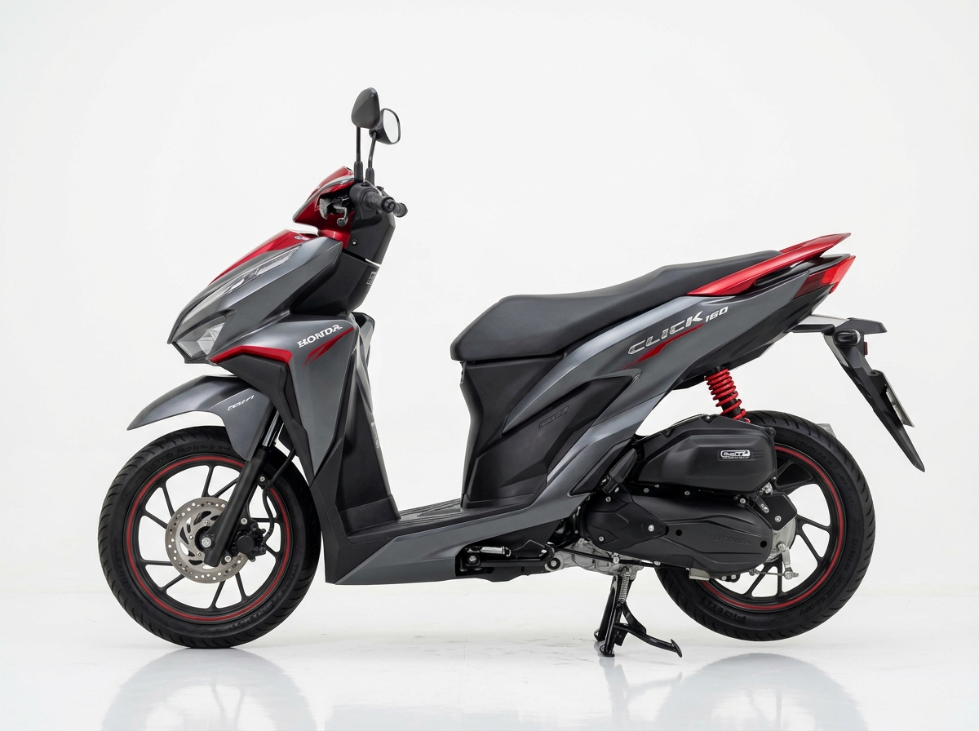
BKK MOTORBIKE RENTAL
6. Products & Tiered Pricing
Balancing customer affordability, vehicle utilization, and healthy contribution margins.
Product / Plan | Customer Price | Variable Cost | Contribution | Margin %
Standard – 1 Day | ฿300 | ฿100 | ฿200 | 66.7%
Standard – 7 Days | ฿1,900 | ฿600 | ฿1,300 | 68.4%
Standard – 30 Days | ฿5,500 | ฿2,000 | ฿3,500 | 63.6%
Premium – 1 Day | ฿450 | ฿150 | ฿300 | 66.7%
Premium – 7 Days | ฿2,800 | ฿900 | ฿1,900 | 67.8%
Premium – 30 Days | ฿9,500 | ฿3,500 | ฿6,000 | 63.1%
Standard Fleet (10 Units)
• Honda Click 160 & Scoopy-i
• 15–37L underseat storage
• Deposit: ฿1k Thai / ฿2k Passport
• Target: Students & daily commuters
Premium Fleet (10 Units)
• Honda Forza 350 & Vespa Sprint
• Traction control & Dual ABS
• Deposit: ฿3k Thai / ฿5k Passport
• Target: Expats & highway touring
Pricing Strategy
• Tiered duration pricing protects contribution margin while locking in long-term cash flow.
• Add-ons: Zero-Deductible Damage Waiver (+฿80–฿150/d) & Doorstep Delivery (+฿200).
BKK Motorbike Rental | Digital Business Project | Bangkok, Thailand

Slide 8
BKK MOTORBIKE RENTAL
7. Revenue Model
Diversified revenue streams combining recurring long-term packages with short-term rentals.
1. Monthly Recurring Anchor (50%)
• Secures ~10 bikes on 30-day contracts (฿5,500–฿9,500/mo).
• Guarantees ~฿75,000/month baseline cash flow to cover 45% of fixed overheads.
2. High-Margin Short-Term Rentals (35%)
• Captures tourist and commuter daily/weekly demand at ฿300–฿450/day.
• Delivers peak contribution margin (67%+) during high season and weekends.
3. Add-ons & Ancillary Services (15%)
• Zero-Deductible Damage Waivers (+฿80–฿150/d) generate over 75% gross margin.
• Doorstep delivery (฿200 flat) and Bluetooth helmet upgrades.
BKK Motorbike Rental | Digital Business Project | Bangkok, Thailand

Slide 9
BKK MOTORBIKE RENTAL
8. Cost Structure
Lean variable operating costs per rental day and controlled monthly fixed overheads.
Fixed Cost Category | Monthly (THB)
Motorcycle Fleet Financing (20 bikes amortized) | ฿30,000
Staff Salaries (Operations, Mechanic, Customer Support) | ฿80,000
Office & Storage Yard Rent (Sathorn Central Depot) | ฿20,000
Commercial Fleet Insurance Policy | ฿15,000
Marketing, Social Ads & Influencers | ฿5,000
Software / App Hosting / SaaS Cloud Services | ฿3,000
4G GPS / IoT Telematics SIM Cards | ฿3,000
Licensing, Permits & DLT Compliance | ฿3,000
Administrative Expenses & Utilities | ฿4,000
Emergency Contingency Reserve | ฿5,000
Variable Costs (Per Rental Day)
• Maintenance & Lubricants: ฿35 / day
Engine oil, CVT belts, standardized servicing.
• Vehicle Sanitization: ฿15 / day
Disinfected helmets, washed bodywork.
• Wear & Tear Amortization: ฿25 / day
Tires, brake pads, battery lifecycle.
• Insurance Allocation: ฿15 / day
Compulsory Por Ror Bor liability pool.
• Payment Gateway & IoT SIM: ฿10 / day
PromptPay transaction fee & 4G data packet.
—— Total Standard Variable Cost: ฿100 / day
—— Total Premium Variable Cost: ฿150 / day
• Cost Control: Scheduled maintenance every 3,000 km reduces major breakdown expenses by 35%.
BKK Motorbike Rental | Digital Business Project | Bangkok, Thailand

Slide 10
BKK MOTORBIKE RENTAL
9. Monthly Profitability Projection
Base-case forecast: 80% fleet utilization across 20 bikes (480 active rental days/month).
฿285,000
Monthly Revenue (80% Util.)
฿60,000
Total Variable Costs
฿168,000
Total Fixed Costs
+฿57,000
Net Operating Profit / Mo
Financial Takeaways
• Break-Even Threshold: Achieved at 75% fleet utilization (15 active bikes).
• Base Case Profitability: 80% utilization produces ฿57,000 monthly profit (20% net margin).
• Peak Upside: High tourist season (95% utilization) yields +฿127,000 net profit/month.
• Annualized Run-Rate: Sustainable base case generates ฿684,000 in annual net operating profit.
BKK Motorbike Rental | Digital Business Project | Bangkok, Thailand

Slide 11
BKK MOTORBIKE RENTAL
10. Break-Even Analysis
Determining sales volume and fleet utilization required to cover all monthly overheads.
฿252,631
Break-Even Revenue / Month
75% Utilization
15 of 20 Active Bikes
66.5%
Average Contribution Margin
Break-Even Mathematical Model
• Formula:
BEP (Revenue) = Fixed Costs ÷ Contribution Margin Ratio
• Calculation:
BEP = ฿168,000 ÷ 0.665 ≈ ฿252,631 per month
• Daily Rental Equivalent:
฿168,000 ÷ ฿250 (avg daily margin) ≈ 672 bike-days/month.
• Fleet Capacity Insight:
20 bikes × 30 days = 600 available days on daily rentals.
Therefore, long-term monthly & weekly contracts are vital to reach break-even at 75% utilization.
Management Operational Rules
• 1. The 15-Bike Rule: Operations must maintain at least 15 active contracts to prevent operating losses.
• 2. Anchor Contracts: Keep 10 bikes on 30-day packages (50% fleet) to cover ฿75,000 in fixed costs.
• 3. Margin Protection: Reserve 10 bikes for daily/weekly tourists at full rate (67%+ margin).
• 4. Safety Cushion: The 80% target provides a ฿57,000 monthly safety buffer above break-even.
BKK Motorbike Rental | Digital Business Project | Bangkok, Thailand

Slide 12
BKK MOTORBIKE RENTAL
11. Digital Marketing Strategy
Prioritizing high-intent search and visual channels where Bangkok commuters look for mobility.
1. Google & SEO
• Capture high-intent searches.
• 'Motorbike rental Bangkok'.
• 'Rent scooter Sathorn / Asok'.
• Top Google Maps local ranking with 5-star customer reviews.
2. TikTok & Reels
• Visual discovery & lifestyle.
• Quick videos: 'How to rent a bike with your phone in Bangkok'.
• Bangkok scenic scooter routes.
• Local expat influencer promos.
3. LINE Official
• Retention & fast support.
• Automated extension reminders.
• 1-tap rental renewals.
• Live chat support & roadside SOS hotline.
4. Strategic Hubs
• Physical-to-digital partners.
• Coworking spaces in Thonglor.
• Hostels in Khaosan & Sukhumvit with QR booking displays.
• Receptionist referral incentives.
5. Referral Credits
• Viral organic word-of-mouth.
• ฿500 rental voucher for friend.
• ฿500 credit for referrer.
• Keeps Customer Acquisition Cost (CAC) under ฿200.
Customer Acquisition Funnel
• Discover (SEO / TikTok) ➔ Trust (Verified Reviews & Zero Passport Hold) ➔ Trial (PromptPay QR) ➔ Repeat (Monthly Contract) ➔ Refer (฿500 Credit)
BKK Motorbike Rental | Digital Business Project | Bangkok, Thailand

Slide 13
BKK MOTORBIKE RENTAL
12. Competitor Analysis
Benchmarking BKK Motorbike Rental against key market competitors in Bangkok.
Feature / Factor | BKK Motorbike Rental | MadBike.co | Fatboy's Motorbike | Traditional Street Shops
Positioning | Smart IoT + Transparent | Multi-station + Western | Established Expat Brand | Informal Local Shops
Daily Price (Standard) | ฿300 / day | ฿300 – ฿350 / day | ฿300 – ฿350 / day | ฿200 – ฿300 / day
Booking Experience | 100% Instant Digital PWA | Static Form / WhatsApp | WhatsApp / In-person | Physical Walk-in Only
Payment Methods | PromptPay QR, Card, App | Cash, Card, Transfer | Cash, Card, Transfer | Cash Only
Passport Policy | Digital KYC (No Holding) | Passport Photocopy | Original Passport Hold | Hold Original Passport
Key Access & Security | Smart Key IoT Unlock + GPS | Physical Key Only | Physical Key Only | Physical Key (No GPS)
Competitive Differentiation
• We win by removing the biggest pain points in the market: instant digital checkout + contactless IoT smart key + zero physical passport holding, while matching competitive market rates.
BKK Motorbike Rental | Digital Business Project | Bangkok, Thailand

Slide 14
BKK MOTORBIKE RENTAL
13. Feasibility Analysis
Evaluating the proposal across the 5 standard e-business feasibility dimensions.
Market Feasibility
• Growing Urban Demand.
• Heavy Bangkok traffic drives consistent scooter reliance.
• Expanding digital nomad population and tourist rebound.
• Preference for cashless, app-based bookings.
Technical Feasibility
• Low Implementation Risk.
• Lightweight PWA: zero App Store installation friction.
• Off-the-shelf 4G cellular IoT smart locks and GPS trackers.
• Standardized Thai PromptPay QR payment gateways.
Operational Feasibility
• Standardized Fleet SOPs.
• Central Sathorn maintenance yard handles storage & repairs.
• Strict 4-point return inspection protocols.
• 15km controlled delivery zone avoids logistics bloat.
Financial Feasibility
• Solid Unit Economics.
• 63%–68% contribution margins absorb variable costs.
• Break-even at 75% fleet utilization (15 active bikes).
• Base case delivers ฿57,000 monthly net operating profit.
Legal & Ethical
• Strict Compliance.
• Thailand PDPA compliant encrypted KYC document storage.
• Mandatory DLT & International Driving Permit (IDP) validation.
• Compulsory Por Ror Bor motor insurance included.
Controlled Pilot Execution
• Launch initially with 20 motorbikes in core central Bangkok hubs (Sathorn & Sukhumvit). Validate real customer acquisition cost (CAC), maintenance wear, and retention before scaling.
BKK Motorbike Rental | Digital Business Project | Bangkok, Thailand

Slide 15
BKK MOTORBIKE RENTAL
14. Risk Analysis & Mitigation Matrix
Identifying potential business risks and management mitigation strategies.
Risk Identified | Potential Impact | Management Mitigation Strategy
Motorbike Theft / Cross-Border Loss | Asset loss, police overhead, fleet shrinkage. | 4G GPS trackers with real-time Bangkok geofencing. Automatic remote engine immobilization if exiting perimeter.
Traffic Accidents & Body Damage | Repair expense, dispute friction, vehicle downtime. | Compulsory Por Ror Bor insurance pool; optional Zero-Deductible Damage Waiver (+฿80/d); mandatory pre/post photo inspection.
Low Off-Peak Tourist Demand | Utilization drops below 75% break-even mark. | Shift fleet focus to 30-day student and expat commuter packages; offer seasonal promotional discounts.
Unlicensed Tourist Drivers | Customer impoundment, legal liability. | Mandatory digital KYC checking for valid Thai license or International Driving Permit (IDP 1949/1968) before key release.
IoT Lock / Cellular Failure | Customer unable to unlock or start trip. | Dual-SIM fallback on telematics unit; manual physical master key backup in tamper-evident sealed compartment.
Deposit Withholding Disputes | Negative reviews on Google Maps. | 100% transparent automated photo comparison at check-out vs return. Instant automated PromptPay deposit refund release.
BKK Motorbike Rental | Digital Business Project | Bangkok, Thailand

Slide 16
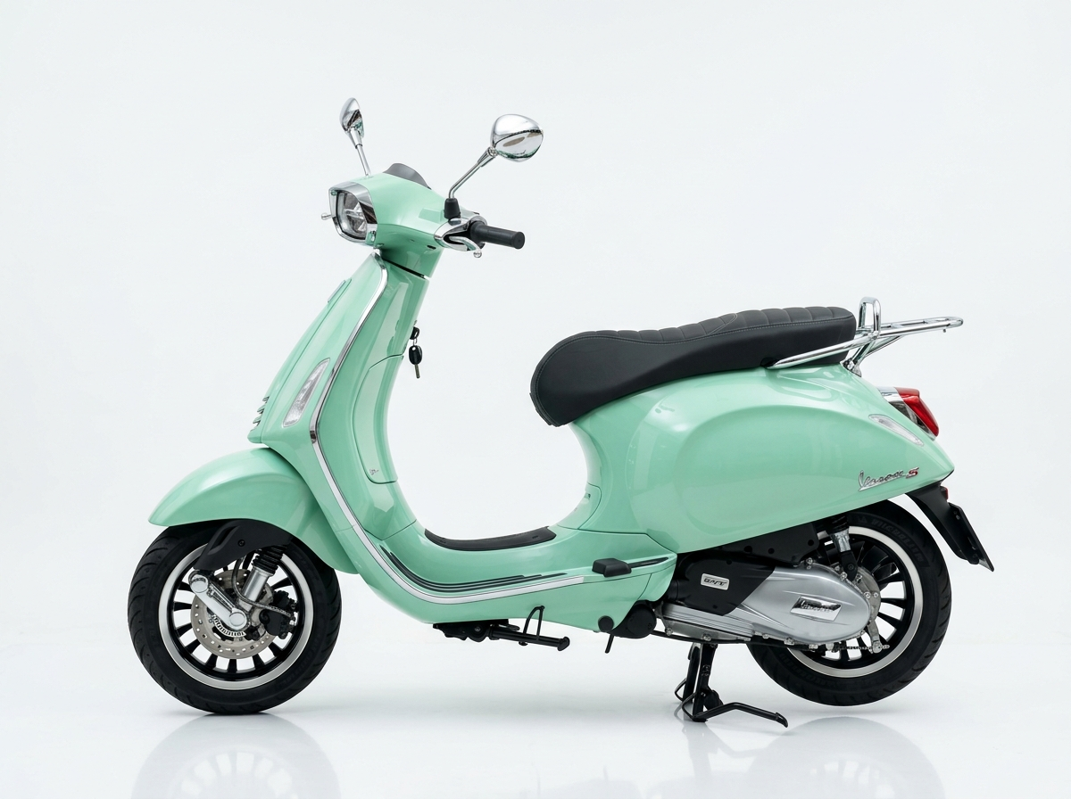
BKK MOTORBIKE RENTAL
Conclusion & Recommendation
Executive decision and final business viability assessment.
Final Recommendation: YES — Launch 20-Bike Pilot
• 1. Genuine Customer Need: Solves real urban friction (traffic gridlock, shop visits, paper contracts, passport withholding).
• 2. Accessible Technology: Built with lightweight PWA, PromptPay QR, and standard 4G IoT hardware without proprietary R&D drag.
• 3. Healthy Unit Economics: 63%–68% contribution margins deliver ฿57,000 monthly net profit (฿684,000 annualized) at 80% utilization.
• 4. Distinct Break-Even Focus: The 75% utilization rule (15 active bikes) gives management clear operational guidance.
• 5. Market Trust Advantage: Zero passport withholding + instant keyless IoT unlock creates an unmatched competitive moat.
Executive Decision Rule
• Launch a 3-month controlled pilot with 20 motorbikes in central Bangkok.
• Scale fleet to 50+ units only when customer retention, unit maintenance costs, and 80%+ utilization are proven.
🛵 BKK RENTAL
Smart. Seamless. Keyless.
Thank You!
Ready for questions & defense.
BKK Motorbike Rental | Digital Business Project | Bangkok, Thailand

