Slide 1
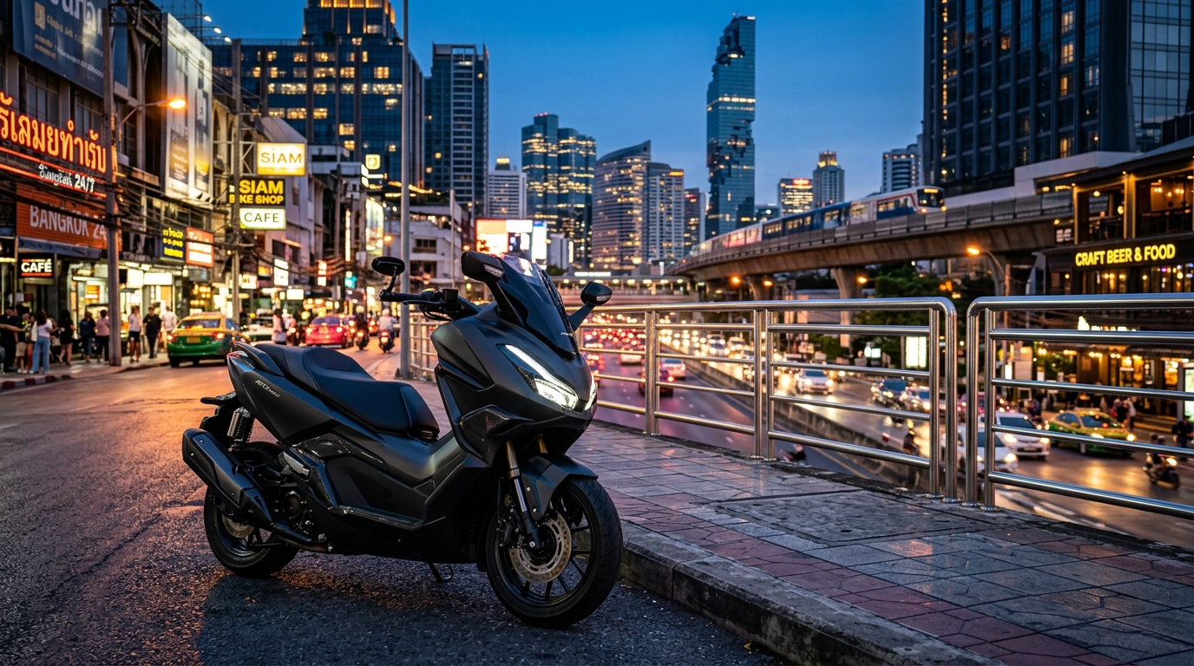
🛵 DIGITAL BUSINESS PROJECT
BKK MOTORBIKE RENTAL
Smart. Seamless. Keyless Mobility in Bangkok.
A modern e-business proposal for an IoT-enabled 20-bike fleet rental service solving urban congestion, manual paperwork, and passport withholding in Bangkok.
Course: Digital Business & Entrepreneurship
Initial Fleet: 20 Units (10 Standard / 10 Premium)
Target Market: Bangkok (Students, Expats, Tourists)
BKK Motorbike Rental — Digital Business Proposal | Confidential

Slide 2
BKK MOTORBIKE RENTAL
1. Project Objective
Evaluating an e-business through value creation, profitability, and operational feasibility.
1. Create Customer Value
• Eliminate friction of visiting physical shops to rent motorbikes.
• Provide 100% transparent pricing with no hidden charges or surprise insurance add-ons.
• Zero passport hostage: digital KYC verification instead of withholding physical passports.
• Instant keyless access via mobile app and IoT smart lock technology.
2. Sustainable Profit
• High contribution margins: 63% to 68% across all rental tiers.
• Diversified revenue: daily, weekly, and high-retention monthly packages.
• Controlled cost structure with ฿168,000/month fixed overheads.
• Break-even achievable at 75% fleet utilization (15 active bikes).
3. Operational Feasibility
• Market Feasibility: High demand near BTS/MRT, universities, and expat areas.
• Technical Feasibility: Lightweight PWA, PromptPay QR gateway, 4G cellular IoT.
• Operational Feasibility: Central hub in Sathorn with scheduled fleet maintenance.
• Legal Compliance: Thailand PDPA data privacy and DLT licensing standards.
Key Principle
• A successful digital business is not merely innovative—it must solve a genuine customer pain point, operate smoothly in the real world, and produce resilient, sustainable profit.
BKK Motorbike Rental — Digital Business Proposal | Confidential

Slide 3
BKK MOTORBIKE RENTAL
2. Business Concept: BKK Motorbike Rental
A mobile-first, IoT-enabled motorbike rental platform for Greater Bangkok.
The Traditional Problem
• Manual & Time-Consuming: Customers must travel physically to rental shops across traffic.
• Opaque Pricing: Unclear rates, arbitrary insurance fees, and unpredictable deposit deductions.
• Physical Passport Withholding: Shops routinely hold customer passports as collateral, creating severe security and travel anxiety.
• Paper Contracts: Slow physical paperwork leads to delays, manual errors, and dispute friction.
• No Fleet Visibility: Customers cannot check live bike availability or model specs before arriving.
The BKK Rental Solution
• Instant Digital Platform: Search, compare, and reserve motorbikes online in under 2 minutes.
• Transparent Tiered Pricing: Guaranteed transparent rates with clear damage waiver options.
• Digital KYC Verification: Upload passport/Thai ID with automated encryption & watermarking—no physical passport holding.
• Keyless Smart IoT Access: Instant digital key in-app; unlock the bike with your phone.
• Live Fleet Management: Real-time GPS tracking, automated maintenance scheduling, and instant deposit returns.
Core Digital Flow
• Search Catalog Online → Digital KYC Upload → PromptPay QR Payment → IoT Smart Unlock → GPS Monitored Ride → Return & Instant Refund
BKK Motorbike Rental — Digital Business Proposal | Confidential

Slide 4
BKK MOTORBIKE RENTAL
3. Value Proposition & Differentiation
Why customers choose BKK Motorbike Rental over traditional street rental shops.
Affordable & Flexible
• Competitive daily (฿300/฿450), weekly (฿1,900/฿2,800), and monthly rates.
• Tiered duration discounts save up to 40% on 30-day rentals.
• Special student discounts and ฿500 referral credits.
Personalized Fleet Choice
• Standard Fleet: Zippy Honda Click 160cc & Scoopy for agile city commuting.
• Premium Fleet: Luxury Honda Forza 350cc & Vespa Sprint for comfort and touring.
• Custom add-ons: full-face Bluetooth helmets, damage waivers, delivery.
Maximum Convenience
• 100% digital booking via mobile web app with instant confirmation.
• Keyless IoT smart access—unlock your motorbike directly from your phone.
• 5 prime Bangkok pickup stations or flat ฿200 doorstep hotel delivery.
Total Transparency & Security
• Clear rental terms with zero hidden fees or arbitrary damage charges.
• Digital rental agreement and automated instant deposit refund.
• Never hold physical passports; encrypted KYC compliant with PDPA.
Competitive Advantage
• Combining contactless IoT locks, PromptPay QR payments, and data-driven fleet telematics.
BKK Motorbike Rental — Digital Business Proposal | Confidential

Slide 5
BKK MOTORBIKE RENTAL
4. Target Market & Personas
Targeting digitally savvy urban residents, university students, expats, and tourists (Age 18–40).
18 – 40 Years
Primary Target Age Group
20 Motorbikes
Initial Pilot Fleet Size
5 Prime Hubs
Sathorn, Asok, Khaosan, Thonglor, Ari
฿300 – ฿450
Target Average Daily Rate
University Students
• Chula, ABAC, Bangkok Univ.
• Need cheap, daily transit between condo and campus.
• Prefer 7-day to 30-day Standard rentals (Click/Scoopy).
• Highly price-sensitive; responsive to student promo codes.
Expats & Digital Nomads
• Tech, finance, and English teachers living in Bangkok.
• Need reliable daily transport to bypass severe BTS rush hours.
• Prefer 30-day Premium rentals (Forza 350 / XMAX).
• Value transparent contracts and cashless digital payments.
Tourists & Visitors
• Short-term vacationers and backpackers (Khaosan/Sukhumvit).
• Need quick 1-day to 7-day rentals for city sightseeing.
• Refuse physical passport confiscation.
• Value included safety helmets and GPS roadside assistance.
Urban Commuters
• Bangkok professionals and gig workers.
• Need temporary vehicle while personal car is serviced.
• Value rapid doorstep delivery to hotel or condo.
• Demand fuel-efficient, well-maintained automatic scooters.
BKK Motorbike Rental — Digital Business Proposal | Confidential

Slide 6
BKK MOTORBIKE RENTAL
5. E-Business Model & Infrastructure
A direct-to-consumer (B2C) digital rental model integrated with IoT smart telematics.
1. Discover
Google Search, Local SEO, TikTok & IG Reels, travel forums.
2. Book
Select model, rental dates, pickup hub & protection add-ons.
3. Pay
Instant PromptPay QR code or Credit/Debit Card checkout.
4. Verify
Digital KYC: upload passport/Thai ID & driver's license.
5. Unlock
Receive Digital Key in app; tap to unlock via 4G IoT lock.
6. Return
Return to station, upload 4-point condition photo, deposit released.
Customer Mobile App (PWA)
• Interactive vehicle catalog with live real-time inventory.
• Dynamic price quote engine with duration discounts.
• Digital KYC dropzone with automated image watermarking.
• Smart Key HUD controller with live trip speedometer.
IoT Telematics Network
• 4G cellular GPS trackers on all 20 motorbikes.
• Encrypted MQTT broker commands for remote immobilizer.
• Geofencing boundary alerts for Greater Bangkok perimeter.
• Automated battery voltage and mileage telemetry logs.
Admin Operations Hub
• Live Leaflet GPS map tracking all active and parked bikes.
• Financial analytics tracking ฿168,000 break-even target.
• Automated maintenance triggers every 3,000 km.
• Omnichannel customer support (LINE OA & WhatsApp).
BKK Motorbike Rental — Digital Business Proposal | Confidential

Slide 7
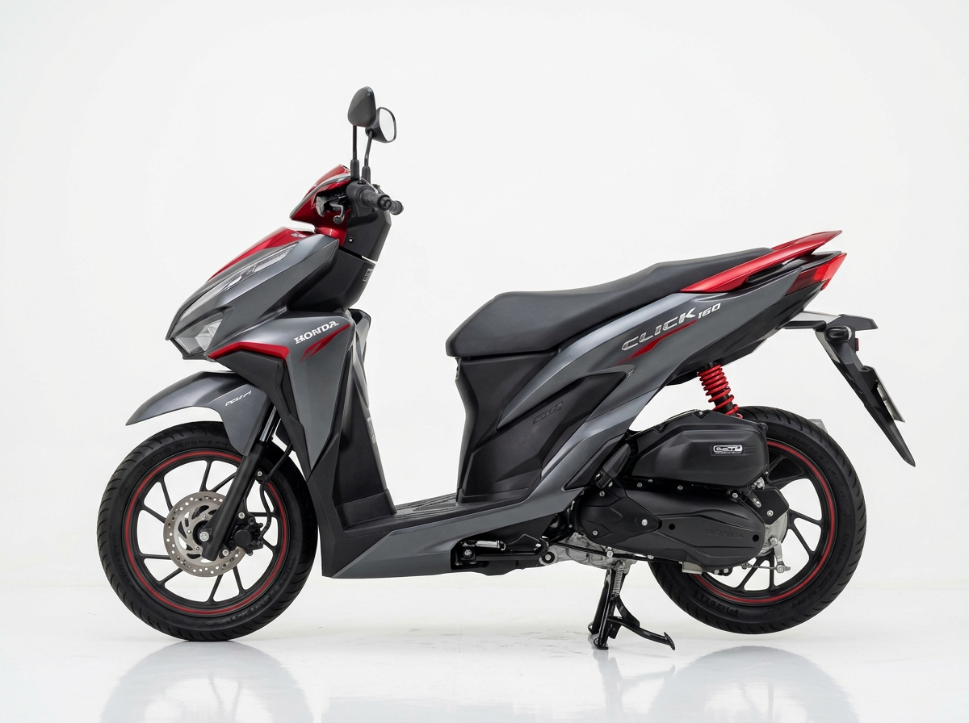
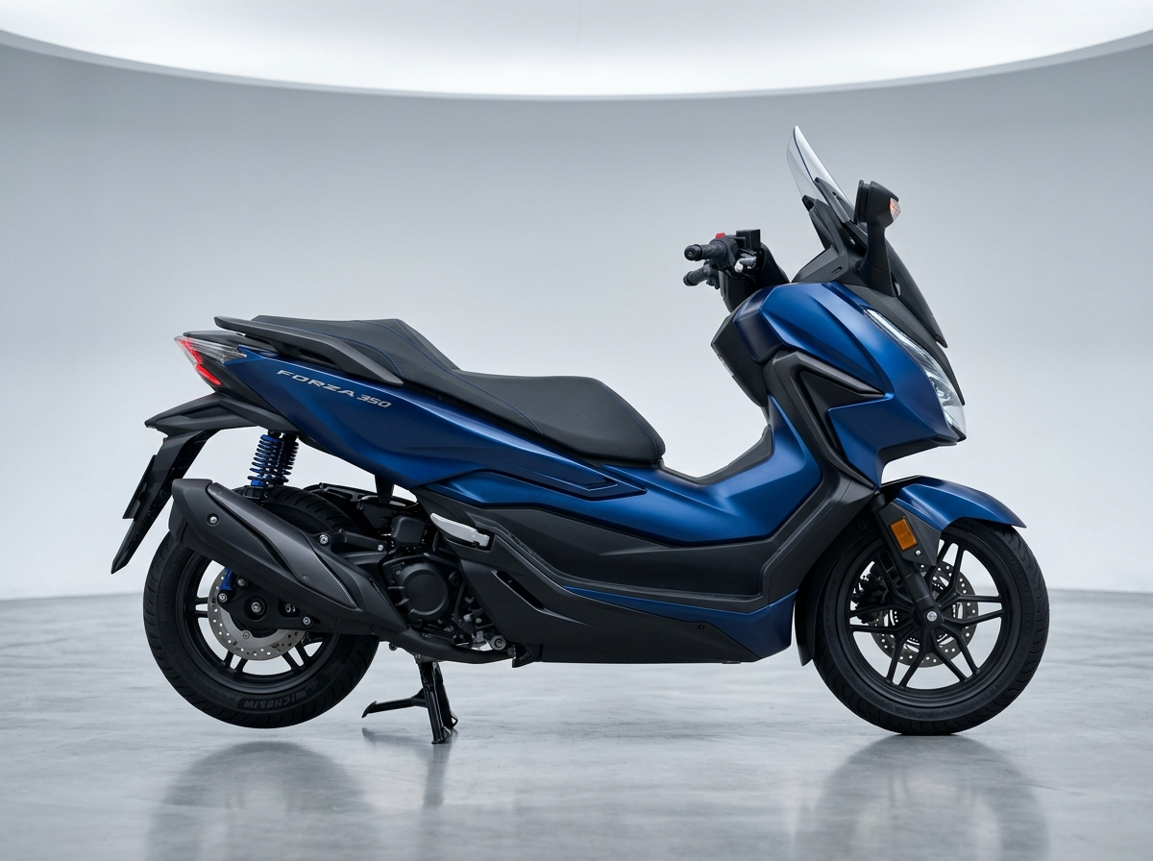
BKK MOTORBIKE RENTAL
6. Products & Tiered Pricing
Balancing customer affordability, fleet utilization, and healthy contribution margins.
Product / Plan | Customer Price | Variable Cost | Contribution | Margin %
Standard – 1 Day | ฿300 | ฿100 | ฿200 | 66.7%
Standard – 7 Days | ฿1,900 | ฿600 | ฿1,300 | 68.4%
Standard – 30 Days | ฿5,500 | ฿2,000 | ฿3,500 | 63.6%
Premium – 1 Day | ฿450 | ฿150 | ฿300 | 66.7%
Premium – 7 Days | ฿2,800 | ฿900 | ฿1,900 | 67.8%
Premium – 30 Days | ฿9,500 | ฿3,500 | ฿6,000 | 63.1%
Standard Fleet (10 Units)
• Honda Click 160 & Scoopy-i
• 15–37L underseat storage
• Deposit: ฿1k Thai / ฿2k Passport
• Ideal for: Students & commuters
Premium Fleet (10 Units)
• Honda Forza 350 & Vespa Sprint
• HSTC Traction control & Dual ABS
• Deposit: ฿3k Thai / ฿5k Passport
• Ideal for: Expats & highway touring
Pricing & Promotion Strategy
• Duration-based discounting protects unit contribution while incentivizing 30-day lock-in.
• Optional add-ons: Zero-Deductible Damage Waiver (+฿80–฿150/d) and Doorstep Delivery (+฿200).
BKK Motorbike Rental — Digital Business Proposal | Confidential

Slide 8
BKK MOTORBIKE RENTAL
7. Revenue Model
Diversified revenue streams combining recurring long-term packages with short-term rentals.
50% Monthly Packages
฿5,500 – ฿9,500/mo
Steady recurring baseline cash flow from expats, digital nomads, and university students.
35% Weekly & Daily Rentals
฿300 – ฿2,800
High-margin short-term tourist demand, weekend getaways, and interim commuters.
10% Protection Add-ons
+฿80 – ฿150 / day
Zero-deductible damage waivers, Bluetooth intercom helmet upgrades.
5% Delivery & Services
฿200 Flat Fee
Doorstep hotel/condo delivery, airport pickup hub handover fees.
Strategic Revenue Logic & Financial Resiliency
• 1. Predictable Anchor Cash Flow: By securing 50% of the 20-bike fleet on 30-day monthly contracts (approx. 10 bikes = ฿75,000/month), the business locks in 45% of its fixed cost coverage regardless of daily tourism fluctuations.
• 2. High Contribution Daily/Weekly Rentals: The remaining 10 bikes generate flexible daily and weekly rentals at ฿300–฿450/day. At an average 75% utilization, they contribute an additional ฿80,000–฿100,000 in monthly margin.
• 3. High Margin Ancillary Services: Optional Zero-Deductible Damage Waivers (฿80–฿150/day) carry over 75% gross margin after factoring actuarial repair incident reserves.
• 4. Deposit Float Management: Refundable security deposits (฿1,000 to ฿5,000 per vehicle) provide an interest-free operating reserve protecting against accidental damage, speeding citations, or vehicle abandonment.
BKK Motorbike Rental — Digital Business Proposal | Confidential

Slide 9
BKK MOTORBIKE RENTAL
8. Cost Structure
Lean variable operating costs per rental day and transparent monthly fixed overheads.
Fixed Cost Category | Monthly (THB)
Motorcycle Fleet Financing (20 bikes amortized) | ฿30,000
Staff Salaries (Operations, Mechanic, Customer Support) | ฿80,000
Office & Storage Yard Rent (Sathorn Depot) | ฿20,000
Commercial Fleet Insurance Policy | ฿15,000
Marketing, Social Ads & Influencers | ฿5,000
Software / App Hosting / SaaS Cloud Services | ฿3,000
4G GPS / IoT Telematics SIM Cards | ฿3,000
Licensing, Permits & DLT Compliance | ฿3,000
Administrative Expenses & Utilities | ฿4,000
Emergency Contingency Reserve | ฿5,000
Variable Costs (Per Rental Day)
• Maintenance & Lubricants: ฿35 / day
(Engine oil, filters, scheduled CVT belt replacements)
• Vehicle Sanitization & Cleaning: ฿15 / day
(Disinfected helmets, washed body panels)
• Wear & Tear Allowance: ฿25 / day
(Tire wear, brake pads, battery lifecycle amortization)
• Commercial Insurance Allocation: ฿15 / day
(Per-rental liability & compulsory Por Ror Bor pool)
• Payment Processing & Telematics: ฿10 / day
(PromptPay QR / card gateway fees & IoT data packets)
—— Total Variable Cost (Standard): ฿100 / day
—— Total Variable Cost (Premium): ฿150 / day
• Cost Control Priority: Standardized preventative maintenance every 3,000 km lowers long-term repair costs by 35%.
BKK Motorbike Rental — Digital Business Proposal | Confidential

Slide 10
BKK MOTORBIKE RENTAL
9. Monthly Profitability Projection
Base-case forecast: 80% fleet utilization across 20 bikes (480 active rental days/month).
฿285,000
Monthly Revenue
Based on 80% blended utilization
฿60,000
Total Variable Costs
฿125 avg VC × 480 rental days
฿168,000
Total Fixed Costs
All overheads, salaries & rent
฿57,000
Net Operating Profit
+20.0% Net Operating Margin
Fleet Utilization Level | Monthly Revenue | Variable Costs | Fixed Costs | Net Operating Profit
60% Low Season | ฿185,000 | ฿45,000 | ฿168,000 | -฿28,000 (Loss)
75% Break-Even | ฿255,000 | ฿60,000 | ฿168,000 | +฿2,000 (Break-Even)
80% Base Case | ฿285,000 | ฿60,000 | ฿168,000 | +฿57,000 (Healthy)
95% Peak Tourist Season | ฿380,000 | ฿85,000 | ฿168,000 | +฿127,000 (High Profit)
Annualized Outlook
• At the base case (80% utilization): Projected Annual Gross Revenue = ฿3,420,000 | Projected Annual Net Operating Profit = ฿684,000.
BKK Motorbike Rental — Digital Business Proposal | Confidential

Slide 11
BKK MOTORBIKE RENTAL
10. Break-Even Analysis
Determining the sales volume and fleet utilization required to cover all monthly overheads.
฿252,631
Break-Even Revenue / Month
Total sales required to cover ฿168,000 fixed costs.
75% Utilization
Break-Even Fleet Utilization
15 of 20 motorbikes rented across the month.
66.5%
Average Contribution Margin
Blended ratio across Standard & Premium packages.
Mathematical Break-Even Model
• Break-Even Revenue Formula:
BEP (Revenue) = Fixed Costs ÷ Contribution Margin Ratio
• Calculation:
BEP = ฿168,000 ÷ 0.665 ≈ ฿252,631 per month
• Break-Even Rental Days (Daily equivalent):
฿168,000 ÷ ฿250 (avg contribution/day) ≈ 672 bike-days
• Fleet Capacity Reality Check:
20 bikes × 30 days = 600 available days on pure daily rentals.
Therefore, long-term monthly & weekly contracts are essential to bridge the gap and achieve break-even at 75% utilization.
Operational Management Takeaways
• 1. The 15-Bike Rule: Operations must always maintain a baseline of at least 15 active rental contracts to prevent operating losses.
• 2. Lock in Long-Term Baseline: Target 10 monthly expat/student contracts (50% fleet) to immediately secure ฿75,000 towards fixed costs.
• 3. Protect High Margins on Remainder: The remaining 10 bikes capture premium tourist daily and weekly rentals (67%+ margin).
• 4. Buffer Margin: The 80% target utilization (16 active bikes) provides a comfortable ฿57,000 monthly safety buffer above break-even.
BKK Motorbike Rental — Digital Business Proposal | Confidential

Slide 12
BKK MOTORBIKE RENTAL
11. Digital Marketing Strategy
Prioritizing digital discovery channels where Bangkok expats, students, and tourists look for mobility.
1. Google & Local SEO
• High-intent search capture.
• 'Motorbike rental Bangkok', 'Rent scooter Sathorn / Asok'.
• Optimized Google Business Profile with 5-star verified reviews.
• Rank #1 on Google Maps for BTS/MRT commuter keywords.
2. TikTok & IG Reels
• Visual discovery & lifestyle.
• Short videos: 'How to rent a bike in Bangkok with your phone'.
• Hidden Bangkok scooter riding routes and food tour guides.
• Micro-influencer collaborations with local expat creators.
3. LINE Official Account
• Retention & quick support.
• Automated extension reminders and instant rental renewal.
• Live chat customer service & emergency SOS hotline.
• Exclusive subscriber discounts for recurring renters.
4. Strategic Hubs
• Physical-to-digital partnerships.
• Coworking spaces in Thonglor (WeWork, The Hive).
• Hostels in Khaosan & Sukhumvit with QR booking stands.
• Direct referral commissions for hostel receptionists.
5. Referral Program
• Viral organic growth.
• 'Refer a Friend': ฿500 rental discount for the new rider.
• ฿500 credit for the referring customer on their next month.
• Lowers Customer Acquisition Cost (CAC) below ฿200.
Priority Acquisition Funnel
• Discover (SEO / TikTok) → Trust (Reviews / Zero Passport Hold) → Trial (Instant PromptPay QR) → Repeat (Monthly Package) → Refer (฿500 Credit)
BKK Motorbike Rental — Digital Business Proposal | Confidential

Slide 13
BKK MOTORBIKE RENTAL
12. Competitor Analysis
Benchmarking BKK Motorbike Rental against key market competitors in Bangkok.
Feature / Factor | BKK Motorbike Rental | MadBike.co | Fatboy's Motorbike | Traditional Street Shops
Positioning | Smart IoT + Transparent | Multi-station + Western | Established Expat Brand | Informal Local Shops
Daily Price (Standard) | ฿300 / day | ฿300 – ฿350 / day | ฿300 – ฿350 / day | ฿200 – ฿300 / day
Booking Experience | 100% Instant Digital PWA | Static Form / WhatsApp | WhatsApp / In-person | Physical Walk-in Only
Payment Methods | PromptPay QR, Card, App | Cash, Card, Transfer | Cash, Card, Transfer | Cash Only
Passport Policy | Digital KYC (No Holding) | Passport Photocopy | Original Passport Hold | Hold Original Passport
Key Access & Security | Smart Key IoT Unlock + GPS | Physical Key Only | Physical Key Only | Physical Key (No GPS)
The BKK Motorbike Rental Competitive Gap
• Win by eliminating traditional rental friction: 100% digital instant checkout + keyless IoT unlock + zero physical passport withholding, while matching or beating market pricing.
BKK Motorbike Rental — Digital Business Proposal | Confidential

Slide 14
BKK MOTORBIKE RENTAL
13. Feasibility Analysis
Evaluating the proposal across the 5 standard e-business feasibility dimensions.
Market Feasibility
• Plausible & Growing Demand.
• Bangkok traffic congestion creates heavy preference for scooters.
• Growing digital nomad population and international tourism recovery.
• Strong user preference for contactless mobile ordering.
Technical Feasibility
• Low Engineering Risk.
• Progressive Web App (PWA) requires no App Store submission friction.
• Cellular 4G IoT telematics and smart locks are off-the-shelf hardware.
• Thai PromptPay QR payment gateways are mature and standardized.
Operational Feasibility
• Controlled & Repeatable.
• Central Sathorn maintenance depot handles fleet repairs and storage.
• Standardized 4-point return inspection SOP.
• Doorstep delivery managed within 15km zone to avoid logistics drag.
Financial Feasibility
• Positive Unit Economics.
• 63%–68% contribution margin covers variable operations comfortably.
• Break-even achievable at 75% fleet utilization (15 active bikes).
• Base case yields ฿57,000 monthly net profit (20% net margin).
Legal & Ethical
• Full Regulatory Compliance.
• Compliant with Thailand PDPA (encrypted KYC storage).
• Mandatory DLT-compliant driver license / IDP validation.
• Every vehicle backed by Compulsory Motor Insurance (Por Ror Bor).
Strategic Pilot-First Execution
• Start with 20 motorbikes in central Bangkok (Sathorn & Sukhumvit). Validate real customer acquisition cost (CAC), maintenance wear, and repeat retention before scaling to 50+ bikes.
BKK Motorbike Rental — Digital Business Proposal | Confidential

Slide 15
BKK MOTORBIKE RENTAL
14. Risk Analysis & Mitigation Matrix
Identifying potential business risks and management mitigation strategies.
Risk Identified | Potential Business Impact | Management Mitigation Strategy
Motorbike Theft / Unauthorized Cross-Border Travel | Asset loss, police reporting overhead, fleet shrinkage. | 4G cellular GPS trackers with real-time Bangkok geofencing. Automatic remote engine immobilization if exiting perimeter; police integration.
Traffic Accidents & Body Damage | Repair expense, customer conflict, bike out-of-service downtime. | Compulsory Por Ror Bor insurance pool; optional Zero-Deductible Damage Waiver (+฿80/d); mandatory pre/post 4-angle photo audit in-app.
Low Off-Peak Tourist Demand | Fleet utilization drops below 75% break-even threshold. | Shift fleet focus to 30-day student and expat corporate commuter packages; offer seasonal promotional discounts.
Unlicensed Tourist Drivers & Police Fines | Customer impoundment, legal liability, reputational blow. | Mandatory digital KYC checking for valid Thai license or International Driving Permit (IDP 1949/1968); digital helmet checks.
IoT Lock / Cellular Telematics Failure | Customer locked out or unable to start active trip. | Dual-SIM fallback on telematics unit; manual physical master key backup in tamper-evident sealed compartment on each bike.
Deposit Withholding Disputes | Negative reviews on Google Maps / Trustpilot. | 100% transparent automated photo comparison at check-out vs return. Instant automated PromptPay deposit refund release within 1 hour.
BKK Motorbike Rental — Digital Business Proposal | Confidential

Slide 16
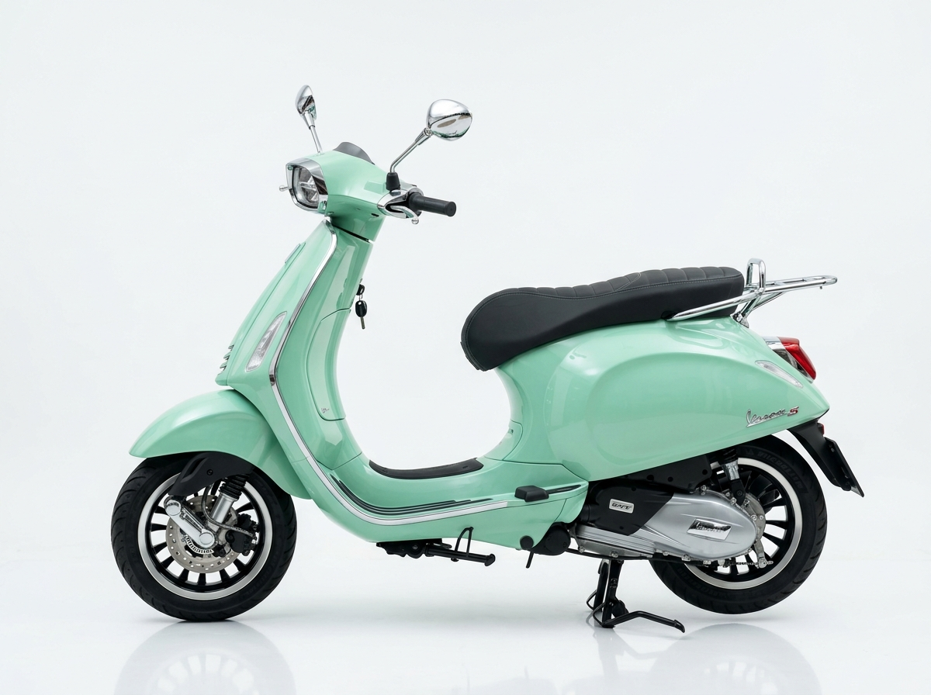
BKK MOTORBIKE RENTAL
Conclusion & Recommendation
Executive decision and final business viability assessment.
Should BKK Motorbike Rental Be Launched? YES.
• 1. Clear Customer Problem & Market Fit: Bangkok commuters and tourists face extreme traffic yet endure opaque, untrustworthy, paper-heavy motorbike rental services. The demand for digital transparency is high.
• 2. Mature & Accessible Technology: Lightweight mobile web app, PromptPay QR integration, and 4G IoT smart locks can be implemented without expensive custom hardware development.
• 3. Financially Sound Base Case: Operating at 80% fleet utilization yields an estimated net profit of ฿57,000/month (฿684,000 annualized) on a lean 20-bike fleet.
• 4. Measurable Break-Even Target: A distinct break-even target of 75% utilization (15 active bikes) gives management clear operational focus.
• 5. Decisive Advantage over Street Shops: Zero passport confiscation + instant keyless IoT unlock creates overwhelming consumer trust.
Executive Decision Rule
• Launch a 3-month controlled pilot (20 bikes in Sathorn/Sukhumvit).
• Scale fleet to 50+ bikes only when customer retention, unit maintenance costs, and 80%+ utilization are proven.
🛵 BKK RENTAL
Smart. Seamless. Keyless Mobility.
Thank You!
Ready for questions & discussion.
BKK Motorbike Rental — Digital Business Proposal | Confidential

