Slide 1

“PRICE COMPARISION APP”
Tsz Fung liu 100905668
Thomas ranga 100931705
Abiodun adeniyi nurudeen 100915263
Shavez ahmad azmi 100938606
Rehan ahmed 100889797

Slide 2
Project Definition and overview.
Project Objective: To create an application that help users to identify desired product by photos, and then get a best deal through price comparison between different e-commerce platforms.

Slide 3
Project Definition and overview.
Project Scope: Object detection, data scrapping, price comparison, user registration and login, user preference record and prediction
Stakeholders: The customers who use ecommerce platform frequently, The ecommerce platforms
Constraints: The platform should be done within 2 months with limited budget

Slide 4
Project Functionalities and stages.
Stage 1 (Viable product): Simple UI with photo uploading component, photo detection and best result showing
Stage 2 (Minimum marketable product): Users registration and login, database for storage of users' preference
Stage 3 (Final product): Promotion of products to users based on their preference in shopping

Slide 5
Application
Frontend
Backend
(Django)
Homepage Image upload
Login page
Search result page + Redirection + Recommendation
User
Management
Price
Scrapping
and comparison
Image Processing
And
recognizing

Slide 6
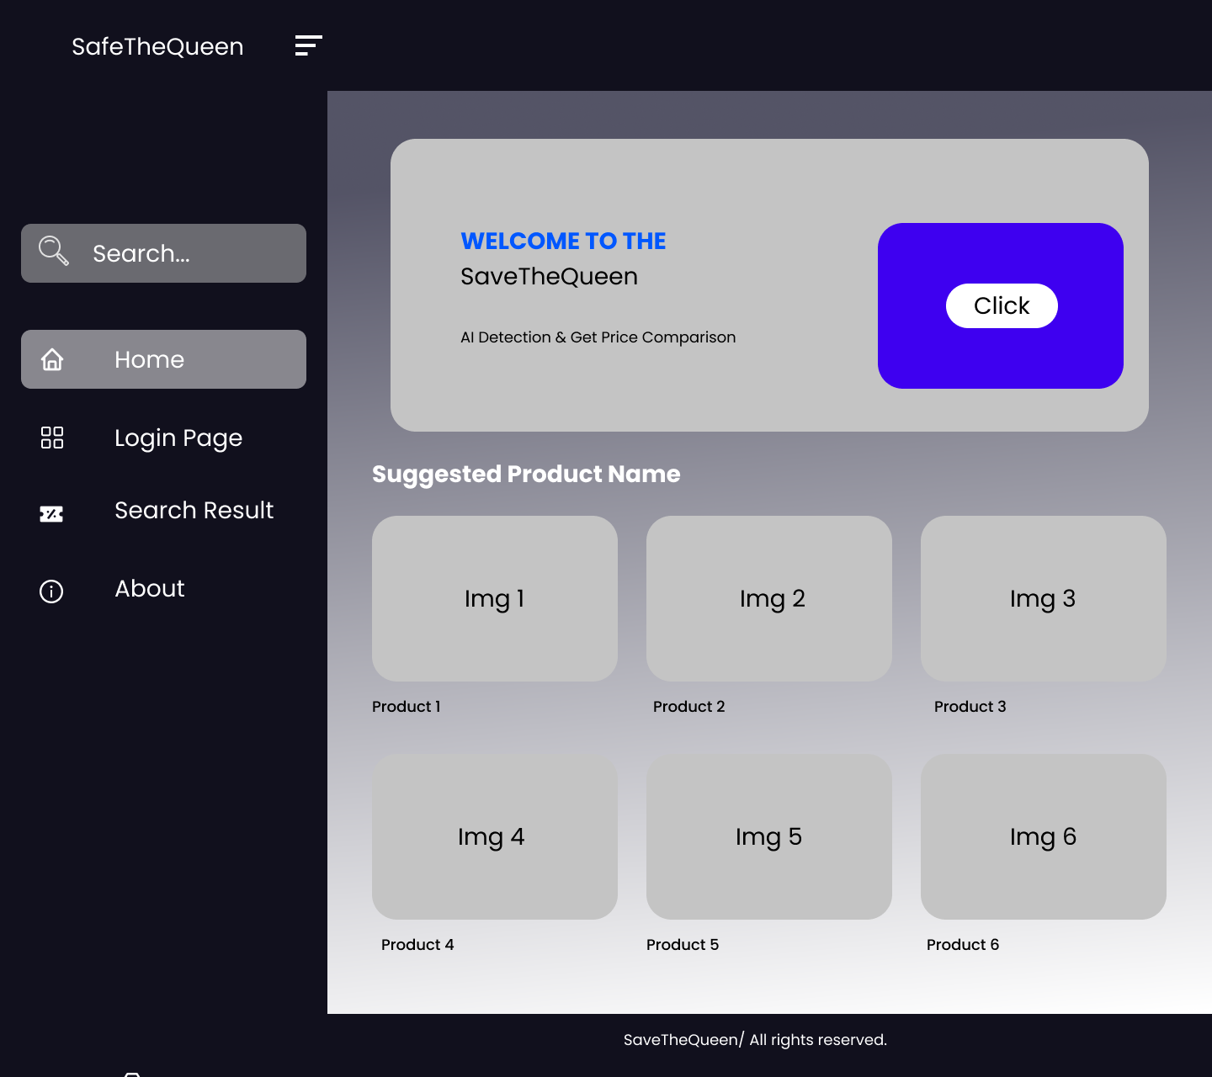
Frontend 1.We will be using React

Slide 7
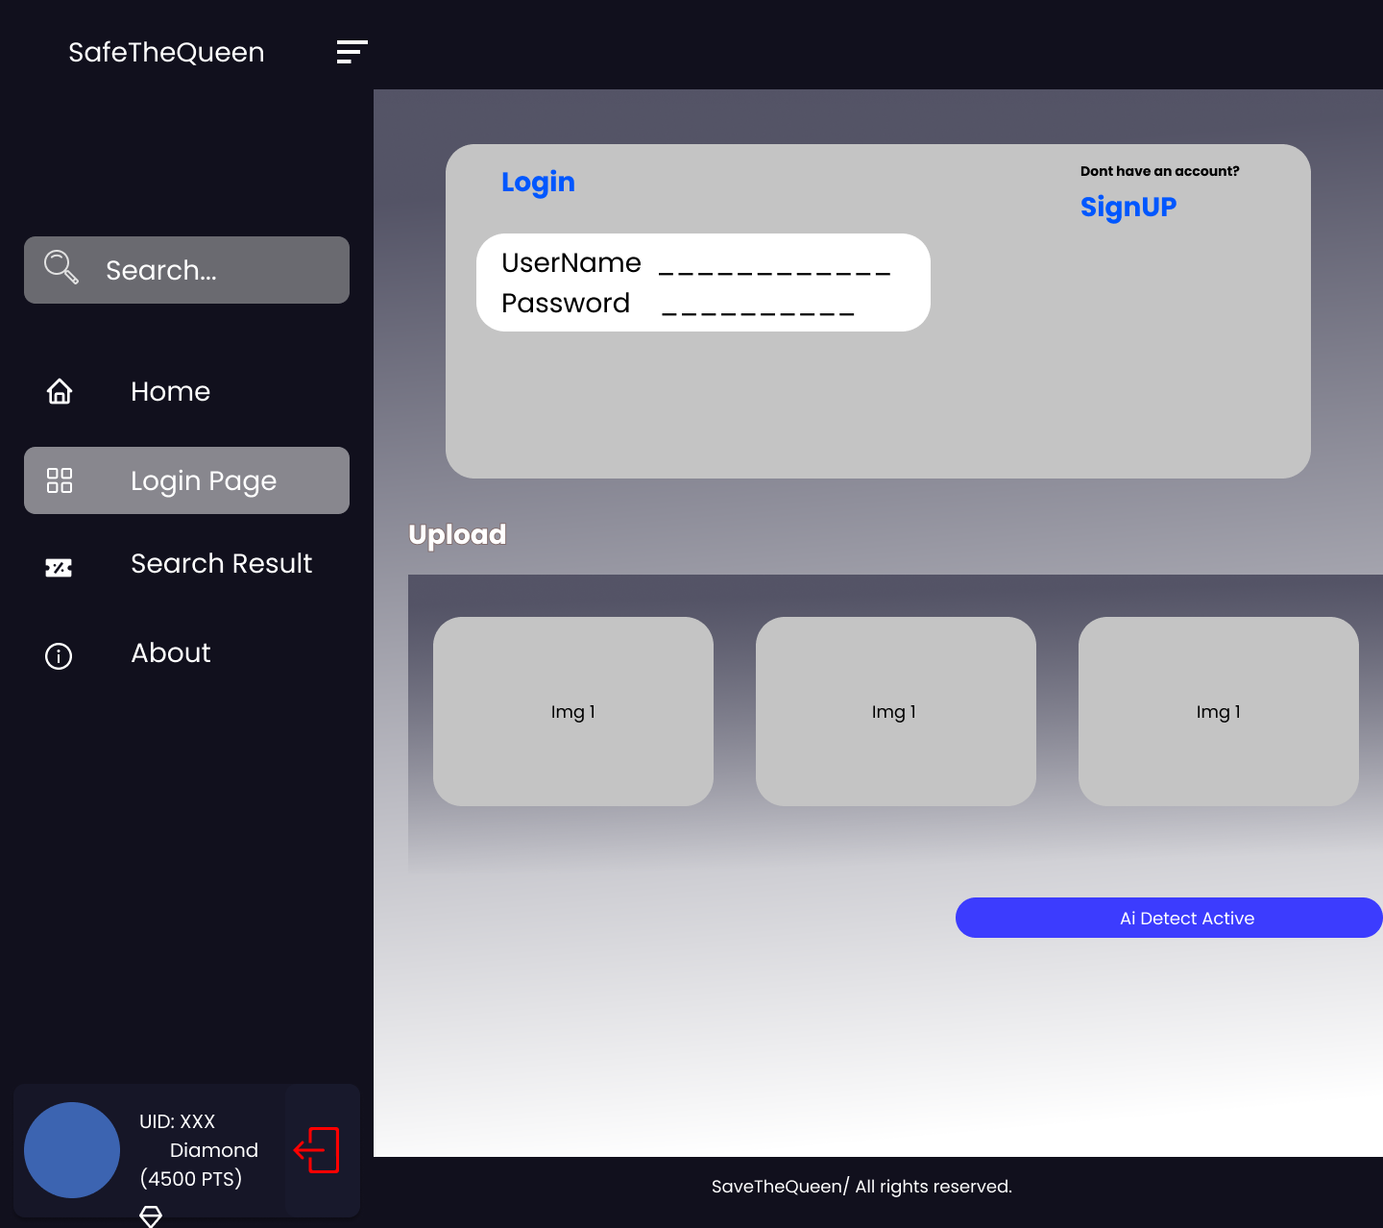
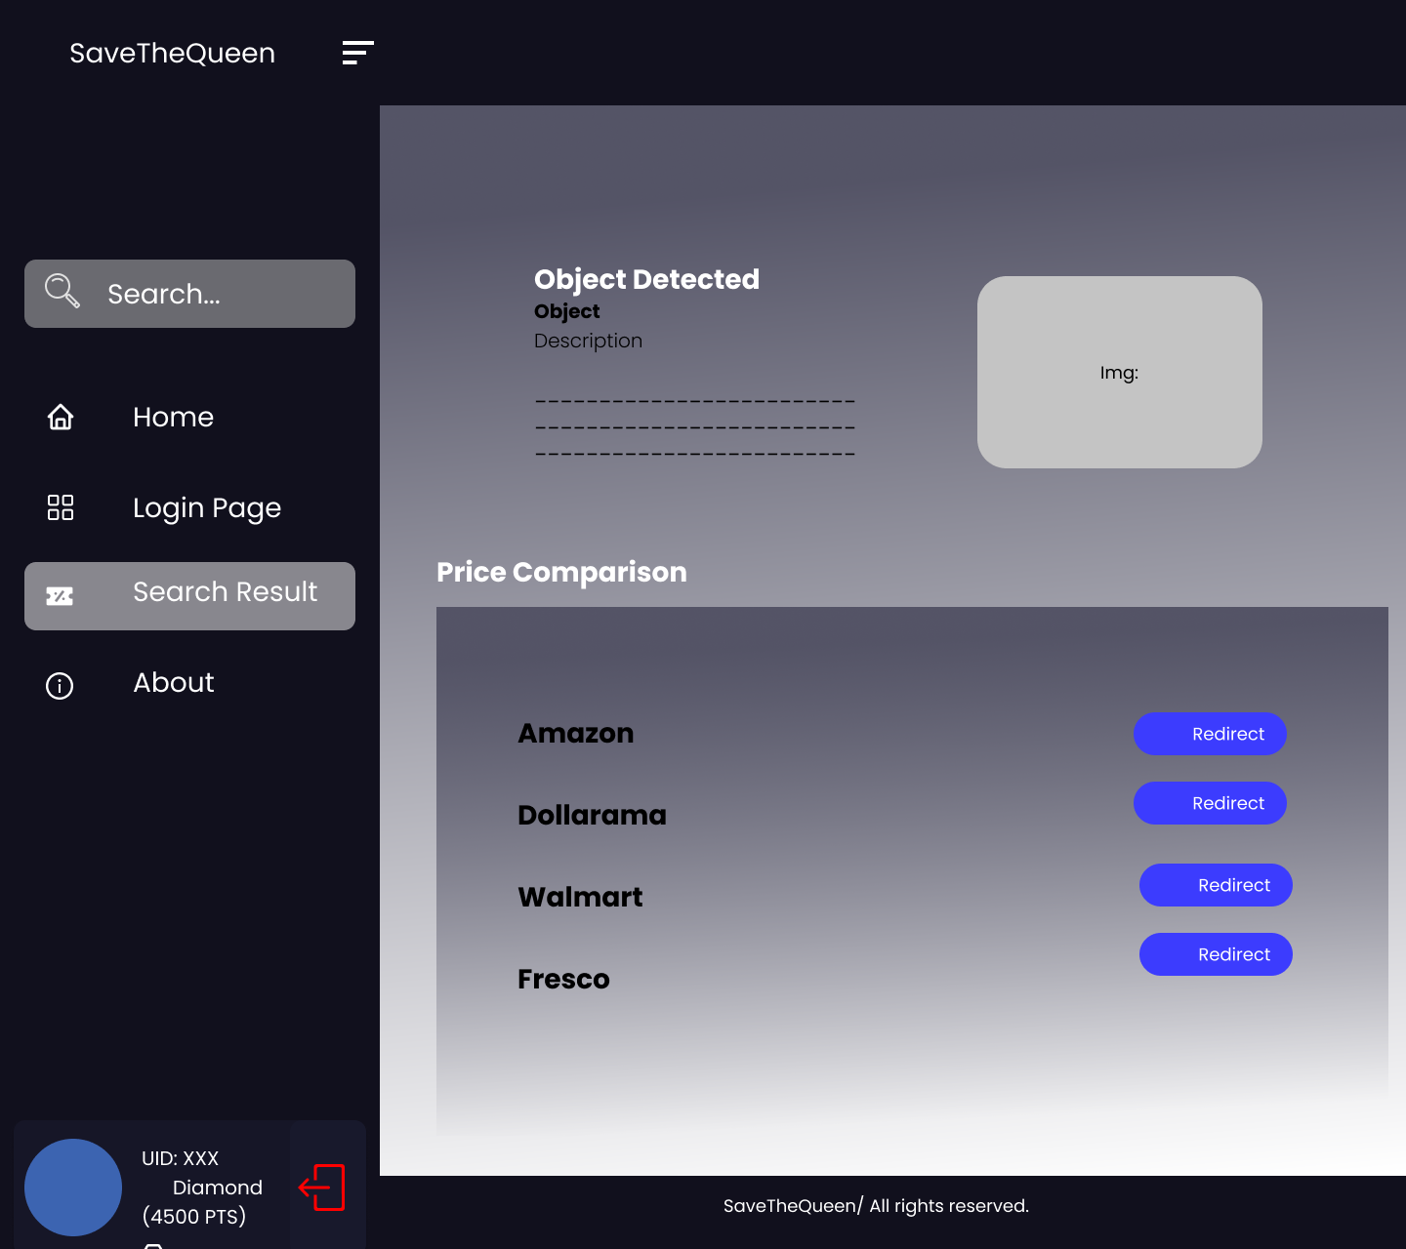
2.Login Page & Upload Multiple pics of object 3. Result and Redirection

Slide 8
Database:
The data for the system will be collected by different mediums to achieve the goal.
Plan is to use APIs available, do web-scrapping and collect publicly available data about the websites which will be considered for comparison.
Structured Data will be collected and stored in MySQL, and if unstructured or semi-structured data is encountered, MongoDB will be used.
User's data will be collected in structured format to improve the recommendation system.

Slide 9
Backend Functionality.
Stage 1:
Image upload and processing
Price scrapping and comparison from eBay, BestBuy and Amazon
API communicate with FE
Stage 2:
User management system
Search history repository
Product rating system
Stage 3:
Product recommendation system based on rating and personal search history

Slide 10
AI Feature
YOLOv5
Locobuzz
Google vision
Amazon Personalize

Slide 11
Thank you

