Slide 1
Authentication
Client
Server
System 1
System 2
Request with username & password (encrypted)
Response
Authorize / Unauthorized

Slide 2
Token based Authentication
Client
Server
Send request with username & password
Authenticate user and generate token
Send the token after authentication
Store the token and use it for future request
Send request with header contain token
Verify the token validity and then response
Receive the response for the request
Verify token authenticity and respond

Slide 3
JWT Authentication Flow
Client
Server
register request with username & password
Register the user
login request with username & password
Store the token and use it for future request
Send the jwt token after authentication
Send request with header contain jwt token
Verify the token validity and then response
Receive the response for the request
Verify jwt token authenticity and respond

Slide 4



Source Code Management
Collaboration
User Profile
Shopping Cart
Payment Gateway

Slide 5
Source Code Management
Repository – It is an online storage.
Website for creating the repository
- GitHub
- Bitbucket
- GitLab
- SourceForge

Slide 6


Source Code Management
GitHub Repository
Clone
Git Client

Slide 7
Git – Pull Command
GitHub Repository
Git Pull
Git Push
Git Client
Git Client
Payment Gateway Team
User Profile Team

Slide 8
Git – Branch Command
Branch represents an independent line of development.
This allow developer to develop feature parallelly
When the repository created for the first time, branch name “master” get created
User Profile Feature
master
Payment Gateway Feature

Slide 9
Git – Merge Command
Merge is the process of combining the branch code with master code & vice versa.
Once the branch is stable, a pull requested is created and shared for code review.
Once the code review is approved , the pull request is merged.
User Profile Feature
Pull request for merge
master
Pull request for merge
Payment Gateway Feature

Slide 10

Continuous Integration & Deployment
Also know as CI/CD pipeline
It is a process of rapid deployment of application in production.
Unit test failure
Code Changes & Merge
Build Application & run unit test
Deploy the Application in test environment
Run System and End to end scenario tests
Deploy in
Production
System Test Failure

Slide 11
CI & CD Tools
Jenkins
Team City
GitLab
Code Fresh

Slide 12
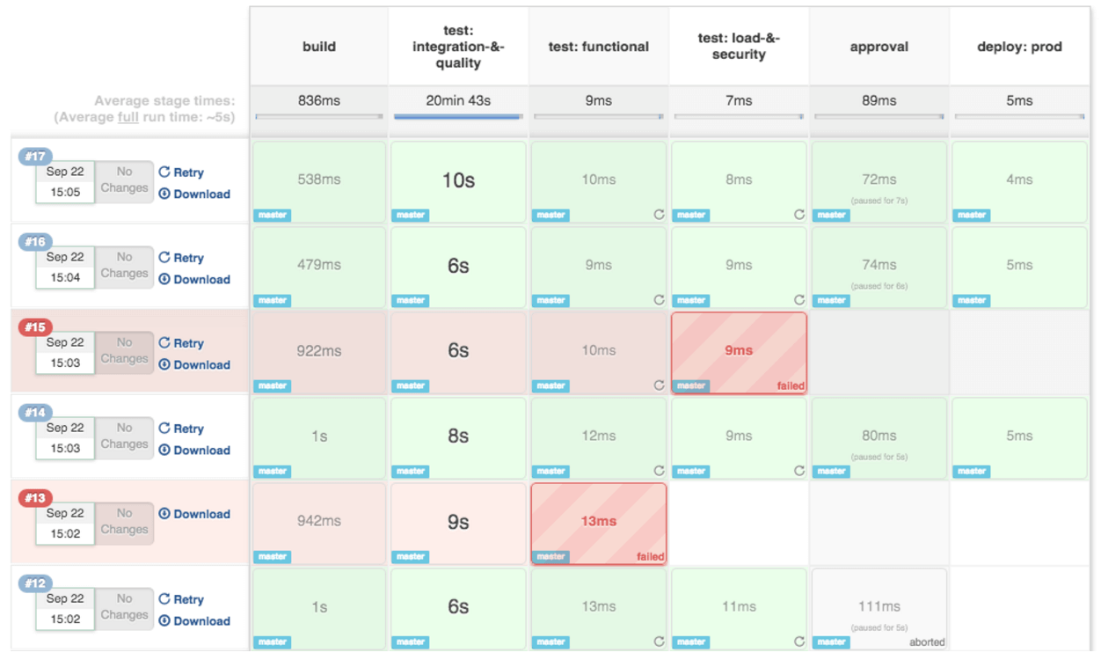
Jenkins Pipeline
Jenkins Pipeline is a combination of plugins that support the integration and implementation of continuous delivery.
One can create simple/complex job configuration using script which uses pipeline DSL (Domain-specific Language) syntax.

Slide 13
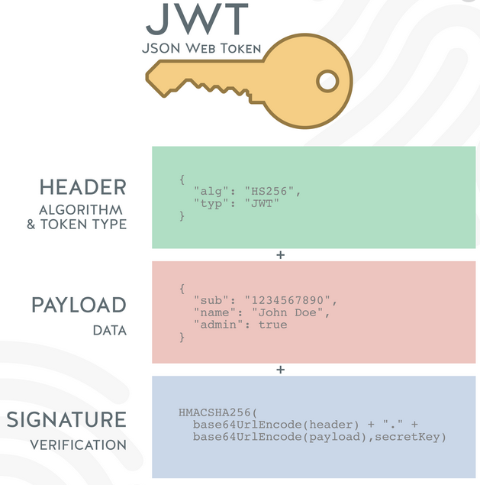
JWT Token
JWT token stands for json web token. It is an encrypted string.
JWT token is more secure than Basic Auth. As these token have an expiry date

