Slide 1
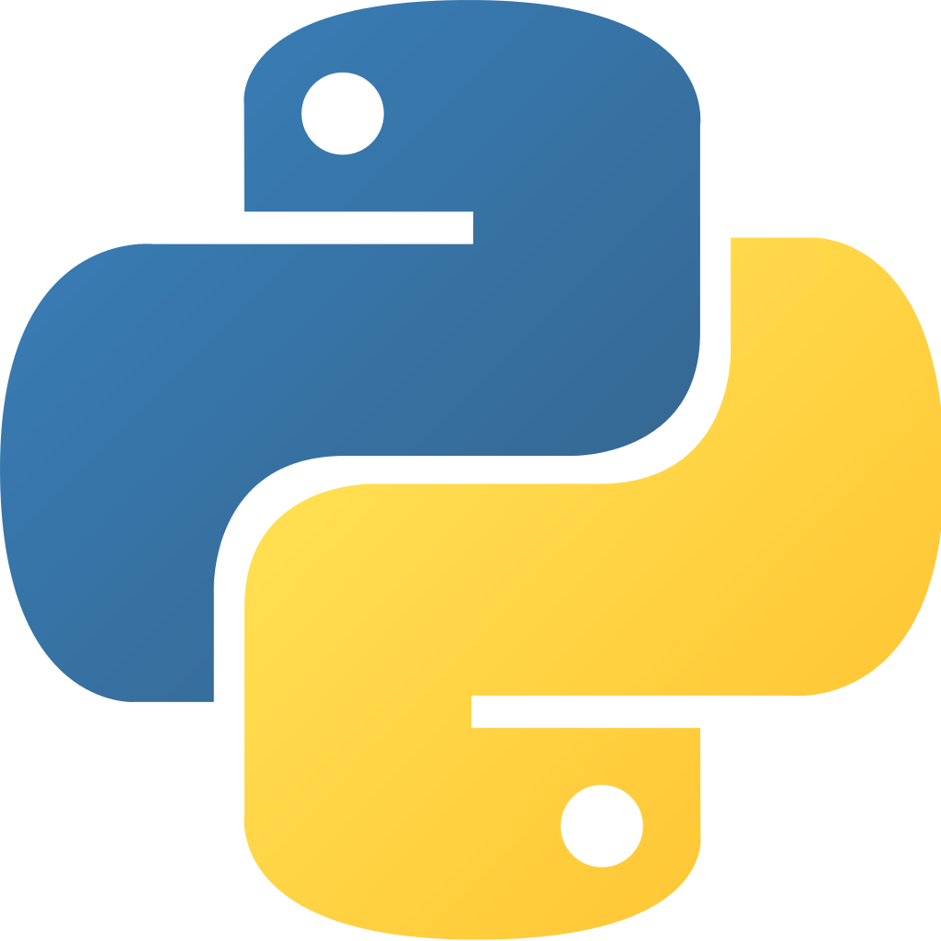
PYTHON

Slide 2
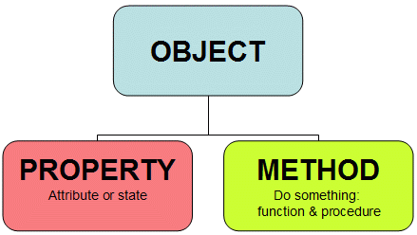
Object oriented programming language
Organized around objects rather than actions
Object- data

Slide 3

High level OPEN SOURCE programming language
A computer software with its source code made available with a license in which the copyright holder provides the rights to study, change, and distribute the software to anyone and for any purpose

Slide 4
Interpreter language
A computer program that directly executes, i.e. performs, instructions written in a programming or scripting language, without previously compiling them into a machine language program
Python within itself is an interpreted programming language that is automatically compiled into bytecode before execution
Compilation need not happen again until and unless the source gets changed

Slide 5

Cross Platform
Available for all Platforms such as Windows, Unix, MacOS etc

Slide 6
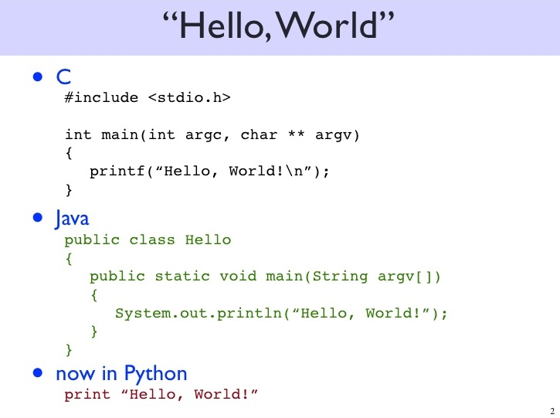
Python – Easy to use and Short

Slide 7
Programming features
Comes with a large standard library that supports many common programming tasks such as connecting to web servers, searching text with regular expressions, reading and modifying files
Indentation is used to indicate where blocks begin and end, which is a very important feature in Python
A variety of basic data types are available: numbers (floating point, complex, and unlimited-length long integers), strings, lists, and dictionaries
Python knows the type of the data.
Python's automatic memory management frees one from having to manually allocate and free memory in the code

Slide 8
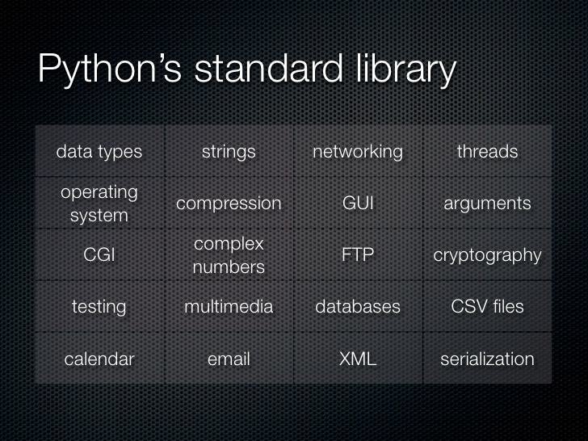

Slide 9
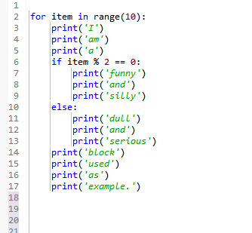
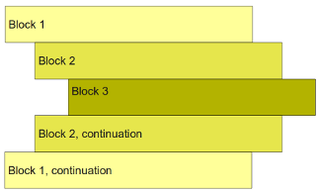
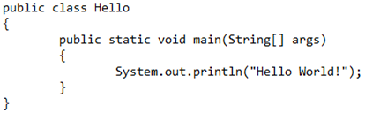
Indentation
Python can understand indentation

Slide 10
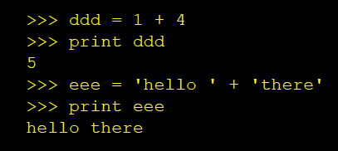
Data Types
In C++, JAVA etc, the datatype need to be specified before using it.
Pyhton can understand th datatype of a variable. No need to initialize.

Slide 11
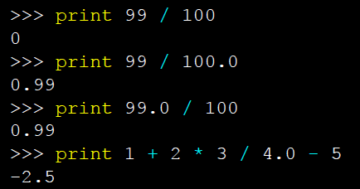
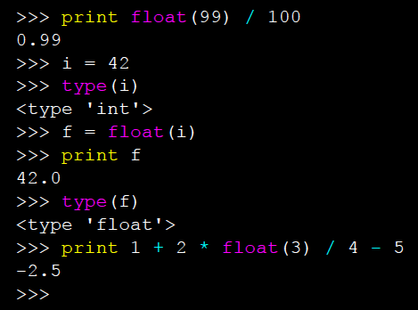
Data Conversions
If at least one operand is a floating point, then the result is a floating point.
We can also control the type with the build in functions.

Slide 12
Thank You

