Slide 1
Internet Of Things

Slide 2

It is a wireless network between objects
Things communicate with each other and with people using short range mobile transceivers.

Slide 3
Basically It is the Evolution of Internet!!!!

Slide 4
So What??????
Dynamic control of industry and daily life.
Improve the resource utilization ratio.
Integrating human society and physical systems.
Flexible Configuration
Acts as Technologies integrator

Slide 5
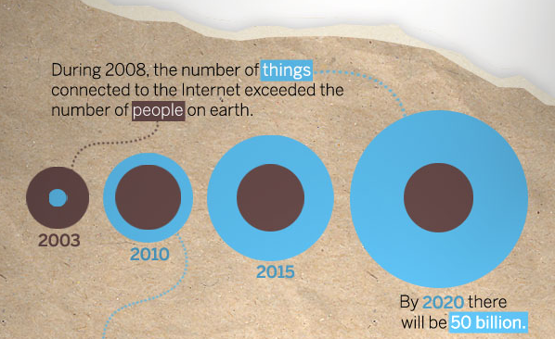
Growth

Slide 6
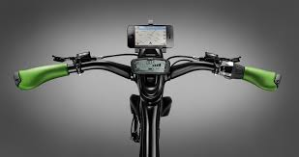
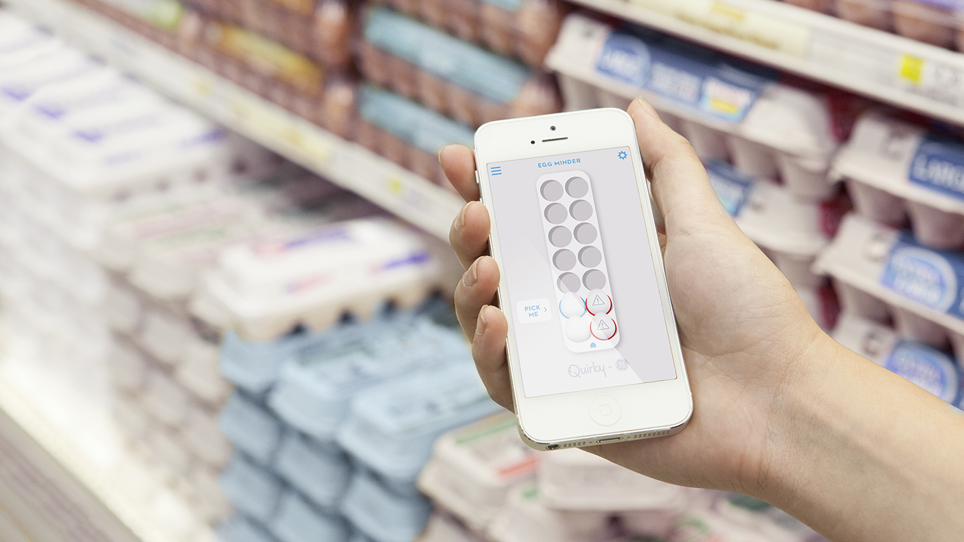
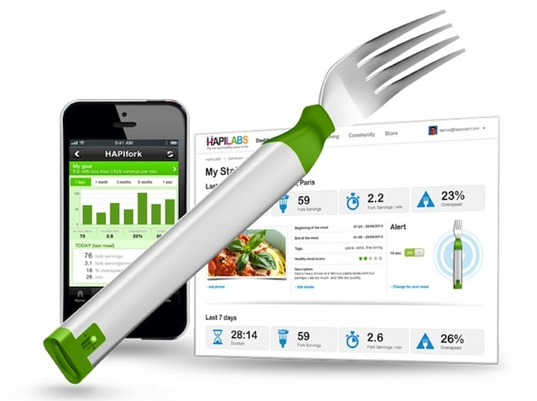
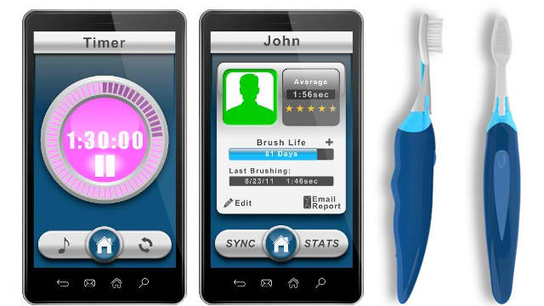
Fields

Slide 7
Is It Easy???
Technological standardization in most areas are still remain fragmented.
Managing and fostering rapid innovation is a challenge for governments.
Privacy
Absence of governance.

Slide 8
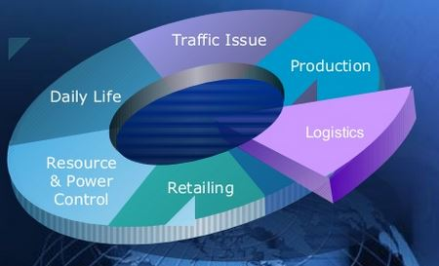
What’s Next???

Slide 9
IoT Components
Sensors and Actuators
Micro Controllers and Processors (Embedded Systems)
Communication Protocols
TCP, UDP, MqTT, CoAP
Servers and Data bases
Software or Applications

Slide 10
Embedded System Characteristics
Some Of Them Are….
Function Oriented
Less Power
Should Meet With Dead Lines

Slide 11
Thank You

