Slide 1
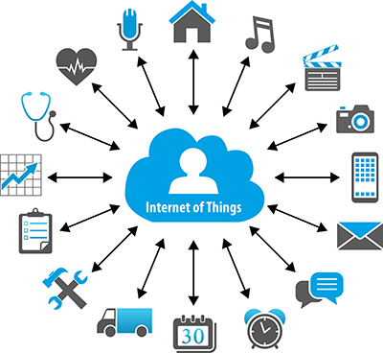
Internet Of Things(IoT)
ELEMENTZ ENGINEERS GUILD PVT LTD
13-02-2017

Slide 2
What is IoT?
The Internet of Things (IoT) is the network of physical objects or "things" embedded with electronics, software, sensors, and network connectivity, which enables these objects to collect and exchange data.
IoT allows objects to be sensed and controlled remotely across existing network infrastructure, creating opportunities for more direct integration between the physical world and computer-based systems, and resulting in improved efficiency, accuracy and economic benefit.

Slide 3
"Things,"
in the IoT sense, can refer to a wide variety of devices such as heart monitoring implants, biochip transponders on farm animals, electric clams in coastal waters, automobiles with built-in sensors, DNA analysis devices for environmental/food/pathogen monitoring or field operation devices that assist fire-fighters in search and rescue operations.
These devices collect useful data with the help of various existing technologies and then autonomously flow the data between other devices.

Slide 4
History of IoT
The concept of the Internet of Things first became popular in 1999, through the Auto-ID Center at MIT and related market-analysis publications. R
Radio-frequency identification (RFID) was seen as a prerequisite for the IoT at that point. If all objects and people in daily life were equipped with identifiers, computers could manage and inventory them. Besides using RFID, the tagging of things may be achieved through such technologies as near field communication, barcodes, QR codes, bluetooth, and digital watermarking.

Slide 5
How IoT Works?
Internet of Things is not the result of a single novel technology; instead, several complementary technical developments provide capabilities that taken together help to bridge the gap between the virtual and physical world. These capabilities include:
Communication and cooperation
Addressability
Identification
Sensing
Actuation
Embedded information processing
Localization
User interfaces

Slide 6
How IoT Works?
RFID
Sensor
Smart Tech
Nano Tech
To identify and track the data of things
To collect and process the data to detect the changes in the physical status of things
To enhance the power of the network by devolving processing capabilities to different part of the network.
To make the smaller and smaller things have the ability to connect and interact.

Slide 7
The Structure of IoT
The IoT can be viewed as a gigantic network consisting of networks of devices and computers connected through a series of intermediate technologies where numerous technologies like RFIDs, wireless connections may act as enablers of this connectivity.
Tagging Things : Real-time item traceability and addressability by RFIDs.
Feeling Things : Sensors act as primary devices to collect data from the environment.
Shrinking Things : Miniaturization and Nanotechnology has provoked the ability of smaller things to interact and connect within the “things” or “smart devices.”
Thinking Things : Embedded intelligence in devices through sensors has formed the network connection to the Internet. It can make the “things” realizing the intelligent control.

Slide 8
IoT as a Network of Networks:
These networks connected with added security, analytics, and management capabilities. This will allow IoT to become even more powerful in what it can help people achieve.

Slide 9
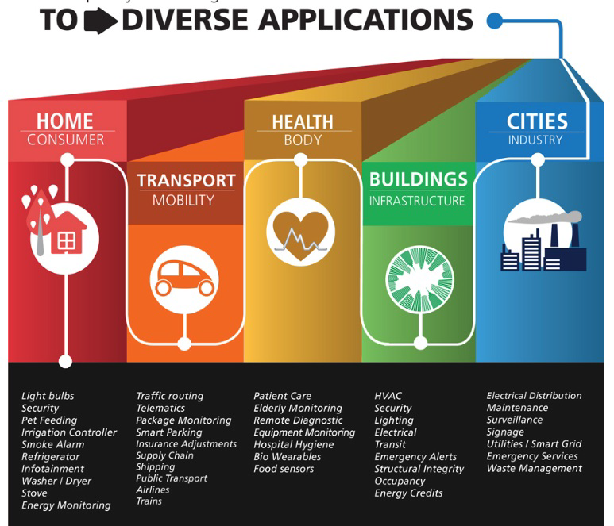

Slide 10
Sensors in even the holy cow!
In the world of IoT, even the cows will be connected and monitored. Sensors are implanted in the ears of cattle. This allows farmers to monitor cows’ health and track their movements, ensuring a healthier, more plentiful supply of milk and meat for people to consume. On average, each cow generates about 200 MB of information per year.

Slide 11
TECHNOLOGICAL CHALLENGES OF IoT
At present IoT is faced with many challenges, such as:
Scalability
Technological Standardization
Inter operability
Discovery
Software complexity
Data volumes and interpretation
Power Supply
Interaction and short range communication
Wireless communication
Fault tolerance

Slide 12
Criticisms and Controversies of IoT
Scholars and social observers and pessimists have doubts about the promises of the ubiquitous computing revolution, in the areas as:
Privacy
Security
Autonomy and Control
Social control
Political manipulation
Design
Environmental impact
Influences human moral decision making

