Slide 1
TCP And UDP
Herat University
Computer Science Faculty
Scientific Writing
Scientific Research Article
What is difference between them?
Where are they used?
Why?
By: Ahmad Khalid
Lecturers:
Mrs. Nabizada
Mr. Fahim Ahmady
Nov 2011

Slide 2
Contents
Introduction
Advantages of TCP
Disadvantages of TCP
Advantages of UDP
Disadvantages of UDP
Where are they used? Why?
Conclusion

Slide 3
Introduction
TCP and UDP works in Transport Layer of OSI Model as well as TCP/IP Model
TCP (Transmission Control Protocol) enables two hosts to establish a connection and exchange streams of data. TCP guarantees delivery of data and also guarantees that packets will be delivered in the same order in which they were sent.
UDP (User Datagram Protocol) a connectionless protocol that, like TCP, runs on top of IP networks. Provides very few error recovery services, offering instead a direct way to send and receive datagrams over an IP network.

Slide 4
Advantages of TCP
TCP guarantees three things: that your data gets there, that it gets there in order, and that it gets there without duplication. (the truth, the whole truth, and nothing but the truth...)
TCP does Flow Control and Congestion Control
For a programmer: The operating system does all the work. you just sit back and watch the show. no need to have the same bugs in your code that everyone else did on their first try; it's all been figured out for you.
Since it's in the OS, handling incoming packets has fewer context switches from kernel to user space and back; all the reassembly, acking, flow control, etc is done by the kernel.
Routers may notice TCP packets and treat them specially. they can buffer and retransmit them
TCP has good relative throughput on a modem or a LAN.

Slide 5
Disadvantages of TCP
TCP cannot conclude a transmission without all data in motion being explicitly acked.
TCP cannot be used for broadcast or multicast transmission.
TCP has no block boundaries; you must create your own.
For a programmer:
OS might be buggy –as well TCP
TCP may have lots of features you don't need. it may waste bandwidth, time, or effort on ensuring things that are irrelevant to the task at hand.
Routers on the internet today are out of memory. they can't pay much attention to TCP flying by, and try to help it. design assumptions of TCP break down in this environment.
Provides much latency in network- SLOW

Slide 6
Advantages of UDP
Broadcast and multicast transmission are available with UDP
It doesn't restrict you to a connection based communication model, so startup latency in distributed applications is much lower, as is operating system overhead FAST.
All flow control, acking, transaction logging, etc is up to user programs; a broken OS implementation is not going to get in your way. additionally, you only need to implement and use the features you need.
The recipient of UDP packets gets them unmangled, including block boundaries.

Slide 7
Disadvantages of UDP
There are no guarantees with UDP. a packet may not be delivered, or delivered twice, or delivered out of order; you get no indication of this unless the listening program at the other end decides to say something.
UDP has no flow control, Congestion Control. implementation is the duty of user programs.
Routers are quite careless with UDP. they never retransmit it if it collides, and it seems to be the first thing dropped when a router is short on memory.
UDP suffers from worse packet loss than TCP

Slide 8
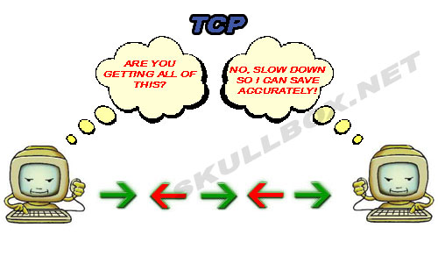

Slide 9
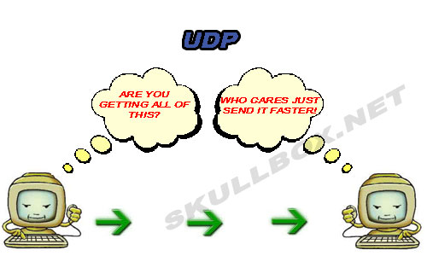

Slide 10
Where are they used? Why?
TCP is used in HTTP, HTTPs, FTP, SMTP Telnet etc...
UDP is used in DNS, DHCP, TFTP, SNMP, RIP, VOIP, Multi media, Online games etc…
Consider Multi media, if we use TCP instead of UDP when ever pocket loss occurred we get long delay to continue watching/listening because TCP is retransmitting lost packets and it takes time

Slide 11
TCP vs. UDP Conclusion
TCP and UDP each have their place. In fact, some applications use a combination of the two. For example, a lot of online multiplayer games use TCP for data transfer and UDP for things like a client heartbeat or to send opponent position updates.
TCP is generally a good choice, though, even with its associated overhead. Most of the overhead is in the connection. Therefore, if your application stays connected for any length of time, then the cost is mitigated. In addition, if you’re sending any quantity of data, then it’s cheaper to use TCP’s built-in reliability, ordering, and flow control instead of building your own.
UDP is a good choice for multi Media like VoIP to provide small jitter

Slide 12
?
Thank You

