Slide 1
The Widening Transfer Aspiration Achievement Gap: Contextualizing the Transfer Intentions of Community College Students in New Mexico
Sociologists and education policy-makers have long recognized the need to improve the transfer rates of community college students into four-year programs …
Thomas Maestas, MA

Slide 2
The Widening Transfer Aspiration Achievement Gap: Contextualizing the Transfer Intentions of Community College Students in New Mexico
Sociologists and education policy-makers have long recognized the need to improve the transfer rates of community college students into four-year programs …
… However, there has been less research beyond quantitative analysis or surface-level bureaucratic and institution-level analyses.
Qualitative data has addressed the transfer issue, yet specialized community college theoretical frameworks have been rare and often dependent on four-year university theoretical models (i.e., persistence-attrition).
This study aims to induce knowledge from observed socio-cultural micro-processes potentially serving to widen the gap between those that aspire to a BA degree and those that achieve it.
Thomas Maestas, MA

Slide 3
The Widening Transfer Aspiration Achievement Gap: Contextualizing the Transfer Intentions of Community College Students in New Mexico
Qualitative data has addressed the transfer issue, yet specialized community college theoretical frameworks have been rare and often dependent on four-year university theoretical models.
This study has induced knowledge from observed socio-cultural micro-processes potentially serving to widen the gap between transfer aspirants and potential achievers.
The findings indicate the plausibility of non-structural factors to help explain, for example, the 6% decline of Latina/o students between 1994 and 2008 (Horn & Skomsvold, 2011), along with that of first-generation students, renewing interest in potential unexplained socio-cultural processes.
In like manner, the unprecedented success of females and African Americans to reverse their transfer achievement declines raises awareness to potential new strategies of success.
Thomas Maestas

Slide 4
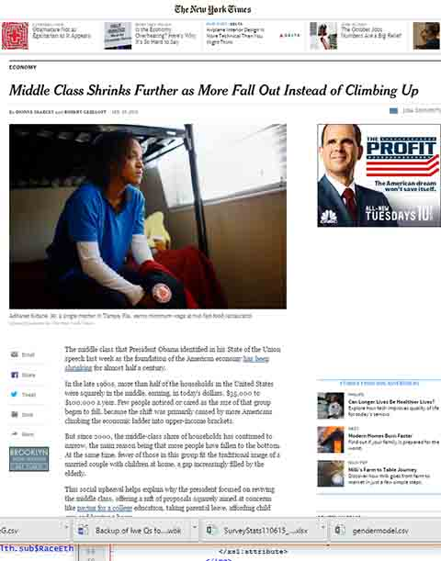
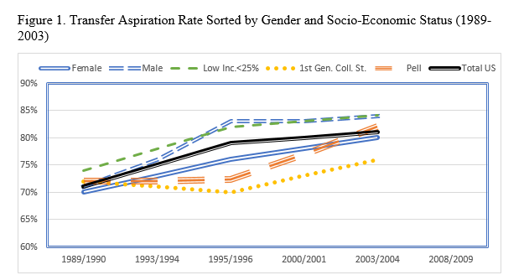
The Community College is the engine of occupational and socio-econonomic mobility for many.

Slide 5


Slide 6
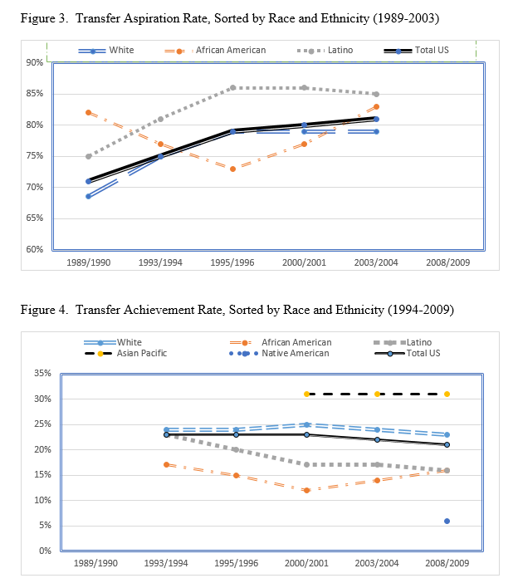
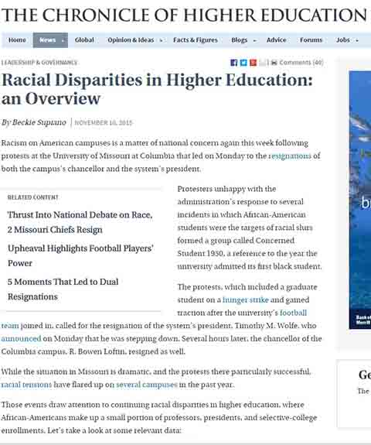
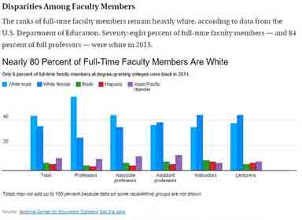
Thus, the Desperate Search for a Solution …

Slide 7

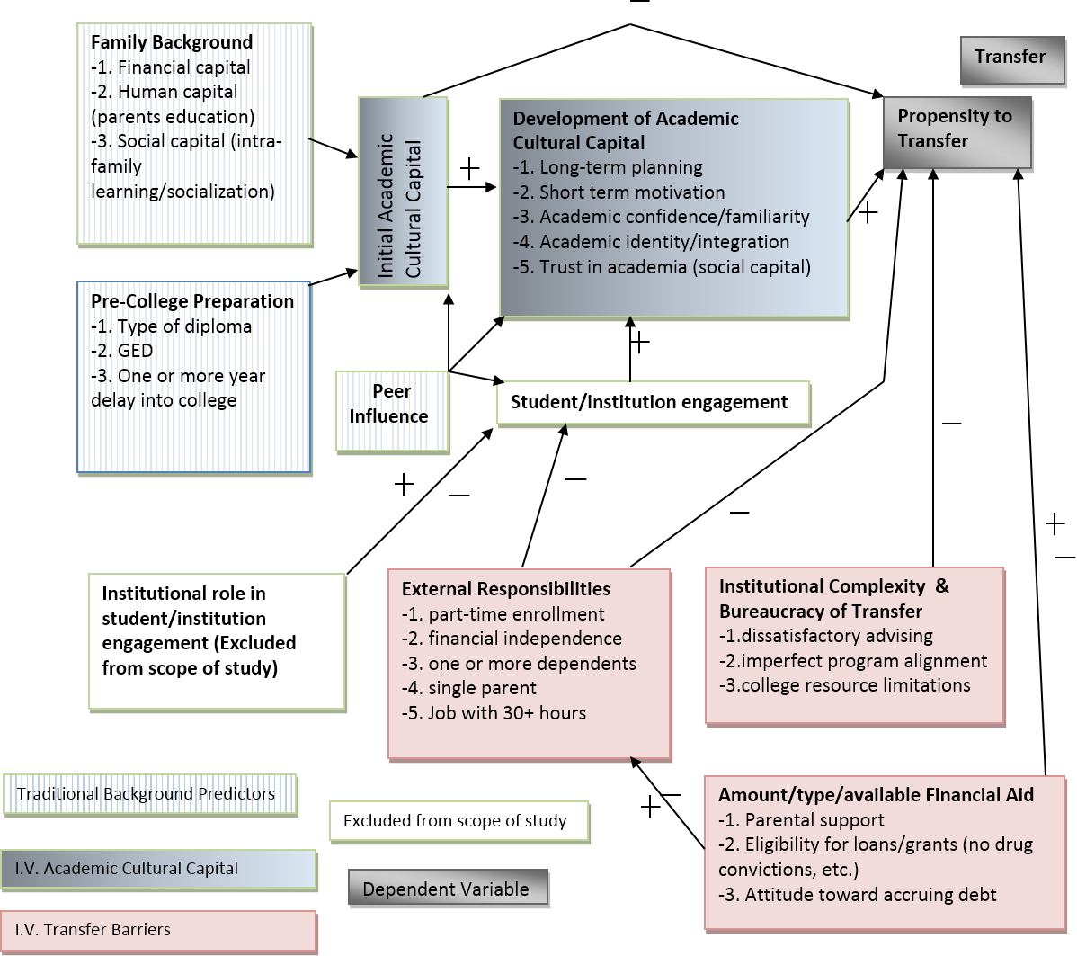
These structural analyses range from macro-level studies:
Inadequate institutional resources (Dougherty, 1992)
Rising demand for vocational programs (Grubb, 1991)
Individual-level issues like:
Student background (Nora & Rendon, 1990)
Pre-college preparation (Wang, 2012)
Academic performance (Crisp and Nora (2010)
Financial concerns (Dowd and Cheslock, 2005).
Etc. (..Will write when I reach the end …)

Slide 8
However, these structural explanations do not tell the whole story. Dougherty (1992; 1994) finds a consistent, unexplainable “11-19%” lower likelihood to earn a Bachelor’s degree among those starting at the community college, other factors held constant (p. 204).
Recent sociological research has continued to apportion inordinate attention to structural questions, with limited attention to social-cultural processes…
Recent community college and education-specific literature focuses on institution-level concerns to explain low transfer rates.

Slide 9
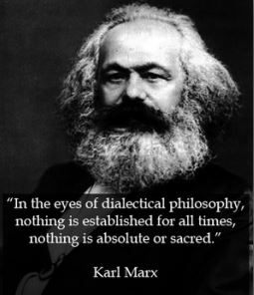
Research RQ: What could account for such a drastic and widening gap between initial educational intentions and eventual outcomes?
Research Strategy: In accordance with a Post-Hegelian/Marxist philosophy Dialectical Materialism, by which truth is based on material, social conditions--not deductive "theoretical" axioms from religion or the ruling class.
Following this logic, I sought to design my project according to the grounded-theory approach that begins with social conditions and generates knowledge and theoretical explanation from evidence—that is, from the students themselves.
I wanted to find out if the driving cause of the transfer gap is largely structural and therefore exogenous to the college, or if there are nuanced, underlying issues deriving from students' cultures, their unique and novel motivations from an increasingly diverse population.

Slide 10
Therefore, how may I go forward in the most analytically strategic manner, without succumbing to deductive theory?
The answer lies in the methodological power of social and cultural capital theories toward conceptualizing a qualitative framework of analysis:
My academic capital analysis includes both the identification and evaluation of five “test” socio-cultural processes, by which I include two Social Capital measures and three Cultural Capital Measures.
I collected data based on: Two social capital variables of academic group membership and trust, in addition to three cultural capital variables including long-term transfer planning and commitment, academic know-how, and finally academic familiarity and comfort-level.

Slide 11
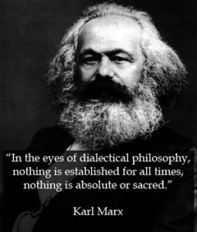


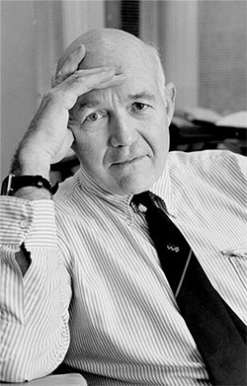
Marx’s Analysis of the Super-Structure and Structural framework of analysis (Economy is the base of power and thus comprises the superstructure, in contrast to the more ephemeral institutions such as government forms and cultural values.
French Philosopher Althusser, a well-recognized bearer of Pre-1892 Marixist doctrine elaborated on the superstructure by explaining the perpetuation of the Economic base by means of the perpetuation of social, cultural, and economic means of production through reproduction: Institutional powers are de facto subservient and complicit in reproducing these inequalities. These processes take place through “Ideological State Apparatuses”, even including health insurance, criminal-justice and educational settings.
The Public Sociologist, Pierre Bourdieu, carries on the “Superstructure” framework by identifying educational and institutional evidence of the reproduction of social, cultural and educational inequalities that help reproduce the social, economic, and hegemonic power of the ruling elite.
Forms of Capital analysis include “Social Capital Theory” as popularized by Sociologist Dr. James Coleman.
The Present Study aims to carry on this tradition of Scholarship.

Slide 12
Cultural Capital, on the other hand, refers to the learned “informal academic standard, a class attribute, a basis for social [and self] selection, and a resource for power …” (Lamont & Lareau, 1988, p. 156).
Cultural Capital variables including long-term transfer planning and commitment, academic know-how, and finally academic familiarity and comfort-level.
Initial Strategy: I operationalized Social Capital based on James Coleman’s seminal usage in educational analysis during the 1980’s. Second I followed suit with three forms from Cultural Capital, as characterized in his Reproduction of Social and Cultural Reproduction. In this way, my exploratory, descriptive study helps define culturally valid and logical research parameters and measurements.
Social capital measures the amount and quality of resources, in both actual and potential terms, which are exchanged within a community or any network (Coleman, 1988; Bourdieu, 1986/2011).
Shared expectations, informational channels, and a normative structure exemplify three forms of social capital (Coleman, 1988).

Slide 13

Sampling Challenge: Survey Reliability is more important than Validity, because reliable data to inform the interview selection is more important than trans-location generalizability.
Strategy by Russian Dolls: The survey administration script is the pre-screen for the survey sample frame, and the survey's sample frame pre-screens from survey sample-frame provthe interview sample frame, which then screensThe survey questionnaire pre-screens and also screens for interview selection. According to qualitative methodology of Maxwell, An ideal interviewee sample should: 1) maximize heterogeneity, 2) include extreme-cases, 3) best represent the target-population parameters (which we are interested in the educational intentions and expectations at the most fluid, and also most stratifying period in the life course.

Slide 14
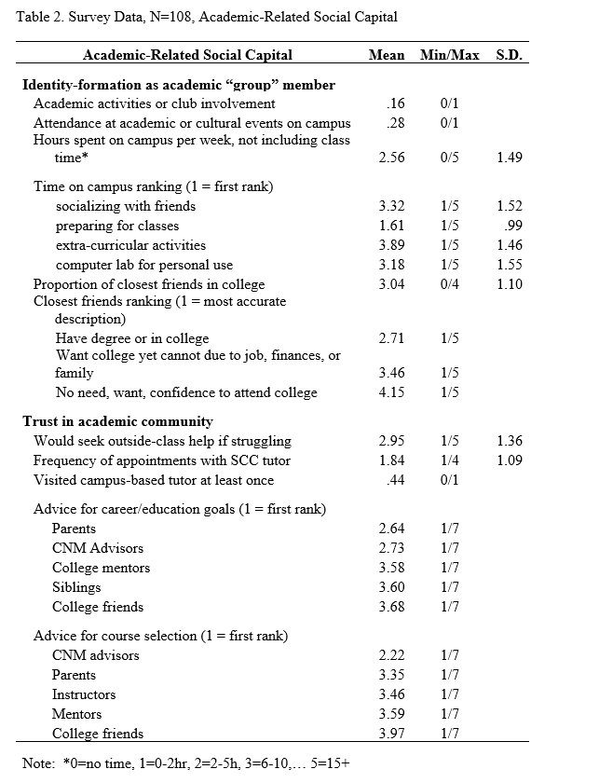
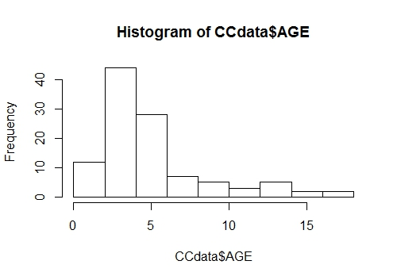
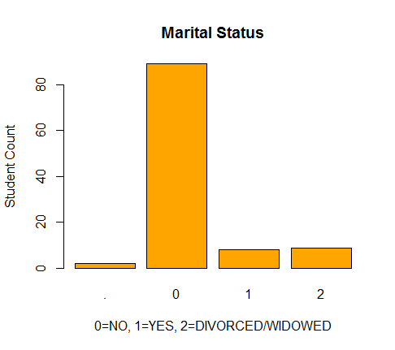

Slide 15
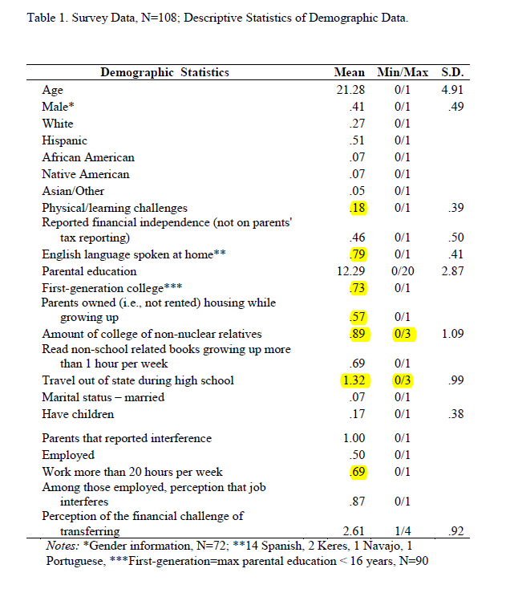
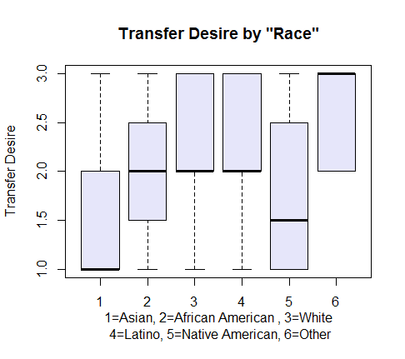
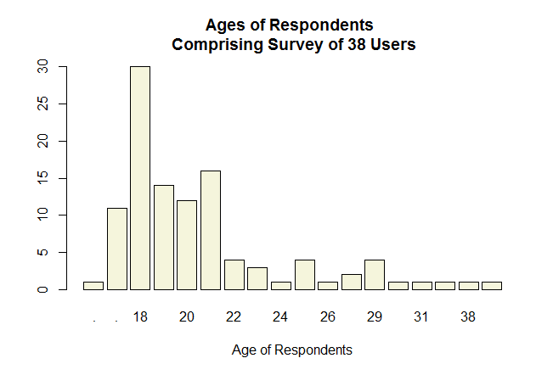

Slide 16
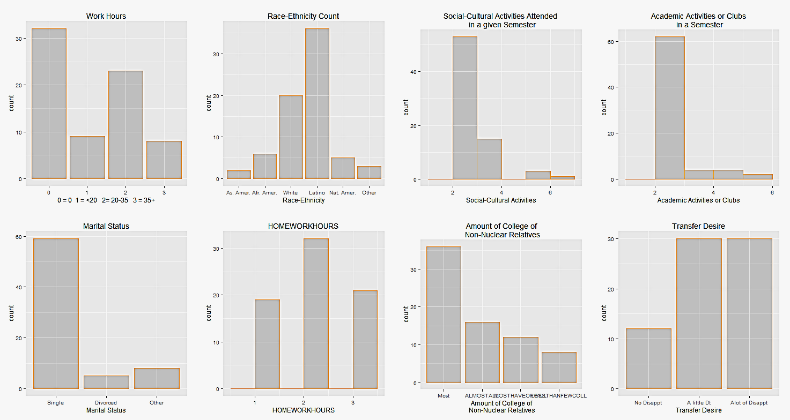

Slide 17
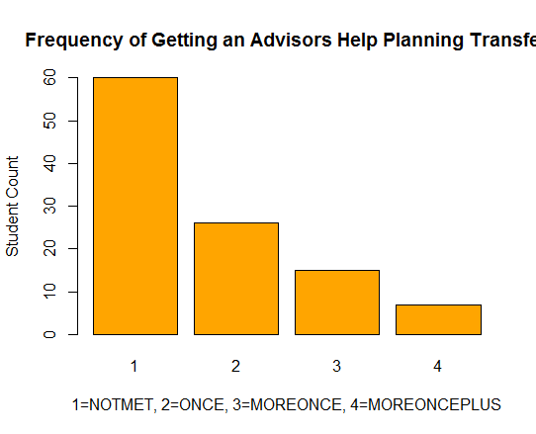
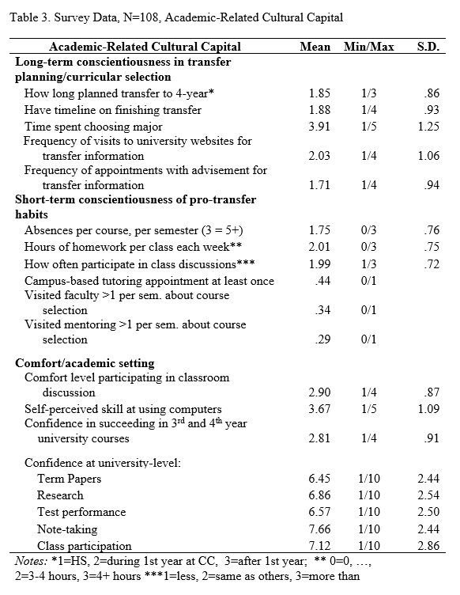
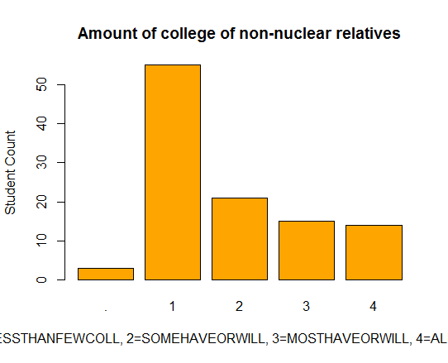

Slide 18
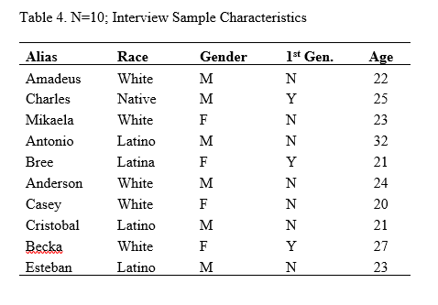
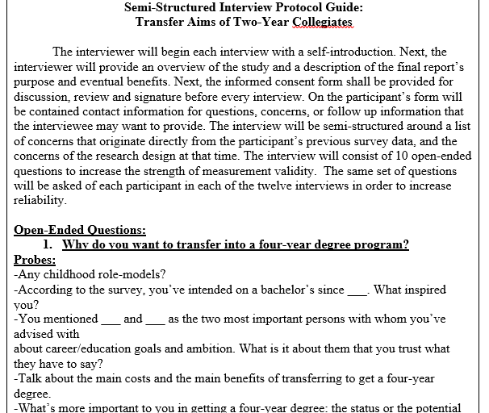

Slide 19
The Interplay between Financial,
Career, and Family Priorities
Many students expressed personal dilemmas and challenges that forced them to re-prioritize their academic work with other life obligations. One 22 year-old White interviewee, Amadeus, contemplated between postponing transfer to begin working or to stay on course to transfer. He said, “Everyone has a buying point … I have a buying point. Title is less important than money. But money is less important than being happy.” Amadeus debated the merit of another two years to obtain a BS in radiology, as immediate
One student’s long-term “meaning” for transferring languished with little event over eight semesters, until being replaced by a new financial “meaning” of a new pursuit. Anderson, a 24 year old White male became convinced that he will pursue a career in welding based on potential earning power

Slide 21
Charles, a 25 year-old Native American and first-generation college student, exemplifies a case of temporarily shifting full priority from his aspiration for a university degree to family concerns. Then, once resolved, he later returned to the community college to pursue full-time transfer credentials and eventually a bachelor’s degree. Charles originally dropped out of school to care for his mother that had fallen ill. He explains, “my mother had gotten sick with breast cancer so I quit school and moved back [home]. That took up a big chunk of my life and then I got back into school when my younger brother finished high school.” Charles clarifies that he worked for his tribal government to provide for his mother and younger brother until the latter graduated high school. Only then did Charles return to SCC.

Slide 22
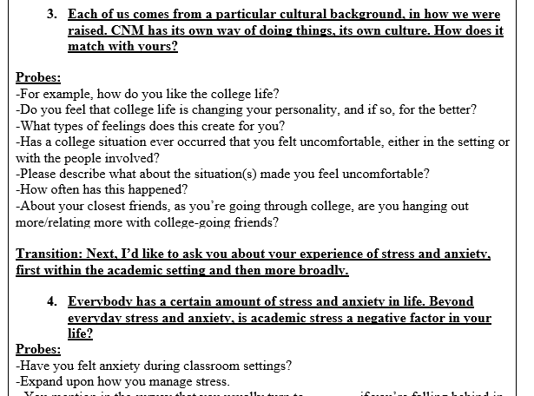

Slide 23
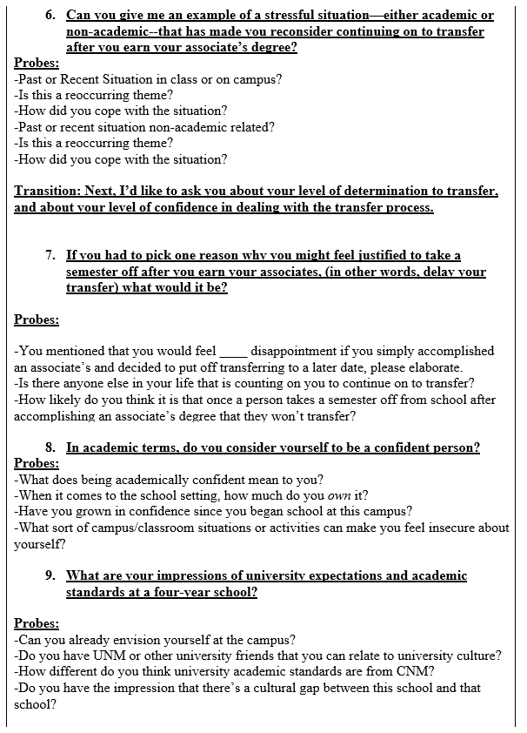
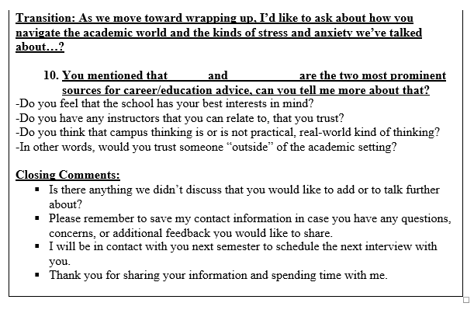

Slide 24
Conclusion
Beginning with insights gained from two social capital indicators and three cultural capital indicators, I found diminishing (and heightening) of transfer intentions associated with these five socio-cultural processes, along with other unexpected processes that emerged during the course of my research.
Trust-building proved effective, while others’ mistrust appeared linked to the failure of inclusion into formal support networks.
Survey results indicated a high proportion of college friends, yet the interviews give the impression of a subdued level of academic peer network formation.
Measures of long-term transfer commitment showed transfer intention to be recently formed and more fragile than expected.
Indications of varying academic comfort levels include examples of heightened confidence and expectations of post-transfer success.
Finally, the different learned habits of strategy and academic know-how varied between students, showing in several cases that mentoring provided key emotional and organizational support.

Slide 25
Conclusion
My primary finding is that student transfer intentions behave dynamically, are more fragile and recently-formed than expected, and exhibit outcome patterns linked to social and cultural experiences while at the community college.
These experiences, as colored by the students’ accounts, feature interactions of identity and student culture, emotional and morale support, differing “comfort-levels,” and the delicate interplay of financial, family and educational priorities.
Trust-building proved effective, while others’ mistrust appeared linked to the failure of inclusion into formal support networks.
Survey results indicated a high proportion of college friends, yet the interviews give the impression of a subdued level of academic peer network formation.
Measures of long-term transfer commitment showed transfer intention to be recently formed and more fragile than expected.
Indications of varying academic comfort levels include examples of heightened confidence and expectations of post-transfer success.
Finally, the different learned habits of strategy and academic know-how varied between students, showing in several cases that mentoring provided key emotional and organizational support.

Slide 26
Implications
Potential implications of the research might help students recognize academic capital resources as key to developing network resources and confidence.
Policy implications become apparent in reference to the under-recognized need for both high and low context pedagogy and an accommodating institutional campus climate.

Slide 27
Implications
The findings indicate the theoretical plausibility of non-structural factors to help explain, for example, the 6% decline of Latina/o students between 1994 and 2008 (Horn & Skomsvold, 2011), along with that of first-generation students, renewing interest in potential unexplained socio-cultural processes.
In like manner, the unprecedented success of females and African Americans to reverse their transfer achievement declines raises awareness to a potential trend leading to new strategies of success.

Slide 28
Implications
The findings indicate the theoretical plausibility of non-structural factors to help explain, for example, the 6% decline of Latina/o students between 1994 and 2008 (Horn & Skomsvold, 2011), along with that of first-generation students, renewing interest in potential unexplained socio-cultural processes.
In like manner, the unprecedented success of females and African Americans to reverse their transfer achievement declines raises awareness to a potential trend leading to new strategies of success.

