Slide 1

Professor Oak’s Pokémon Love Calculator
A Love App
By Angus, Declan, Jeff, Nobu & Tom

Slide 2
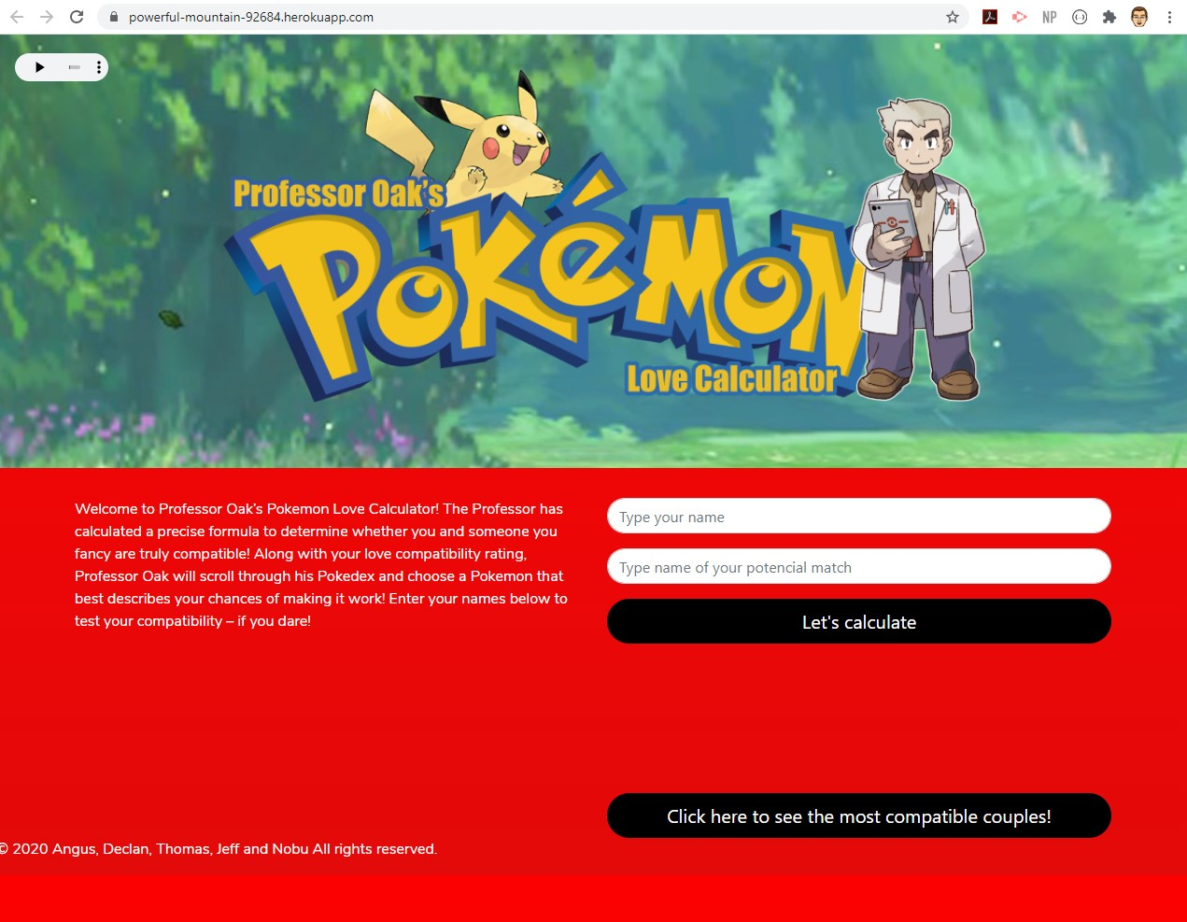

Elevator Pitch
Notes:
Tired of dating so many people you could fill a Poxédex? Ever wanted more certainty when it came to choosing a potential partner? Do you ever reminisce on those nostalgic childhood moments where Pokémon cards, Pokémon Nintendo games and Pokémon tv episodes were the centre of your universe? Traditional API’s will give you a match %, but what does that even mean? Where’s the cut-off, and as a Pokémon fan, how can I relate to that? What if I told you that we can relive that feeling of nostalgia in order to help you decide who should be the centre of your universe in today’s times. Thanks to Professor Oak’s Pokémon Love Calculator, you now have the possibility of getting a love compatibility rating for you and your potential partner, and based on that rating, you will be assigned a Pokémon that best describes your relationship outlook with that person. Is your love compatibility electric like Pikachu, or will it struggle to evolve into something strong like Magikarp? Thanks to Professor Oak’s Pokémon Love calculator, you don’t have to catch them all to find the right catch!

Slide 3
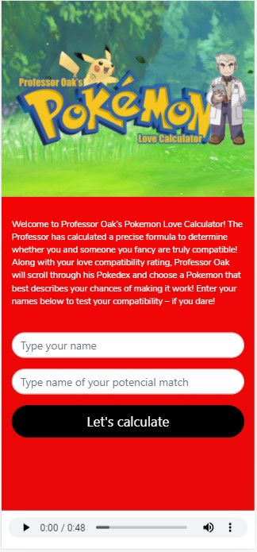

Concept - Description
User types their name and the name of their love interest into the boxes on the home page
When user clicks calculate, the site runs an API to determine how compatible the user’s name is with that of their interest.
This compatibility will then be compared to a Pokémon, giving the user a fun and profoundly accurate description of how a relationship with this person would be!
The app then saves the highest compatibility scores for reference.

Slide 4

Concept
Motivation for development:
A love compatibility search that incorporates Pokémon for fun.
Allows users to discover the compatibility of their name with a potential
match, then compare their score with a Pokémon and a description.
Saves the highest scores recorded on the app.
Engaging and fun user interface.
User story:
As a single person and lover of Pokémon: I want to search the compatibility of my name with that of a potential partner. I would then like the potential relationship rated in relation to a Pokémon I know. I would also like to know some of the most compatible names. This is so I can have fun investigating my compatibility with different people, and have a laugh at the same time.

Slide 5

Process
Technologies used
HTML
CSS: Bootstrap, Google Fonts
JavaScript: JQuery
Node, Express
MySQL
Handlebars
Heroku
MVC
Sequelize ORM
Eslint
Travis
Schema
Unirest
New Package
GET, POST
Love-Calculator API: rapidapi.com
Pokémon API – pokeapi.co

Slide 6

Process – Breakdown of tasks & roles
Angus
Pokémon love descriptions
Presentation PowerPoint
Concept & Documentation
Declan
Unirest API calls
Routing
Backend JS (Node/Express)
Data storage
Jeff
Schema
Handlebars
Database
Nobu
Page layout design &
HTML
CSS & Bootstrap
Tom
Heroku
API Integration
Front-end JS
Pokémon love descriptions & pitch

Slide 7

Process
Challenges
When merging files, small discrepancies in naming caused difficulties.
Heroku integration took some time to perfect.
Saving of names in a database to be viewed by other users presented issues.
Successes
Visually appealing interface.
Effective data functionality to achieve goals.
Strong mobile display & usability.
Strong and active collaboration & teamwork.

Slide 8

Demo

Slide 9

Directions for Future Development
Link into Dating App tech to match with compatible people nearby.
User compares 2 potential matches by simulating Pokémon battle.
• Links to sellers of Pokémon merchandise following result, could generate revenue.
• • Permission could be sought from Nintendo to make the app generate revenue through the above

Slide 10

Links
Deployed: https://powerful-mountain-92684.herokuapp.com/
GitHub Repo: https://github.com/thomasmaglaris/ Professor-Oaks-s-Pokemon-Love-Calculator

