Slide 1
False Positive Bias in Genetic Capture-Recapture

Slide 2
Animal Abundance
Abundance is the number of individuals from a given species inhabiting a certain area
Monitoring abundance is important for several reasons:
Exploring factors that affect abundance
Estimating biodiversity
Monitoring endangered species

Slide 3
Estimating Abundance
It is rarely possible to determine the exact abundance of a population
Census surveys are resource intensive and often impractical
Abundance is usually estimated, and various techniques exist for this

Slide 4
Capture-Recapture
The technique is based on capturing animals and marking them in some way
The animals are released back into the wild, and allowed to reintegrate
Another sample is then taken, and the proportion of animals that were previously captured (as determined by the marks) is used to estimate the abundance

Slide 5
Capture-Recapture
It is not necessary to understand the details of capture-recapture for this presentation
More information:
MT5751
Estimating Animal Abundance: Closed Populations - Borchers, Buckland and Zucchini

Slide 6
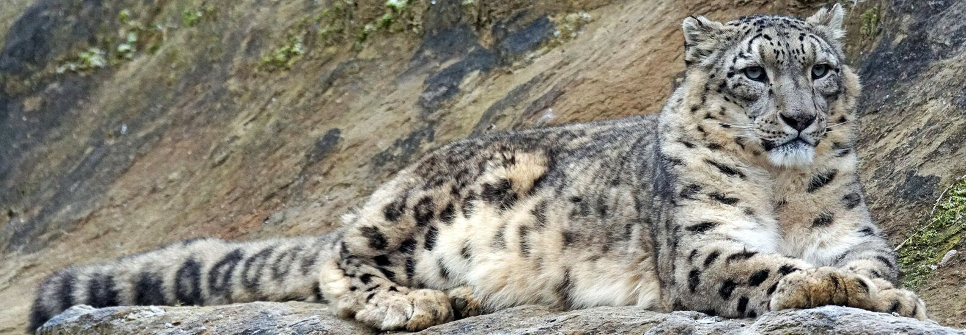
Example: Snow Leopards
Capture-recapture has been used to study the abundance of snow leopards
Non-invasive captures – camera traps, dropping DNA

Slide 7
The problem
The areas inhabited by snow leopards have low average temperatures, often below freezing
It has been suggested that this could preserve droppings, allowing them to remain detectable long after the snow leopard that left it has left the area
An estimate based on dropping information may therefore be significantly biased
My work has focussed on exploring this problem through simulation studies

Slide 8
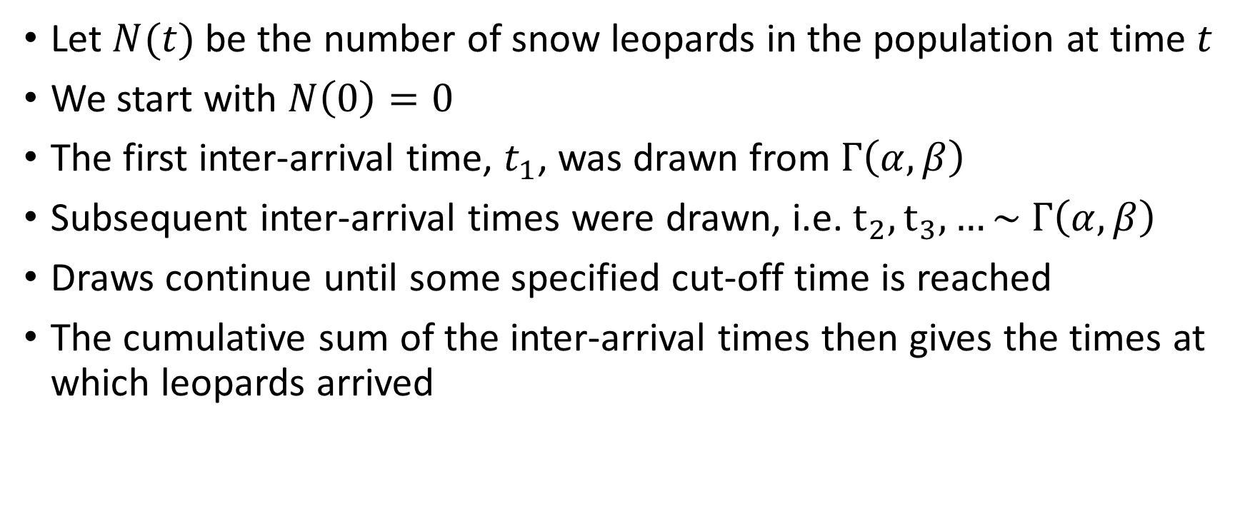
Simulating Arrivals
Let $N(t)$ be the number of snow leopards in the population at time $t$
We start with $N\left(0\right)=0$
The first inter-arrival time, $t_{1}$, was drawn from $Γ\left(α, β\right)$
Subsequent inter-arrival times were drawn, i.e. $t_{2},t_{3},…\sim Γ\left(α, β\right)$
Draws continue until some specified cut-off time is reached
The cumulative sum of the inter-arrival times then gives the times at which leopards arrived

Slide 9
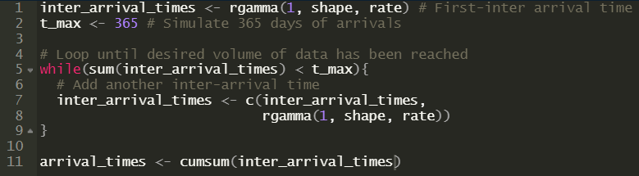
Simulating Arrivals

Slide 10
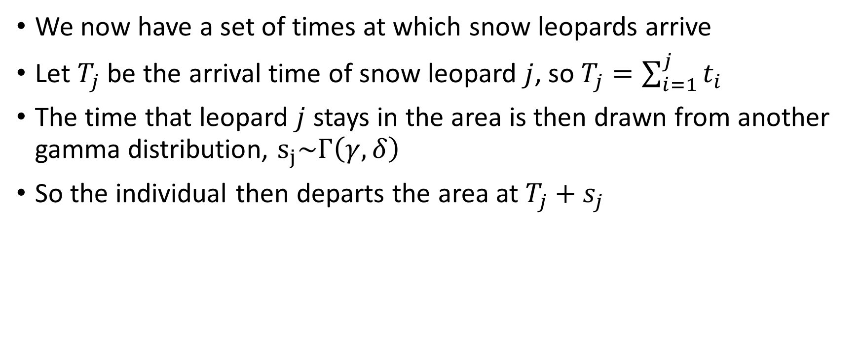
Simulating Departures
We now have a set of times at which snow leopards arrive
Let $T_{j}$ be the arrival time of snow leopard $j$, so $T_{j}=\sum_{i=1}^{j}{t_{i}}$
The time that leopard $j$ stays in the area is then drawn from another gamma distribution, $s_{j}\sim Γ\left(γ, δ\right)$
So the individual then departs the area at $T_{j}+s_{j}$

Slide 11
Simulating Departures

Slide 12
Combining
At the times in arrival_times, the population increases by one
At the times in leave_times, the population decreases by one
We can use this to calculate the size of the population at any time up to the end of the simulation:

Slide 13
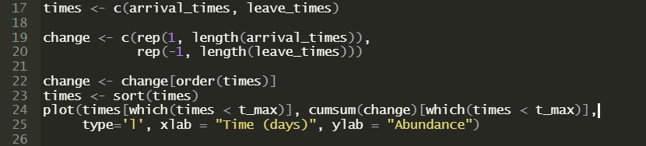
Combining

Slide 14
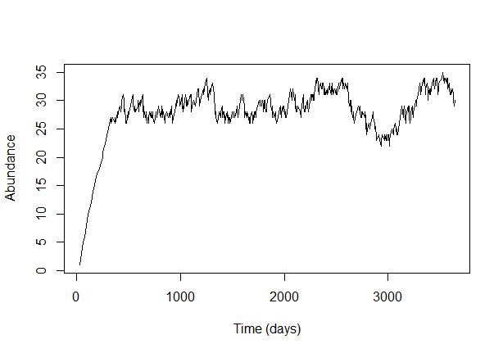
Combining

Slide 15
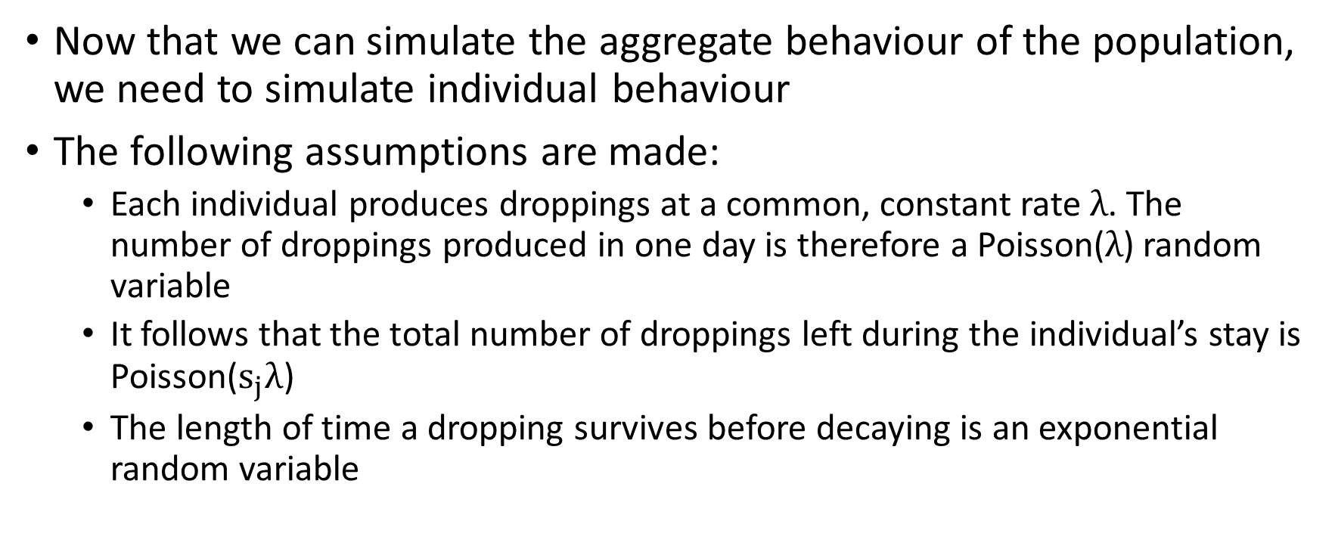
Simulating Individual Behaviour
Now that we can simulate the aggregate behaviour of the population, we need to simulate individual behaviour
The following assumptions are made:
Each individual produces droppings at a common, constant rate $λ$. The number of droppings produced in one day is therefore a Poisson($λ$) random variable
It follows that the total number of droppings left during the individual’s stay is Poisson($s_{j}λ$)
The length of time a dropping survives before decaying is an exponential random variable

Slide 16
Spatial Information
As we are considering a spatial capture-recapture frame-work, we need to simulate the spatial information too
Each individual is assumed to have an “activity centre”, which is the spatial average of their movement around their habitat
This activity centre is drawn by selecting the x and y coordinates independently from uniform distributions
The droppings are then placed with coordinates drawn from independent normal distributions centred on the activity centre

Slide 17
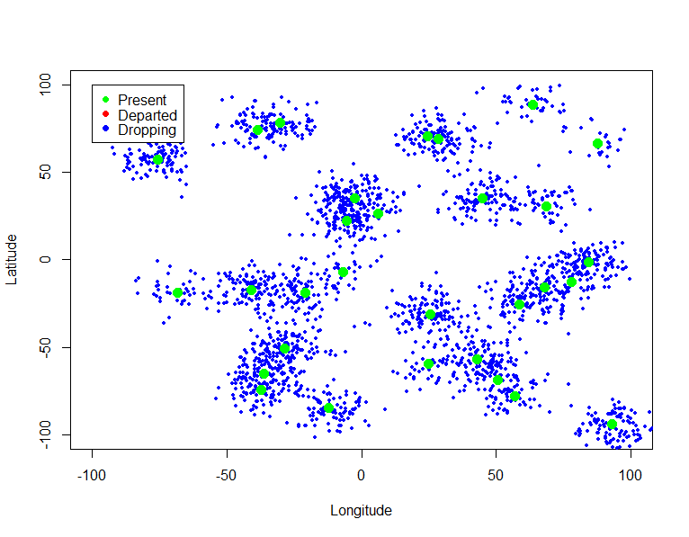
Spatial Information – Animals Present

Slide 18
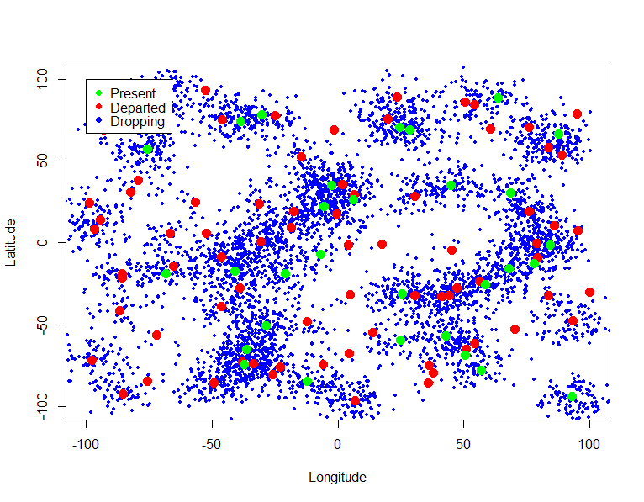
Spatial Information – Animals Detectable

Slide 19
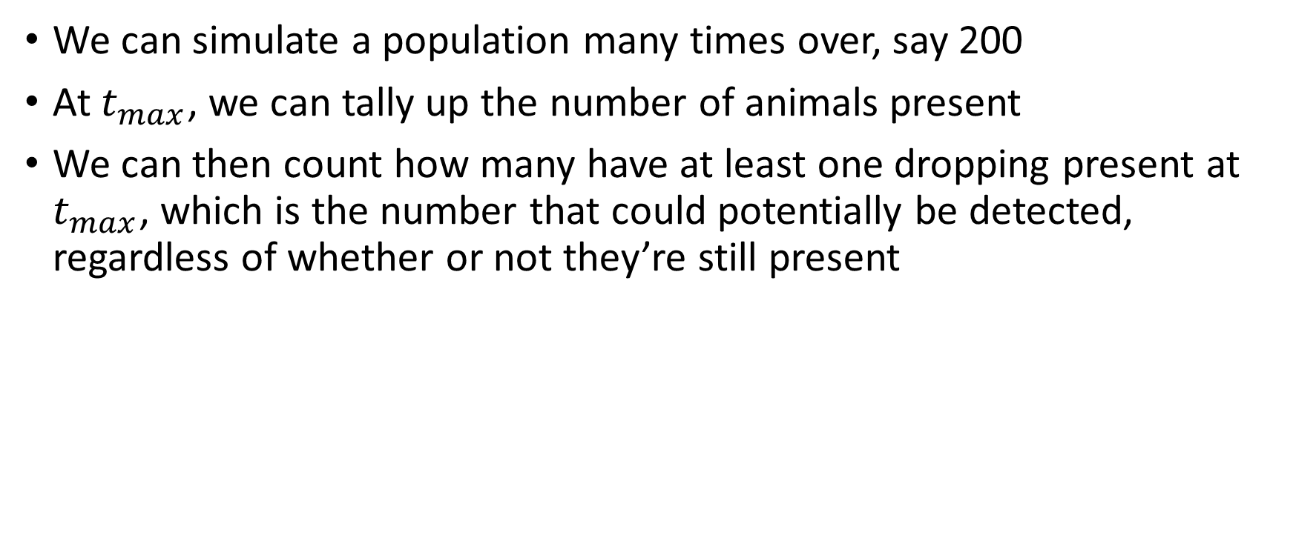
Detectable vs Present
We can simulate a population many times over, say 200
At $t_{max}$, we can tally up the number of animals present
We can then count how many have at least one dropping present at $t_{max}$, which is the number that could potentially be detected, regardless of whether or not they’re still present

Slide 20
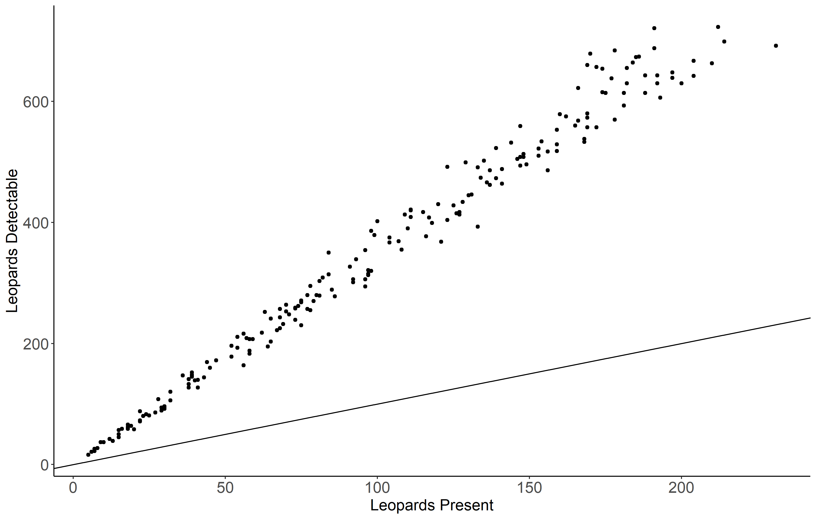
Detectable vs Present

