Slide 1
False Positive Bias in Genetic Capture-Recapture
Thomas McFarlane

Slide 2
Animal Abundance
Abundance is the number of individuals from a given species inhabiting a certain area
Monitoring abundance is important for several reasons:

Slide 3
Animal Abundance
Abundance is the number of individuals from a given species inhabiting a certain area
Monitoring abundance is important for several reasons:
Exploring factors that affect abundance

Slide 4
Animal Abundance
Abundance is the number of individuals from a given species inhabiting a certain area
Monitoring abundance is important for several reasons:
Exploring factors that affect abundance
Estimating biodiversity

Slide 5
Animal Abundance
Abundance is the number of individuals from a given species inhabiting a certain area
Monitoring abundance is important for several reasons:
Exploring factors that affect abundance
Estimating biodiversity
Monitoring endangered species

Slide 6
Estimating Abundance
It is rarely possible to determine the exact abundance of a population
Abundance is usually estimated, and various techniques exist for this

Slide 7
Capture-Recapture
The technique is based on capturing animals and marking them in some way
The animals are released back into the wild, and allowed to reintegrate
Another sample is then taken, and the proportion of animals that were previously captured (as determined by the marks) is used to estimate the abundance

Slide 8
Capture-Recapture
It is not necessary to understand the details of capture-recapture for this presentation
More information:
MT5751 – Estimating Animal Abundance and Biodiversity
Estimating Animal Abundance: Closed Populations - Borchers, Buckland and Zucchini

Slide 9
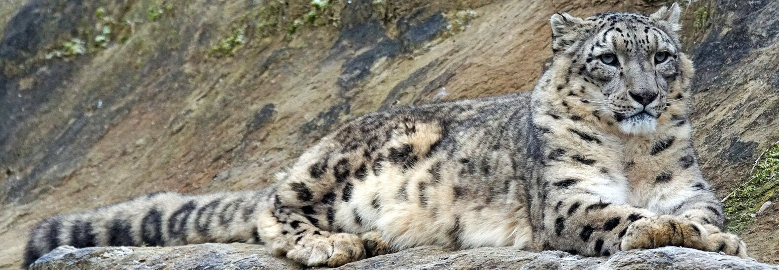
Example: Snow Leopards
Capture-recapture has been used to study the abundance of snow leopards
Non-invasive captures – camera traps, dropping DNA

Slide 10
The problem
Snow leopards inhabit areas with low average temperatures, often below freezing
This could preserve droppings, allowing them to remain detectable after the snow leopard that produced it has left the area
An estimate based on droppings may therefore be significantly biased
My work has focused on exploring this problem through simulation studies

Slide 11
Population Simulation
The population model is based on queuing theory
We start with a population of zero, then simulate animals arriving and leaving randomly
We start by drawing interarrival times from some distribution

Slide 12
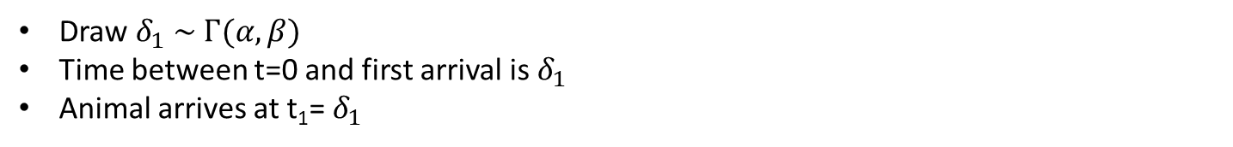

Simulating Arrivals
$$δ_{1}$$
t₁
Draw $δ_{1} \sim Γ(α, β)$
Time between t=0 and first arrival is $δ_{1}$
Animal arrives at t₁= $δ_{1}$

Slide 13
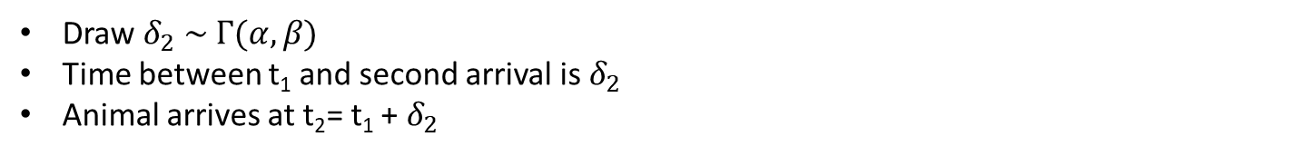

Simulating Arrivals
$$δ_{2}$$
t₁
t₂
Draw $δ_{2} \sim Γ(α, β)$
Time between t₁ and second arrival is $δ_{2}$
Animal arrives at t₂= t₁ + $δ_{2}$

Slide 14
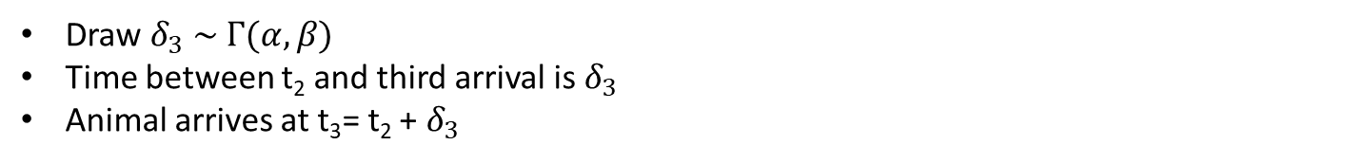

Simulating Arrivals
$$δ_{3}$$
t₁
t₂
t₃
Draw $δ_{3} \sim Γ(α, β)$
Time between t₂ and third arrival is $δ_{3}$
Animal arrives at t₃= t₂ + $δ_{3}$

Slide 15
Simulating Arrivals
t₁
t₂
t₃
t₀
t_{max}
We simulate arrivals until a pre-defined stopping rule is met
This takes the form of t_{j} ≥ t_{max}

Slide 16
Simulating Arrivals
t₁
t₂
t₃
t₄
t₀
t_{max}
We simulate arrivals until a pre-defined stopping rule is met
This takes the form of t_{j} ≥ t_{max}

Slide 17

Simulating Departures
Let $t_{j}$ be the arrival time of snow leopard $j$
The time that leopard $j$ stays in the area is then drawn from another gamma distribution, $s_{j}\sim Γ\left(ε, ζ\right)$
The individual then departs the area at $t_{j}+s_{j}$

Slide 18
Arrivals and Departures
s₁
j=1
s₂
j=2
s₃
j=3
s₄
j=4
s₅
j=5
s₆
j=6
Time
t₁
t₂
t₃
t₄
t₅
t₆

Slide 19
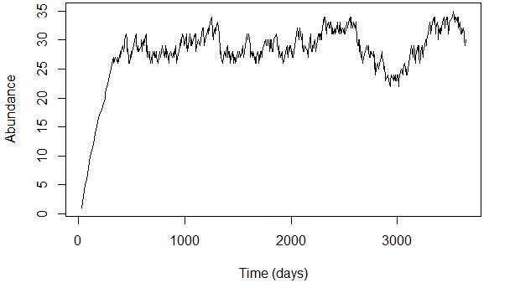

Finding Abundance
By counting the number of animals with $t_{j}≤t≤t_{j}+s_{j}$, we can determine the size of the population at time t

Slide 20
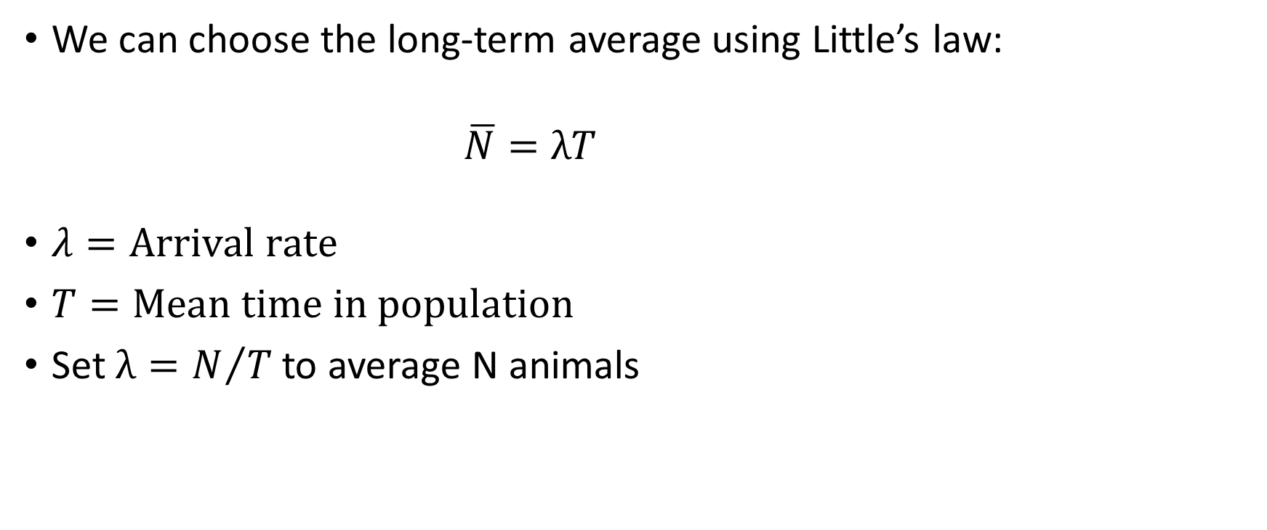
Expected Abundance
We can choose the long-term average using Little’s law:
$$\overline{N}=λT$$
$λ=\text{Arrival} \text{rate}$
$T=\text{Mean} \text{time} \text{in} \text{population}$
Set$λ=N/T$ to average N animals

Slide 21
Simulating Individual Behaviour
We now need to simulate data for each individual
The following assumptions are made:

Slide 22

Simulating Individual Behaviour
We now need to simulate data for each individual
The following assumptions are made:
The number of droppings produced in one day is a Poisson($λ$) random variable

Slide 23

Simulating Individual Behaviour
We now need to simulate data for each individual
The following assumptions are made:
The number of droppings produced in one day is a Poisson($λ$) random variable
The total number of droppings left during the stay is therefore Poisson($s_{j}λ$)

Slide 24
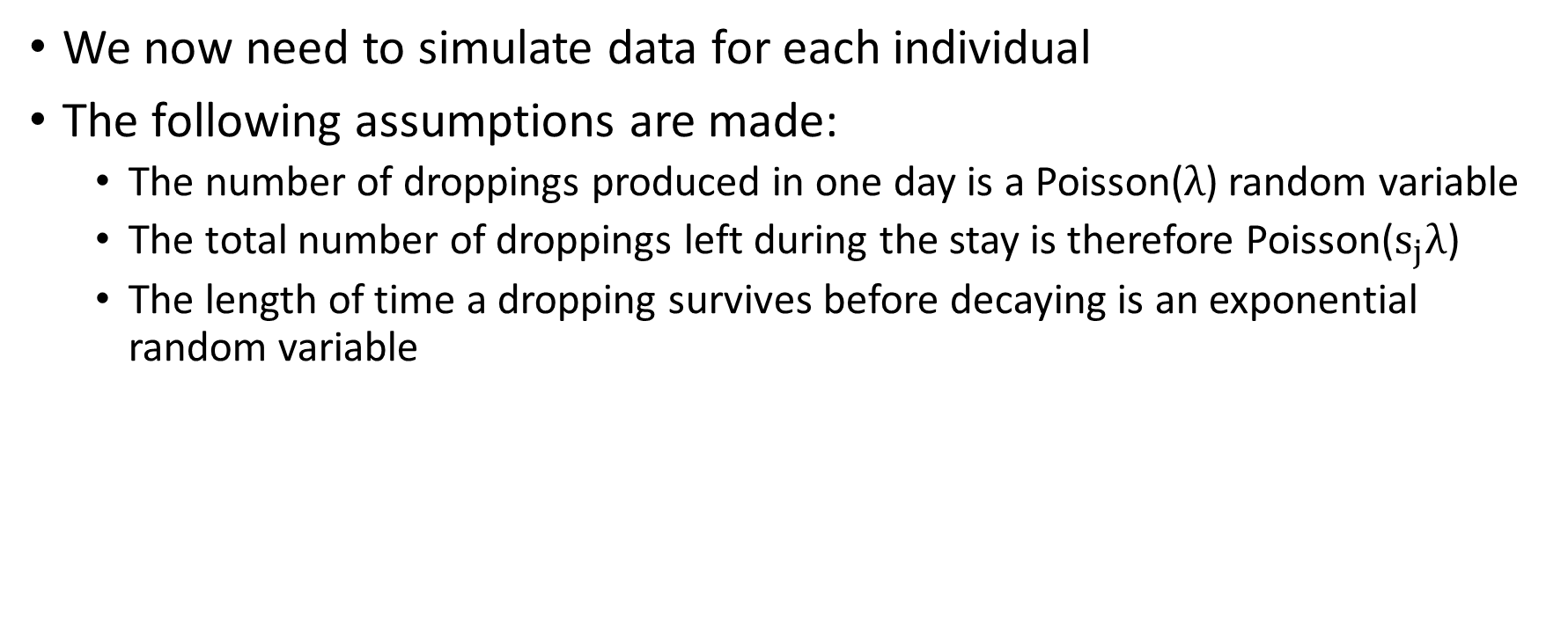
Simulating Individual Behaviour
We now need to simulate data for each individual
The following assumptions are made:
The number of droppings produced in one day is a Poisson($λ$) random variable
The total number of droppings left during the stay is therefore Poisson($s_{j}λ$)
The length of time a dropping survives before decaying is an exponential random variable

Slide 25
Present vs Detectable
j=1
Time
t₁
t₁ + s₁
Present
Still detectable

Slide 26
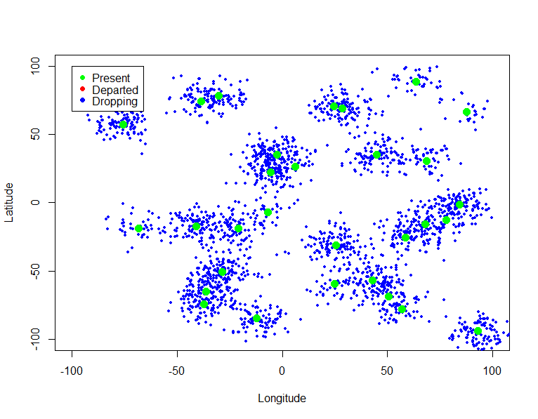
Spatial Information – Animals Present

Slide 27
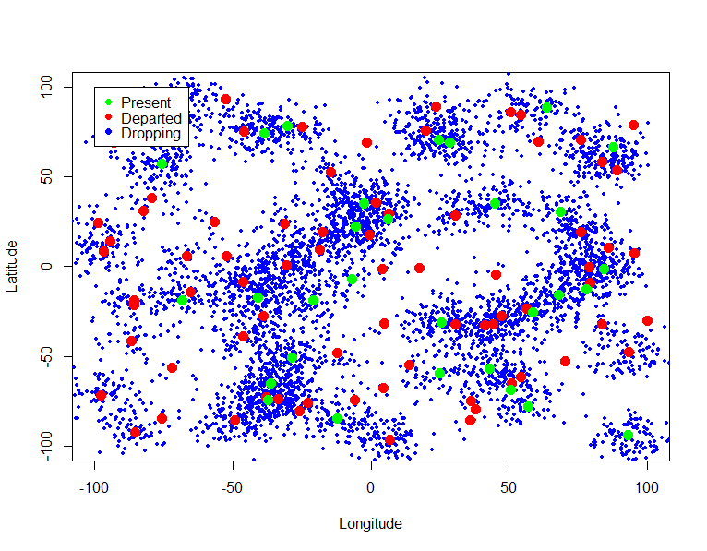
Spatial Information – Animals Detectable

Slide 28

Detectable vs Present
After simulating a population, we can count the number of animals present at $t_{max}$
Then count how many have at least one dropping present at $t_{max}$
Repeat this many times over for different $\overline{N}$

Slide 29
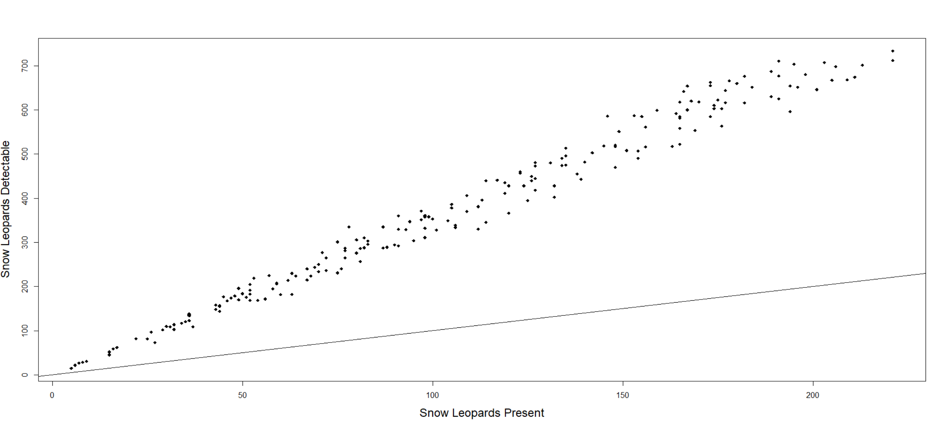
Detectable vs Present

Slide 30
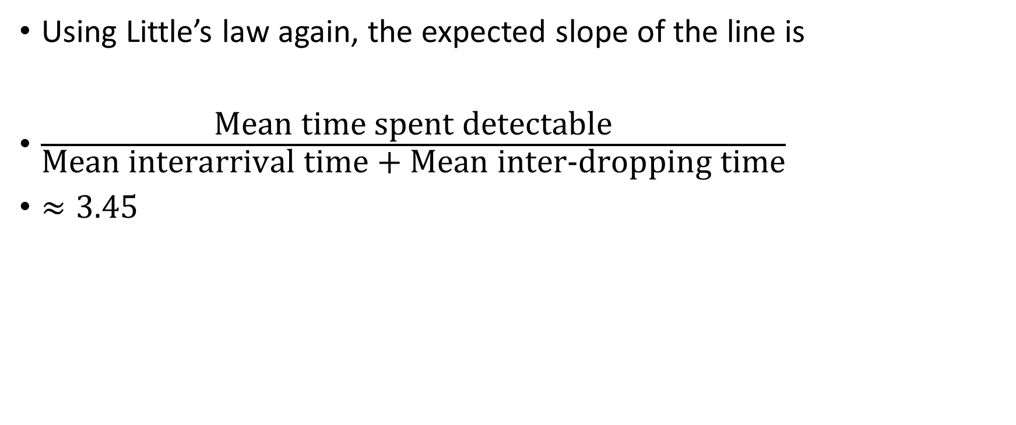
Detectable vs Present
Using Little’s law again, the expected slope of the line is
$\frac{\text{Mean} \text{time} \text{spent} \text{detectable}}{\text{Mean} \text{interarrival} \text{time}\text{ + }\text{Mean} \text{inter}\text{−}\text{dropping} \text{time}}$
$≈3.45$

Slide 31
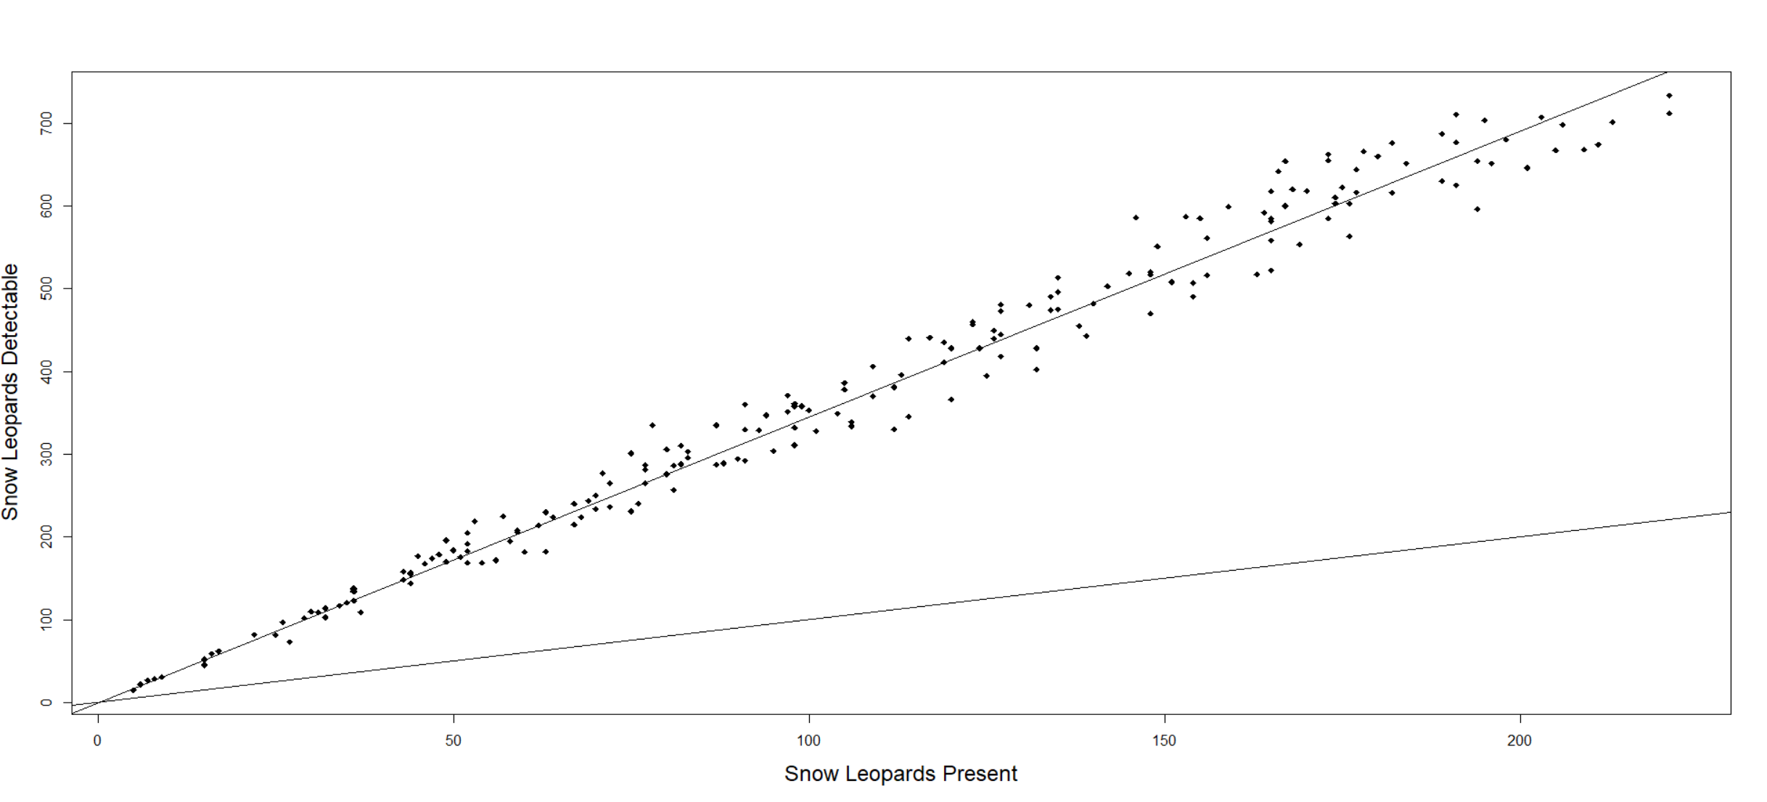
Detectable vs Present

