Slide 1
The Many Types of AI
And the Obstacle of Generality
Thomas Nield JavaMug 3/13/2019

Slide 2
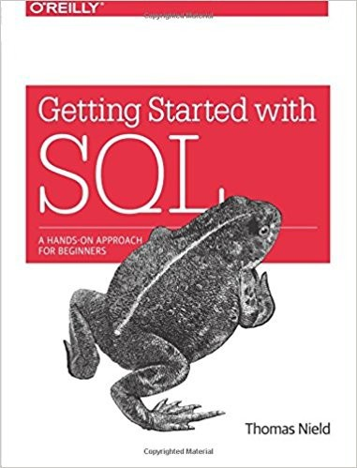
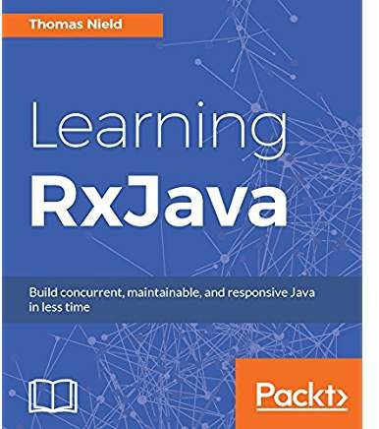
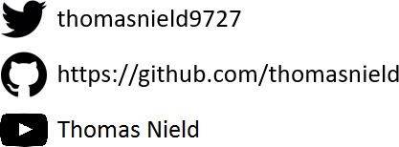
Thomas Nield
Business Consultant at Southwest Airlines
Author
Getting Started with SQL by O'Reilly
Learning RxJava by Packt
Trainer and content developer at O’Reilly Media OSS Maintainer/Collaborator
RxKotlin
Kotlin-Statistics
TornadoFX RxKotlinFX
RxJavaFX RxPy
2

Slide 3

Agenda
Anecdote – Monty Hall Problem
Why Learn Mathematical Modeling Live Examples
Discrete Optimization
Machine Learning
2

Slide 4

The Monty Hall Problem

Slide 5







The Monty Hall Problem
DOOR 1
DOOR 2
DOOR 3
Choose a door, one has a prize. Two others have goats.
5

Slide 6


The Monty Hall Problem
DOOR 1
DOOR 2
DOOR 3
You choose Door 1.
What is the probability it has the prize?
5

Slide 7


The Monty Hall Problem
DOOR 1
33.33%
DOOR 2
33.33%
DOOR 3
33.33%
You choose Door 1.
What is the probability it has the prize? 33%
5

Slide 8

The Monty Hall Problem
DOOR 1
DOOR 2
Twist! Door 3 was just opened. It’s a goat.
Did you want to switch from Door 1 to Door 2?
5

Slide 9
The Monty Hall Problem
DOOR 1
?%
DOOR 2
?%
What is the prize probability of each door now?
5

Slide 10

The Monty Hall Problem
DOOR 1
?%
DOOR 2
?%
HINT: The prize probability of either door is not 50%

Slide 11


The Monty Hall Problem
DOOR 1
33.33%
DOOR 2
66.66%
The probability of Door 1 is 33.33% while Door 2 is now 66.66%. You should switch! But why?

Slide 12
The Monty Hall Problem
33.33%
66.66%
33.33%

Slide 13
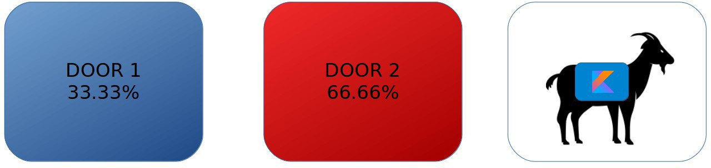

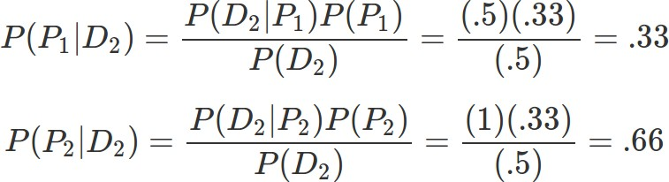
The Monty Hall Problem
According to Bayes Theorem...

Slide 14
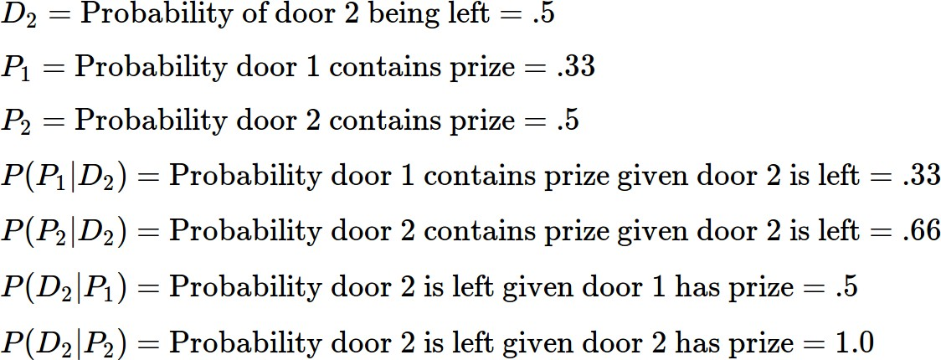
The Monty Hall Problem

Slide 16
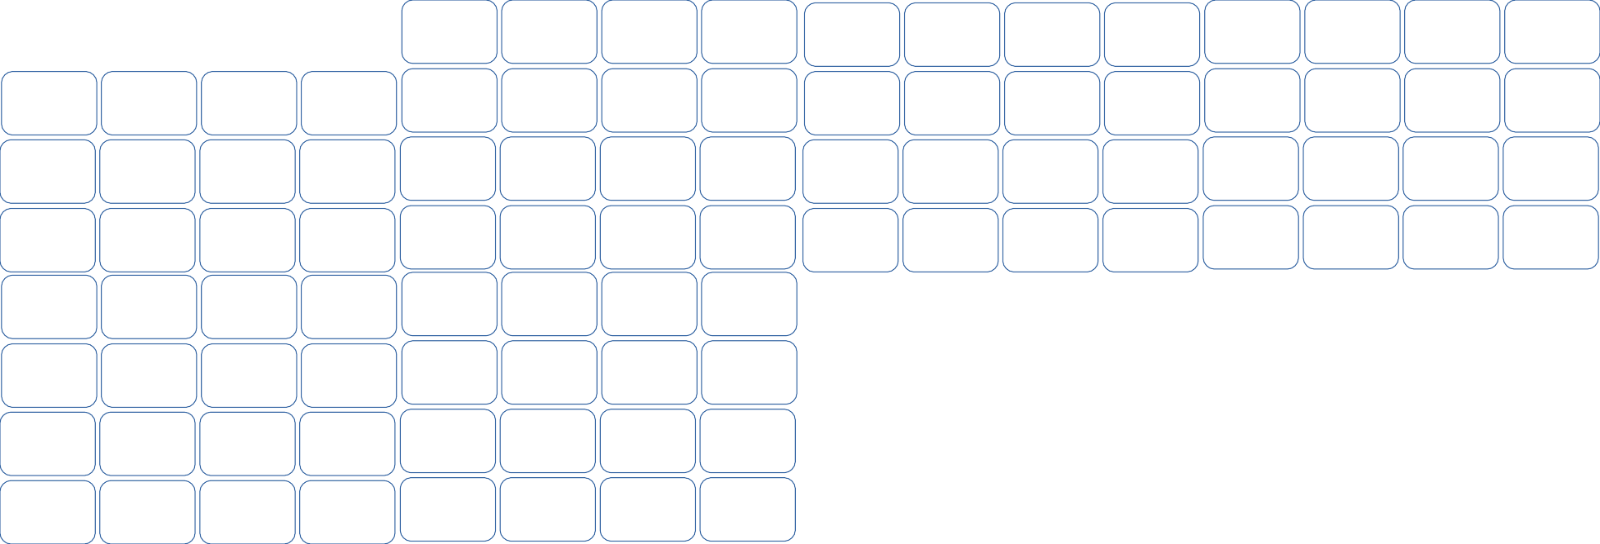

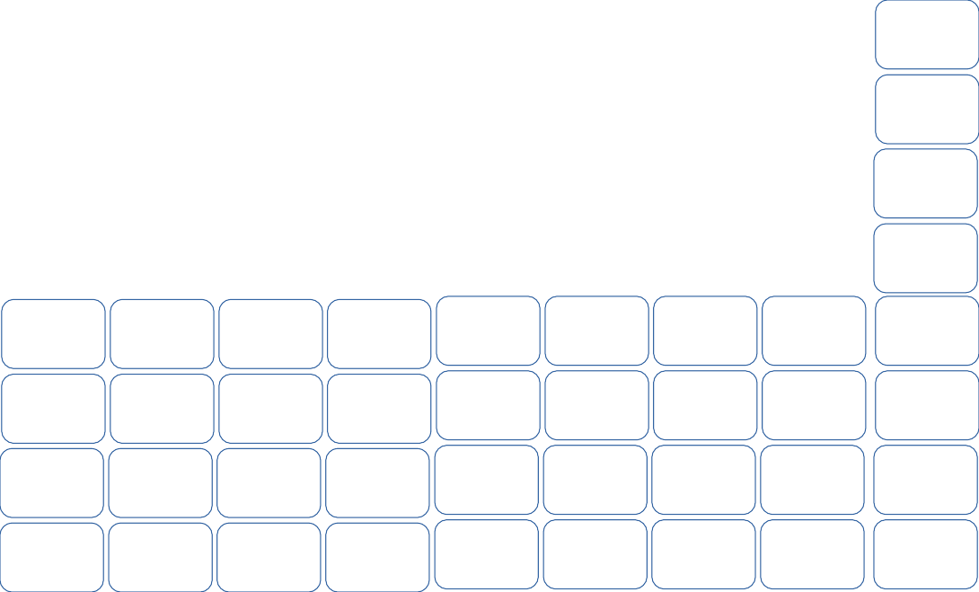



The Monty Hall Problem
All other doors are opened but yours and Door #77. Inclined to switch now?
19
77

Slide 17


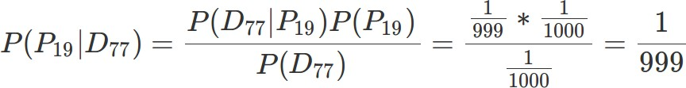
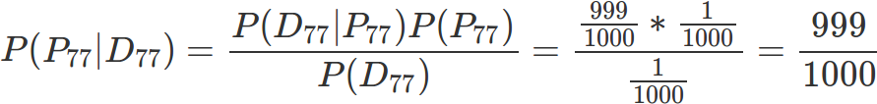


The Monty Hall Problem
#19
#77
Yes, you should switch!

Slide 18
Monty Hall Simulation in Kotlin
Monte Carlo simulation of the Monty Hall Problem https://gist.github.com/thomasnield/7fe76d27a57afbea49939dc1879c9883

Slide 19
Why Am I Showing This?
The Monty Hall problem encapsulates the critical (and misunderstood) nuances of probability.
Sometimes we only have incomplete data, but we need to make a decision anyway.
When new partial data is available, we must merge (not abandon) the data we previously had.
As programmers, we thrive in certainty and exactness.
But the valuable, high-profile problems today often tackle uncertainty and approximation.
Users and businesses expect “smarter” applications that will predict what they want. Machine learning and optimization is nondeterministic and unavoidably has error.
Many search spaces are too large to exhaustively explore.

Slide 20

Part I:
Why Learn Mathematical Modeling?

Slide 21
What is Mathematical Modeling?
Mathematical modeling is a broad discipline that attempts to solve real-world problems using mathematical concepts.
Applications range broadly, from biology and medicine to engineering, business, and economics.
Mathematical Modeling is used heavily in optimization, machine learning, and data science.
There is no “general artificial intelligence”, but rather the right technique for the right type of problem.
Real-World Examples
Product recommendations | Staff/resource scheduling | Airline network optimizer
Dynamic pricing | Inventory forecaster | DNA sequencing
Sport event planning | Kidney exchanges | Disaster Management

Slide 22
Why Learn Mathematical Modeling?
Technologies, frameworks, and languages come and go… but math never changes.
Classic mathematical techniques have survived decades (even centuries) and are not prone to obsolescence and deprecation.
Knowing mathematical modeling will greatly improve your professional marketability for decades to come, without constant investment in learning new technologies.
Math does not get deprecated.

Slide 23






Mathematical Modeling Part I: Discrete Optimization

Slide 24
What Is Discrete Optimization?
Discrete optimization is a space of algorithms that tries to find a feasible or optimal solution to a constrained problem.
Scheduling classrooms, staff, transportation, sports teams, and manufacturing Finding an optimal route for vehicles to visit multiple destinations
Optimizing manufacturing operations
Solving a Sudoku
Discrete optimization is a mixed bag of algorithms and techniques, which can be built from scratch or with the assistance of a library.

Slide 25







Traveling Salesman Problem
The Traveling Salesman Problem (TSP) is one of the most elusive and studied computer science problems since the 1950’s.
Objective: Find the shortest round-trip tour across several geographic points/cities.
The Challenge: Just 60 cities = 8.3 x 10⁸¹ possible tours
That’s more tour combinations than there are observable atoms in the universe!

Slide 26
Tour Distance
Tour Configurations

Slide 27
LOCAL MINIMUM
Tour Distance
GLOBAL MINIMUM
Tour Configurations

Slide 28
Tour Distance
Tour Configurations

Slide 29
Tour Distance
Tour Configurations

Slide 30
Tour Distance
Greedy algorithm gets stuck
Tour Configurations

Slide 31
Tour Distance
We really want to be here
Tour Configurations

Slide 32
Tour Distance
Or even here
Tour Configurations

Slide 33
Tour Distance
How do we escape?
Tour Configurations

Slide 34
Tour Distance
Make me slightly less greedy!
Tour Configurations

Slide 35
Tour Distance
Occasionally allow a marginally inferior move...
Tour Configurations

Slide 36
Tour Distance
To find superior solutions!
Tour Configurations

Slide 37
Tour Distance
To find superior solutions!
Tour Configurations

Slide 38
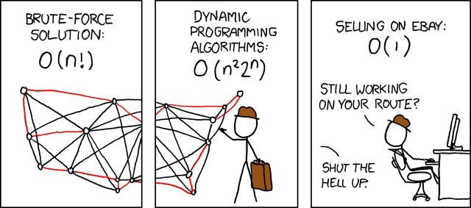
Source Code
Traveling Salesman Demo https://github.com/thomasnield/traveling_salesman_demo
Traveling Salesman Plotter https://github.com/thomasnield/traveling_salesman_plotter
SOURCE: xkcd.com

Slide 39
Generating a Schedule
You need to generate a schedule for a single classroom with the following classes:
Psych 101 (1 hour, 2 sessions/week)
English 101 (1.5 hours, 2 sessions/week)
Math 300 (1.5 hours, 2 sessions/week)
Psych 300 (3 hours, 1 session/week)
Calculus I (2 hours, 2 sessions/week) Linear Algebra I (2 hours, 3 sessions/week) Sociology 101 (1 hour, 2 sessions/week)
Biology 101 (1 hour, 2 sessions/week)
Supply Chain 300 (2.5 hours, 2 sessions/week)
Orientation 101 (1 hour, 1 session/week)
Available scheduling times are Monday through Friday, 8:00AM-11:30AM, 1:00PM-5:00PM Slots are scheduled in 15 minute increments.

Slide 40
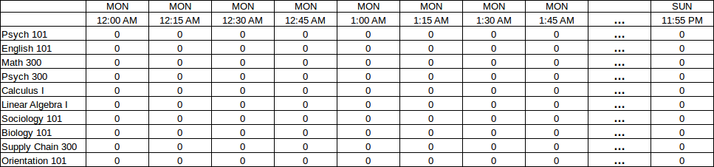
Generating a Schedule
Visualize a grid of each 15-minute increment from Monday through Sunday, intersected with each possible class.
Each cell will be a 1 or 0 indicating whether that’s the start of the first class.

Slide 41
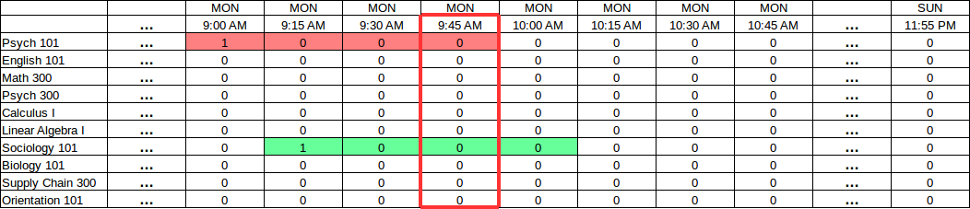
Generating a Schedule
Next visualize how overlaps will occur.
Notice how a 9:00AM Psych 101 class will clash with a 9:15AM Sociology 101.
We can sum all blocks that affect the 9:45AM block and ensure they don’t exceed 1.
Sum of affecting slots = 2 FAIL, sum must be <=1

Slide 42
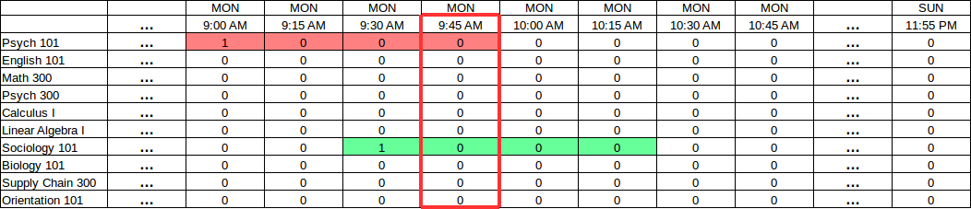
Generating a Schedule
Next visualize how overlaps will occur.
Notice how a 9:00AM Psych 101 class will clash with a 9:30AM Sociology 101.
We can sum all blocks that affect the 9:45AM block and ensure they don’t exceed 1.
Sum of affecting slots = 2 FAIL, sum must be <=1

Slide 43
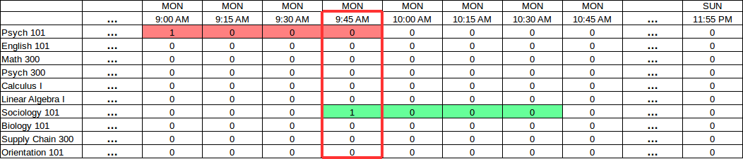
Generating a Schedule
Next visualize how overlaps will occur.
Notice how a 9:00AM Psych 101 class will clash with a 9:45AM Sociology 101.
We can sum all blocks that affect the 9:45AM block and ensure they don’t exceed 1.
Sum of affecting slots = 2 FAIL, sum must be <=1

Slide 44
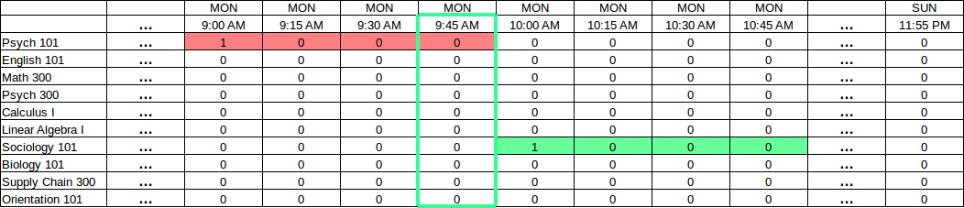
Generating a Schedule
If the “sum” of all slots affecting a given block are no more than 1, then we have no conflicts!
Sum of affecting slots = 1 SUCCESS!

Slide 45
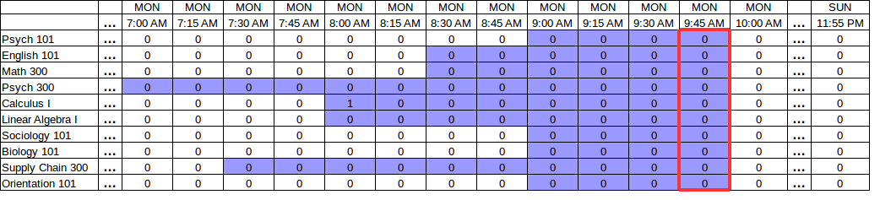
Generating a Schedule
For every “block”, we must sum all affecting slots (shaded below) which can be identified from the class durations.
This sum must be no more than 1.

Slide 46
Generating a Schedule
Taking this concept even further, we can account for all recurrences.
The “affected slots” for a given block can query for all recurrences for each given class.
View image here.

Slide 47
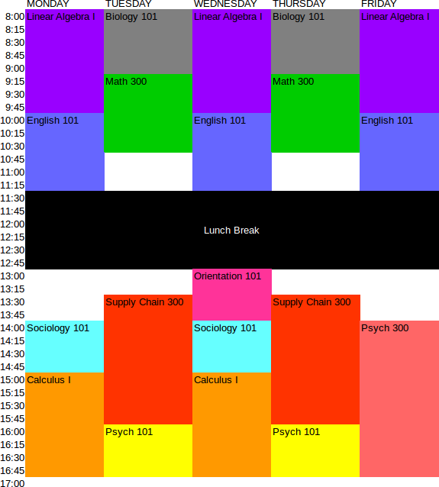
Generating a Schedule
Plug these variables and feasible constraints into the optimizer or a tree search algorithm (which I’ll show next), and you will get a solution.
Most of the work will be finding the affecting slots for each block.

Slide 48
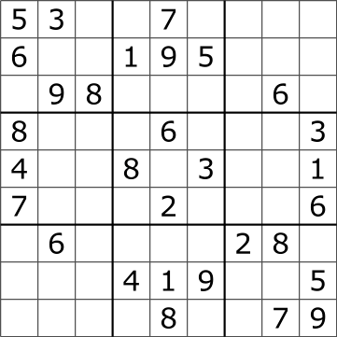
Hold that Thought,
Let’s Talk About State Space Search
Imagine you are presented a Sudoku.
Rather than do an exhaustive brute-force search, think in terms of constraint programming to reduce the search space.
First, sort the cells by the count of possible values they have left:

Slide 49
Solving a Sudoku
[4,4] → 5
[2,6] → 7
[7,7] → 3
[8,6] → 4
[1,4] → 2, 5
[0,7] → 2, 3
[3,2] → 2, 3
[4,2] → 3, 4
[5,2] → 2, 4
[3,5] → 5, 9
[5,5] → 1, 4
[4,6] → 3, 5
[5,8] → 2, 6
[6,7] → 3, 6
[0,2] → 1, 2, 3
[1,3] → 1, 2, 5
…
[2,6] → 1,3,4,5,7,9
0 1 2 3 4 5 6 7 8
0
1
2
3
4
5
6
7
8
Put cells in a list sorted by possible candidate count

Slide 50
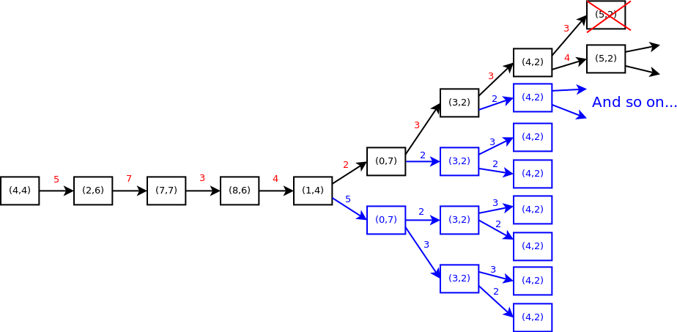
Solving a Sudoku
[4,4] → 5
[2,6] → 7
[7,7] → 3
[8,6] → 4
[1,4] → 2, 5
[0,7] → 2, 3
[3,2] → 2, 3
[4,2] → 3, 4
[5,2] → 2, 4
[3,5] → 5, 9
[5,5] → 1, 4
[4,6] → 3, 5
[5,8] → 2, 6
[6,7] → 3, 6
[0,2] → 1, 2, 3
[1,3] → 1, 2, 5
…
[2,6] → 1,3,4,5,7,9
With this sorted list, create a decision tree that explores each Sudoku cell and its possible values.
This state space search technique is called branch-and-prune.

Slide 51
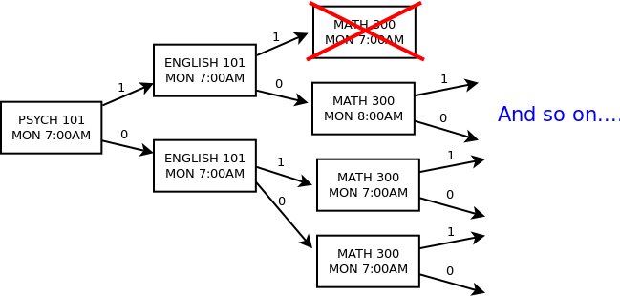
Branch-and-Prune for Scheduling
You could solve the scheduling problem from scratch with branch-and-prune.
Start with the most “constrained” slots first to narrow your search space (e.g. slots fixed to zero first, followed by Monday slots for 3-recurrence classes).
HINT: Proactively prune the tree as you go, eliminating any slots ahead that must be zero due to a “1” decision propagating an occupied state.

Slide 52
Generating a Schedule
If you want to schedule against multiple rooms, plot each variable using three dimensions.
MON 8:00
MON 8:15
MON 8:30
MON 8:45
MON 9:00
MON 9:15
MON 9:30
MON 9:45
PSYCH 300
1
0
0
0
MATH 300
PSYCH 101
1
0
0
0
ROOM 1
1
0
0
0
ROOM 2
1
0
0
0
ROOM 3

Slide 53
Continuous Labor Shifts
You have three drivers who charge the following rates:
Driver 1: $10 / hr Driver 2: $12 / hr Driver 3: $15 / hr
From 6:00 to 22:00, schedule one driver at a time to provide coverage, and minimize cost.
Each driver must work 4-6 hours a day. Driver 2 cannot work after 11:00.

Slide 54
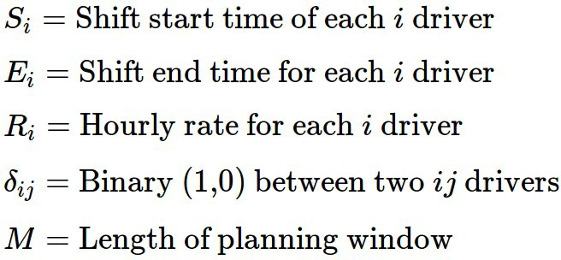
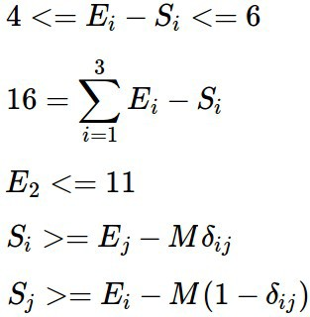
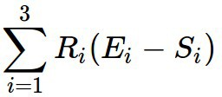
Stay Calm
Variables and Constants
Constraints
Minimize

Slide 55
Source Code
Continuous Scheduling Example
https://github.com/thomasnield/continuous-optimization-example

Slide 56
Discrete Optimization Summary
Discrete Optimization is a best-kept secret well-known in operations research.
Machine learning itself is an optimization problem, finding the right values for variables to minimize an error function.
Many folks misguidedly think of neural networks and other machine learning when discrete optimization would be more appropriate.
Recommended Java Libraries:
OjAlgo! OptaPlanner

Slide 57
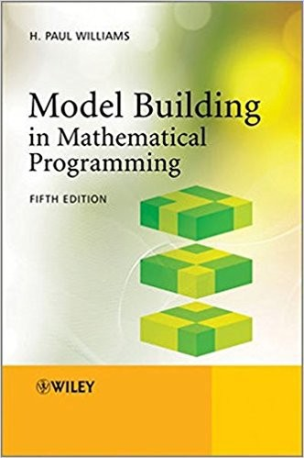
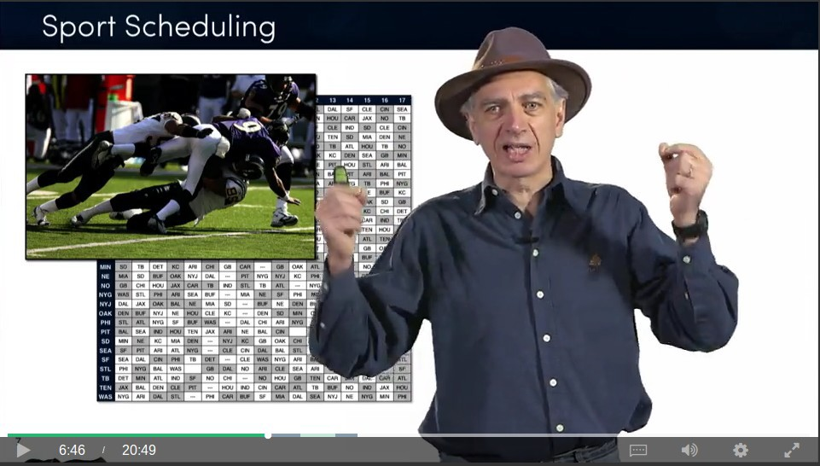
Learn More About Discrete Optimization
Discrete Optimization

Slide 58
Fun with Random Numbers
You may be familiar with random number generators
When any number is equally likely to be generated, this is known as a Uniform
distribution
But what if we wanted some numbers to be generated more likely than others?
This can be a powerful tool and can be used to, for instance, fit a line to points. It can also be used to create simulations.

Slide 59
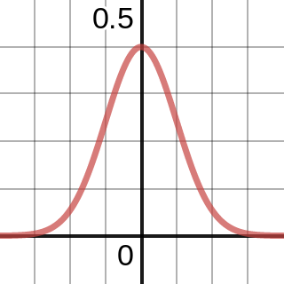
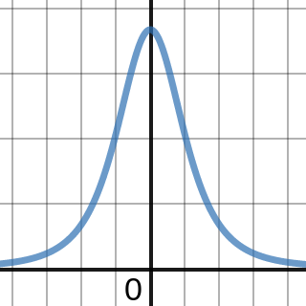
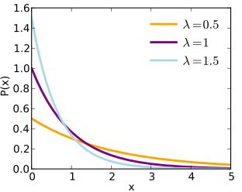
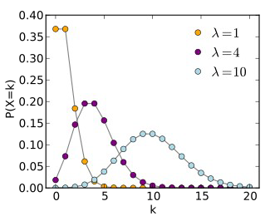
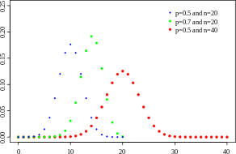
Some Useful Distributions
Normal
T-Distribution
Exponential
Poisson
Binomial
Learn More:
https://www.coursera.org/learn/introductiontoprobability

Slide 60
Mathematical Modeling Part II: Classification w/ Naive Bayes

Slide 61
Classifying Things
Probably the most common task in machine learning is classifying data:
How do I identify images of dogs vs cats? What words are being said in a piece of audio? Is this email spam or not spam?
What attributes define high-risk, medium-risk, and low-risk loan applicants?
How do I predict if a shipment will be late, early, or on-time?
There are many techniques to classify data, with pros/cons depending on the task:
Neural Networks Support Vector Machines
Decision Trees/Random Forests Naive Bayes
Linear/Non-linear regression

Slide 62
Naive Bayes
Let’s focus on Naive Bayes because it is simple to implement and effective for a common task: text categorization.
Naive Bayes is an adaptation of Bayes Theorem that can predict a category C for an item T with multiple features F.
A common usage example of Naive Bayes is email spam, where each word is a feature and spam/not spam are the possible categories.

Slide 63
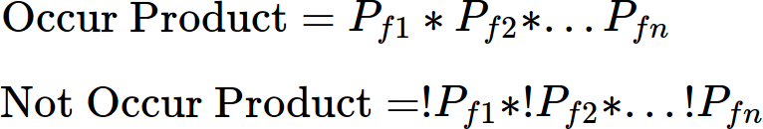
Implementing Naive Bayes
Naive Bayes works by mapping probabilities of each individual feature occurring/not occurring for a given category (e.g. a word occurring in spam/not spam).
A category can be predicted for a new set of features by…
1) For a given category, combine the probabilities of each feature occuring and not occuring by multiplying them.
2) Divide the products to get the probability for that category.

Slide 64
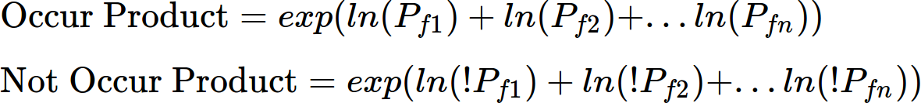
Implementing Naive Bayes
3) Calculate this for every category, and select the one with highest probability.
Dealing with floating point underflow.
A big problem is multiplying small decimals for a large number of features may cause a floating point underflow.
To remedy this, transform each probability with log() or ln() and sum them, then call exp() to convert the result back!

Slide 65
Implementing Naive Bayes
One last consideration, never let a feature have a 0 probability for any category!
Always leave a little possibility it could belong to any category so you don’t have 0
multiplication or division mess anything up.
This can be done by adding a small value to each probability’s numerator and denominator (e.g. 0.5 and 1.0).

Slide 66
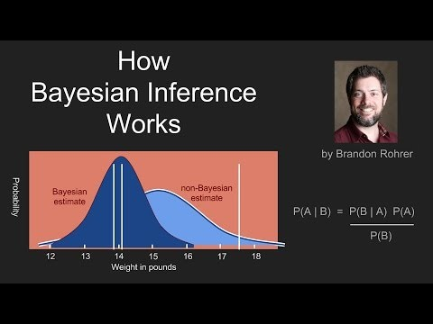

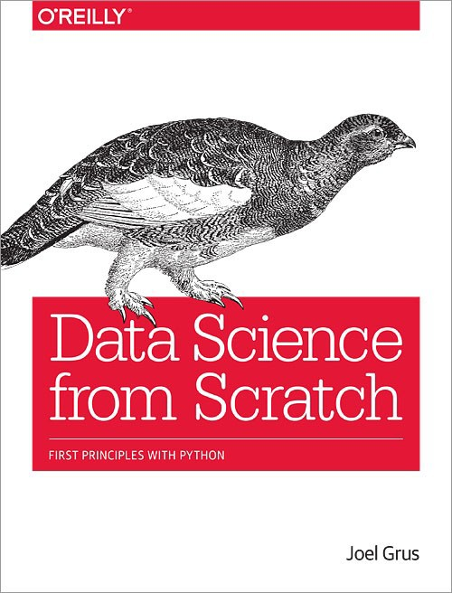
Learn More About Bayes
Brandon Rohrer - YouTube

Slide 67
Source Code
Bank Transaction Categorizer Demo https://github.com/thomasnield/bayes_user_input_prediction
Email Spam Classifier Demo https://github.com/thomasnield/bayes_email_spam

Slide 68








Part III:
Neural Networks

Slide 69







What Are Neural Networks?
Neural Networks are a machine learning tool that takes numeric inputs and predicts numeric outputs.
A series of multiplication, addition, and nonlinear functions are applied to the numeric inputs.
The mathematical operations above are iteratively tweaked until the desired output is met.

Slide 70
The Problem
Suppose we wanted to take a background color (in RGB values) and predict a light/dark font for it.
Hello
Hello
If you search around Stack Overflow, there is a nice formula to do this:
But what if we do not know the formula? Or one hasn’t been discovered?

Slide 71
A Simple Neural Network
Let’s represent background color as 3 numeric RGB inputs, and predict whether a DARK/LIGHT font should be used.
255
0
Hello
204
Mystery Math
1
Hello
204

Slide 72
A Simple Neural Network
255w₁+
204w₂+
204w₃
255
W₁
W₄
W
W
10
Multiply and sum again
2
Hello
W₃
255w₄+
204w₅+
204w₆
^{W}11
204
W₅
W
W
^{W}14
12
13
Multiply and sum again
Hello
W_{6 W}
7
W
8
255w +
W
7
204w₈+
204w₉
^{W}15
204
9

Slide 73
A Simple Neural Network
This is the “mystery math”
255w₁+
204w₂+
204w₃
255
W₁
W₄
W
W
10
Multiply and sum again
2
Hello
W₃
255w₄+
204w₅+
204w₆
^{W}11
204
W₅
W
W
^{W}14
12
13
Multiply and sum again
Hello
W_{6 W}
7
W
8
255w +
W
7
204w₈+
204w₉
^{W}15
204
9

Slide 74
A Simple Neural Network
Each weight w_{x} value is between -1.0 and 1.0
255w₁+
204w₂+
204w₃
255
W₁
W₄
W
W
10
Multiply and sum again
2
Hello
W₃
255w₄+
204w₅+
204w₆
^{W}11
204
W₅
W
W
^{W}14
12
13
Multiply and sum again
Hello
W_{6 W}
7
W
8
255w +
W
7
204w₈+
204w₉
^{W}15
204
9

Slide 75
A Simple Neural Network
Million Dollar Question:
What are the optimal weight values to get the desired output?
255w₁+
204w₂+
204w₃
255
W₁
W₄
W
W
10
2
1.0
Hello
W₃
255w₄+
204w₅+
204w₆
^{W}11
204
W₅
W₇
W
^{W}14
12
13
W
0.0
Hello
W_{6 W}
8
255w +
W
7
204w₈+
204w₉
^{W}15
204
9

Slide 76
A Simple Neural Network
Million Dollar Question:
What are the optimal weight values to get the desired output?
255w₁+
204w₂+
204w₃
255
W₁
W₄
W
W
10
2
1.0
Hello
W₃
255w₄+
204w₅+
204w₆
^{W}11
204
W₅
W₇
W
^{W}14
12
13
W
0.0
Hello
W_{6 W}
8
255w +
W
7
204w₈+
204w₉
^{W}15
204
9

Slide 77
A Simple Neural Network
Answer:
This is an optimization problem!
255w₁+
204w₂+
204w₃
255
W₁
W₄
W
W
10
2
.998
Hello
W₃
255w₄+
204w₅+
204w₆
^{W}11
204
W₅
W₇
W
^{W}14
12
13
W
.01
Hello
W_{6 W}
8
255w +
W
7
204w₈+
204w₉
^{W}15
204
9

Slide 78
A Simple Neural Network
We need to solve for the weight values that gets our training colors as close to their desired outputs as possible.
255w₁+
204w₂+
204w₃
255
W₁
W₄
W
W
10
2
.998
Hello
W₃
255w₄+
204w₅+
204w₆
^{W}11
204
W₅
W₇
W
^{W}14
12
13
W
.01
Hello
W_{6 W}
8
255w +
W
7
204w₈+
204w₉
^{W}15
204
9

Slide 79
Just like the Traveling Salesman Problem, you need to explore configurations seeking an acceptable local minimum.
Error Function
Weight Configurations

Slide 80
Stochastic gradient descent, simulated annealing, and
other optimization techniques can help tune a neural network.
Error Function
Weight Configurations

Slide 81
Activation Functions
RELU
SOFTMAX
You might also consider using activation functions on each layer.
255w₁+
204w₂+
204w₃
255w₄+
204w₅+
204w₆
255w₇+
204w₈+
204w₉
Multiply and sum again
Multiply and sum again
255
These are nonlinear functions that smooth, scale, or compress
the resulting sum values.
204
These make the network operate more naturally and smoothly.
204

Slide 82
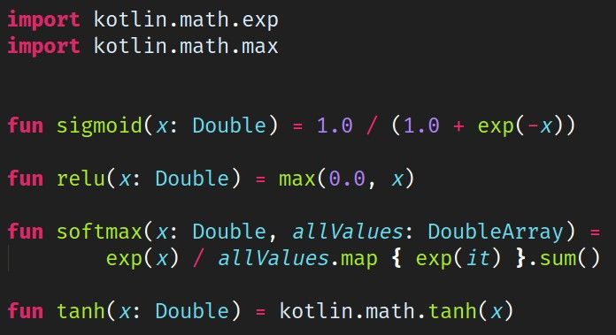
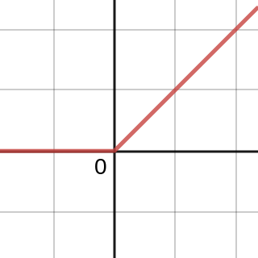
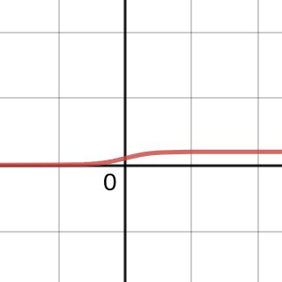
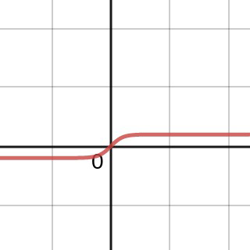
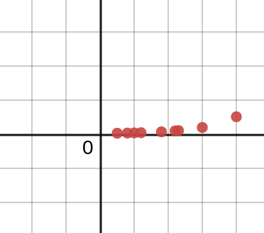
Activation Functions
Four common neural network activation functions implemented using kotlin-stdlib
RELU
SIGMOID
TANH
SOFTMAX
https://www.desmos.com/calculator/jwjn5rwfy6

Slide 83
Other Design Decisions
While optimizing weights is a core part of neural networks, there are other components to consider too:
How many middle layers are needed?
How many nodes are needed in each layer?
What activation functions should be applied to each layer?
Middle Layers - Should the layers be recurrent, recursive, convolutional, etc?
Loss function – How should we measure error?
Learning Rate - How aggressively should the optimization move towards the local minimum?

Slide 84
The Practicality of Neural Networks
Despite some seemingly intelligent applications like image recognition, neural networks have drawbacks:
Requires LOTS of labeled data for training.
Difficult for the data scientist to understand convoluted layers and nodes.
Has a quick diminishing return for problem spaces outside of image and natural language processing.
Neural networks generate excitement because many believe they will generalize solutions to most problems one day.
In reality, specialized and incumbent algorithms will outperform neural networks for most practical problems.
There are many academic papers citing research applying neural networks to the Traveling Salesman Problem and while this is interesting, the results are underwhelming.

Slide 85
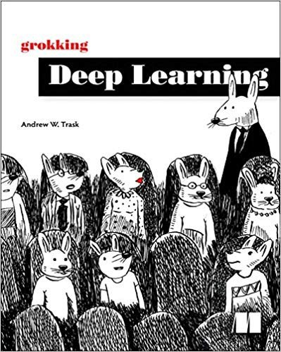
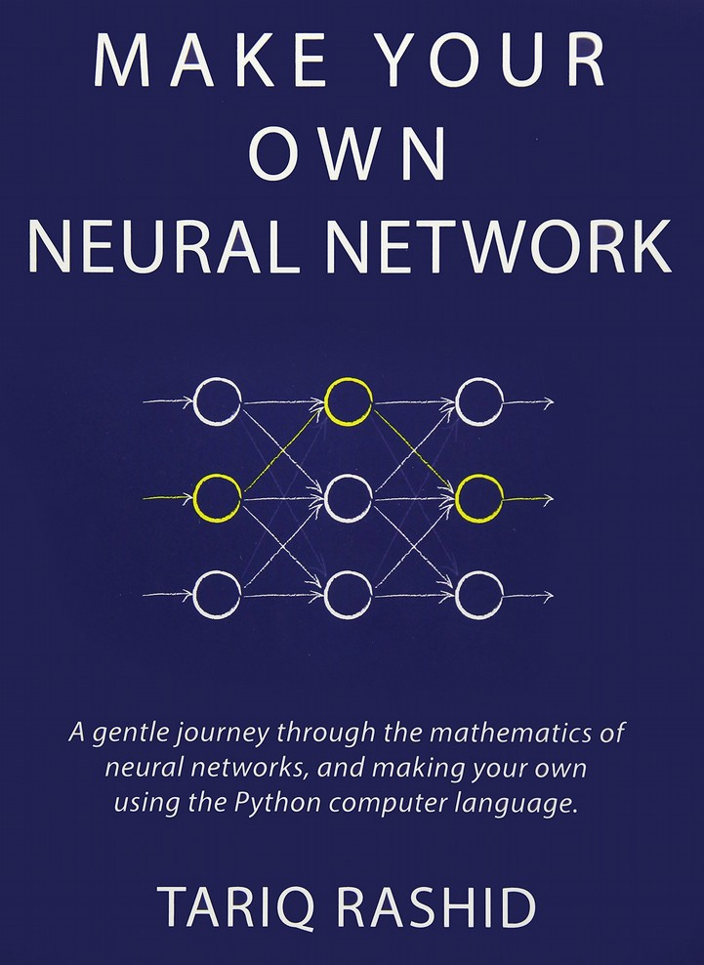

Learn More About Neural Networks
3Blue1Brown - YouTube

Slide 86
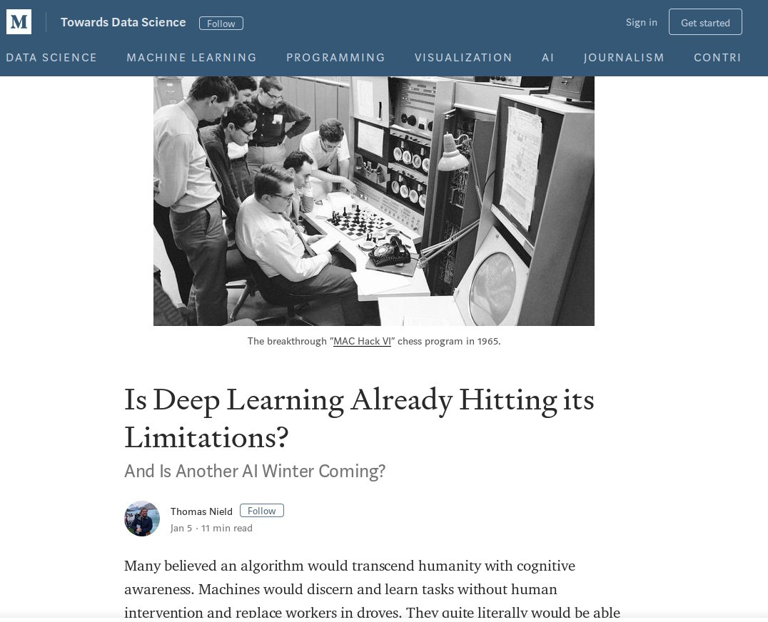
Also Read My Recent Blog Article

Slide 87
Source Code
Kotlin Neural Network Example https://github.com/thomasnield/kotlin_simple_neural_network

Slide 88
Going Forward

Slide 89
The Obstacle of Generality
Generalized terms like “AI” are helpful to spur positive change and embrace new mindsets.
However such terms do not help with solution planning and execution, and can even create red herrings and frustration.
Silicon Valley may have categorically different problems from your industry.
Only a handful of problem spaces (e.g. image and language processing) are optimally solved with “deep learning” and “neural networks.”
Unsupervised learning is very much in infancy, and therefore general AI is nowhere in sight.

Slide 90
The Obstacle of Generality
How to avoid the “Obstacle of Generality”:
Be detailed and specific about your problem.
Find models that align to your problem’s nature.
Choose a model that provides a clear and intuitive path to a solution. Approach convoluted models with a healthy amount of skepticism.

Slide 91



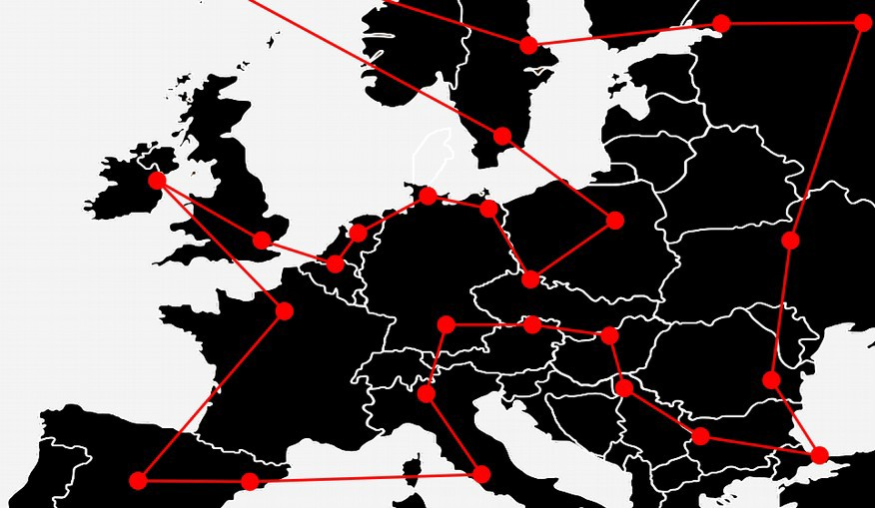
Use the Right “AI” for the Job
Neural Networks
Bayesian Inference
Discrete Optimization
●
Image/Audio/Video Recognition
“Cat” and “Dog” photo classifier
●
Text classification
Email spam, sentiment analysis, document categorization
●
Routing and Scheduling
Staff, transportation, classrooms, sports tournaments, server jobs
●
Natural language processing
●
Document summarization
●
On-Time Optimization
Transportation, manufacturing
●
Any fuzzy, difficult problems that have no clear model but lots of data Self-driving vehicles
Difficult nonlinear regressions Problems w/ mysterious unknowns
●
Probability inference Disease diagnosis, updating predictions
●
Industry
Manufacturing, farming, nutrition, energy, engineering, finance

Slide 92
GitHub and Slides
https://github.com/thomasnield/JavaMug2019_Many_Types_of_AI

Slide 93
Appendix

Slide 94
Pop Culture
Traveling Salesman (2012 Movie)
http://a.co/d/76UYvXd
Silicon Valley (HBO) – The “Not Hotdog” App
https://youtu.be/vIci3C4JkL0
Silicon Valley (HBO) – Making the “Not Hotdog” App
https://tinyurl.com/y97ajsac
XKCD – Traveling Salesman Problem
https://www.xkcd.com/399/
SOURCE: xkcd.com
XKCD – NP-Complete
https://www.xkcd.com/287/
XKCD – Machine Learning
https://xkcd.com/1838/

Slide 95
Areas to Explore
Machine Learning Linear Regression Nonlinear Regression Neural Networks
Bayes Theorem/Naive Bayes
Support Vector Machines Decision Trees/Random Forests K-means (nearest neighbor) XGBoost
Optimization
Discrete Optimization Linear/Integer/Mixed Programming Dynamic Programming
Constraint programming Metaheuristics

Slide 96
Java/Kotlin ML and Optimization Libraries
Java/Kotlin Library | Python Equivalent | Description
ND4J | NumPy | Numerical computation Java library
DeepLearing4J | TensorFlow | Deep learning Java/Scala/Kotlin library
SMILE | scikit-learn | Comprehensive machine learning suite for Java
ojAlgo and okAlgo | PuLP, NumPy | Linear algebra and optimization library for Java
Apache Commons Math | scikit-learn | Math, statistics, and ML for Java
TableSaw / Krangl | Pandas | Data frame libraries for Java/Kotlin
Kotlin-Statistics | scikit-learn | Statistical/probability operators for Kotlin
JavaFX / Vegas / Data2Viz | matplotlib | Charting libraries

Slide 97
Online Class Resources
Coursera – Discrete Optimization
https://www.coursera.org/learn/discrete-optimization/home/
Coursera – Machine Learning
https://www.coursera.org/learn/machine-learning/home/welcome

Slide 98
YouTube Channels and Videos
Thomas Nield https://youtu.be/F6RiAN1A8n0
Brandon Rohrer https://www.youtube.com/c/BrandonRohrer
3Blue1Brown https://www.youtube.com/channel/UCYO_jab_esuFRV4b17AJtAw
YouTube – P vs NP and the Computational Complexity Zoo https://youtu.be/YX40hbAHx3s
The Traveling Salesman Problem Visualization https://youtu.be/SC5CX8drAtU
The Traveling Salesman w/ 1000 Cities (Video) https://youtu.be/W-aAjd8_bUc

Slide 99
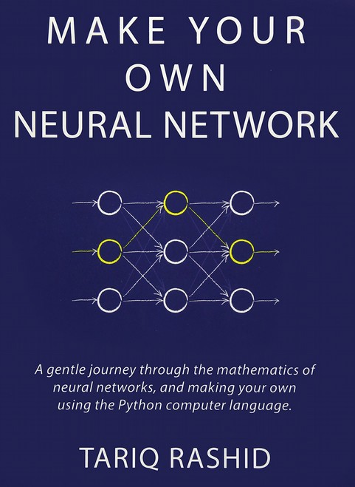
Books

Slide 100
Interesting Articles
Does A.I. Include Constraint Solvers?
https://www.optaplanner.org/blog/2017/09/07/DoesAIIncludeConstraintSolv ers.html
Can You Make Swiss Trains Even More Punctual?
https://medium.com/crowdai/can-you-make-swiss-trains-even-more-punct ual-ec9aa73d6e35
The SkyNet Salesman
https://multithreaded.stitchfix.com/blog/2016/07/21/skynet-salesman/
100

Slide 101
Interesting Articles
Essential Math for Data Science
https://towardsdatascience.com/essential-math-for-data-science-why-and-how-e 88271367fbd
The Unreasonable Reputation of Neural Networks
http://thinkingmachines.mit.edu/blog/unreasonable-reputation-neural-networks
Mario is Hard, and that’s Mathematically Official
https://www.newscientist.com/article/mg21328565.100-mario-is-hard-and-thats- mathematically-official/
100

Slide 102
Interesting Papers
The Lin-Kernighan Traveling Salesman Heuristic
http://akira.ruc.dk/~keld/research/LKH/LKH-1.3/DOC/LKH_REPORT.pdf
The Traveling Salesman: A Neural Network Perspective
http://www.iro.umontreal.ca/~dift6751/paper_potvin_nn_tsp.pdf
The Interplay of Optimization and Machine Learning Research
http://jmlr.org/papers/volume7/MLOPT-intro06a/MLOPT-intro06a.pdf
100

