Slide 1

Kotlin for Data Science
Thomas Nield
ChicagoMUG
April 17th, 2018

Slide 2

Agenda
Motivational Examples
What Is Data Science?
Challenges in the Data Science Domain
Why Kotlin for Data Science?
Mathematical Modeling
Getting Involved

Slide 3
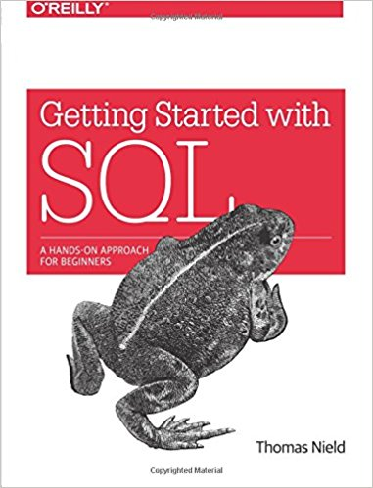
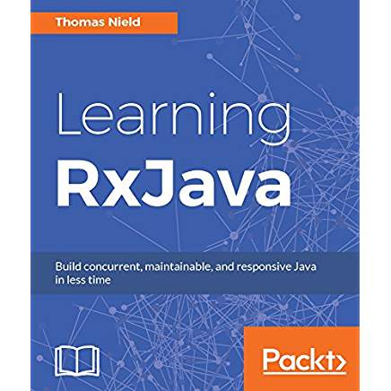
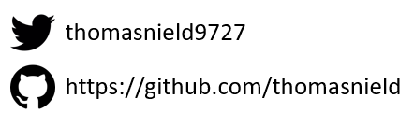
Thomas Nield
Business Consultant at Southwest Airlines
Author
Getting Started with SQL by O'Reilly
Learning RxJava by Packt
Trainer and content developer at O’Reilly Media
OSS Maintainer/Collaborator
RxKotlin TornadoFX RxJavaFX
Kotlin-Statistics RxKotlinFX RxPy

Slide 4
What Is Data Science?

Slide 5
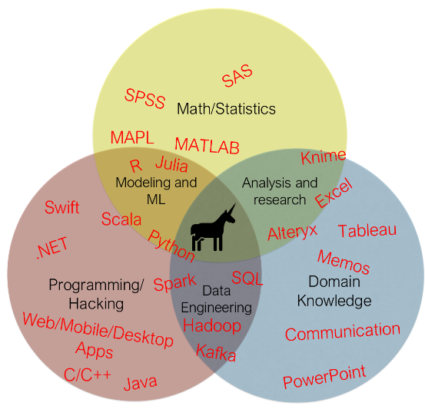
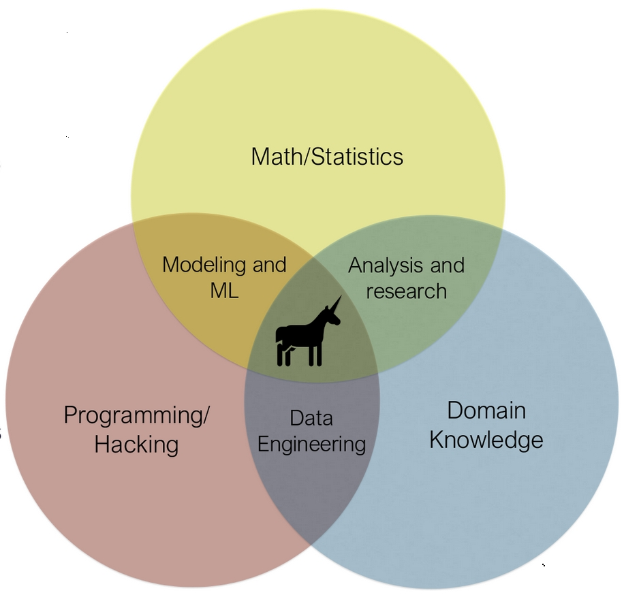
What Is Data Science?
Data Science attempts to turn data into insight.
Insight can then be used to aid business decisions or create data-driven products.
A strong data science professional has some mix of programming, math/statistics, and business domain knowledge.

Slide 6
Data Scientist Archetypes
The Statistician
  Summarizes data using classic statistical methods and probability metrics.
The Mathematician
  Likes using the words “vector”, “matrix”, and “Bayes”.
The Data Engineer
  Architect and wrangler of SQL, NoSQL, and “Big Data” pipelines, who makes data usable to rest of the team.

Slide 7
Data Scientist Archetypes
ML Engineer
  A more advanced mathematician who can juggle various machine learning algorithms.
The Programmer
  A trained software developer who likely knows Java, Scala, or Python and often creates code from scratch tailored to specific business problems.
The Bard
  The person who crafts communications about data findings to leaders and stakeholders, often telling stories with memos, charts, slides, infographics, spreadsheets, and other visual tools.

Slide 8
What is a Model?
What is a model?
  A code representation of a problem, often mathematical in nature, that provides a solution in some form.
Examples:
  A discrete optimization system that generates a train schedule maximizing the flow of passengers.
  A clustering model that groups customers based on their attributes.
  Natural language processor that parses, interprets, and links legal documents.
  Neural network that identifies or categorizes images or speech.

Slide 9
Data Science Challenges

Slide 10
A Model is Not A Product!
A current struggle in the data science domain is putting models in production
  A model is often a hacky Python or R script that simply does not plug into a large enterprise ecosystem (which is often built on Java or .NET)
  Models often use dynamically typed languages with tabular data structures and procedural code which is difficult to modularize, test, evolve, and refactor.
  A model may have never been tested in a production environment, which may have drastically different dynamics and data patterns.

Slide 11
Twitter
  There was only one problem—all of my work was done in my local machine in R. People appreciate my efforts but they don’t know how to consume my model because it was not “productionized” and the infrastructure cannot talk to my local model. Hard lesson learned!
  - Robert Chang, Data Scientist at Airbnb (formerly Twitter)

Slide 12
Stitch Fix
  Data scientists are often frustrated that engineers are slow to put their ideas into production and that work cycles, road maps, and motivations are not aligned. By the time version 1 of their ideas are put into [production], they already have versions 2 and 3 queued up. Their frustration is completely justified.
  - Jeff Magnusson, Director of Data at Stitch Fix

Slide 13
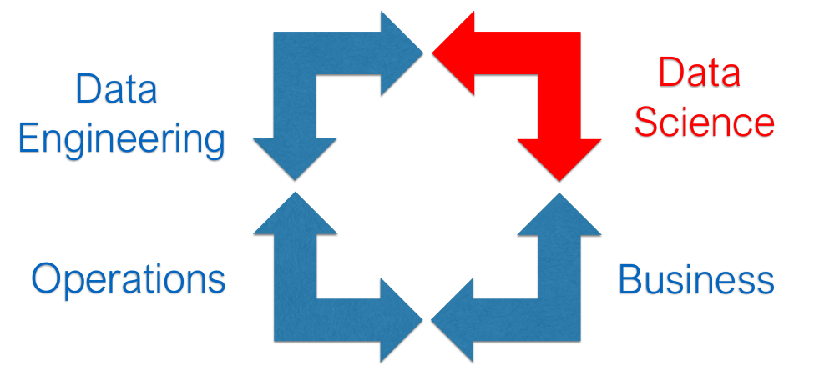
Slack
  “The infinite loop of sadness.”
  - Josh Wills, Director of Data Engineering

Slide 14
Why Kotlin for Data Science?

Slide 15
Why Not Use Java For Data Science?
Java is a robust, production-grade platform with decent data science libraries.
Software engineers often use it to “productionize” data science models.
So why hasn’t Java gotten mainstream adoption in data science?
  Verbose, hard to script quickly with.
  Boilerplate makes it hard to experiment.
  Challenging language compared to Python, R.

Slide 16
Why Not Use Scala For Data Science?
Scala has been positioned into the data science domain with moderate success, especially on the “Big Data” front (e.g. Apache Spark).
So why hasn’t Scala taken significant share from Python?
  Python is simple, Scala is complex.
  Scala’s plethora of features-- good or overwhelming?
  Numerical libraries are increasingly going back to C, not JVM.

Slide 17
What About Kotlin? - YES!
Data scientists who code often need the following:
  Rapid turnaround, quick iterative development
  Easy to learn, flexible code language
  Mathematical and machine learning libraries
Experienced software engineers often want the following:
  Static typing and object-oriented code
  Production-grade architecture and support
  Refactorability, reusability, concurrency, and scaling
  Compatibility with established systems (Java codebases)
Kotlin encompasses all the qualities above!

Slide 18
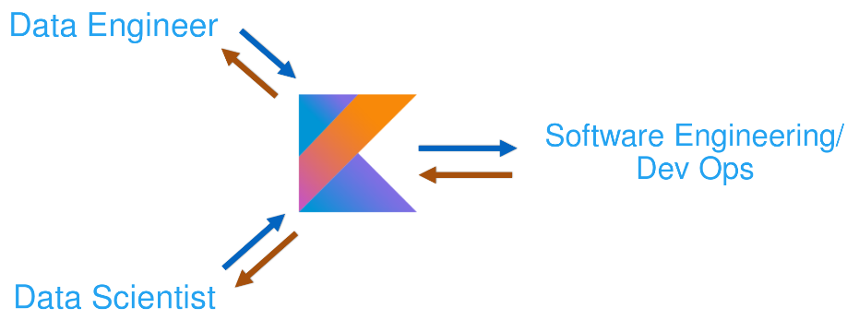
One language, one codebase, one platform

Slide 19
Strengths and Weaknesses
Strengths
  Accessible, inuitive coding language
  Minimal boilerplate, fast turnaround
  Interoperability with Java
  Pragmatic features – data classes, DSL, nullable types, robust higher order functions
Weaknesses
  Not dynamically typed – data structures have to be explicitly defined
  Numerical efficiency – boxing hurtful for computations?
  Libraries – Decent JVM data science libraries, but not like Python or R

Slide 20
Java/Kotlin Data Science Libraries
Java/Kotlin Library | Python Equivalent | Description
ND4J | NumPy | Numerical computation Java library
DeepLearing4J | TensorFlow | Deep learning Java library
SMILE | scikit-learn | Comprehensive machine learning suite for Java
ojAlgo! | PuLP, NumPy | Linear algebra and optimization library for Java
Apache Commons Math | scikit-learn | Math, statistics, and ML for Java
TableSaw / Krangl | Pandas | Data frame libraries for Java/Kotlin
Kotlin-Statistics | scikit-learn | Statistical/probability operators for Kotlin
JavaFX / Vegas | matplotlib | Charting libraries

Slide 21
Mathematical Modeling with Kotlin

Slide 22
What is Mathematical Modeling?
Mathematical modeling is a broad discipline that attempts to solve practical problems using mathematical concepts.
  Applications range broadly, from biology and medicine to business and economics.
  Mathematical Modeling was rebranded as “Data Science” as data availability grew.
  There is no “silver bullet” artificial intelligence, but rather the right technique for the right type of problem.
Real-World Examples
  Product recommendations Staff/resource scheduling Airline network optimizer
  Dynamic pricing Sales forecaster DNA sequencing
  Sport event planning Kidney exchanges Disaster Management

Slide 23
Why Learn Mathematical Modeling?
Technologies, frameworks, and languages come and go… but math never changes.
  Classic mathematical techniques have survived decades (even centuries) and are not prone to obsolescence and deprecation.
  Knowing mathematical modeling will greatly improve your job security for decades to come, without constant investment in learning new technologies.
Work smarter, not harder
  Many challenges, like staff scheduling, are impractical to solve with brute-force programming approaches.
  Mathematical modeling allows you to gracefully find solutions to a broad category of problems.

