Slide 1















Slide 2

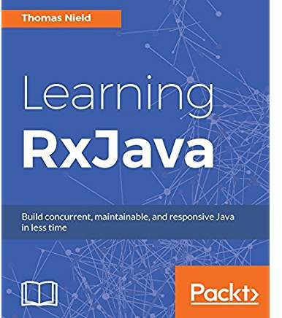
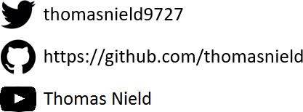
Thomas Nield
Business Consultant at Southwest Airlines Dallas, Texas
Author
Getting Started with SQL by O'Reilly
Learning RxJava by Packt
Trainer and content developer at O’Reilly Media OSS Maintainer/Collaborator
RxKotlin
Kotlin-Statistics
TornadoFX RxKotlinFX
RxJavaFX
2

Slide 3

Agenda
Why Learn Mathematical Modeling?
Discrete Optimization
Traveling Salesman
Classroom Scheduling
Solving a Sudoku
Machine Learning
Naive Bayes
Neural Networks
2

Slide 4
Part I:
Why Learn Mathematical Modeling?

Slide 5
What is Mathematical Modeling?
Mathematical modeling is a broad discipline that attempts to solve real- world problems using mathematical concepts.
Applications range broadly, from biology and medicine to engineering, business, and
economics.
Mathematical Modeling is used heavily in optimization, machine learning, and data science.
Real-World Examples
Product recommendations | Staff/resource scheduling | Text categorization
Dynamic pricing | Image/audio recognition | DNA sequencing
Sport event planning | Game “AI” (Sudoku, Chess) | Disaster Management
5

Slide 6
Why Learn Mathematical Modeling?
As programmers, we thrive in certainty and exactness.
But the valuable, high-profile problems today often tackle uncertainty and approximation.
Technologies, frameworks, and languages come and go… but math never changes.
5

Slide 7




Part II:
Discrete Optimization

Slide 8
What Is Discrete Optimization?
Discrete optimization is a space of algorithms that tries to find a feasible or optimal solution to a constrained problem.
Scheduling classrooms, staff, transportation, sports teams, and manufacturing Finding an optimal route for vehicles to visit multiple destinations
Optimizing manufacturing operations Solving a Sudoku or Chess game
Discrete optimization is a mixed bag of algorithms and techniques, which can be built from scratch or with the assistance of a library.
8

Slide 9






Traveling Salesman Problem
The Traveling Salesman Problem (TSP) is one of the most elusive and studied computer science problems since the 1950’s.
Objective: Find the shortest round-trip tour across several geographic points/cities.
The Challenge: Just 60 cities = 8.3 x 10⁸¹ possible tours
That’s more tour combinations than there are observable atoms in the universe!
8

Slide 10
Tour Distance
Tour Configurations

Slide 11
LOCAL MINIMUM
Tour Distance
GLOBAL MINIMUM
Tour Configurations

Slide 12
Tour Distance
Tour Configurations

Slide 13
Tour Distance
Tour Configurations

Slide 14
Tour Distance
Greedy algorithm gets stuck
Tour Configurations

Slide 15
Tour Distance
We really want to be here
Tour Configurations

Slide 16
Tour Distance
Or even here
Tour Configurations

Slide 17
Tour Distance
How do we escape?
Tour Configurations

Slide 18
Tour Distance
Make me slightly less greedy!
Tour Configurations

Slide 19
Tour Distance
Occasionally allow a marginally inferior move...
Tour Configurations

Slide 20
Tour Distance
To find superior solutions!
Tour Configurations

Slide 21
Tour Distance
To find superior solutions!
Tour Configurations

Slide 22
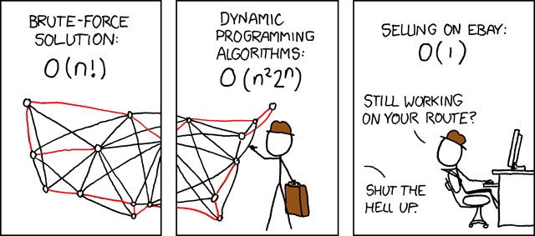
Source Code
Traveling Salesman Demo https://github.com/thomasnield/traveling_salesman_demo
Traveling Salesman Plotter https://github.com/thomasnield/traveling_salesman_plotter
SOURCE: xkcd.com

Slide 23
Generating a Schedule
You need to generate a schedule for a single classroom with the following classes:
Psych 101 (1 hour, 2 sessions/week)
English 101 (1.5 hours, 2 sessions/week)
Math 300 (1.5 hours, 2 sessions/week)
Psych 300 (3 hours, 1 session/week)
Calculus I (2 hours, 2 sessions/week) Linear Algebra I (2 hours, 3 sessions/week) Sociology 101 (1 hour, 2 sessions/week)
Biology 101 (1 hour, 2 sessions/week)
Supply Chain 300 (2.5 hours, 2 sessions/week)
Orientation 101 (1 hour, 1 session/week)
Available scheduling times are Monday through Friday, 8:00AM-11:30AM, 1:00PM-5:00PM Slots are scheduled in 15 minute increments.

Slide 24
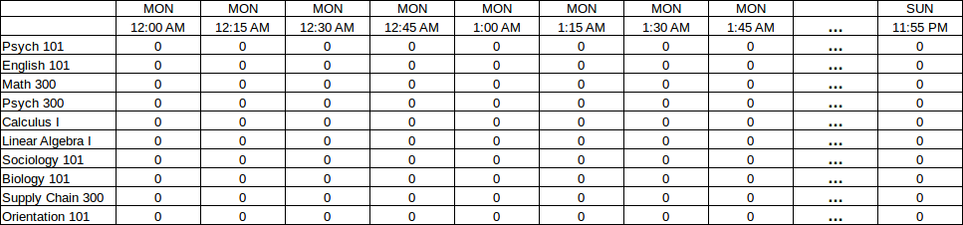
Generating a Schedule
Visualize a grid of each 15-minute increment from Monday through Sunday, intersected with each possible class.
Each cell will be a 1 or 0 indicating whether that’s the start of the first class.

Slide 25
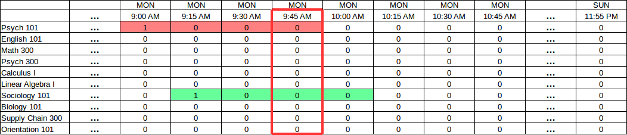
Generating a Schedule
Next visualize how overlaps will occur.
Notice how a 9:00AM Psych 101 class will clash with a 9:15AM Sociology 101.
We can sum all blocks that affect the 9:45AM block and ensure they don’t exceed 1.
Sum of affecting slots = 2 FAIL, sum must be <=1

Slide 26
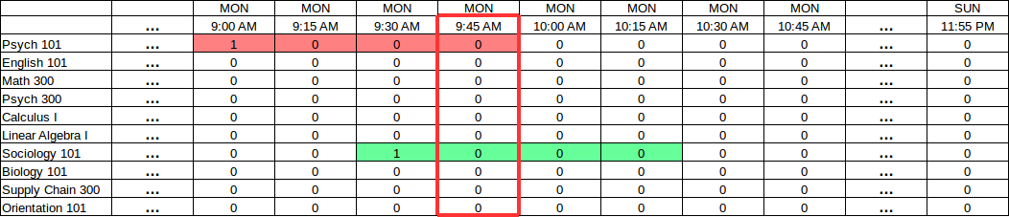
Generating a Schedule
Next visualize how overlaps will occur.
Notice how a 9:00AM Psych 101 class will clash with a 9:30AM Sociology 101.
We can sum all blocks that affect the 9:45AM block and ensure they don’t exceed 1.
Sum of affecting slots = 2 FAIL, sum must be <=1

Slide 27
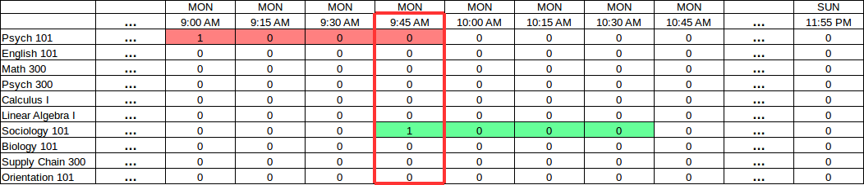
Generating a Schedule
Next visualize how overlaps will occur.
Notice how a 9:00AM Psych 101 class will clash with a 9:45AM Sociology 101.
We can sum all blocks that affect the 9:45AM block and ensure they don’t exceed 1.
Sum of affecting slots = 2 FAIL, sum must be <=1

Slide 28
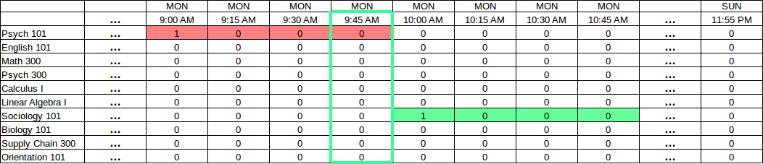
Generating a Schedule
If the “sum” of all slots affecting a given block are no more than 1, then we have no conflicts!
Sum of affecting slots = 1 SUCCESS!

Slide 29
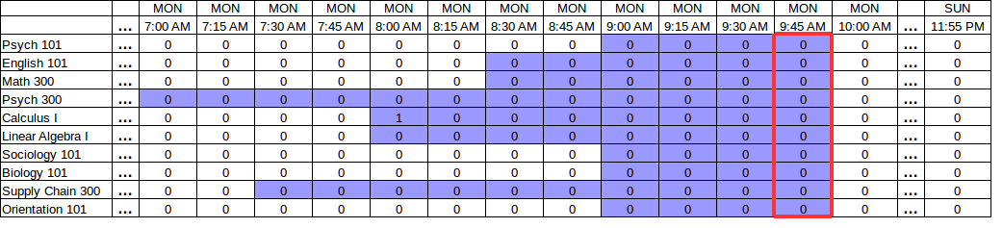
Generating a Schedule
For every “block”, we must sum all affecting slots (shaded below) which can be identified from the class durations.
This sum must be no more than 1.

Slide 30
Generating a Schedule
Taking this concept even further, we can account for all recurrences.
The “affected slots” for a given block can query for all recurrences for each given class.
View image here.

Slide 31
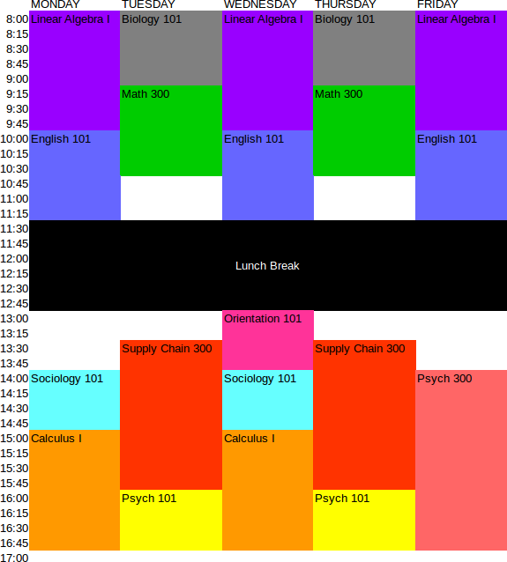
Generating a Schedule
Plug these variables and feasible constraints into the optimizer, and you will get a solution.
Most of the work will be finding the affecting slots for each block.

Slide 32
Generating a Schedule
If you want to schedule against multiple rooms, plot each variable using three dimensions.
MON 8:00
MON 8:15
MON 8:30
MON 8:45
MON 9:00
MON 9:15
MON 9:30
MON 9:45
PSYCH 300
1
0
0
0
MATH 300
PSYCH 101
1
0
0
0
ROOM 1
1
0
0
0
ROOM 2
1
0
0
0
ROOM 3

Slide 33
Source Code
Classroom Scheduling Optimizer https://github.com/thomasnield/optimized-scheduling-demo

Slide 34
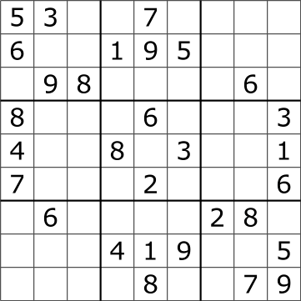
Solving a Sudoku
Imagine you are presented a Sudoku.
Rather than do an exhaustive brute-force search, think in terms of constraint programming to reduce the search space.
First, sort the cells by the count of possible values they have left:

Slide 35
Solving a Sudoku
[4,4] → 5
[2,6] → 7
[7,7] → 3
[8,6] → 4
[1,4] → 2, 5
[0,7] → 2, 3
[3,2] → 2, 3
[4,2] → 3, 4
[5,2] → 2, 4
[3,5] → 5, 9
[5,5] → 1, 4
[4,6] → 3, 5
[5,8] → 2, 6
[6,7] → 3, 6
[0,2] → 1, 2, 3
[1,3] → 1, 2, 5
…
[2,6] → 1,3,4,5,7,9
0 1 2 3 4 5 6 7 8
0
1
2
3
4
5
6
7
8
Put cells in a list sorted by possible candidate count

Slide 36
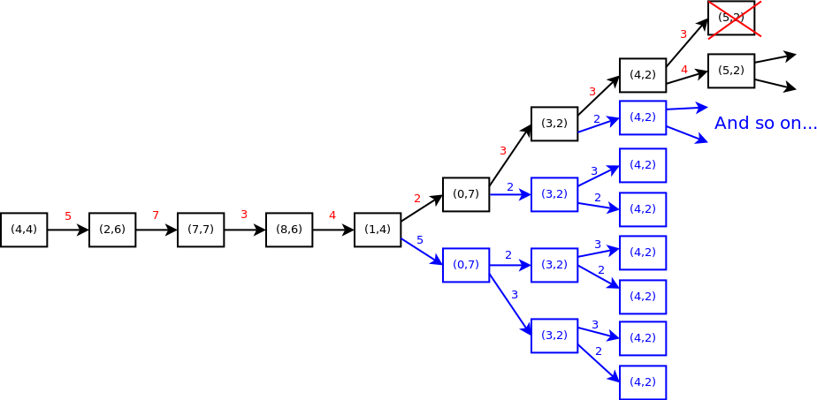
Solving a Sudoku
[4,4] → 5
[2,6] → 7
[7,7] → 3
[8,6] → 4
[1,4] → 2, 5
[0,7] → 2, 3
[3,2] → 2, 3
[4,2] → 3, 4
[5,2] → 2, 4
[3,5] → 5, 9
[5,5] → 1, 4
[4,6] → 3, 5
[5,8] → 2, 6
[6,7] → 3, 6
[0,2] → 1, 2, 3
[1,3] → 1, 2, 5
…
[2,6] → 1,3,4,5,7,9
With this sorted list, create a decision tree that explores each Sudoku cell and its possible values.
This technique is called branch-and- bound.

Slide 37
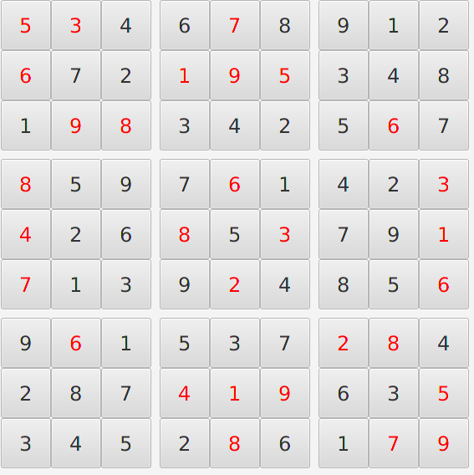
Solving a Sudoku
A branch should terminate immediately when it finds an infeasible configuration, and then explore the next branch.
After we have a branch that provides a feasible value to every cell, we have solved our Sudoku!
Unlike many optimization problems, Sudokus are trivial to solve because they constrain their search spaces quickly.

Slide 38
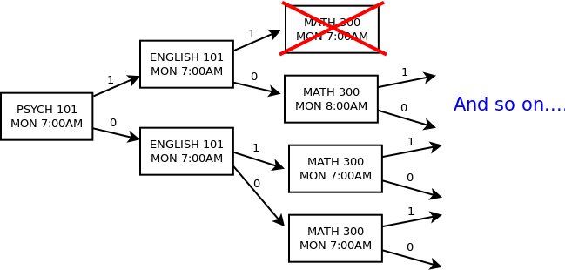
Branch-and-Bound for Scheduling
You could solve the scheduling problem from scratch with branch-and-bound.
Start with the most “constrained” slots first to narrow your search space (e.g. slots fixed to zero first, followed by Monday slots for 3-recurrence classes).
HINT: Proactively prune the tree as you go, eliminating any slots ahead that must be zero due to a “1” decision propagating an occupied state.

Slide 39
Source Code
Kotlin Sudoku Solver https://github.com/thomasnield/kotlin-sudoku-solver

Slide 40
Discrete Optimization Summary
Discrete Optimization is a best-kept secret well-known in operations research.
Machine learning itself is an optimization problem, finding the right values for variables to minimize an error function.
Many folks misguidedly turn to neural networks and other machine learning when discrete optimization would be more appropriate.
Recommended Java Libraries:
OjAlgo! OptaPlanner

Slide 41
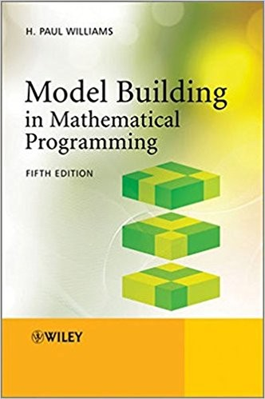
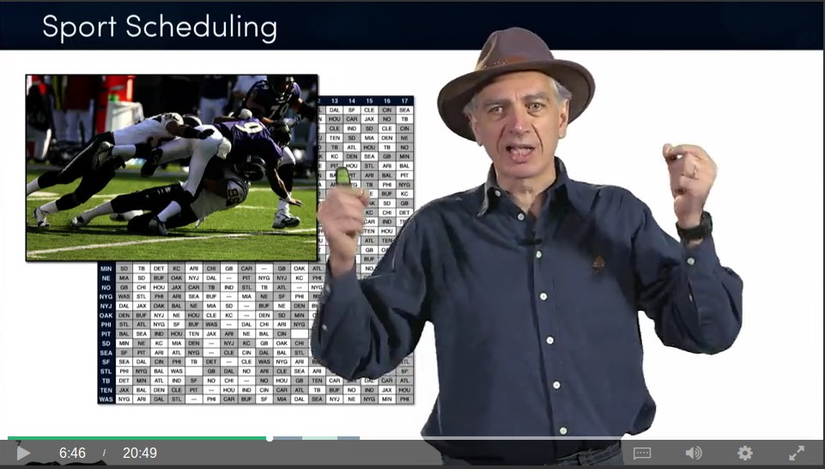
Learn More About Discrete Optimization
Discrete Optimization

Slide 42
Part III:
Classification w/ Naive Bayes

Slide 43
Classifying Things
Probably the most common task in machine learning is classifying data:
How do I identify images of dogs vs cats? What words are being said in a piece of audio? Is this email spam or not spam?
What attributes define high-risk, medium-risk, and low-risk loan applicants?
How do I predict if a shipment will be late, early, or on-time?
There are many techniques to classify data, with pros/cons depending on the task:
Neural Networks Support Vector Machines
Decision Trees/Random Forests Naive Bayes
Linear/Non-linear regression

Slide 44
Naive Bayes
Let’s focus on Naive Bayes because it is simple to implement and effective for a common task: text categorization.
Naive Bayes is an adaptation of Bayes Theorem that can predict a category C for an item T with multiple features F.
A common usage example of Naive Bayes is email spam, where each word is a feature and spam/not spam are the possible categories.

Slide 45
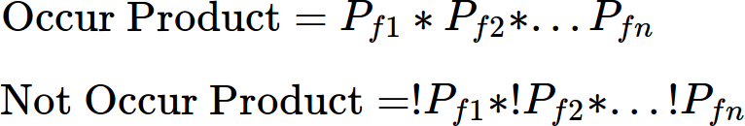
Implementing Naive Bayes
Naive Bayes works by mapping probabilities of each individual feature occurring/not occurring for a given category (e.g. a word occurring in spam/not spam).
A category can be predicted for a new set of features by…
1) For a given category, combine the probabilities of each feature occuring and not occuring by multiplying them.
2) Divide the products to get the probability for that category.

Slide 46
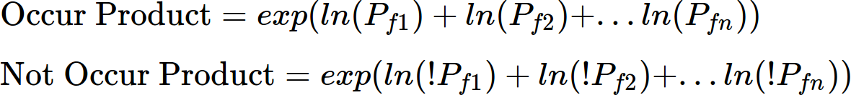
Implementing Naive Bayes
3) Calculate this for every category, and select the one with highest probability.
Dealing with floating point underflow.
A big problem is multiplying small decimals for a large number of features may cause a floating point underflow.
To remedy this, transform each probability with log() or ln() and sum them, then call exp() to convert the result back!

Slide 47
Implementing Naive Bayes
One last consideration, never let a feature have a 0 probability for any category!
Always leave a little possibility it could belong to any category so you don’t have 0
multiplication or division mess anything up.
This can be done by adding a small value to each probability’s numerator and denominator (e.g. 0.5 and 1.0).

Slide 48
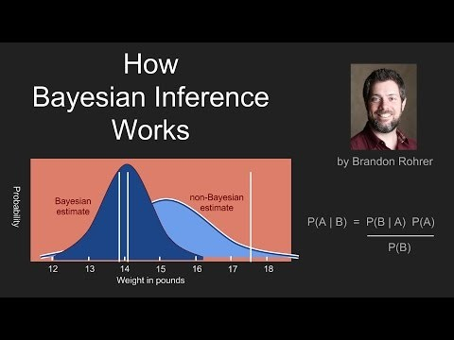

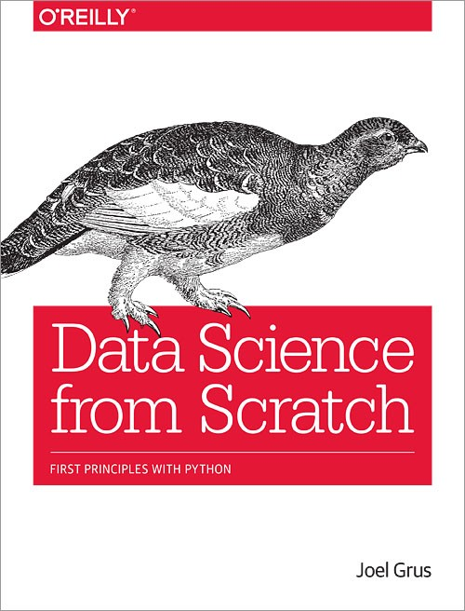
Learn More About Bayes
Brandon Rohrer - YouTube

Slide 49
Source Code
Bank Transaction Categorizer Demo https://github.com/thomasnield/bayes_user_input_prediction
Email Spam Classifier Demo https://github.com/thomasnield/bayes_email_spam

Slide 50








Part V:
Neural Networks

Slide 51







What Are Neural Networks?
Neural Networks are a machine learning tool that takes numeric inputs and predicts numeric outputs.
A series of multiplication, addition, and nonlinear functions are applied to the numeric inputs.
The mathematical operations above are iteratively tweaked until the desired output is met.

Slide 52
The Problem
Suppose we wanted to take a background color (in RGB values) and predict a light/dark font for it.
Hello
Hello
If you search around Stack Overflow , there is a nice formula to do this:
But what if we do not know the formula? Or one hasn’t been discovered?

Slide 53
A Simple Neural Network
Let’s represent background color as 3 numeric RGB inputs, and predict whether a DARK/LIGHT font should be used.
255
0
Hello
204
Mystery Math
1
Hello
204

Slide 54
A Simple Neural Network
255w₁+
204w₂+
204w₃
255
W₁
W₄
W
W
10
Multiply and sum again
2
Hello
W₃
255w₄+
204w₅+
204w₆
^{W}11
204
W₅
W
W
^{W}14
12
13
Multiply and sum again
Hello
W_{6 W}
7
W
8
255w +
W
7
204w₈+
204w₉
^{W}15
204
9

Slide 55
A Simple Neural Network
This is the “mystery math”
255w₁+
204w₂+
204w₃
255
W₁
W₄
W
W
10
Multiply and sum again
2
Hello
W₃
255w₄+
204w₅+
204w₆
^{W}11
204
W₅
W
W
^{W}14
12
13
Multiply and sum again
Hello
W_{6 W}
7
W
8
255w +
W
7
204w₈+
204w₉
^{W}15
204
9

Slide 56
A Simple Neural Network
Each weight w_{x} value is between -1.0 and 1.0
255w₁+
204w₂+
204w₃
255
W₁
W₄
W
W
10
Multiply and sum again
2
Hello
W₃
255w₄+
204w₅+
204w₆
^{W}11
204
W₅
W
W
^{W}14
12
13
Multiply and sum again
Hello
W_{6 W}
7
W
8
255w +
W
7
204w₈+
204w₉
^{W}15
204
9

Slide 57
A Simple Neural Network
Million Dollar Question:
What are the optimal weight values to get the desired output?
255w₁+
204w₂+
204w₃
255
W₁
W₄
W
W
10
2
0.0
Hello
W₃
255w₄+
204w₅+
204w₆
^{W}11
204
W₅
W₇
W
^{W}14
12
13
W
1.0
Hello
W_{6 W}
8
255w +
W
7
204w₈+
204w₉
^{W}15
204
9

Slide 58
A Simple Neural Network
Million Dollar Question:
What are the optimal weight values to get the desired output?
255w₁+
204w₂+
204w₃
255
W₁
W₄
W
W
10
2
0.0
Hello
W₃
255w₄+
204w₅+
204w₆
^{W}11
204
W₅
W₇
W
^{W}14
12
13
W
1.0
Hello
W_{6 W}
8
255w +
W
7
204w₈+
204w₉
^{W}15
204
9

Slide 59
A Simple Neural Network
Answer:
This is an optimization problem!
255w₁+
204w₂+
204w₃
255
W₁
W₄
W
W
10
2
.01
Hello
W₃
255w₄+
204w₅+
204w₆
^{W}11
204
W₅
W₇
W
^{W}14
12
13
W
.998
Hello
W_{6 W}
8
255w +
W
7
204w₈+
204w₉
^{W}15
204
9

Slide 60
A Simple Neural Network
We need to solve for the weight values that gets our training colors as close to their desired outputs as possible.
255w₁+
204w₂+
204w₃
255
W₁
W₄
W
W
10
2
.01
Hello
W₃
255w₄+
204w₅+
204w₆
^{W}11
204
W₅
W₇
W
^{W}14
12
13
W
.998
Hello
W_{6 W}
8
255w +
W
7
204w₈+
204w₉
^{W}15
204
9

Slide 61
Just like the Traveling Salesman Problem, you need to explore configurations seeking an acceptable local minimum.
Error Function
Weight Configurations

Slide 62
Gradient descent, simulated annealing, and
other optimization techniques can help tune a neural network.
Error Function
Weight Configurations

Slide 63
Activation Functions
RELU
SOFTMAX
You might also consider using activation functions on each layer.
255w₁+
204w₂+
204w₃
255w₄+
204w₅+
204w₆
255w₇+
204w₈+
204w₉
Multiply and sum again
Multiply and sum again
255
These are nonlinear functions that smooth, scale, or compress
the resulting sum values.
204
These make the network operate more naturally and smoothly.
204

Slide 64
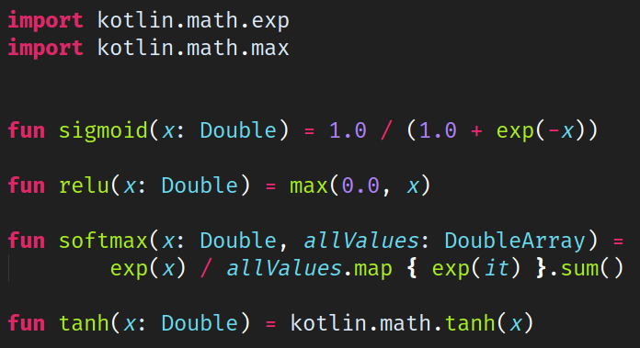
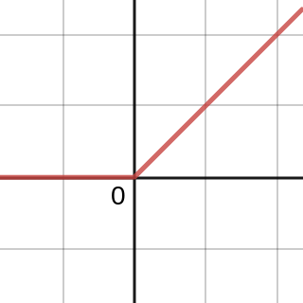
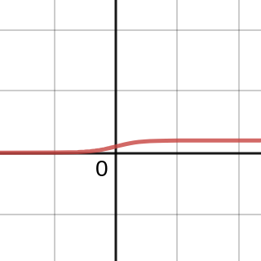
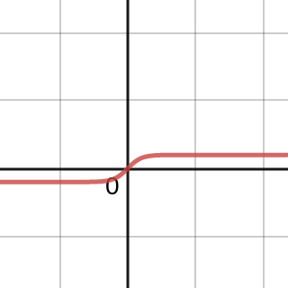
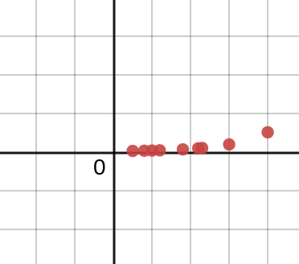
Activation Functions
Four common neural network activation functions implemented using kotlin-stdlib
RELU
SIGMOID
TANH
SOFTMAX
https://www.desmos.com/calculator/jwjn5rwfy6

Slide 65
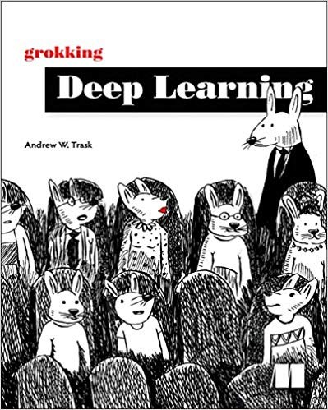
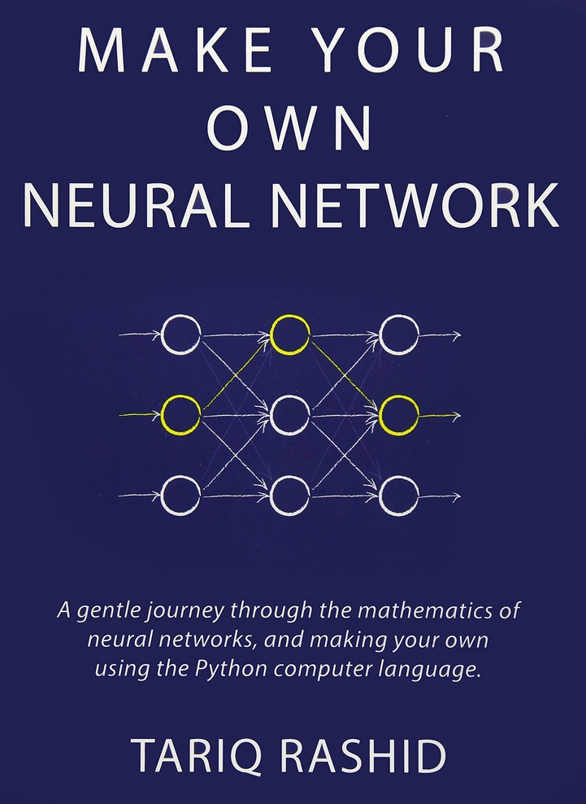

Learn More About Neural Networks
3Blue1Brown - YouTube

Slide 66
Source Code
Kotlin Neural Network Example https://github.com/thomasnield/kotlin_simple_neural_network
67

Slide 67
Going Forward

Slide 68



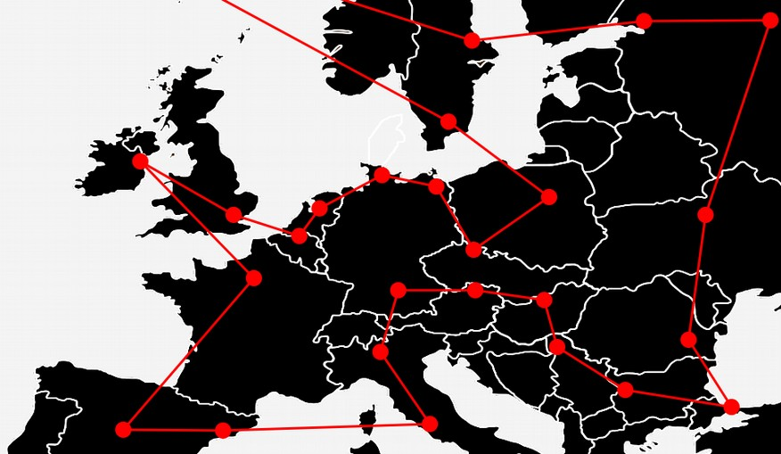
Use the Right “AI” for the Job
Neural Networks
Bayesian Inference
Discrete Optimization
●
Image/Audio/Video Recognition
“Cat” and “Dog” photo classifier
●
Text classification
Email spam, sentiment analysis, document categorization
●
Scheduling
Staff, transportation, classrooms, sports tournaments, server jobs
●
Nonlinear regression
●
Document summarization
●
Route Optimization
Transportation, communications
●
Any fuzzy, difficult problems that have no clear model but lots of data Self-driving vehicles
Natural language processing Problems w/ mysterious unknowns
●
Probability inference Disease diagnosis, updating predictions
●
Industry
Manufacturing, farming, nutrition, energy, engineering, finance

Slide 69
GitHub Page for this Talk
Slides have links to code examples
https://github.com/thomasnield/kotlinconf-2018-mathematical-m odeling

Slide 70
Appendix

Slide 71
The Best Way to Learn
The best way to become proficient in machine learning, optimization, and mathematical modeling is to have specific projects.
Instead of chasing vague objectives, pursue specific curiosities like:
Sports tournament optimization Recognizing handwritten characters Creating a Chess A.I.
Sentiment analysis of political candidates on social media
Turn these specific curiosities into self-contained projects or apps.
You will be surprised by how much you learn, and develop insight in which solutions work best for a given problem.
72

Slide 72
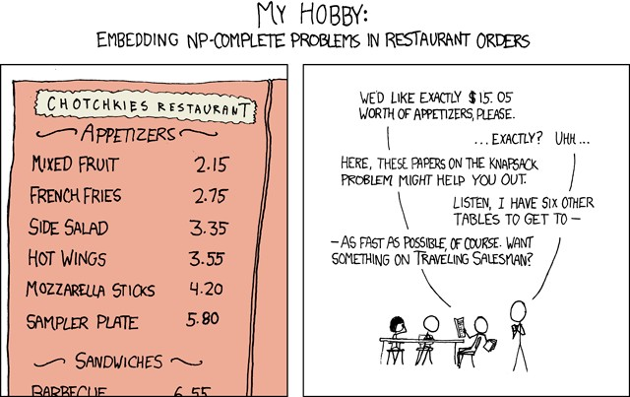
Pop Culture
Traveling Salesman (2012 Movie)
http://a.co/d/76UYvXd
Silicon Valley (HBO) – The “Not Hotdog” App
https://youtu.be/vIci3C4JkL0
Silicon Valley (HBO) – Making the “Not Hotdog” App
https://tinyurl.com/y97ajsac
XKCD – Traveling Salesman Problem
https://www.xkcd.com/399/
XKCD – NP-Complete
https://www.xkcd.com/287/
SOURCE: xkcd.com
XKCD – Machine Learning
https://xkcd.com/1838/

Slide 73
Areas to Explore
Machine Learning Linear Regression Nonlinear Regression Neural Networks
Bayes Theorem/Naive Bayes Support Vector Machines Decision Trees/Random Forests K-means (nearest neighbor) XGBoost
Optimization
Discrete Optimization Linear/Integer/Mixed Programming Dynamic Programming
Constraint programming Metaheuristics

Slide 74
Java/Kotlin ML and Optimization Libraries
Java/Kotlin Library | Python Equivalent | Description
ND4J / Koma / ojAlgo | NumPy | Numerical computation Java libraries
DeepLearing4J | TensorFlow | Deep learning Java/Scala/Kotlin library
SMILE | scikit-learn | Comprehensive machine learning suite for Java
ojAlgo / OptaPlanner | PuLP | Optimization libraries for Java
Apache Commons Math | scikit-learn | Math, statistics, and ML for Java
TableSaw / Krangl | Pandas | Data frame libraries for Java/Kotlin
Kotlin-Statistics | scikit-learn | Statistical/probability operators for Kotlin
JavaFX / Data2Viz / Vegas | matplotlib | Charting libraries

Slide 75
Online Class Resources
Coursera – Discrete Optimization
https://www.coursera.org/learn/discrete-optimization/home/
Coursera – Machine Learning
https://www.coursera.org/learn/machine-learning/home/welcome

Slide 76
YouTube Channels and Videos
Thomas Nield (Channel) https://youtu.be/F6RiAN1A8n0
Brandon Rohrer (Channel) https://www.youtube.com/c/BrandonRohrer
3Blue1Brown (Channel) https://www.youtube.com/channel/UCYO_jab_esuFRV4b17AJtAw
YouTube – P vs NP and the Computational Complexity Zoo (Video) https://youtu.be/YX40hbAHx3s
The Traveling Salesman Problem Visualization (Video) https://youtu.be/SC5CX8drAtU
The Traveling Salesman w/ 1000 Cities (Video) https://youtu.be/W-aAjd8_bUc
Writing My First Machine Learning Game (Video) https://youtu.be/ZX2Hyu5WoFg

Slide 77
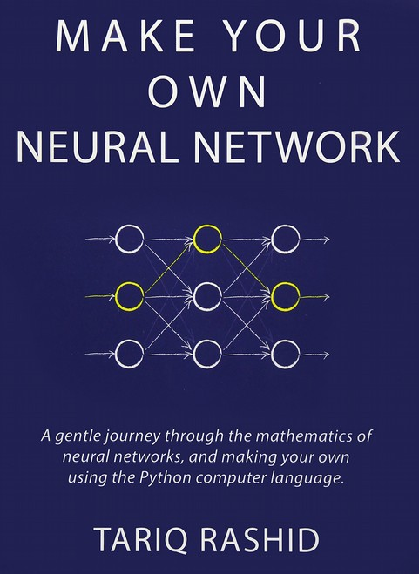
Books

Slide 78
Interesting Articles
Does A.I. Include Constraint Solvers?
https://www.optaplanner.org/blog/2017/09/07/DoesAIIncludeConstraintSolvers.html
Can You Make Swiss Trains Even More Punctual?
https://medium.com/crowdai/can-you-make-swiss-trains-even-more-punctual-ec9aa73d6e35
Building a Simple Chess A.I.
https://medium.freecodecamp.org/simple-chess-ai-step-by-step-1d55a9266977
The SkyNet Salesman
https://multithreaded.stitchfix.com/blog/2016/07/21/skynet-salesman/

Slide 79
Interesting Articles
Essential Math for Data Science
https://towardsdatascience.com/essential-math-for-data-science-why-and-how-e88271367fbd
The Unreasonable Reputation of Neural Networks
http://thinkingmachines.mit.edu/blog/unreasonable-reputation-neural-networks
The Hard Thing About Deep Learning
https://www.oreilly.com/ideas/the-hard-thing-about-deep-learning
Mario is Hard, and that’s Mathematically Official
https://www.newscientist.com/article/mg21328565.100-mario-is-hard-and-thats-mathematically-of ficial/

Slide 80
Interesting Papers
The Lin-Kernighan Traveling Salesman Heuristic (A powerful TSP algorithm)
http://akira.ruc.dk/~keld/research/LKH/LKH-1.3/DOC/LKH_REPORT.pdf
The Traveling Salesman: A Neural Network Perspective
http://www.iro.umontreal.ca/~dift6751/paper_potvin_nn_tsp.pdf
The Interplay of Optimization and Machine Learning Research
http://jmlr.org/papers/volume7/MLOPT-intro06a/MLOPT-intro06a.pdf

