Slide 1
Mathematical Modeling with Kotlin
Thomas Nield

Slide 2
Part I – Discrete Optimization

Slide 3
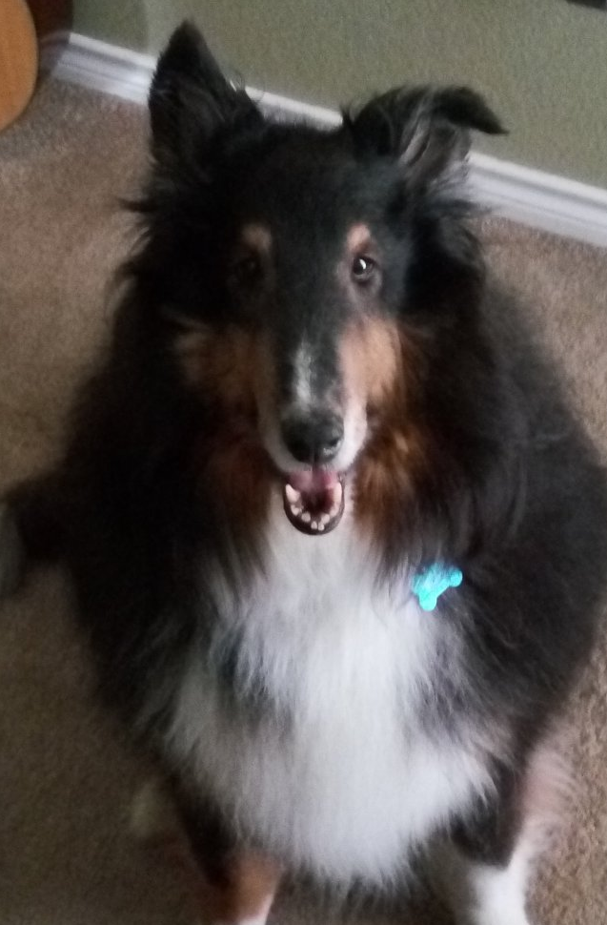


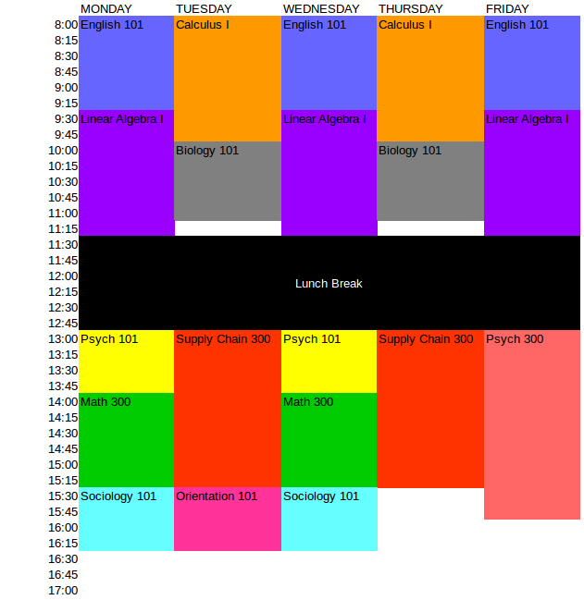

Use the Right Tool for the Job
Use the right mathematical model for your specific problem.
There is no “General AI”.

Slide 4
