Slide 1

The Monty Hall Problem

Slide 2

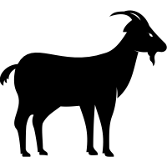

The Monty Hall Problem
DOOR 1
DOOR 2
DOOR 3
Choose a door, one has a prize.
Two others have goats.

Slide 3
The Monty Hall Problem
DOOR 1
DOOR 2
DOOR 3
You choose Door 1.
What is the probability it has the prize?

Slide 4
The Monty Hall Problem
DOOR 1
33.33%
DOOR 2
33.33%
DOOR 3
33.33%
You choose Door 1.
What is the probability it has the prize? 33%

Slide 5
The Monty Hall Problem
DOOR 1
DOOR 2
Twist! Door 3 was just opened. It’s a goat.
Did you want to switch from Door 1 to Door 2?

Slide 6
The Monty Hall Problem
DOOR 1
?%
DOOR 2
?%
What is the prize probability of each door now?

Slide 7
The Monty Hall Problem
DOOR 1
?%
DOOR 2
?%
HINT: The prize probability of either door is not 50%

Slide 8
The Monty Hall Problem
DOOR 1
33.33%
DOOR 2
66.66%
The probability of Door 1 is 33.33% while Door 2 is now 66.66%.
You should switch! But why?

Slide 9
The Monty Hall Problem
33.33%
66.66%
33.33%

Slide 10
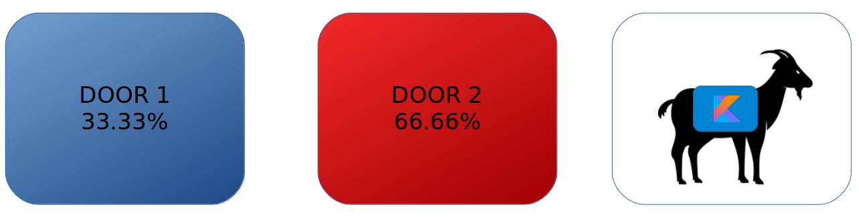
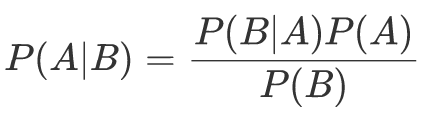
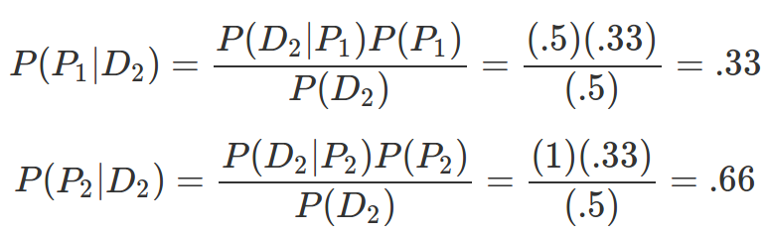
The Monty Hall Problem
According to Bayes Theorem...
Notes:
$$
P(A|B) = \frac{P(B|A) P(A)}{P(B)}
$$
$$
P(P_1|D_2) = \frac{P(D_2|P_1) P(P_1)}{P(D_2)} = \frac{(.5)(.33)}{(.5)} = .33
$$
$$
P(P_2|D_2) = \frac{P(D_2|P_2) P(P_2)}{P(D_2)} = \frac{(1)(.33)}{(.5)} = .66
$$
$$D_2 = \text{Probability of door 2 being left} = .5$$
$$P_1 = \text{Probability door 1 contains prize} = .33$$
$$P_2 = \text{Probability door 2 contains prize} = .5$$
$$P(P_1|D_2) = \text{Probability door 1 contains prize given door 2 is left} = .33$$
$$P(P_2|D_2) = \text{Probability door 2 contains prize given door 2 is left} = .66$$
$$P(D_2|P_1) = \text{Probability door 2 is opened given door 1 has prize} = .33$$
$$P(D_2|P_2) = \text{Probability door 2 is opened given door 2 has prize} = .66$$

Slide 11
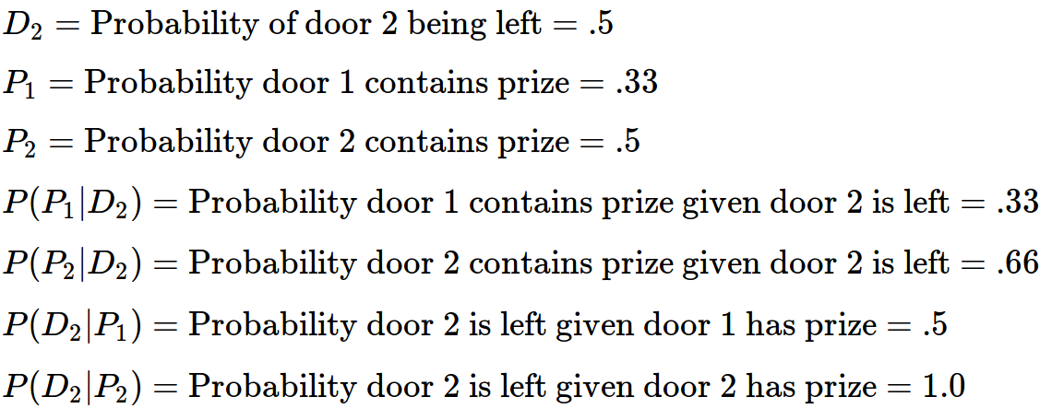
The Monty Hall Problem

Slide 12
The Monty Hall Problem
Still confused? Hyperbolize! Imagine you had 1000 doors, and you chose Door #19.
19

Slide 13
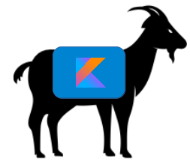
The Monty Hall Problem
All other doors are opened but yours and Door #77. Inclined to switch now?
19
77

Slide 14
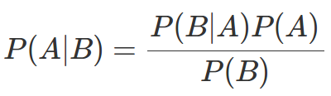
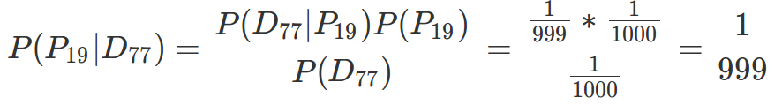
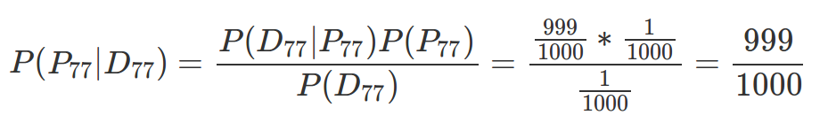
The Monty Hall Problem
#19
#77
Yes, you should switch!
Notes:
$$
P(A|B) = \frac{P(B|A) P(A)}{P(B)}
$$
$$
P(P_{19}|D_{77}) = \frac{P(D_{77}|P_{19}) P(P_{19})}{P(D_{77})} = \frac{{\frac{1}{999}} * \frac{1}{1000}}{\frac{1}{1000}}= \frac{1}{999}
$$
$$
P(P_{77}|D_{77}) = \frac{P(D_{77}|P_{77}) P(P_{77})}{P(D_{77})} = \frac{\frac{999}{1000} * \frac{1}{1000}}{\frac{1}{1000}} = \frac{999}{1000}
$$
$$D_{77}= \text{probability of door 77 being opened}$$
$$P_{19}= \text{probability door 19 contains prize}$$
$$P_{77} = \text{probability door 77 contains prize}$$
$$P(P_{19}|D_{77}) = \text{Probability door 19 contains prize given door 77 is opened}$$
$$P(P_{77}|D_77)) = \text{Probability door 77 contains prize given door 77 is opened}$$

Slide 15
Monty Hall Simulation in Kotlin
Monte Carlo simulation of the Monty Hall Problem
https://gist.github.com/thomasnield/7fe76d27a57afbea49939dc1879c9883

Slide 16
Modeling Uncertainty and Approximation
The Monty Hall problem encapsulates the critical (and misunderstood) nuances of.
As programmers, we thrive in certainty and exactness.
But the valuable, high-profile problems today often tackle uncertainty and approximation.
  Users and businesses expect “smarter” applications that will predict what they want.
  Machine learning and optimization is nondeterministic and unavoidably has error.
  Many search spaces are too large to exhaustively explore.

