Slide 1
SQL Fundamentals for Data
Thomas Nield
O’Reilly Media

Slide 2
What to Expect in the Next Two Days
The role of databases and SQL in the business, data science, and data engineering landscape
Understand relational databases
Query and transform data with SQL
Database Design
Writing data in tables

Slide 3
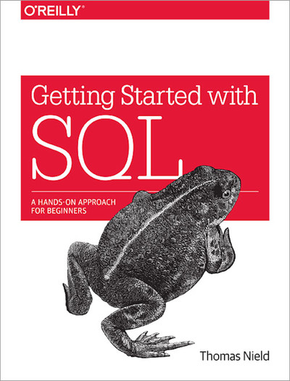
Supplementary Material

Slide 4
Why Learn SQL?
Business, data science, and technology professionals can both reap benefits from learning SQL.
SQL is a highly lucrative skill to have according to StackOverflow’s Annual Survey.
It can be utilized and open up many career paths in both business and IT.
Business Side - Analytical, data science, managerial, strategic, research, and project roles
Technology Side - Database design, database administration (DBA), data engineering, systems engineering, IT project management, machine learning, and software development

Slide 5
Section I
Introduction to Databases

Slide 6
What is a Database?
Broad definition: A database is anything that collects and organizes data
Examples:
Excel spreadsheets
Text files (CSV, XML, JSON)
File cabinet with organized documents
When referred to professionally, a database is typically a Relational Database Management System (RDBMS)

Slide 7
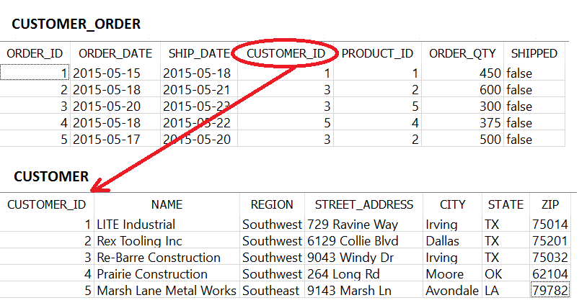
Understanding Relational Databases
A Relational Database Management System is simply a type of database holding tables that may have relationships
A field in a table can point to another table for information

Slide 8
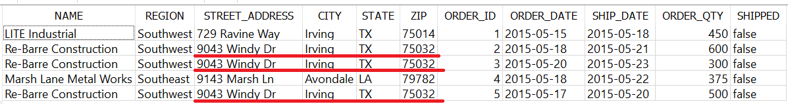
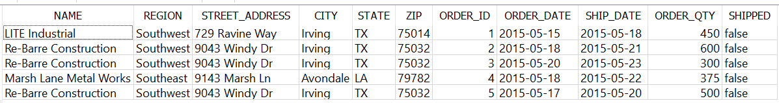
Why Separate Tables?
This idea of separating different types of data (e.g. CUSTOMER versus a CUSTOMER_ORDER) is known as normalization
Putting both CUSTOMER and CUSTOMER_ORDER information in one table would be bloated, redundant and difficult to maintain
Example of a non-normalized table:
Imagine if we needed to change an address.
We would have to do it three times!

Slide 9
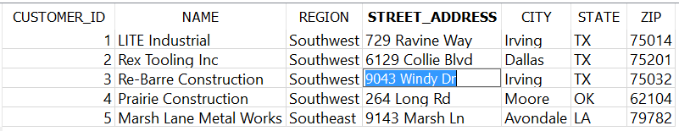
Why Separate Tables?
This is why it is better to separate the CUSTOMER and CUSTOMER_ORDER information into separate tables
You only need to update the address in one place

Slide 10
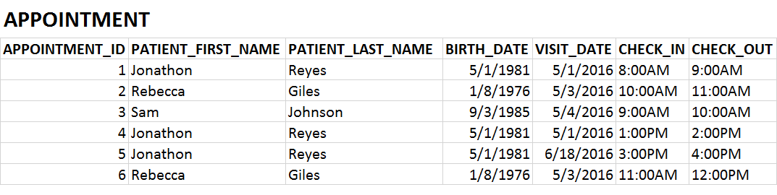
Exercise 1.1
Is this table normalized?

Slide 11
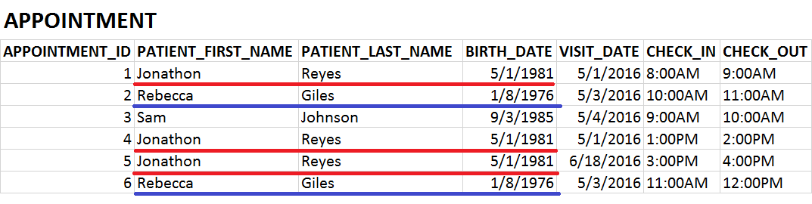
Exercise 1.1
Is this table normalized? It is not!

Slide 12
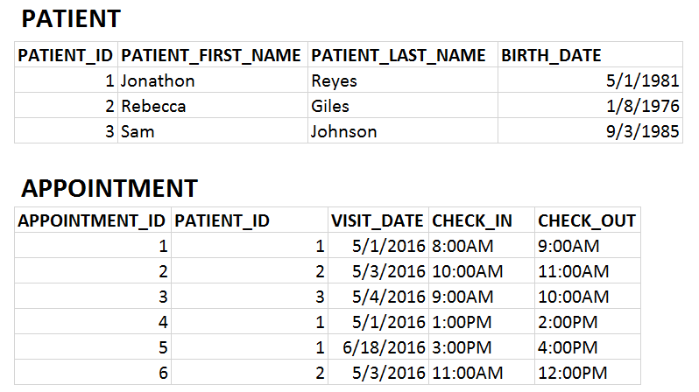
Exercise 1.1
PATIENT and APPOINTMENT data should be in separate tables

Slide 13
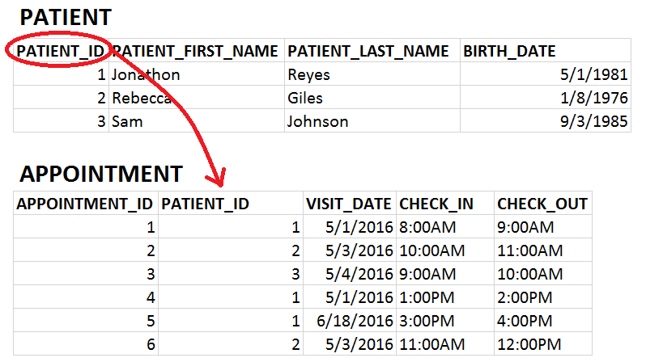
Exercise 1.1
PATIENT and APPOINTMENT data should be in separate tables

Slide 14
Types of Databases
Relational databases and SQL are not proprietary to one company or organization
Many companies and organizations have created their own relational database software
Do not be confused by “SQL” being used to brand database software, like Microsoft SQL Server, MySQL, and SQLite. SQL is the universal language used on all RDBMS platforms
MySQL Oracle IBM DB2 | Microsoft Access Microsoft SQL Server PostgreSQL | SQLite MariaDB SAP Sybase

Slide 15
NoSQL and “Big Data”
NoSQL stands for not only SQL, and is often used to describe “Big Data” platforms that may leverage SQL but are not relational.
  NoSQL databases include MongoDB, Couchbase, Apache Cassandra, and Redis.
  These platforms store massive amounts of data in a variety of raw and unstructured formats (e.g. documents, key-value).
  Most of these solutions are distributed across multiple machines, which is difficult to do with relational databases.
Other “Big Data” solutions such as Apache Hadoop and Apache Spark can be interacted with using SQL, but are not limited to relational databases.
Therefore most of the knowledge in this course can be applied to “Big Data” solutions.
Caution using NoSQL and Big Data: “When all you have is a hammer, everything starts to look like a nail.”
  Do not fall into the trap of treating all data problems as Big Data problems, because most are not.
  Be aware of the “Silver Bullet Syndrome”: https://www.youtube.com/watch?v=3wyd6J3yjcs

Slide 16
SQL vs NoSQL
Feature | SQL | NoSQL | Winner
Integrity/Consistency | Data is enforced with logical relationships, minimized redundancy, and “Up-to-date” consistency. | Simple key-value and document storage does not enforce any rules or structure. Redundancy and write latency is common. | SQL
Design changes | Easy to “add” to database, but harder to modify. | NoSQL can quickly and arbitrarily change what data it stores. | NoSQL
Analysis | SQL is a universal language that makes accessing and analyzing data simple. | SQL support is sparse, and proprietary languages are esoteric and hardly universal. | SQL
Programming | Programmers of Java, Python, and .NET have to map entities to tables, which can be tedious. But data integrity is given. | Programming against a NoSQL database is quick and simple, but onus is on programmer to validate data. | Draw
Performance | Relational databases can store data for most use cases, but struggle with true “big data” cases. Integrity constraints also slow down performance. | NoSQL is capable of storing vast amounts of data with horizontal scaling. It also performs quickly due to horizontal scaling and no integrity constraints. | NoSQL

Slide 17
SQL versus NoSQL Summary
SQL = integrity and accuracy
NoSQL = speed and scalability
SQL should be a prerequisite before learning NoSQL and “Big data”.
If you are absolutely uncertain which to use, always start with SQL.

Slide 18
Lightweight vs Centralized Databases

Slide 19
Lightweight Databases
When you want a simple solution for a small number of users, lightweight databases are a great place to start
They store data in a file that can be shared, but can break down when edited simultaneously
Common Lightweight Databases
  Microsoft Access
  SQLite
  H2

Slide 20
Centralized Databases
When you need to support tens, hundreds, or thousands of users and applications, you need a centralized database
These databases are designed to handle a high volume of traffic efficiently
Some examples of centralized database platforms
  Oracle
  Microsoft SQL Server
  MySQL
  PostgreSQL
  Teradata

Slide 21

Typical Centralized Database Setup
CLIENT
Centralized databases use a
Client/Server Setup
SERVER
SQL User 1
Laptop with MySQL
CLIENT
SQL User 2

Slide 22

Typical Centralized Database Setup
CLIENT
For production, you typically use a server computer to host the database rather than a laptop or desktop
SQL User 1
Server Computer with MySQL
CLIENT
SQL User 2

Slide 23


Typical Centralized Database Setup
CLIENT
A popular architecture nowadays is to have cloud services from Amazon, Microsoft and Alphabet host your database for you.
SQL User 1
Cloud Server with MySQL
CLIENT
SQL User 2

Slide 24
What We Will Use
Upon entering a workplace, there is a good chance you will need access to an existing centralized database
We will not be using centralized databases in this course, but we will be using SQLite
The experience between lightweight and centralized databases should largely be the same

Slide 25
Exercise 1.2
Identify the following as being a lightweight or centralized database:
1. Facebook’s MySQL database holding all user data
CENTRALIZED
2. A SQLite database holding an iPhone user’s data locally on the hard drive
LIGHTWEIGHT
3. An Oracle database with shopping data for a storefront website
CENTRALIZED

Slide 26
Section VII
JOIN

Slide 27
Revisiting Table Relationships
Remember when we were talking about tables having relationships with each other?
A table can supply data to another table, like CUSTOMER information for a CUSTOMER_ORDER

Slide 28
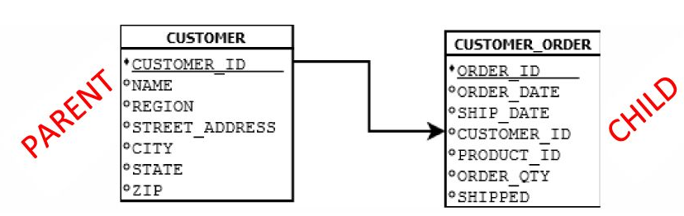
Parent/Child Tables
Because the CUSTOMER table supplies data to CUSTOMER_ORDER, it is the parent table to CUSTOMER_ORDER
Because the CUSTOMER_ORDER table receives data from CUSTOMER, it is the child table to CUSTOMER

Slide 29
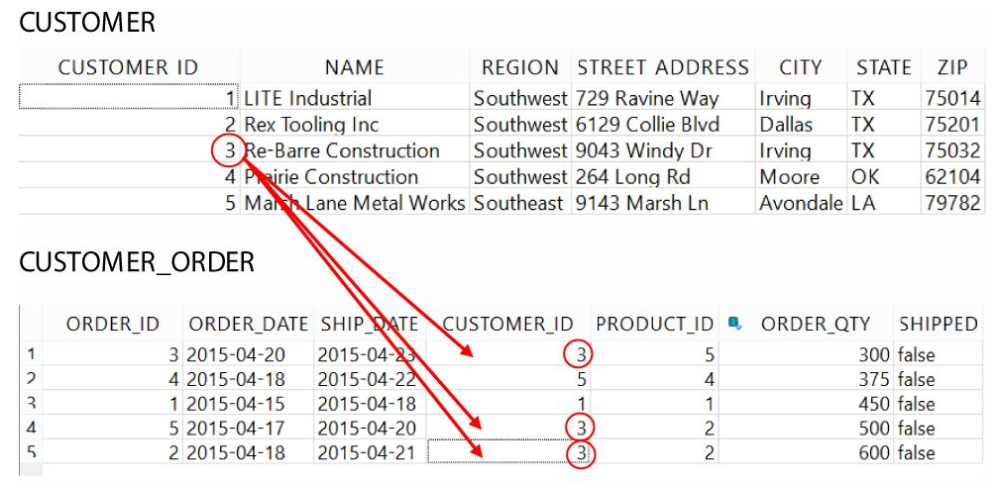
Primary/Foreign Keys
Typically, a parent table will have a primary key and the child table will have a foreign key.
The primary key is unique and can map to multiple foreign keys
Primary Key
Foreign Key

Slide 30
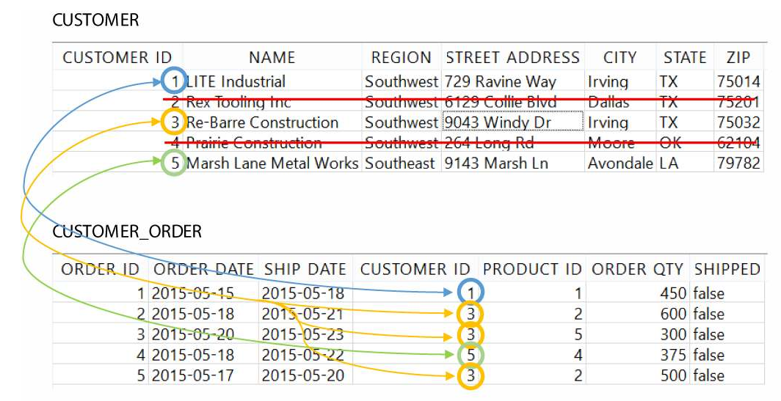
INNER JOIN

Slide 31
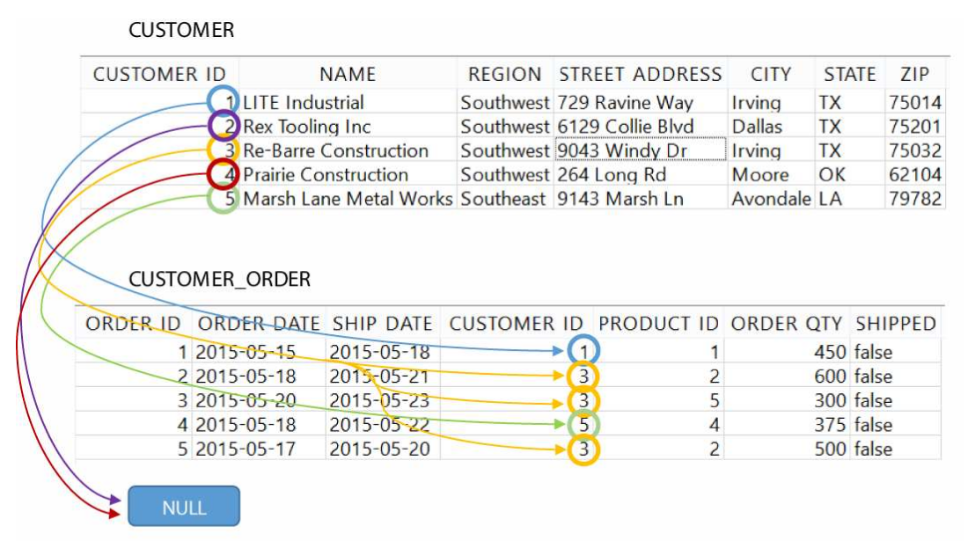
LEFT OUTER JOIN

Slide 32
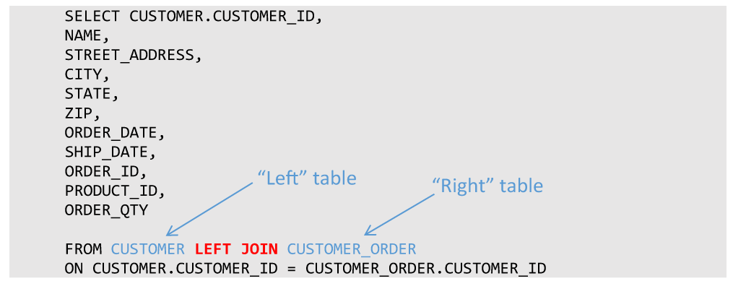
LEFT OUTER JOIN

Slide 33
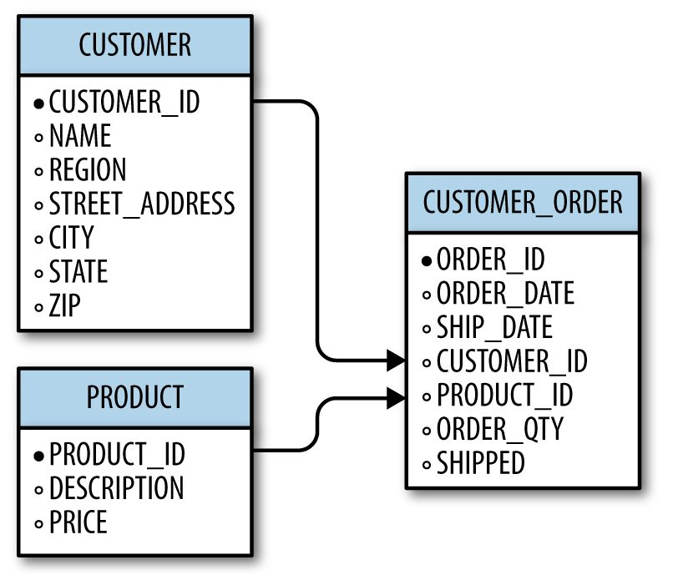
Joining Multiple Tables
It is not uncommon to have a table be a parent to one table, but a child to another
A given table can also be a child to more than one table, so what does this look like?
We can bring in a third table PRODUCT to supply product information to CUSTOMER_ORDER

Slide 34
Section VIII
Database Design

Slide 35
Planning a Database
Design Questions
What are the business requirements?
What tables will I need to fulfill those requirements?
What columns will each table contain?
How will the tables be normalized?
What will their parent/child relationships be?

Slide 36
Planning a Database
Data Questions
How much data will be populated into these tables?
Who/what will populate data into these tables?
Where will the data come from?
Do we need processes to automatically populate these tables?

Slide 37
Planning a Database
Security Questions
Who should have access to this database?
Who should have access to which tables? Read-only access? Write access?
Is this database critical to business operations?
What backup plans do we have in the event of disaster/failure?
Should changes to tables be logged?
If the database is used for websites or web applications, is it secure?

Slide 38

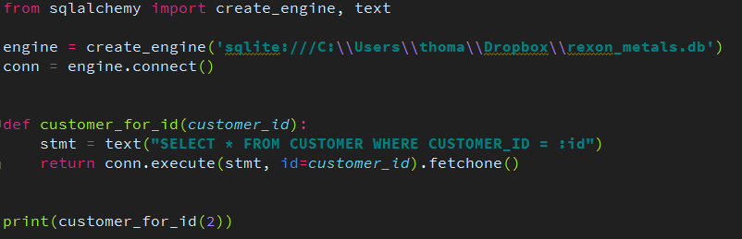
Preventing SQL Injection
To prevent SQL injection, never concatenate a SQL string with parameters
Instead, use the right tools and libraries to safely inject parameters for you
For Python, use SQLAlchemy
More info at:
http://www.sqlalchemy.org/

Slide 39
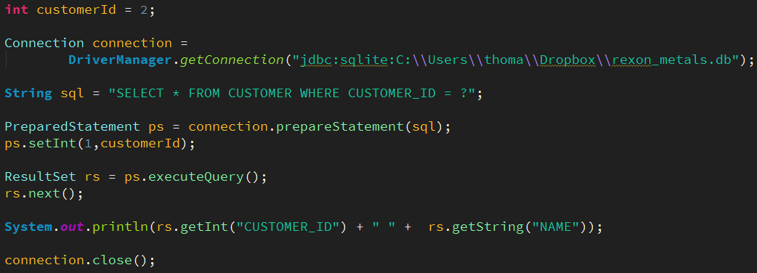
Preventing SQL Injection
For Java, Scala, Kotlin, and other JVM languages use JDBC’s PreparedStatement
More info at:
http://tutorials.jenkov.com/jdbc/index.html
http://www.marcobehler.com/make-it-so-java-db-connections-and-transactions

Slide 40

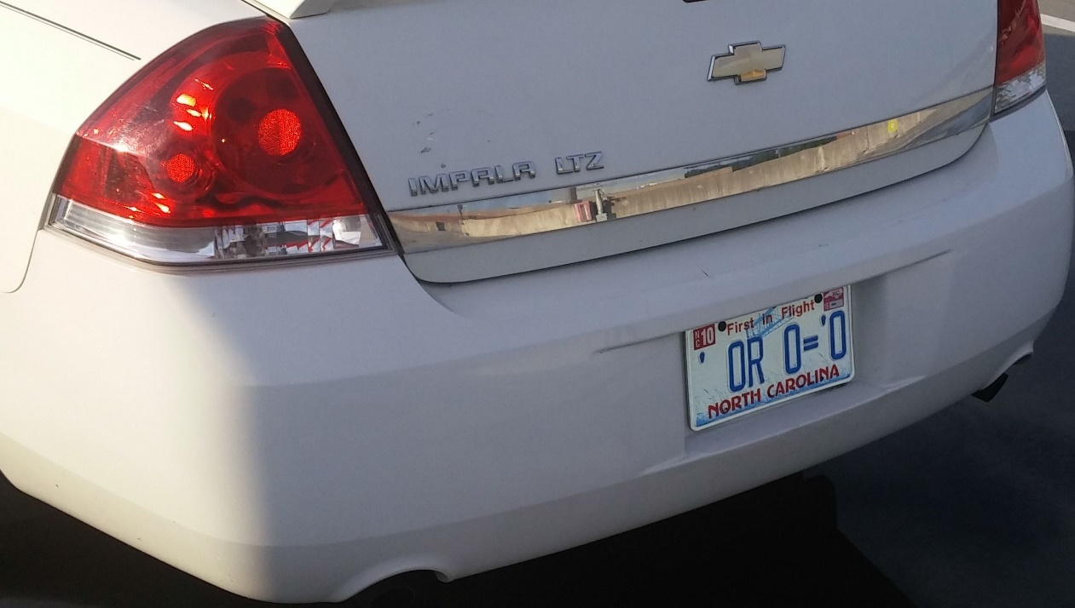
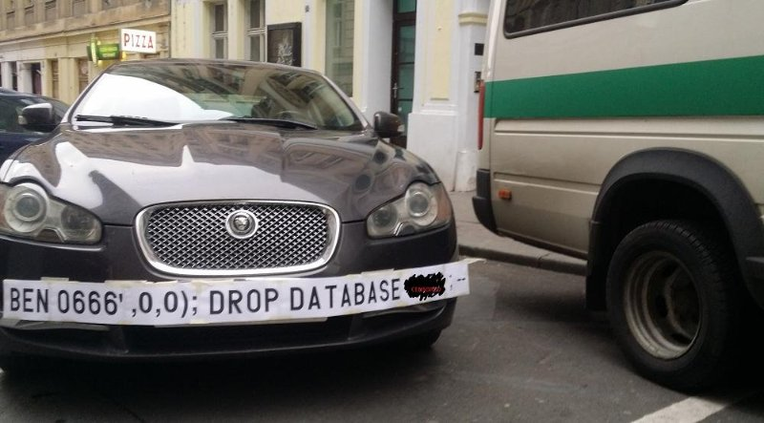
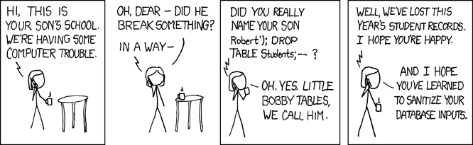
SQL Injection Humor
Source: Google Images
Source: https://xkcd.com/327/

Slide 41
SQL Injection in the News
How to Hack Your Alexa Using a Voice Command SQL Injection
https://hackernoon.com/voice-command-sql-injection-hack-uncovered-for-alexa-9914x3zwp
How a NULL License Plate Landed One Hacker In Ticket Hell
https://www.wired.com/story/null-license-plate-landed-one-hacker-ticket-hell/
This couple cannot do the simplest things online because their last name is ‘Null’
  Https://thenextweb.com/insider/2016/03/27/last-name-null-is-tough-for-computers/

Slide 42
The SurgeTech Conference
Let’s design a database for a real-world scenario!
You are a staff member for the SurgeTech conference, a gathering of tech startup companies seeking publicity and investors. The organizer has tasked you with creating a database to manage the attendees, companies, presentations, rooms, and presentation attendance. How should this database be designed?
There are five entities here that can be turned into tables
ATTENDEE
COMPANY
PRESENTATION
ROOM
PRESENTATION_ATTENDANCE

Slide 43
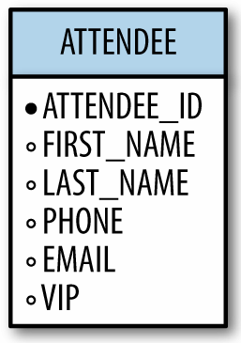
ATTENDEE
The attendees are guests (including some VIP’s) who have registered for the conference
Each attendee holds the following information:
  ID
  Name
  Phone Number
  Email
  VIP status
To the right is our design for the ATTENDEE table

Slide 44
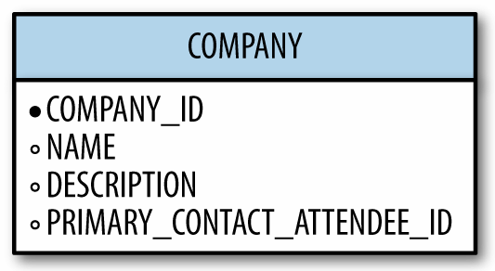
COMPANY
The startup companies need to be tracked as well
Each company holds the following information:
  Company ID
  Name
  Description
  Primary contact attendee ID
To the right is our design for the COMPANY table

Slide 45
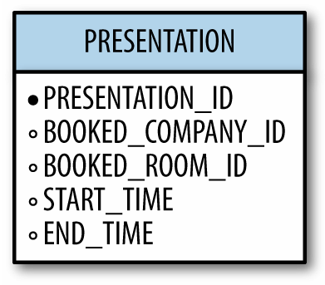
PRESENTATION
Some companies will schedule a presentation for a specific slot of time
Each presentation is defined by:
  Presentation ID
  Booked company ID
  Booked room ID
  Start time
  End time
To the right is our design for the PRESENTATION table

Slide 46
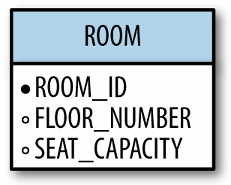
ROOM
Rooms are available for presentations
Each room is defined with these attributes:
  Room ID
  Floor number
  Seat capacity
To the right is our design for the ROOM table

Slide 47
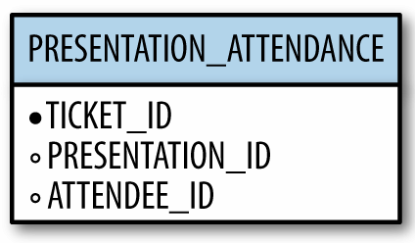
PRESENTATION_ATTENDANCE
When an ATTENDEE wants to attend a PRESENTATION, they can acquire a ticket with a ticket id
We can use these tickets to keep track of presentation attendance
Each presentation attendance is defined with these attributes:
  Ticket ID
  Presentation ID
  Attendee ID
To the right is our design for the PRESENTATION_ATTENDANCE table

Slide 48
Revisiting Primary/Foreign Keys
With table relationships it is important to distinguish the primary key from the foreign key
The field that supplies data to other tables is the primary key, and a field that receives data from another table is a foreign key.
Primary Key
Foreign Key

Slide 49
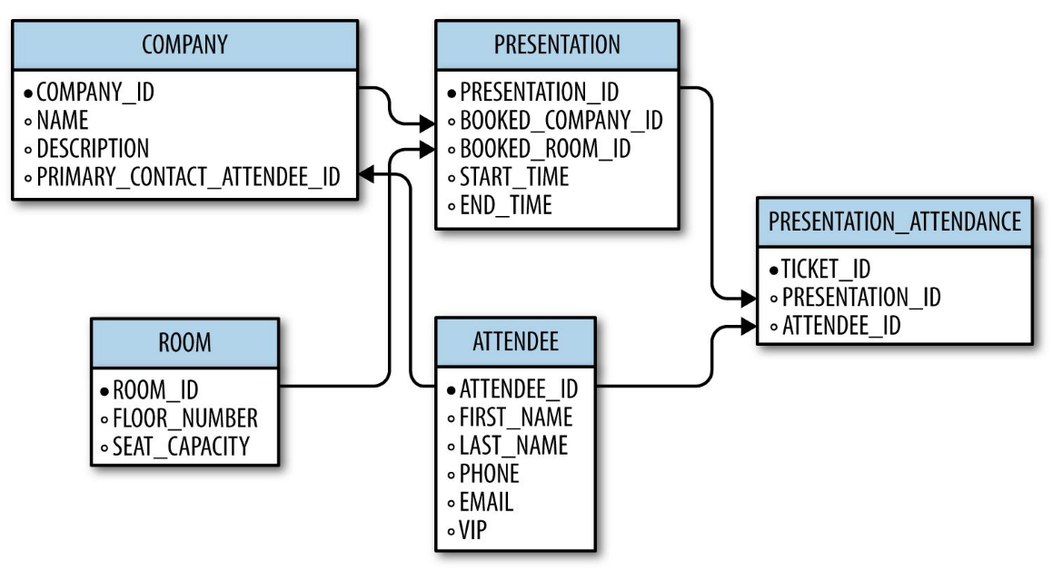
The Database Schema
With our knowledge of primary and foreign keys, we can create a database schema of all tables and their relationships for the SurgeTech conference
*Primary Key → Foreign Key

Slide 50
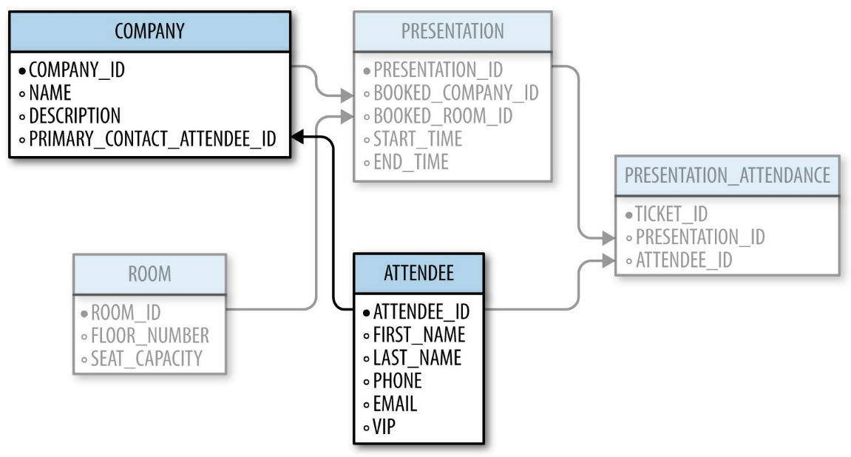
The Database Schema
It can be overwhelming seeing all tables and their relationships at once, so the secret to reviewing a database schema is to focus on 2-3 tables at a time
*Primary Key → Foreign Key

