Slide 1

Systèmes Embarqués Microprogrammés
Dino Run
Thomason Zhou

Slide 2
NDS features: checklist (1/2)
ARM Processors
ARM9: Timers/Interrupts, LCD TFT, A/up/left/right keys
ARM7: Touchscreen, Audio
Timers / Interrupts
The physics is updated up to 60 times a second, based on the state of jumping + applied gravity
Collisions are tested more frequently(12 times a second), the level graphics are updated(4 times a second),obstacles and items are introduced at regular intervals (5 and 11 seconds, and 6 seconds respectively)
Graphics
The background is initialized with tile mode using the main and sub engine since it consists of solid colours
- 2 layers of main: permanent background, moving collidables
- The dino sprite is used as the main character, taking up another VRAM bank
Keypad
Press up or A to make the sprite jump
Press left and right to move within the bounds of the screen

Slide 3
NDS features: checklist (2/2)
Touchscreen
Touch the screen to restart the music
Sound
Game music handled with the Maxmod library to loop 4wtudone.it in the background
wav sound effects for hitting spikes, evolution, and item collection
Sprites
The main playable character is a dinosaur sprite, moving across the map and jumping in response to key presses. It flips horizontally based on the direction it is facing

Slide 4
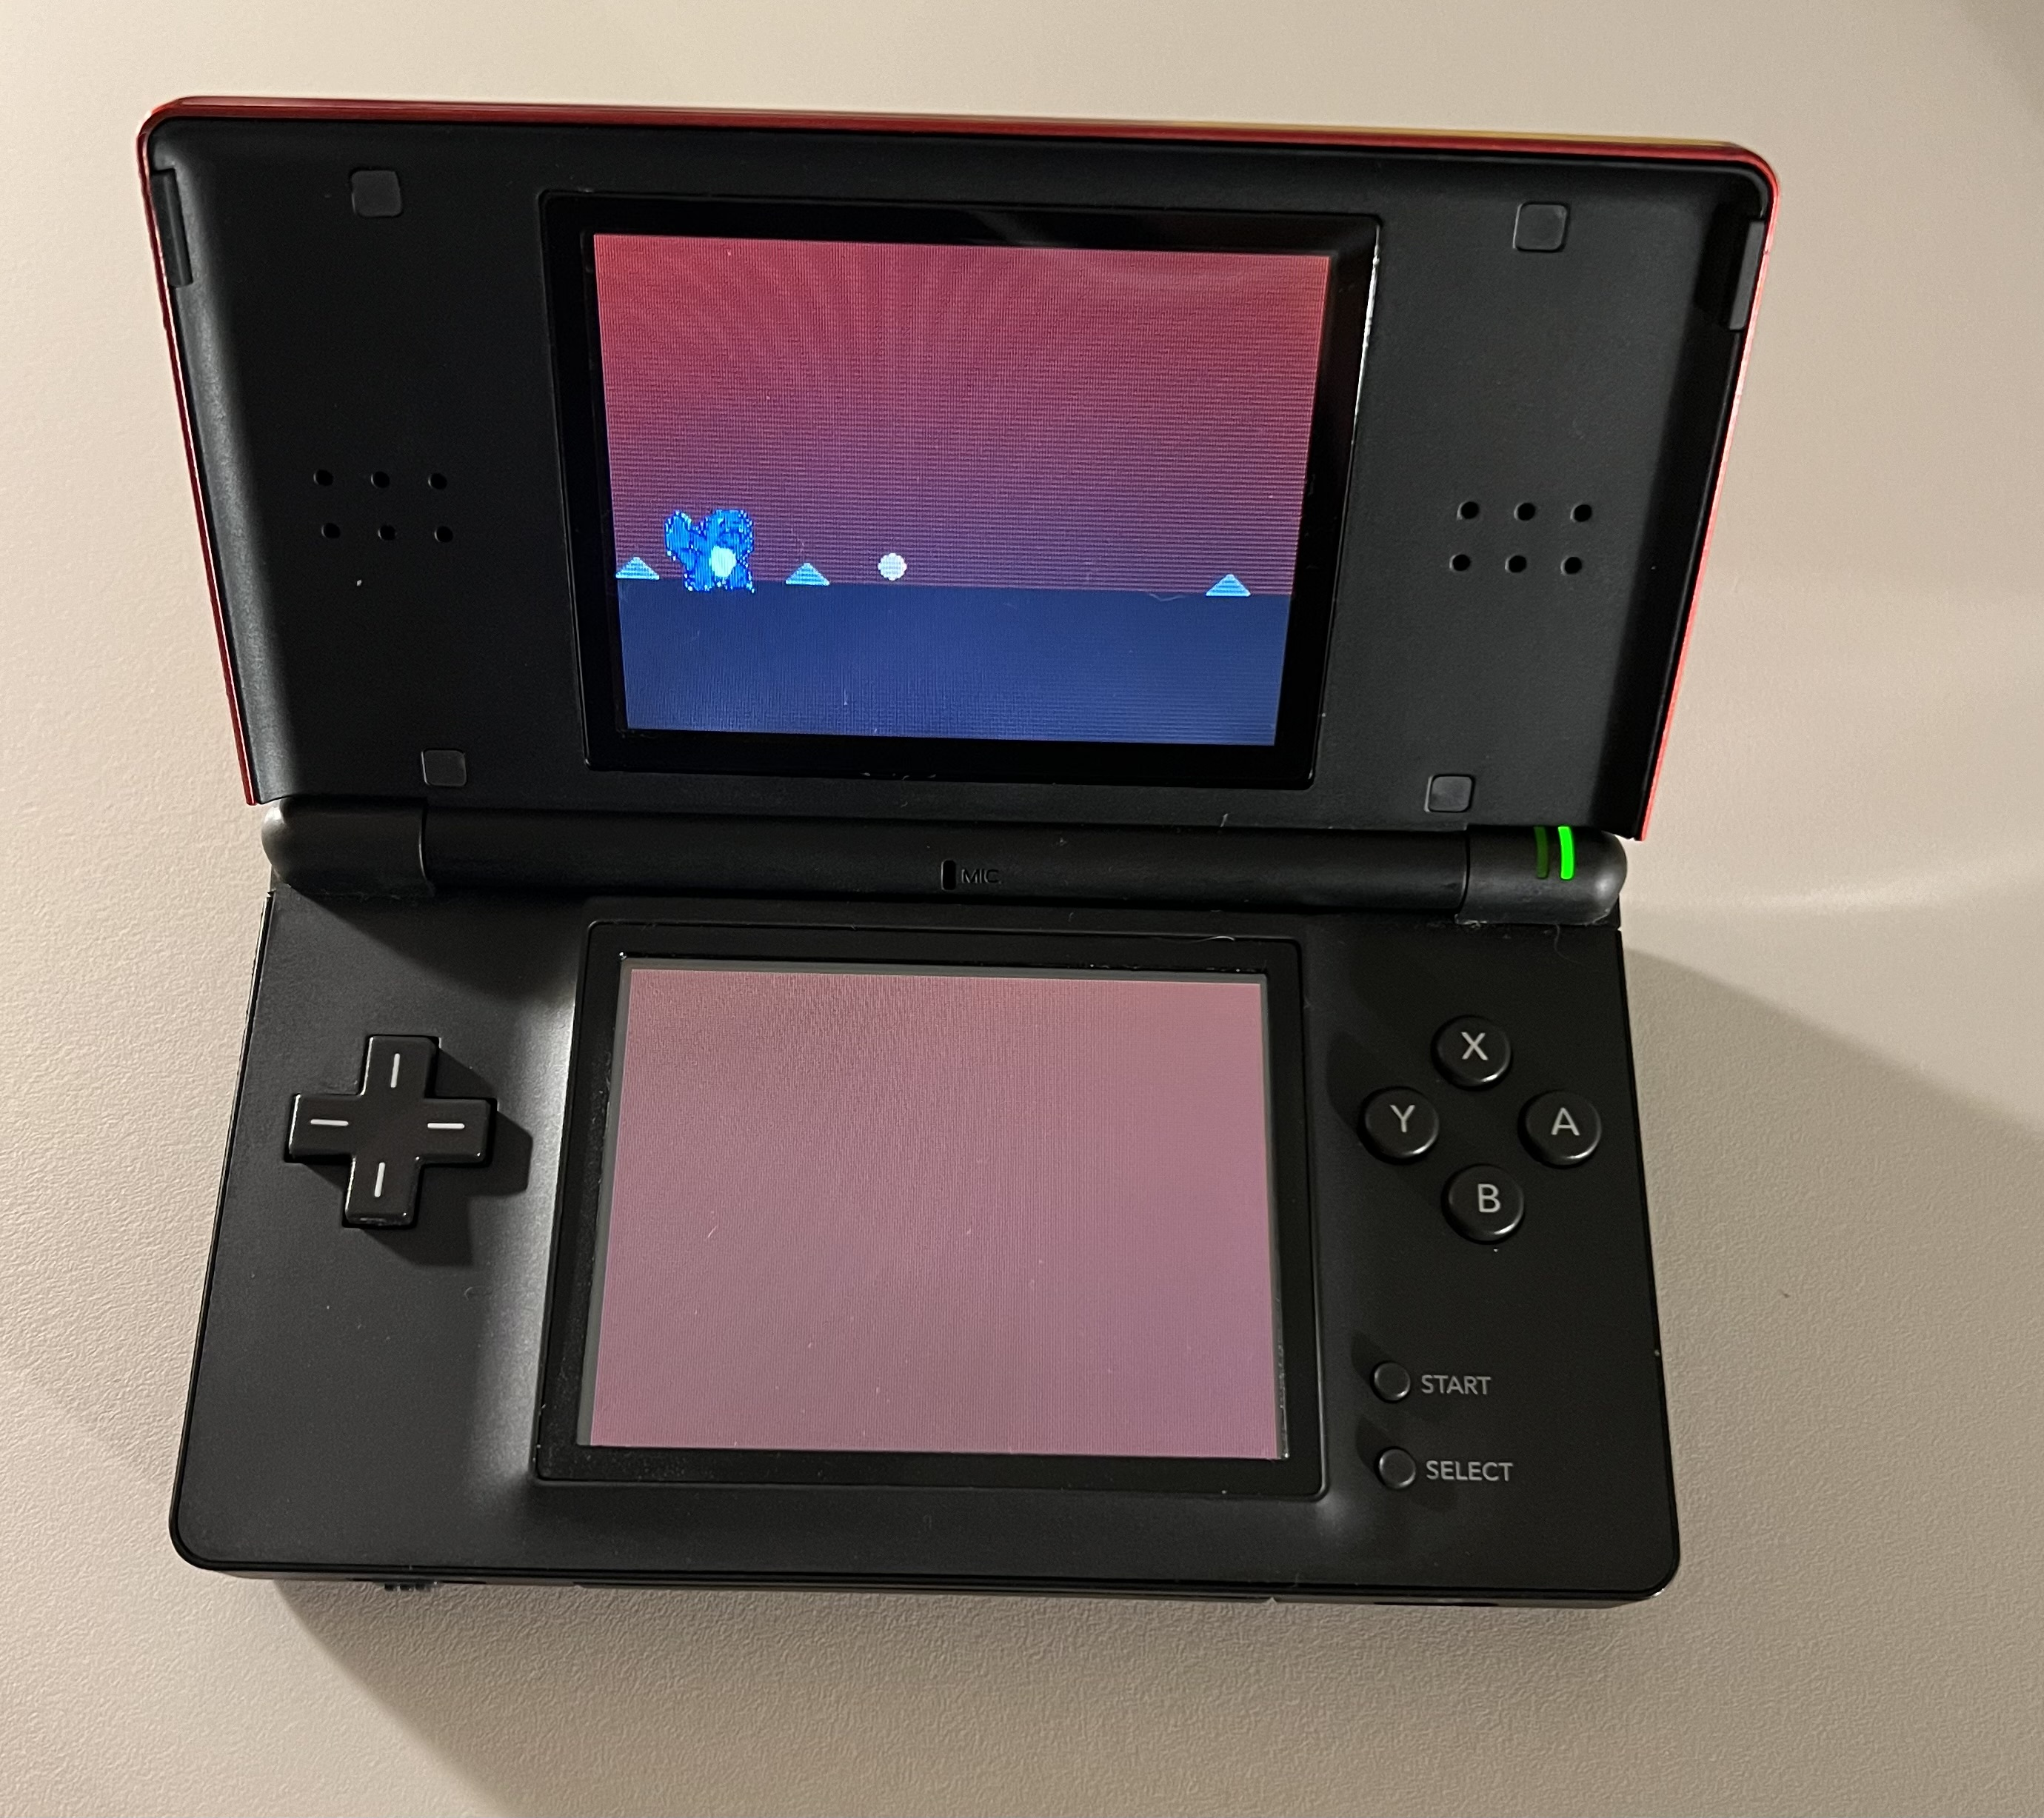
NDS project screenshot
Include an image with the final view/s of your project on the actual NDS device

