Slide 1
FOAM: Searching for Hardware Optimal SPN Structures and Components with Fair Comparison
Khoongming Khoo, DSO
Thomas Peyrin, NTU
Axel Y. Poschmann, NXP Semiconductors
Huihui Yap, DSO

Slide 2
Outline
Motivation
SPN Structures: Extended AES Permutations
FOAM: Figure of Adversarial Metric
Optimal Diffusion Matrices
FOAM Comparison Example

Slide 3
Motivation
Existing: FOM (Figure Of Merit), power-throughtput trade-off.
This work: FOAM (Figure Of Adversarial Merit), power-throughput-security trade-off
Fairer Comparison: E.g. PRESENT much lighter than AES but not as secure (according to best crytanalysis)
Focus: We apply FOAM on Extended AES Permutations

Slide 4
Our Goal
To help designers to get an easy method to assess what would be the best cipher and hash construction

Slide 5
Extended AES Permutation

Slide 6
Extended AES Permutation
Iterate a AES-like cipher for R rounds
AES uses 4 by 4 state array, we use r (rows) by c (columns) state array
Each round consists of the following step:
Substitution layer
MixColumns
Generalized ShiftRow
AddRoundkey

Slide 7
Component Choice
State array is r rows by c columns
Substitution layer: 4-bit PRESENT or 8-bit AES Sboxes
MixColumns Matrix:
r by r Circulant or Serial Matrices.
Branch number B is between 3 to r+1.
Finite field representation and subfield construction choose-able
Generalized ShiftRow: Do uniform mixing across columns
Implementation Model: Each round is fully serialized or fully round-based.
Many Options: By considering some of the above options for 64-bit blocksize, we already need to compare more than 300 cases.

Slide 8
Example
Consider a 8 by 3 byte-array (192-bit blocksize).
Apply S-box to each of the 24 cells (e.g. use AES S-box with DC and LC prob = 2⁻⁶)
A₁ | B₁ | C₁
A₂ | B₂ | C₂
A₃ | B₃ | C₃
A₄ | B₄ | C₄
A₅ | B₅ | C₅
A₆ | B₆ | C₆
A₇ | B₇ | C₇
A₈ | B₈ | C₈

Slide 9
Example
Consider a 8 by 3 byte-array (192-bit blocksize).
Apply S-box to each of the 24 cells (e.g. use AES S-box with DC prob = 2⁻⁶)
Apply 8 by 8 Diffusion matrix on each column (e.g., let branch number B=7)
A₁ | B₁ | C₁
A₂ | B₂ | C₂
A₃ | B₃ | C₃
A₄ | B₄ | C₄
A₅ | B₅ | C₅
A₆ | B₆ | C₆
A₇ | B₇ | C₇
A₈ | B₈ | C₈

Slide 10
Example
Can we know in advance if this particular construction is a good starting point ?
Consider a 8 by 3 byte-array (192-bit blocksize).
Apply S-box to each of the 24 cells (e.g. use AES S-box with DC prob = 2⁻⁶)
Apply 8 by 8 Diffusion matrix on each column (e.g., let branch number B=7)
Generalized Shiftrow (uniform mixing across columns below)
A₁ | B₁ | C₁
A₂ | B₂ | C₂
A₃ | B₃ | C₃
A₄ | B₄ | C₄
A₅ | B₅ | C₅
A₆ | B₆ | C₆
A₇ | B₇ | C₇
A₈ | B₈ | C₈
A₁ | B₁ | C₁
A₂ | B₂ | C₂
A₃ | B₃ | C₃
C₄ | A₄ | B₄
C₅ | A₅ | B₅
C₆ | A₆ | B₆
B₇ | C₇ | A₇
B₈ | C₈ | A₈
Shift 0
Shift 1
Shift 2

Slide 11
Differential/Linear Cryptanalysis Security Bound
When r ≤ c, number of active Sboxes over 4 rounds is ≥ B² where B is branch number (known result)
When r > c, Theorem 1 in the paper allows us to compute number of active Sboxes over 4 rounds
Previous example: r=8, c=3, B=7 implies number of active AES-Sboxes over 4 rounds is ≥ 21.
DC/LC characteristic probability over 4 rounds is (2⁻⁶)²¹ = 2⁻¹²⁶
8 rounds provide sufficient security because (2⁻¹²⁶)² = 2⁻²⁵² < 2⁻¹⁹²

Slide 12
FOAM: Figure of Adversarial Merit

Slide 13
FOAM: Figure of Adversarial Merit
FOAM is defined by:
FOAM(x) = 1/(S(x) × A²)
S(x) = p(x) × t
p(x) is the number of rounds to achieve security level x
t is number of clock cycles per round
S(x) is number of clock cycles to achieve security level x
Example: In AES, p(2¹²⁸) = 4 for DC/LC. If each round takes 1 clock cycle, then S(2¹²⁸) = 4.
No need to restrict to DC/LC, can define S(x) for other attacks
A is the area requirements (in GE for ASIC)

Slide 14
Hardware Implementation
The area requirements A is split into 6 parts:
C_{mem}: Memory Cost
C_{sbox}: S-boxes Cost
C_{diff}: Diffusion matrix Cost
C_{cst}: Constant addition Cost
C_{log}: Control logic cost
C_{io}: Input/Output logic cost
A = C_{mem} + C_{sbox} + C_{diff} + C_{cst} + C_{log} + C_{io}

Slide 15
Optimal Diffusion Matrices

Slide 16
Lightweight Coefficient
Conventional wisdom:
Low Hamming weight = Lightweight multiplication
Consider GF(2⁸) defined by 0x11b, i.e. α⁸+α⁴+α³+α+1 = 0
0x04⋅x = α²⋅(x₇α⁷+x₆α⁶+x₅α⁵+x₄α⁴+x₃α³+x₂α²+x₁α+x₀)
= (x₅, x₄, x₃+x₇, x₂+x₆+x₇, x₁+x₆, x₀+x₇, x₆+x₇, x₆)
0x08⋅x = α³⋅(x₇α⁷+x₆α⁶+x₅α⁵+x₄α⁴+x₃α³+x₂α²+x₁α+x₀)
= (x₄, x₃+x₇, x₂+x₆+x₇, x₁+x₅+x₆, x₀+x₅+x₇, x₆+x₇, x₅+x₆, x₅)
0x8d⋅x = (α⁷+α³+α²+1)⋅x
= (x₀, x₇, x₆, x₅, x₀+x₄, x₀+x₃, x₂, x₀+x₁)
0x04 weight 1
6 XORs
0x08 weight 1
9 XORs
0x8d weight 4
Only 3 XORs because of cancellation
Now we should NOT be looking at Hamming Weight, but total XOR count

Slide 17
Optimal Diffusion Matrices
Over GF(2⁸)/0x11b, we found MDS matrix circ(1,1,4,8d) [33 XORs per row] which is lighter than AES (MDS) matrix circ(2,3,1,1) [38 XORs per row]
Our matrix: 132 XORs
AES matrix:
152 XORs

Slide 18
Subfield Construction
Main Idea: We can split each byte into two nibbles and apply GF(2⁴)-MDS matrix on each half [interleaving].
We still get MDS matrix over GF(2⁸) in this way, but can be lighter
MDS Matrix | XOR
Two copies of circ(1,1,4,9) over GF(2⁴)/0x13 | 60×2 = 120
circ(1,1,4,8d) over GF(2⁸)/0x11b | 132
AES matrix circ(2,3,1,1) over GF(2⁸)/0x11b | 152

Slide 19
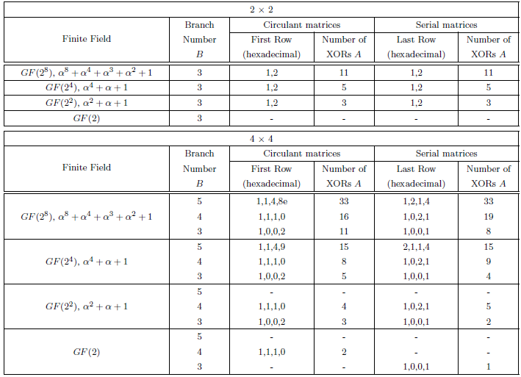
Optimal 2×2, 4×4 Matrices

Slide 20
FOAM Comparison Example

Slide 21
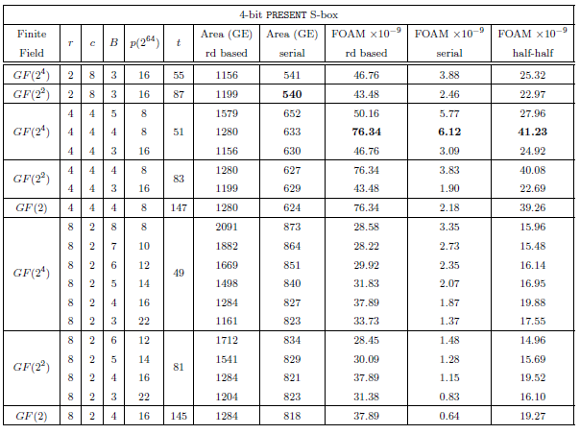
FOAM Comparison (64-bit Blocksize, r×r Circulant Matrix, PRESENT S-box)

Slide 22
Observations on 64-bit FOAM with PRESENT Sbox
For previous table, we fix 64-bit blocksize and PRESENT Sbox
We vary the state array geometry and diffusion matrix
Best Results: 4 by 4 array using almost-MDS matrix with B=4 for round-based, serial and half-half implementations
For different block-sizes, optimal design uses other geometries and branch number

Slide 23
Conclusion
Introduced FOAM (Figure Of Adversarial Metric) for power-throughput-security trade-off.
Fairer comparison for different designs
Allows designers to very easily estimate which design choice should be the best
Proved new 4-round security bound for generalized AES-structure for r by c design (r > c).

Slide 24
Conclusion (cont’d)
Found new diffusion matrices (both circulant and serial) better than AES, PHOTON and LED by studying XOR-count
Introduced a model for estimating hardware cost for round based and serial implementations
Studied the 64-bit SPN structures case, and we provide constructions with the best FOAM. This confirm some general trends.
Can do the same for other block sizes.

Slide 25
Future Work
We can compute FOAM for other variations:
Different Sboxes (not just AES, PRESENT but also Khazad, Whirlpool Sboxes)
Different Structures (not just SPN but also Feistel, GFN)
Different Diffusion Matrix types (not just circulant, serial but also Hadamard, Cauchy, Involution)
Different use-cases (not just encryption only but also encryption and decryption, involution)
Different platforms (not just hardware but also software)
New implementation estimation models (not just fully serialized or fully round based but in between)

Slide 26
Thank you!
Full paper can be found at https://eprint.iacr.org/2014/530.pdf

