Slide 1
Fraud Detection Within The Hut Group
Thomas Pinder, Nicholas Abad, Julie Sun, Omar Khan, Luke Lorenzi, Mengnan Sun
Notes:
Aimed at academics

Slide 2
Project Background

Slide 3
What is The Hut Group?
E-commerce company that sells a wide range of products to customers all over the world
Why is detecting fraud important?
Helps limit the amount of money lost via fraudsters
How does the fraud process work at The Hut Group?
Use an automated program to flag a transaction as potential fraud
Pass these individual suspicious transactions to someone who determines if the transaction will be approved

Slide 4
Aims & Objectives

Slide 5
Goal: Build an artificial fraud investigator to understand and explain fraudulent behaviour
Analyze 3 main .csv files in order to detect fraud within a three month period between March 2016 and May 2016
Determine the importance of each of the preexisting variables and attempt to develop new ones
Statistically analyze our model
Make predictions and conclusions based on that model

Slide 6
Overview of steps taken to detect fraud

Slide 7
Discuss fraud with The Hut Group
Research and understand current fraud research
Determine language and technologies to use
Perform feature engineering to extract more information from pre-existing variables
Determine importance of both original and new variables
Use logistic regression to determine whether a transaction is more likely to be fraudulent

Slide 8
Understanding the data and current fraud research

Slide 9
Data came from 3 main .csv files with lookup tables with over 418,000 observations for our main transaction page
Originally given variables such as account key, location, date of transaction, category of item, delivery option, etc.
Not much publicly available literature on current fraud research

Slide 10
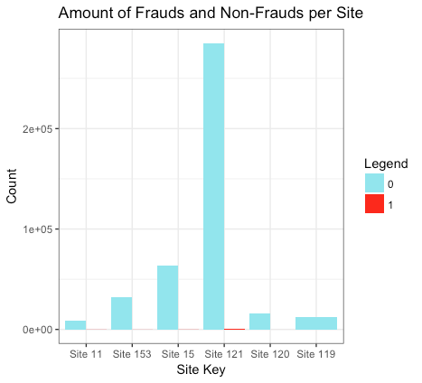
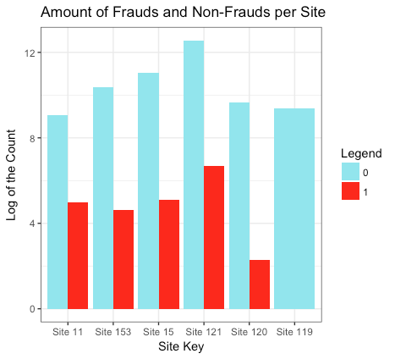

Slide 11
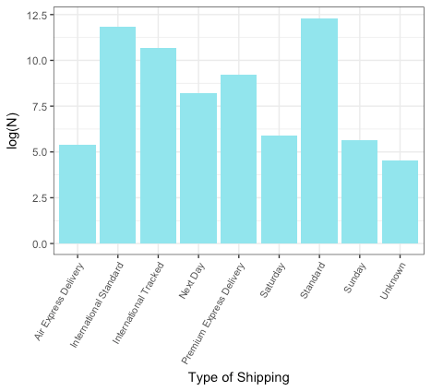
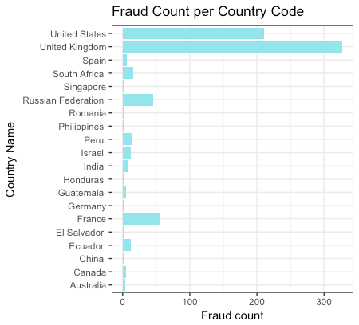

Slide 12
Cleaning Data and Feature Engineering

Slide 13
Joined together three separate .csv files in R to create one large data frame with 42 unique variables
In order to extract more information from our data, we engineered new variables from the original variables that we were given
Examples of these include
Notes:
Talk about examples of missing data

Slide 14
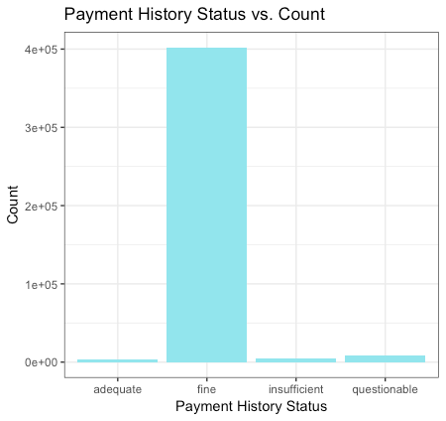
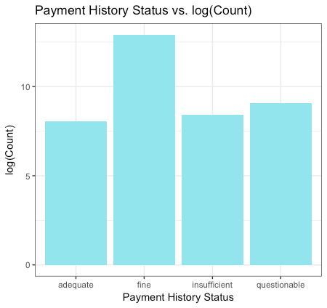

Slide 15
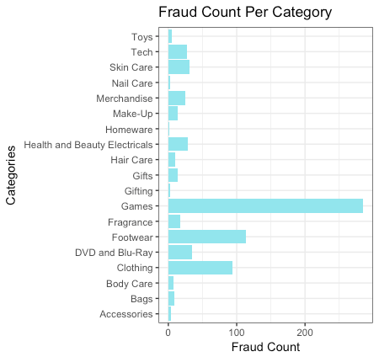

Slide 16
Examples of new variables created
*** Wait until random forest / variable importance to talk about those here ***
Prop, customer trustworthiness, status, some one-hot encoding DVD, footwear and skincare ranked highly

Slide 17
Problems with data:
Missing data and received NA for several values
One-hot encoding didn’t quite work
Disproportionate dataset with not very many frauds

Slide 18
Modeling

Slide 19
Disproportionate dataset
Only 0.29% of our dataset were classified as fraudulent
To account for this, we undersampled the non-fraudulent observations and created “synthetic” examples of fraudulent data through a method called SMOTE
SMOTE (Synthetic Minority Over-Sampling Technique)

Slide 20
Synthetic Minority Over-Sampling Technique (SMOTE)
“The minority class is over-sampled by taking each minority class sample and introducing synthetic examples along the line segments joining any/all of the k minority class nearest neighbors”
Notes:
Make this look nicer

Slide 21
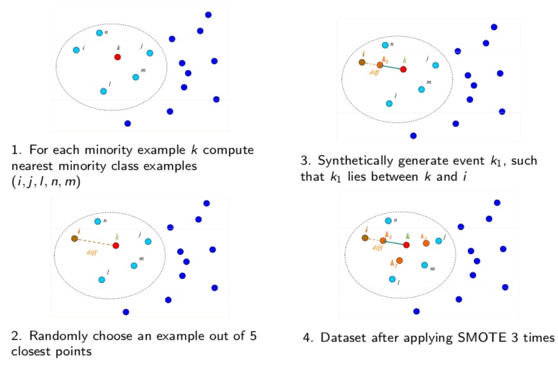

Slide 22
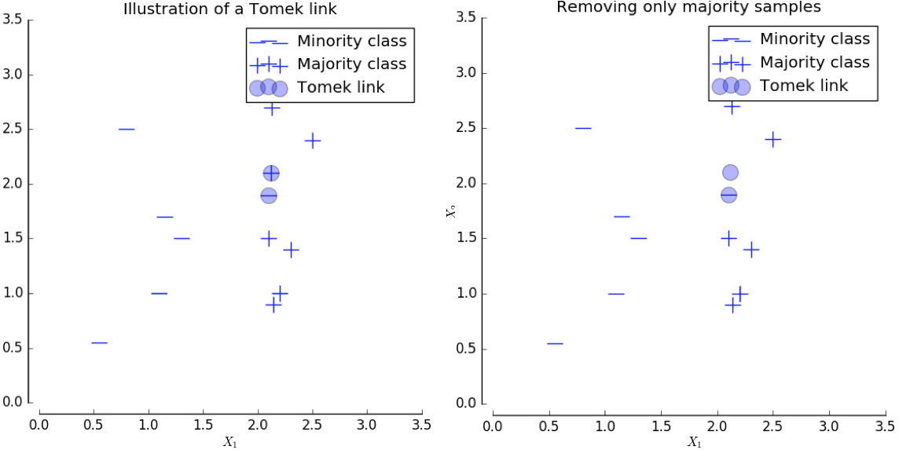

Slide 23
Stratifying on the 5 separate site keys but used every observation of fraud
Result of the training data set is …
Both Type I and II errors were equally as detrimental to the company

Slide 24
Why use logistic regression?
The Hut Group previously used logistic regression within their fraud detection department
Response variable can only take 2 possible values
Easy to interpret in comparison to other models such as random forests or neural networks
There are examples of past research papers that have used logistic regression for fraud detection

Slide 25
Why use Random Forests? (maybe?)

Slide 26
Results

Slide 27
Steps of Analysis

Slide 28




 | Accuracy | Recall | Precision | F-Score | AUC
Logistic Regression | 89.6 | 53.5 | 8.4 | 14.5 | 78.3
Random Forest | 98.9 | 59.2 | 71.2 | 64.6 | 93.7

Slide 29
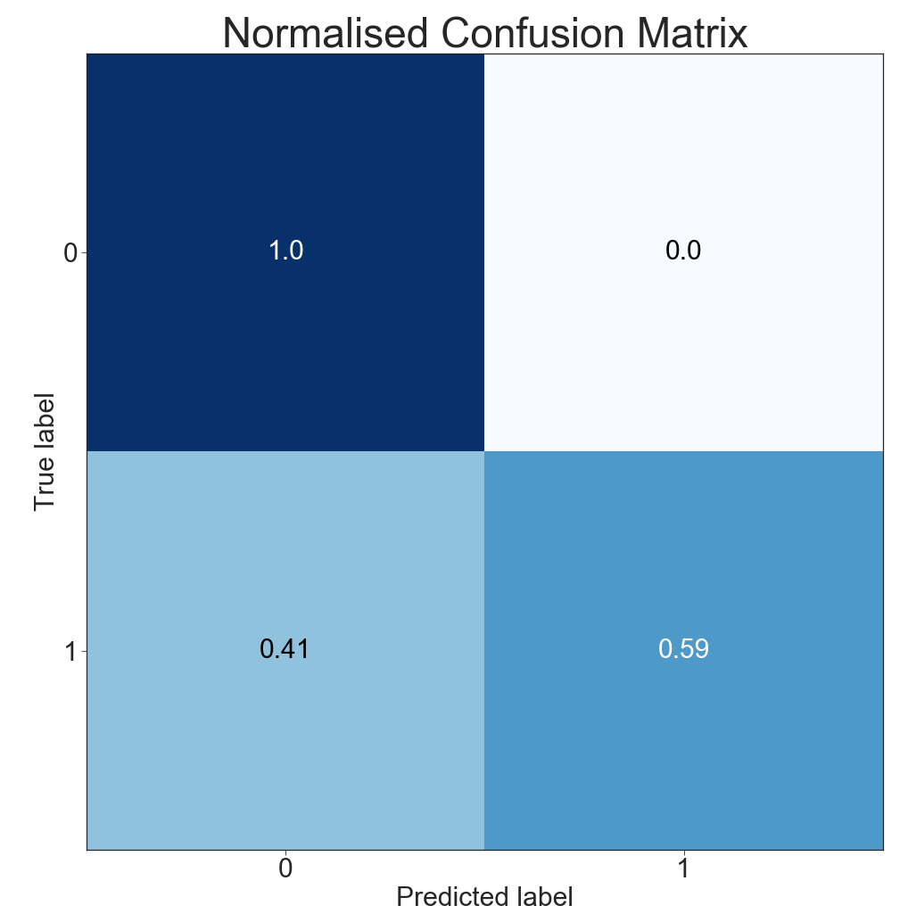
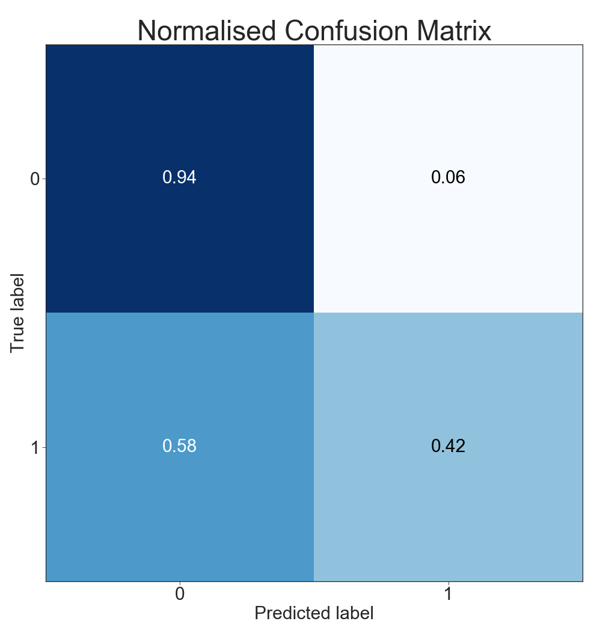
Normalised Confusion Matrix
Logitstic Regression
Random Forest

Slide 30
Bias and Validity concerns

Slide 31
Bias and Validity concerns:
Undersampling the amount of non-frauds using SMOTE
Oversampling the amount of frauds using TOMEK
External Validity / Generalizability
Only received data during a three month period
Reporting Bias
Some observations may have gone through the system as non-fraudulent when in reality they actually are fraudulent
Stratifying on the 6 unique account keys rather than using the entire data set
Notes:
External validity concerns due to only sampling for a 3 month period

Slide 32
Conclusions

Slide 33
Page saved for conclusion

Slide 34
Thank You For Listening.
Are There Any Questions?

