Slide 1
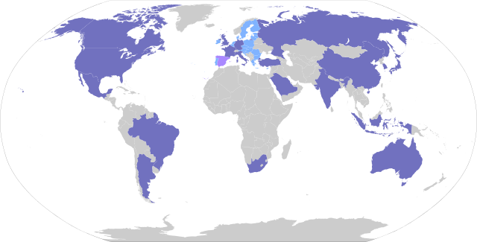
Map Quiz 1: The G-20 Major Economies
The G-20 is the group of 20 countries that dominate the global economy.
They account for about 80% of world economic output, measured by Gross Domestic Product, or GDP.
There are only 19 countries in the G-20.
The 20th is the European Union.
You probably already know most of these. Soon, you will know all of them, and be able to ID them on a world map.

Slide 2
Map Quiz 1: The G-20 Major Economies
On a blank map, you will label the 19 member states of the G-20.
The names of the 19 will not be provided.

Slide 3
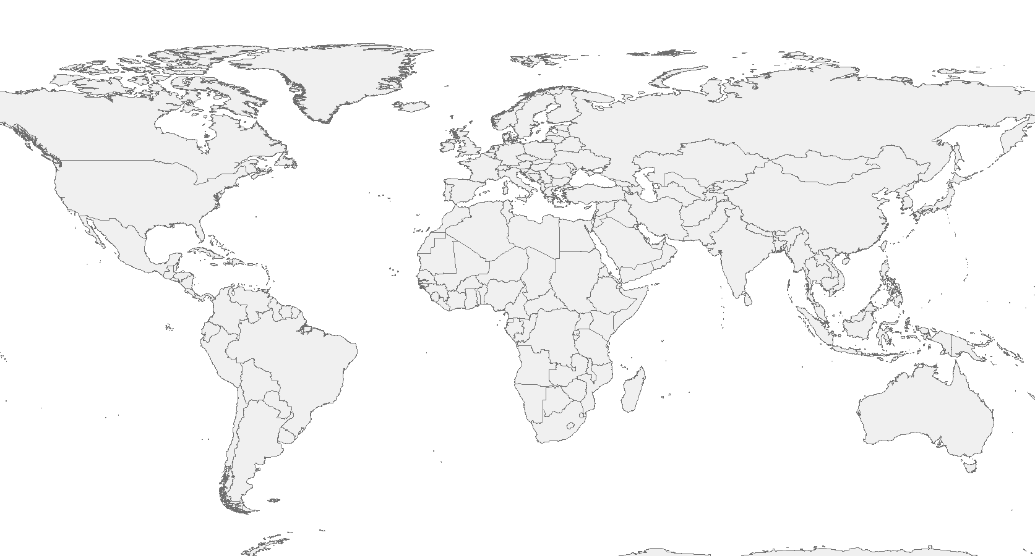
“Label the 19 countries of the G-20”

Slide 4
