Slide 1
PDIP PRIMER
Global Administrator | Post Administrator | Approver

Slide 2
Prerequisite
Make sure you’ve first seen the Standard User Primer, as it covers all the basics of this Powerpoint presentation

Slide 3
Approver
Approves submitted documents for publication
Publishes documents
Rejects submissions

Slide 4
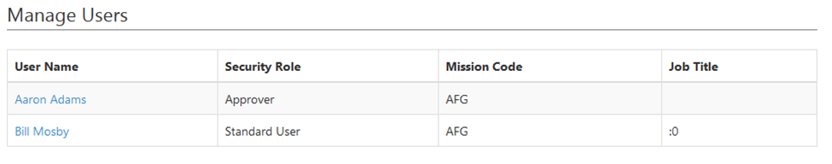
Post Administrator
Access to Users page
Select a name to open a dialogue
Modifies security role and job title
Can’t change mission code

Slide 5
Global Administrator

Slide 6
Plans
Normally shows working drafts and published plans for a mission
Link on bottom reveals every draft and published plan

Slide 7
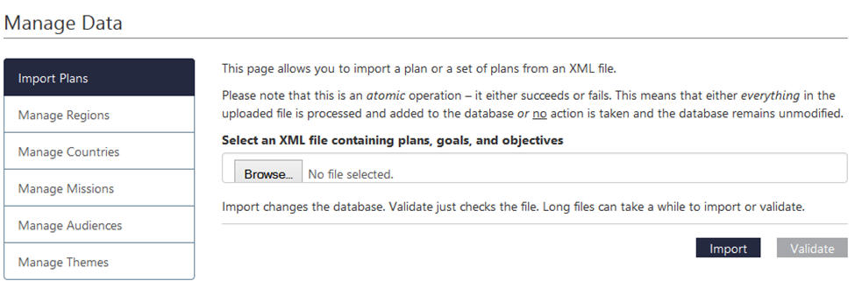
Manage Data
Only available to Global Administrators
Six sub-pages
Import Plans: plans can be initially imported into the database from XML files, and validated to check if working

Slide 8
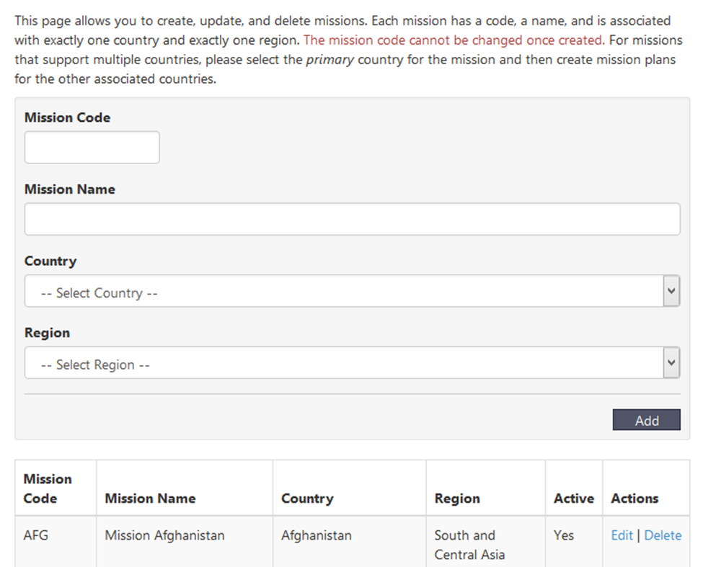
Manage Missions
Mission creation requires
Mission code (alphanumeric characters).
Mission Name
Country (list selection)
Region (list selection)

Slide 9
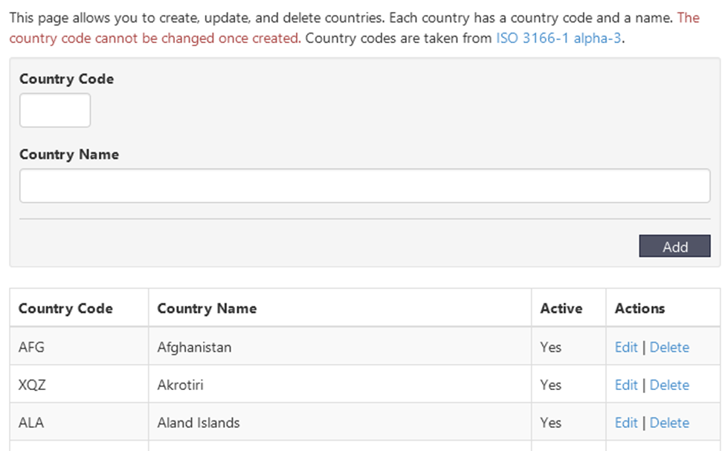
Manage Countries
Similar controls to Missions
Country codes follow ISO 3166-1 alpha-3

Slide 10
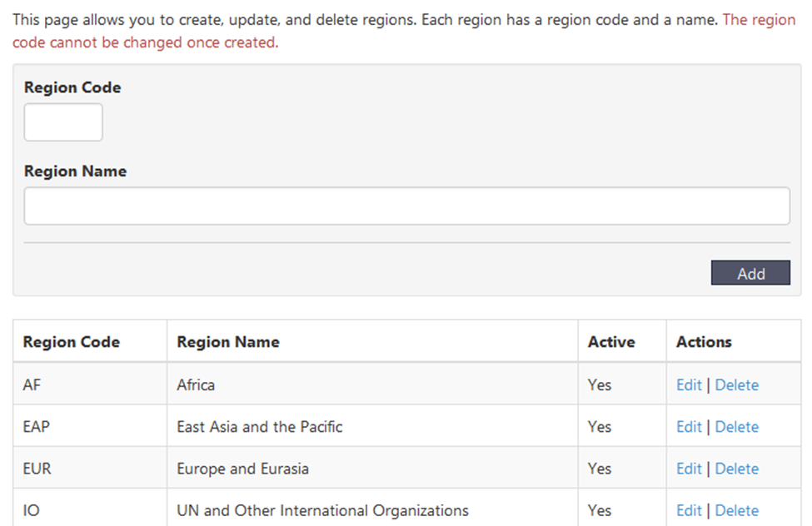
Manage Regions
Same controls as countries
The region code cannot be changed once created

Slide 11
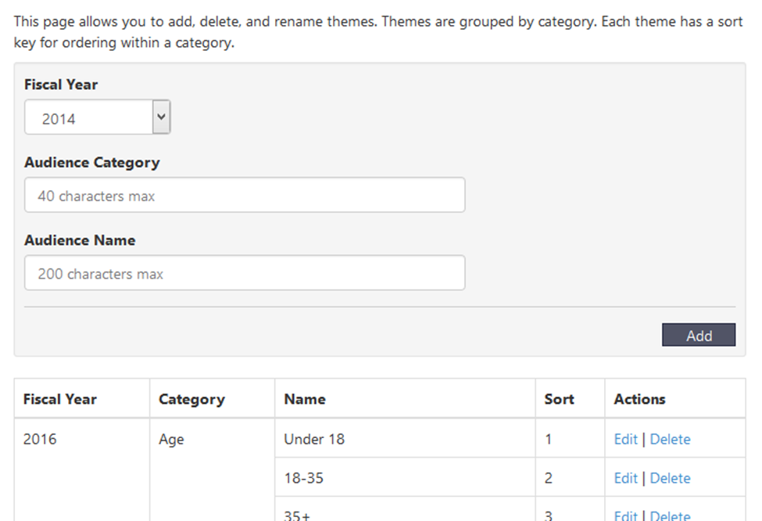
Manage Audiences
Create, edit, and delete audiences
Audiences require:
Fiscal year (list selection)
Category
Name

Slide 12
Manage Themes
You’re allowed to add, delete, and rename themes.
Themes are grouped by category.
Click Add to save your changes.

Slide 13
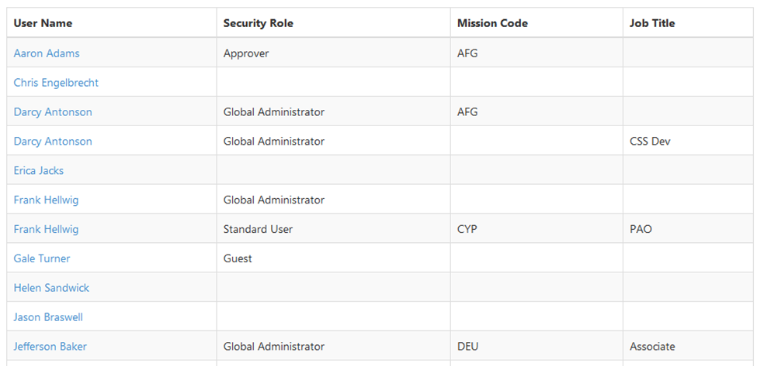
Users
Add, view, edit all user accounts
Set mission code of users

Slide 14
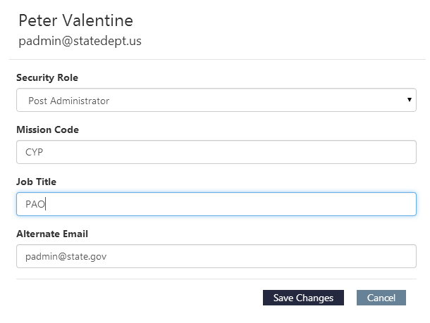
Editing Users
After you’ve clicked on a name to edit, a small window will pop up and give a list of items that are able to be changed.
Click on Save Changes if you want to save your new changes.
If you don’t wish to save your changes then click on the Cancel button.

Slide 15
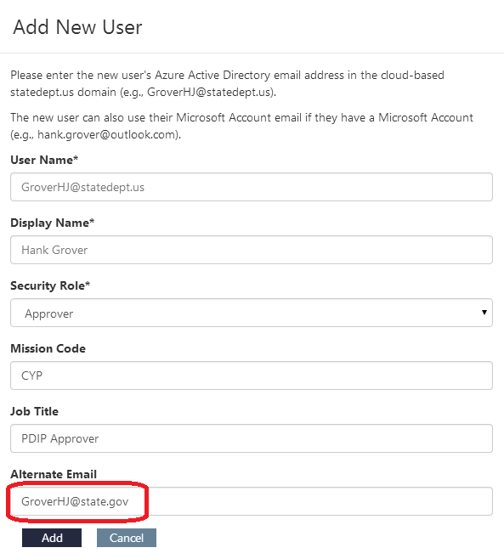
Adding New Users
Enter the new user’s Azure Active Directory email address in the cloud-based statedept.us domain (e.g., GroverHJ@statedept.us).
The new user can also use their Microsoft Account email if they have a Microsoft Account (e.g., hank.grover@outlook.com).
Your state department email address should go into the alternate email field as indicated on the right.
Click the Add button to save the new user that you’ve just created.

