Slide 1
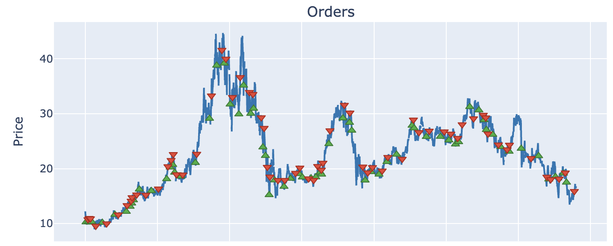
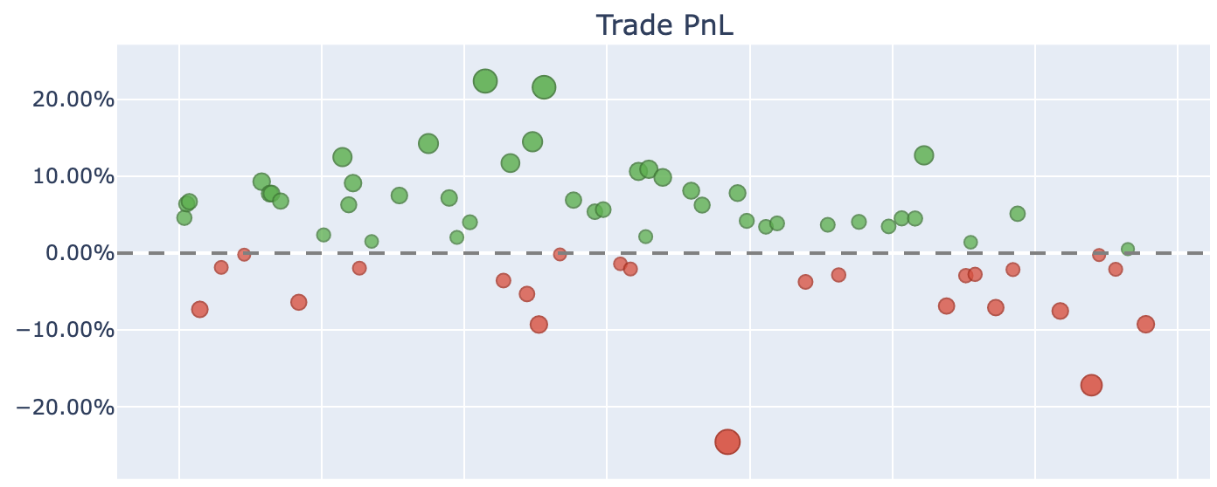

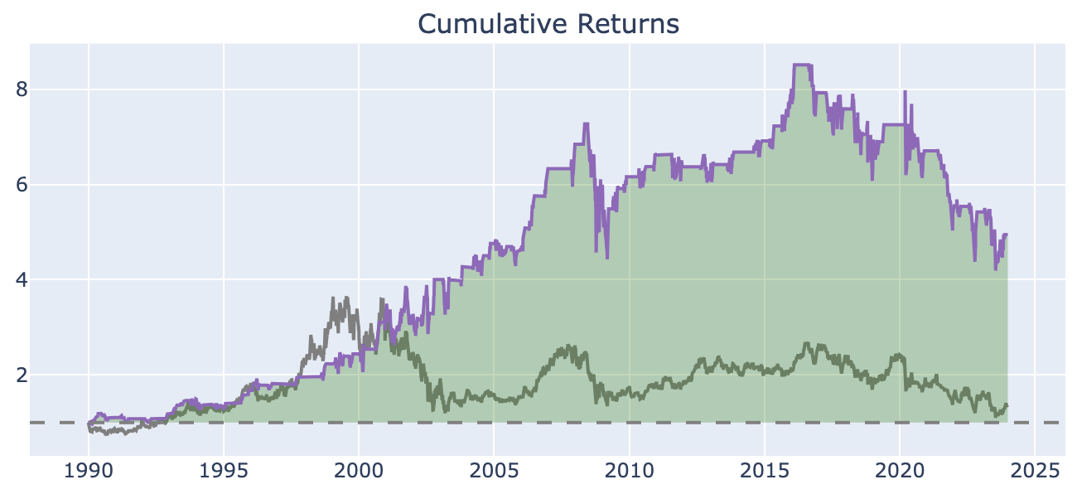
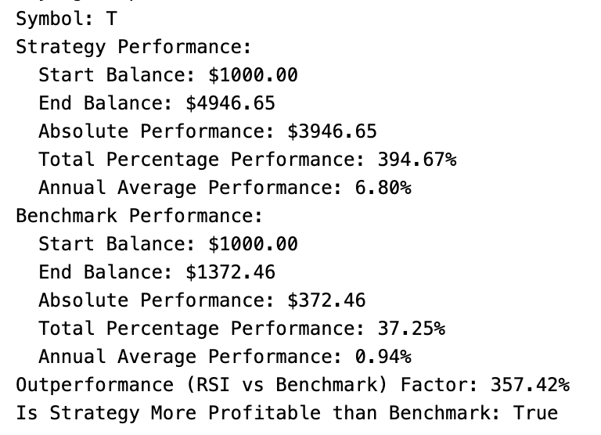

Slide 2
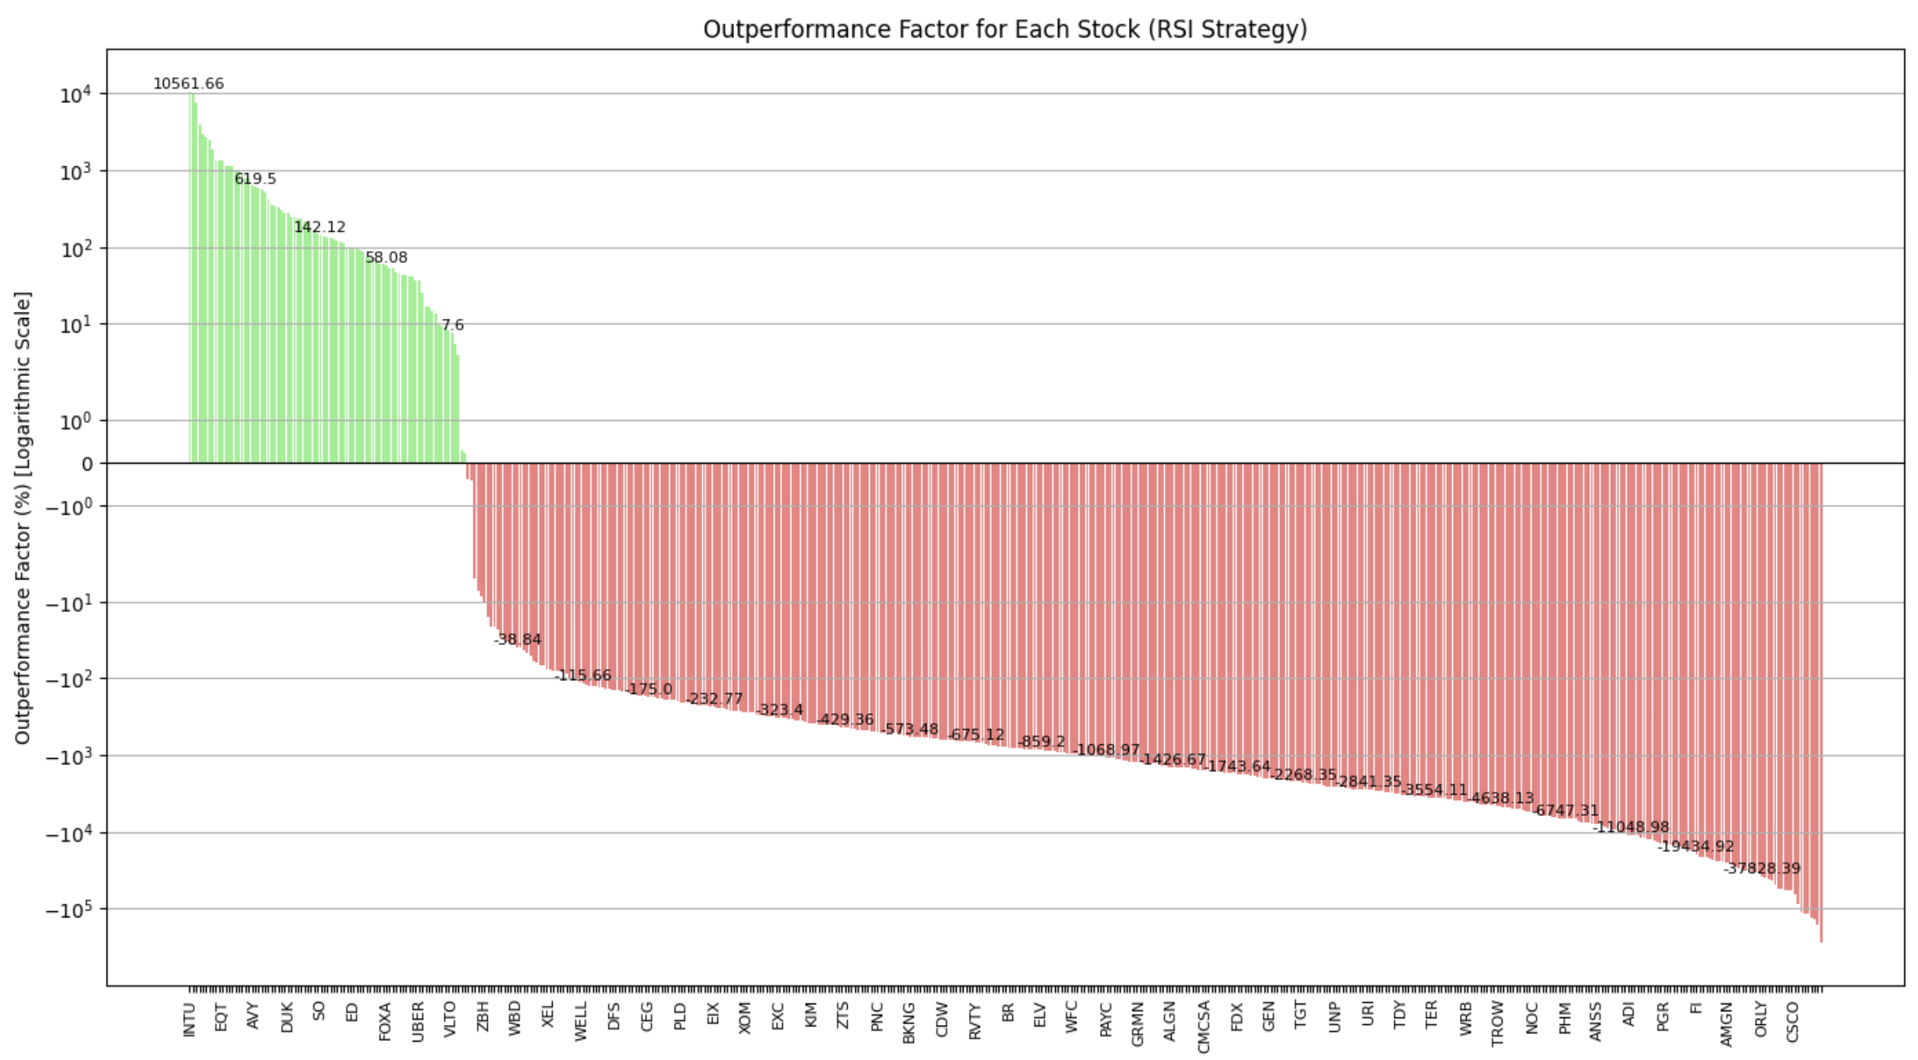
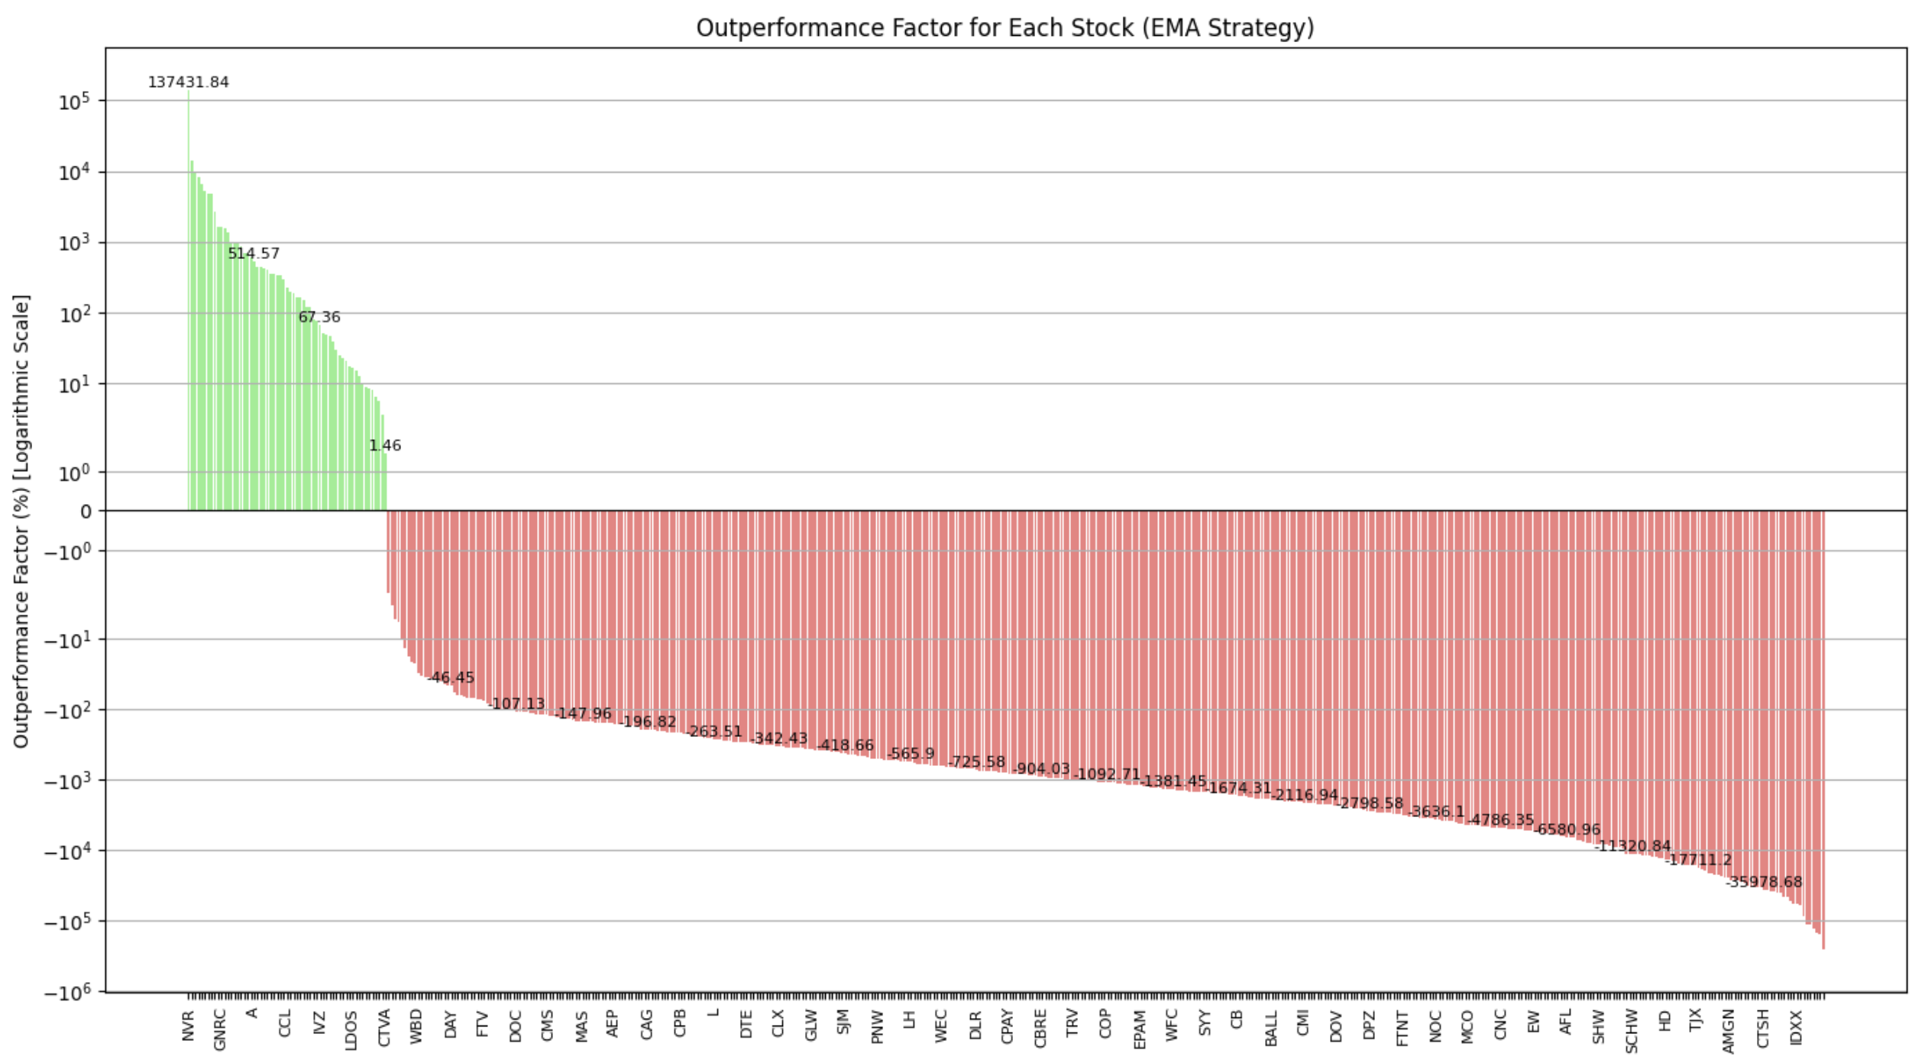
Avg. Outperformance Factor: -6209.03%
499 symbols
85 symbols more profitable than benchmark (17.03%)
414 symbols less profitable than benchmark (82.97%)
Avg. Outperformance Factor: -5570.44%
499 symbols
61 symbols more profitable than benchmark (12.22%)
438 symbols less profitable than benchmark (87.88%)

