Slide 1
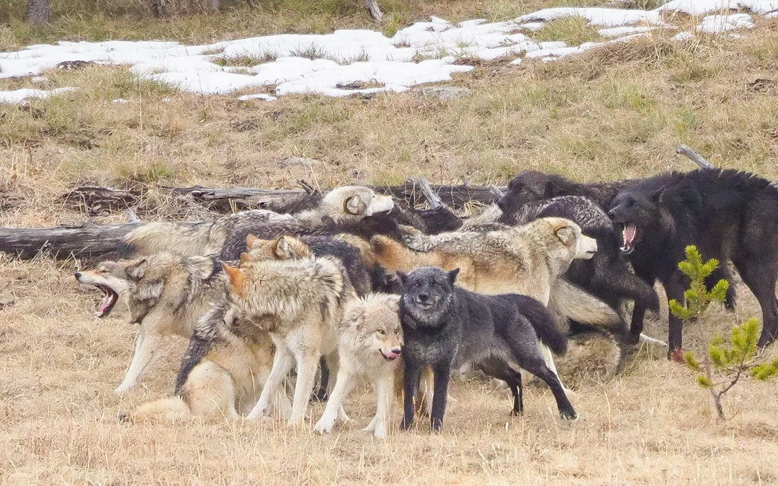

Lecture 2b: How do MCMC samplers work and how much do priors matter?
Also: how many wolves are in an average wolf pack?
Code gently borrowed from Kéry & Kellner (2024) Academic Press

Slide 2
Outline
Where do posterior distributions come from?
How can we directly understand and visualize the effects of priors?
Some thoughts about ‘sampling good’

Slide 3


Let’s imagine (and simulate) a dataset: counts (y) of wolf pack size
$$μ=6.068$$
$$σ^{2}=6.192$$
$$se=0.111$$

Slide 4

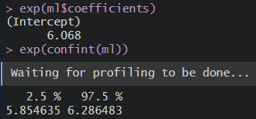
And calculate our best (ML) estimate given the data

Slide 5
Note I’m taking the exponent of our parameter estimates

Slide 6
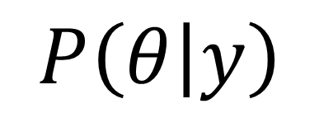
We want to obtain a posterior distribution (estimate) for pack size
$$P\left(θ | y\right)$$

Slide 7
Posterior distributions are composed of many samples

Slide 8
Where do these samples come from?
How do we do that?

Slide 9
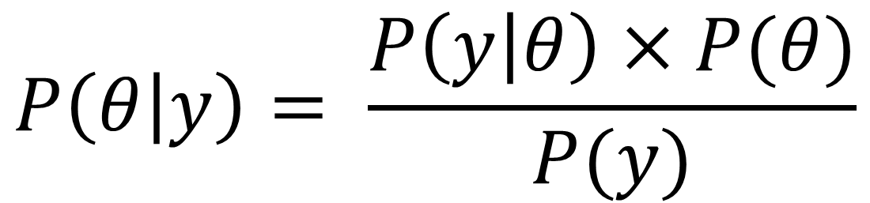
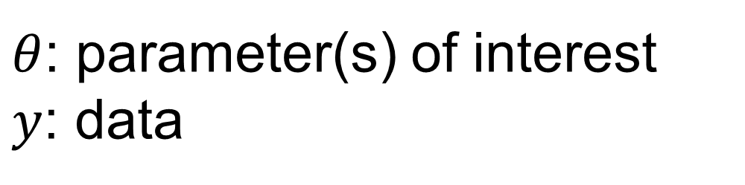
BAYES THEOREM
$$P\left(θ | y\right)= \frac{P\left(y | θ\right)×P(θ)}{P(y)}$$
$θ$: parameter(s) of interest
$y$: data

Slide 10
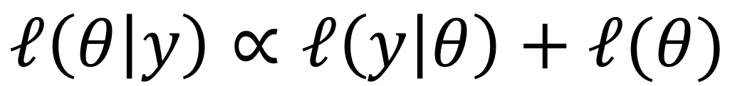
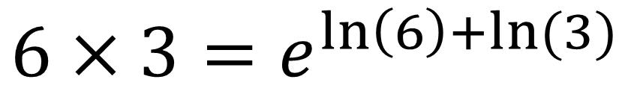
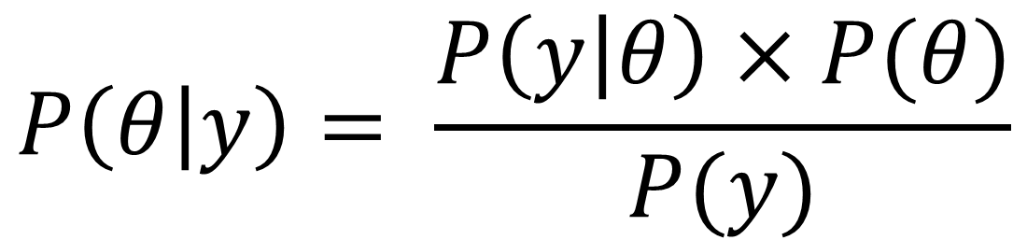
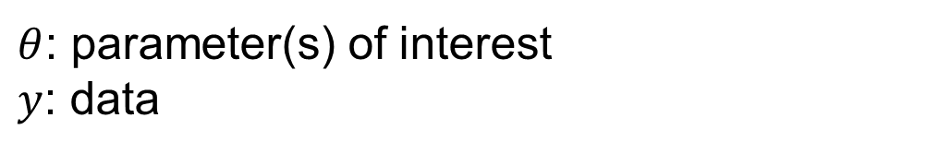
BAYES THEOREM
$$P\left(θ | y\right)= \frac{P\left(y | θ\right)×P(θ)}{P(y)}$$
$$ℓ\left(θ | y\right)∝ℓ\left(y | θ\right)+ℓ(θ)$$
$θ$: parameter(s) of interest
$y$: data
$$6×3=e^{\ln\left(6\right)+ln⁡(3)}$$

Slide 11
The key is in the name: Markov Chain Monte Carlo
We will generate these samples one at a time…

Slide 12
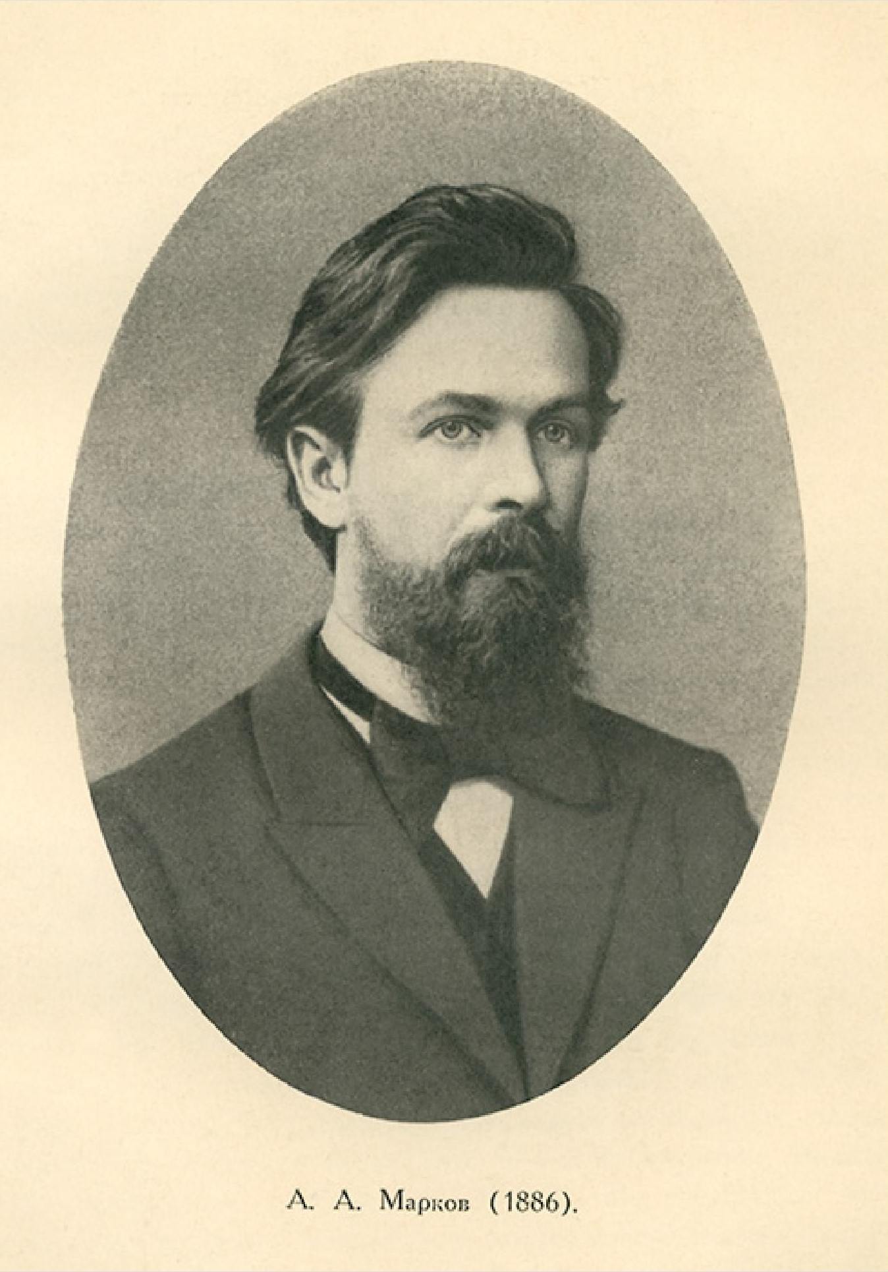
Markov Chain Monte Carlo
Andrey Markov (1856-1922)
Russian mathematician
Thesis: On the binary square forms with positive determinant
Dissertation: On certain applications of the algebraic continuous fractions
Markov Chains: stochastic processes on which the probability of an event depends (only) on the state attained in the previous event
e.g., multistate models, survival models, behavior models, step-selection functions, MCMC sampling, agent or individual based models
Alert
Eat
φ
Alive
1-φ
Dead
Run
Walk
1
Most (all?) things are Markovian.

Slide 13
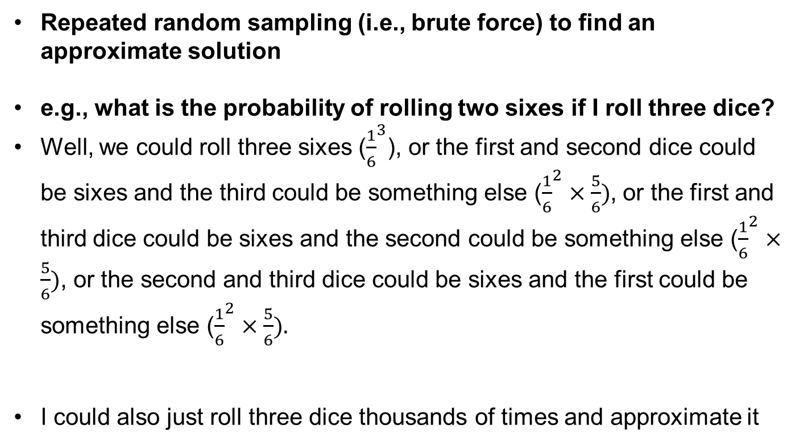
Markov Chain Monte Carlo
Repeated random sampling (i.e., brute force) to find an approximate solution
e.g., what is the probability of rolling two sixes if I roll three dice?
Well, we could roll three sixes (${\frac{1}{6}}^{3}$), or the first and second dice could be sixes and the third could be something else (${\frac{1}{6}}^{2}×\frac{5}{6})$, or the first and third dice could be sixes and the second could be something else (${\frac{1}{6}}^{2}×\frac{5}{6})$, or the second and third dice could be sixes and the first could be something else (${\frac{1}{6}}^{2}×\frac{5}{6}).$
I could also just roll three dice thousands of times and approximate it
$$P\left(≥two sixes from three rolls\right)={\frac{1}{6}}^{3}+3×\text{(}{\frac{1}{6}}^{2}×\frac{5}{6})=0.07407407$$

Slide 14
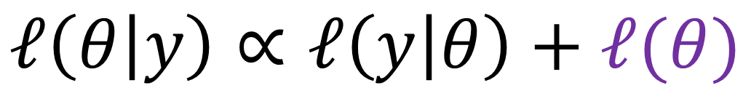
We need a prior…
$$ℓ\left(θ | y\right)∝ℓ\left(y | θ\right)+ℓ(θ)$$
Normal(0, 1)

Slide 15
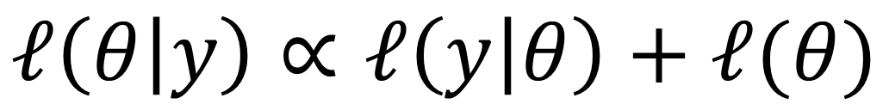
To build a chain we have to start somewhere (initial value[s])
$$ℓ\left(θ | y\right)∝ℓ\left(y | θ\right)+ℓ(θ)$$
Let’s start at 1 (remember, e¹)… why not?

Slide 16
To build a chain we have to start somewhere (initial value[s])
$$ℓ\left(θ | y\right)∝ℓ\left(y | θ\right)+ℓ(θ)$$
First, we’ll calculate the log-likelihood

Slide 17
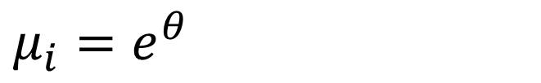
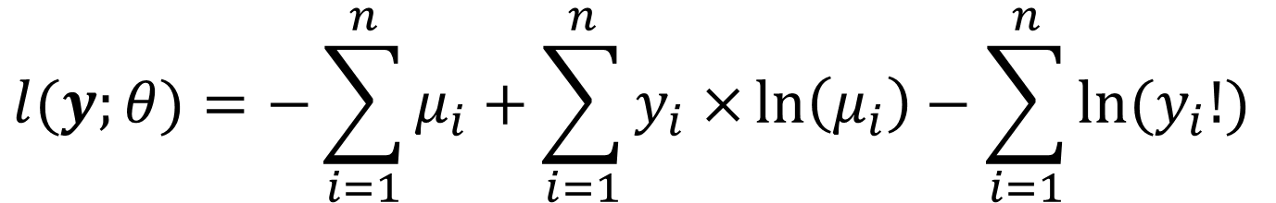

Poisson log-likelihood (a quick refresher or novel nosedive)
$$l⁡(y;θ)=−\sum_{i=1}^{n}{μ_{i}}+\sum_{i=1}^{n}{y_{i}×}\ln\left(μ_{i}\right)−\sum_{i=1}^{n}{ln⁡(y_{i}!) }$$
$$μ_{i}=e^{θ}$$
$$l⁡(y;θ)=−1914.989$$

Slide 18
Poisson log-likelihood (a quick refresher or novel nosedive)

Slide 19
To build a chain we have to start somewhere (initial value[s])
$$ℓ\left(θ | y\right)∝ℓ\left(y | θ\right)+ℓ(θ)$$
Then, we’ll calculate the log of the prior probability

Slide 20

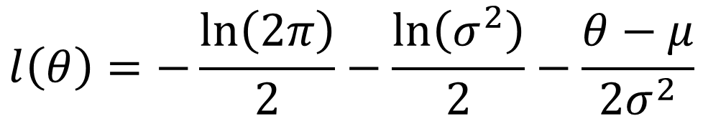

Normal log-likelihood (a quick refresher or novel nosedive)
$$l\left(θ\right)=−\frac{\ln\left(2π\right)}{2}−\frac{\ln\left(σ^{2}\right)}{2}−\frac{θ−μ}{2σ^{2}}$$
$$l\left(θ\right)=−1.419$$
$$θ=1$$
$$μ=0$$
$$σ=1$$
Remember, our prior is Normal(0, 1)

Slide 21
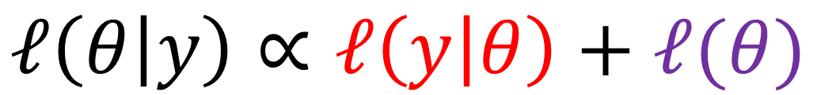
The log-posterior for our initial value is…
$$ℓ\left(θ | y\right)∝ℓ\left(y | θ\right)+ℓ(θ)$$
$$ℓ\left(θ | y\right)∝−1914.99−1.419$$
Contribution of data is 1350x that of prior…

Slide 22
That’s where we’re starting.
We tried 1. It wasn’t great.
We need 10k numbers. Let’s try again.

Slide 23

From that initial value, we will sample a candidate for inclusion
$$θ^{∗}\sim Normal(θ,σ^{∗})$$
Let’s imagine we sampled the number 2

Slide 24

Poisson log-likelihood (but now θ = 2)
$$l⁡(y;θ)=−\sum_{i=1}^{n}{μ_{i}}+\sum_{i=1}^{n}{y_{i}×}\ln\left(μ_{i}\right)−\sum_{i=1}^{n}{ln⁡(y_{i}!) }$$
$$μ_{i}=e^{θ}$$
$$l⁡(y;θ)=−1216.4$$

Slide 25
Poisson log-likelihood (a quick refresher or novel nosedive)

Slide 26


Normal log-likelihood (a quick refresher or novel nosedive)
$$l\left(θ\right)=−\frac{\ln\left(2π\right)}{2}−\frac{\ln\left(σ^{2}\right)}{2}−\frac{θ−μ}{2σ^{2}}$$
$$l\left(θ\right)=−2.919$$
$$θ=2$$
$$μ=0$$
$$σ=1$$
Remember, our prior is Normal(0, 1)

Slide 27
We will assess the ‘value’ of that new proposal, or candidate…
$$ℓ\left(θ=1 | y\right)∝−1914.99−1.419$$
$$ℓ\left(θ^{∗}=2 | y\right)∝−1216.38−2.919$$
Via its log-posterior relative to the previous sample

Slide 28
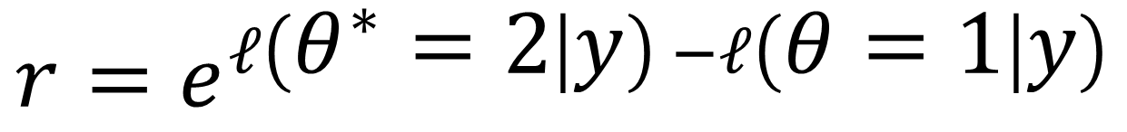
We will assess the ‘value’ of that new proposal, or candidate…
$$ℓ\left(θ=1 | y\right)∝−1914.99−1.419$$
$$ℓ\left(θ=2 | y\right)∝−1216.38−2.919$$
$$r=e^{ℓ\left(θ^{∗}=2 | y\right) −ℓ\left(θ=1 | y\right)}$$
Via its log-posterior relative to the previous sample

Slide 29
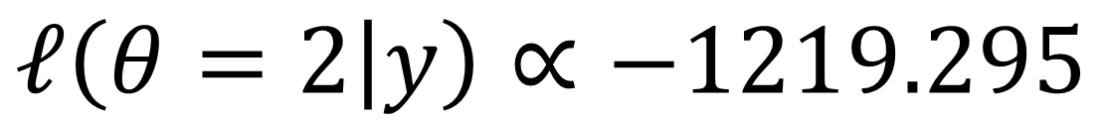
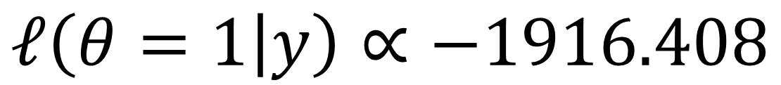
Let’s dig into r
$$r=e^{ℓ\left(θ^{∗}=2 | y\right) −ℓ\left(θ=1 | y\right)}$$
$$ℓ\left(θ=1 | y\right)∝−1916.408$$
$$ℓ\left(θ=2 | y\right)∝−1219.295$$
Via its log-posterior relative to the previous sample

Slide 30
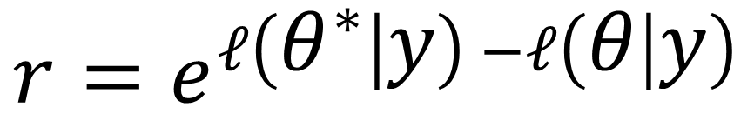
Let’s dig into r
$$r=e^{ℓ\left(θ^{∗} | y\right) −ℓ\left(θ | y\right)}$$
$$ℓ\left(θ=1 | y\right)∝−1916.408$$
$$ℓ\left(θ=2 | y\right)∝−1219.295$$
Via its log-posterior relative to the previous sample

Slide 31
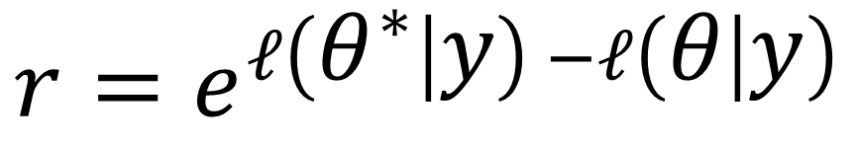
Acceptance rate (ideally approx. 1 out of 3)
If r > 1, accept proposed θ
If 1 > r > 0, draw a random number between 0 and 1. If r is greater than that random number, accept proposed θ
If it isn’t, then θ_{i} = θ_{i-1}
‘Good’ acceptance rate(s) are 25-40% (Gelman et al. 2014)
Why?!
$$r=e^{ℓ\left(θ^{∗} | y\right) −ℓ\left(θ | y\right)}$$

Slide 32
We’ll do that again… and again…

Slide 33
The red points are our posterior
The black points are all our proposed (i.e., candidate) values

Slide 34
What about burn-in?
We could ignore the first X% while the chain converges

Slide 35
What about burn-in? Here, we burn the first 1000 samples…
This effectively just gets rid of the ‘finding out’ phase

Slide 36
What about thinning?
Remember, if the candidate is not accepted, then θ_{t} = θ_{t-1}

Slide 37
Acceptance rate (we want approximately 1 out of 3)
If r > 1, accept proposed α
If 1 > r > 0, draw a random number between 0 and 1. If r is greater than that random number, accept proposed α
If it isn’t, then α_{i} = α_{i-1}
‘Good’ acceptance rate(s) are 25-40% (Gelman et al. 2014)
Why?

Slide 38
Rolling mean of acceptance rate (across previous 100 samples)
Here is our acceptance rate when σ* = 0.075. Nice!

Slide 39
Rolling mean of acceptance rate (across previous 100 samples)
Here is our acceptance rate when σ* = 0.005. ugh, why?!

Slide 40
Rolling mean of acceptance rate (across previous 100 samples)
Here is our acceptance rate when σ* = 0.15. ugh, why?!

Slide 41
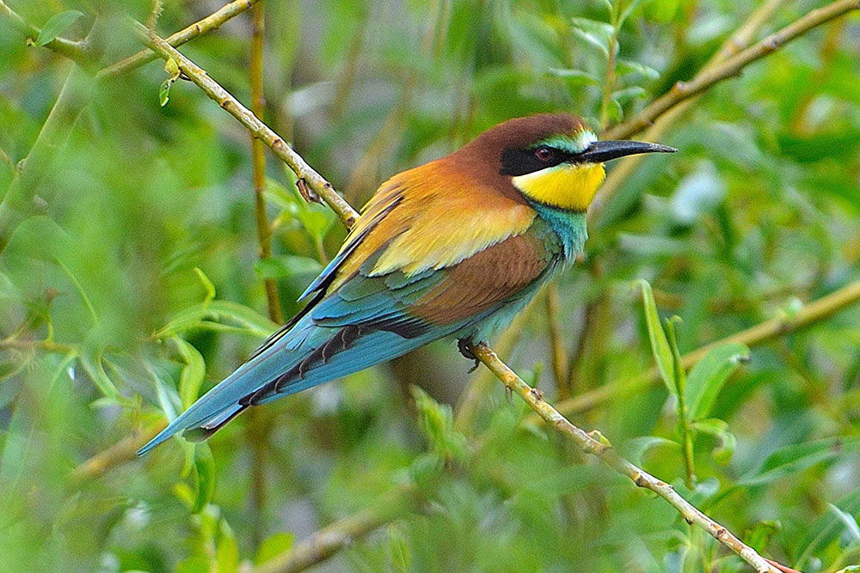
If tuning parameters are too small…
We’ll just wander around inside our posterior
Acceptance rate will be >0.5
If tuning parameters are too large…
Sampling inefficiency will occur, acceptance < 0.1
Most of our guesses will be outside of the posterior
If tuning parameters are just right (0.25 – 0.4)…
We’ll adequately explore our posterior

Slide 42
Question(s)
How do we interpret posterior distributions (95% CrIs, medians, means)?
i.e., how would we infer support for a hypothesis?
We could change our priors in the log.posterior function (Line 67). Would that help with sampling efficiency?
We started with terrible initial values. Would ‘better’ values help, or is it helpful to use ‘bad’ ones? How and why?
What effects do tuning parameter(s) have on sampling efficiency?
Think about the trade-off between rapidly reaching realistic values vs. acceptance rate

