Slide 1

Week 3 Lab Exercises
A/Prof Jian Zhang
School of Electrical & Data Engineering
University of Technology, Sydney

Slide 2
Threads: Motivation
Process created and managed by the OS kernel
Process creation expensive, e.g., fork system call
Context switching expensive
IPC requires kernel intervention expensive
Cooperating processes – no need for memory protection, i.e., separate address spaces

Slide 3
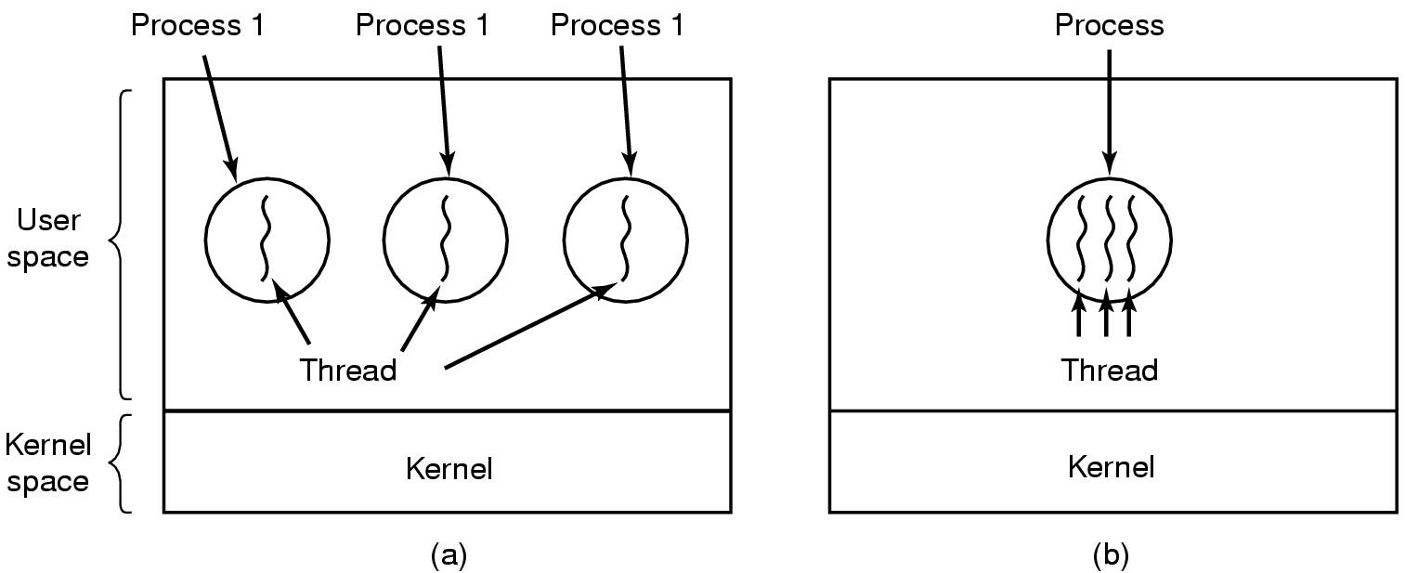
Threads The Thread Model (1)
(a) Three processes each with one thread
(b) One process with three threads

Slide 4
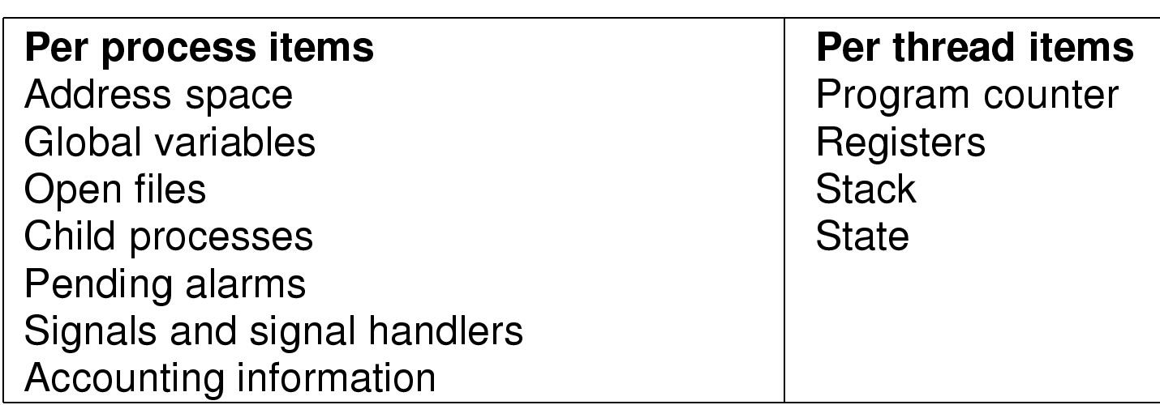
The Thread Model (2)
Items shared by all threads in a process
Items private to each thread

Slide 5
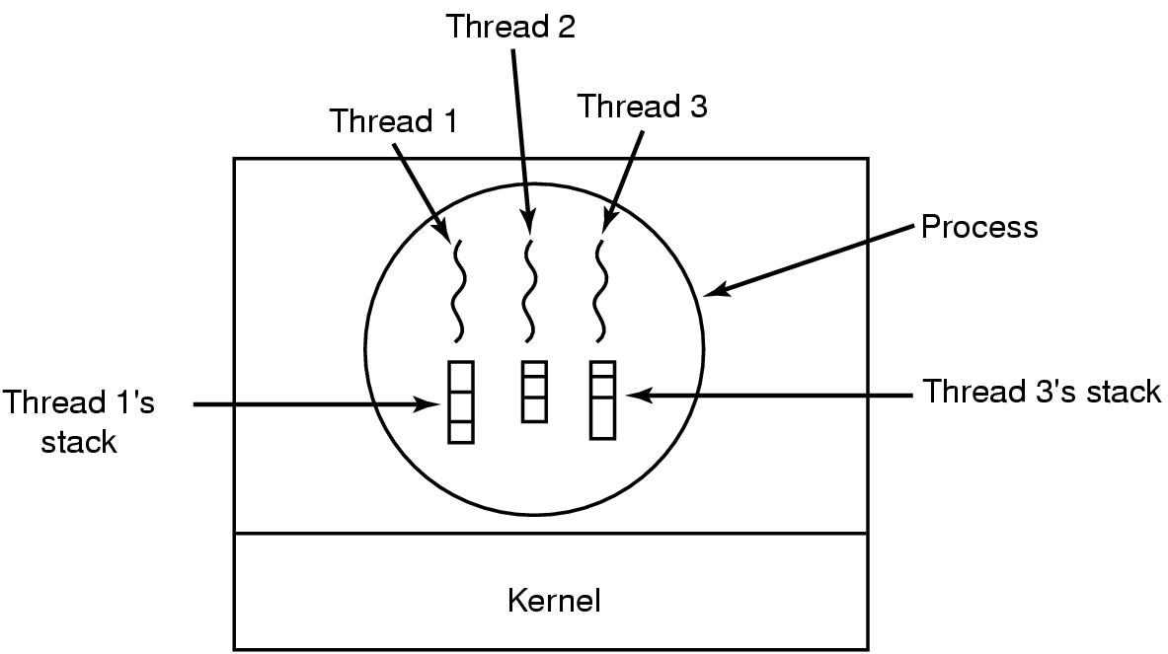
The Thread Model (3)
Each thread has its own stack

Slide 6
A Summary of the Thread
What is a Thread? a process is a job or a program that can be executed by the computer. A process can contain multiple threads.
Why Multithreading? A thread is also known as lightweight process. The idea is to achieve parallelism by dividing a process into multiple threads
Process vs Thread? The primary difference is that threads within the same process run in a shared memory space, while processes run in separate memory spaces.
Advantages of Thread over Process Responsiveness, Resource Sharing, Economy, Scalability
https://www.youtube.com/watch?v=ynCc-v0K-do

Slide 7
Mutex lock in POSIX Programmers’ Manual
What is Mutex?
A mutual exclusion object (mutex) is a program object that allows multiple program threads to share the same resource, but not simultaneously. A mutex is to provide locking mechanism on the shared resources. Therefore, Mutex is a lock that we set before using a shared resource and release after using it. When the lock is set, no other thread can access the locked region of code.
Why do we need mutex?
In multiple threads or processes, mutex provide a safe way to access the shared resources, for example access a file.
https://www.youtube.com/watch?v=GXXE42bkqQk

Slide 8
Mutex variables
A typical sequence in the use of a mutex is as follows:
Create and initialize a mutex variable
Several threads attempt to lock the mutex
Only one succeeds and that thread owns the mutex
The owner thread performs some set of actions
The owner unlocks the mutex
Another thread acquires the mutex and repeats the process
Finally the mutex is destroyed

Slide 9
Mutex operations
Creation:
pthread_mutex_t my = PTHREAD_MUTEX_INITIALIZER
Destroying:
pthread_mutex_destroy(pthread_mutex_t *mutex);
Locking and unlocking mutexes
pthread_mutex_lock(pthread_mutex_t *mutex);
pthread_mutex_trylock(pthread_mutex_t *mutex);
pthread_mutex_unlock(pthread_mutex_t *mutex);

Slide 10
Mutex Locks in our program
Simplest is mutex lock
pthread_mutex_t mutex
Protect a critical section by first acquire() a lock -- pthread_mutex_lock(&mutex) then release() a lock -- pthread_mutex_unlock(&mutex)
Boolean variable indicating if lock is available or not
Calls to acquire() and release() must be atomic
Usually implemented via hardware atomic instructions
But this solution requires busy waiting
This lock therefore called a spinlock

Slide 11
5.15 Consider how to implement a mutex lock using an atomic hardware
instruction. Assume that the following structure defining the mutex
lock is available:
typedef struct {
int available;
} lock;
(available == 0) indicates that the lock is available, and a value of 1 indicates that the lock is unavailable. Using this struct, illustrate how the following functions can be implemented using the test and set() and compare and swap() instructions:
• void acquire(lock *mutex)
• void release(lock *mutex)
Be sure to include any initialization that may be necessary.

Slide 12
// initialization
mutex->available = 0;
// acquire using compare and swap()
void acquire(lock *mutex) {
while (compare and swap(&mutex->available, 0, 1) != 0)
;
return;
}
// acquire using test and set()
void acquire(lock *mutex) {
while (test and set(&mutex->available) != 0)
{…. }
return;
}
void release(lock *mutex) {
mutex->available = 0;
return;
}
int compare_and_swap (int* reg, int oldval, int newval)
{ ATOMIC(); int old_reg_val = *reg;
if (old_reg_val == oldval)
*reg = newval; END_ATOMIC ();
return old_reg_val; }
#define LOCKED 1
int TestAndSet(int* lockPtr) {
int oldValue;
oldvalue=*lockPtr;
*lockPtr = LOCKED;
return oldVaue }

Slide 13
5.23 Show how to implement the wait() and signal() semaphore operations in multiprocessor environments using the test and set() instruction. The solution should exhibit minimal busy waiting.
int guard = 0;
int semaphore value = 0;
wait()
{
while (TestAndSet(&guard) == 1);
if (semaphore value == 0) {
atomically add process to a queue of processes
waiting for the semaphore and set guard to 0;
}else {
semaphore value--;
guard = 0;
}
}
signal()
{
while (TestAndSet(&guard) == 1);
if (semaphore value == 0 && there is a process on the wait queue)
//wake up the first process in the queue
//of waiting processes (busy waiting)
else
semaphore value++;
guard = 0;
}

