Slide 1

Week 2 Lab Exercises
A/Prof Jian Zhang
School of Computing and Communication
University of Technology, Sydney

Slide 2
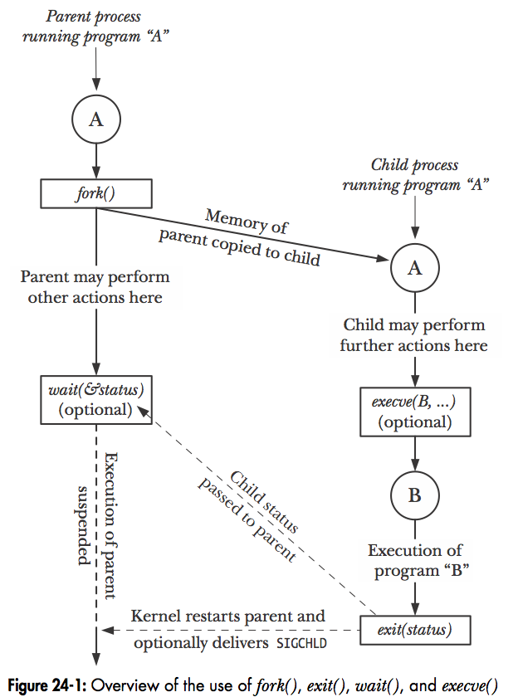
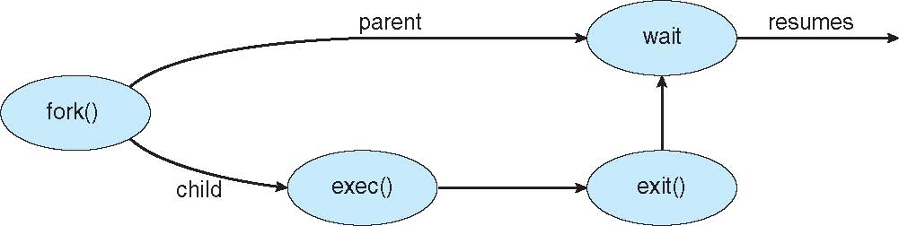
Process Creation
Linux examples
fork() system call creates new process
exec() system call used after a fork() to replace the process’ memory space with a new process
https://www.youtube.com/watch?v=9seb8hddeK4

Slide 3
Process Termination
Process executes last statement and then asks the operating system to delete it using the exit() system call.
Returns status data from child to parent (via wait())
Process’ resources are deallocated by operating system
“The wait() system call suspends execution of the current process until one of its children terminates. The call wait(&status) is equivalent to: waitpid(-1, &status, 0); The waitpid() system call suspends execution of the current process until a child specified by pid argument has changed state”
Parent may terminate the execution of children processes using the abort() system call. Some reasons for doing so:
Child has exceeded allocated resources
Task assigned to child is no longer required
The parent exits and the operating systems does not allow a child to continue if its parent terminates
You can use “man exit”, “man wait” and “man abort” to check the manual of these system calls. Or Google them!

Slide 4
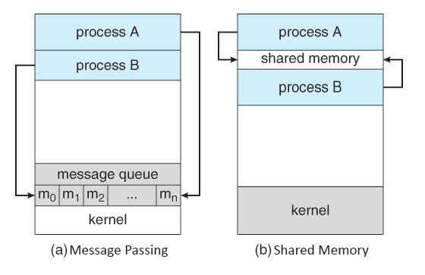
Inter-process Communication
Processes within a system may be independent or cooperating
Cooperating process can affect or be affected by other processes, including sharing data
Reasons for cooperating processes:
Information sharing, Computation speedup, Modularity and Convenience
The cooperating processes need inter-process communication (IPC), Two models of IPC are defined
Shared memory
Message passing

Slide 5
Shared memory
Shared memory is the fastest method of interprocess communication (IPC) under Linux and other Unix-like systems. The system provides a shared memory segment which the calling process can map to its address space. After that, it behaves just like any other part of the process's address space.
Message Passing
The sending process places a message (via some (OS) message-passing module) onto a queue which can be read by another process. Each message is given an identification or type so that processes can select the appropriate message. Process must share a common key in order to gain access to the queue in the first place.
https://www.youtube.com/watch?v=dQE6BDNc3z0
https://www.softprayog.in/programming/interprocess-communication-using-posix-shared-memory-in-linux

Slide 6
Makefiles
It refers to a Makefile for instructions on invoking the compiler, linker and many other tools and utilities
Most programs of meaningful purpose are composed of many source files, make helps in building the executable (and can do much more)
make looks at the Makefile to identify dependencies and targets
It can also incorporate environment variables
When porting source code between two Linux systems, the Makefile usually needs to be modified by the programmer
An example follows:
make -f P8-4-Makefile
Notes:
11

Slide 7
make in use
A very simple program that consists of four (4) source files. Make is used to build two different executables - one that prints Hi, another that prints Bye.
/* main.h */
void printMessage(void);
/* main.c */
#include <stdlib.h>
#include "main.h”
int main(void)
{
printMessage();
return 0;
}
/* hi.c */
#include <stdio.h>
void printMessage(void)
{
printf("Hi\n");
return;
}
/* bye.c */
#include <stdio.h>
void printMessage(void)
{
printf("Bye\n");
return;
}
Notes:
13

Slide 8
Makefiles
#Makefile
CC = gcc
CFLAGS = -Wall -O2
all: hi bye clean
P8-1-main.o: P8-1-main.c P8-1-main.h
$(CC) -c P8-1-main.c
hi:P8-2-hi.o P8-1-main.o
$(CC) -o hi P8-2-hi.o P8-1-main.o
bye:P8-3-bye.o P8-1-main.o
$(CC) -o bye P8-3-bye.o P8-1-main.o
clean:
rm -rf *.o core

