Slide 1
DevOps
Thomas Shewan
22080488

Slide 2


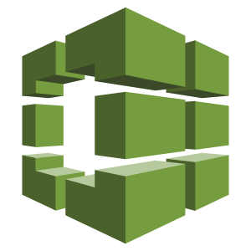

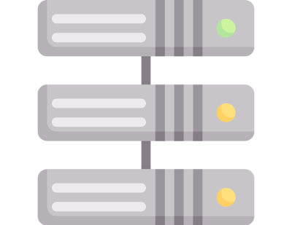
Project Pipeline
Code Pipeline
Code Source
Code Build
Test Wave
Alpha Stage
Prod Stage
Input
  GitHub Code
Output
  Source Artifacts
Input
  Source Artifacts
Process
  Install dependencies and cdk synth
Output
  CloudFormation Template
Input
  Source Artifacts
Process
  Run unit tests
Output
  Test Results
Input
  Synth CF Template
Process
  Deploy resources to alpha environment
Output
  Production like Infrastructure
Tests
  Functional
  Integration
Input
  Synth CF Template
Process
  Manual approval
  Deploy resources to production environment
Output
  Production Infrastructure
Notes:
- Code Source: comes from github using webhook on push events, creating the source artifacts for the later stages
- Code Build: Uses the source from github to install dependencies and synthesise the cf template
- Test Wave: Uses the source as well to run the unit tests quickly – using wave instead of a full stage just so it speeds up deployment and not needing a whole environment to run the unit tests, mocking the aws services
- Alpha Stage: Uses the cf template to deploy a production like environment to run the func and int tests
- Prod Stage: Also uses the cf template to deploy a production environment, but requires manual approval before it gets deployed, once done, the production environment is done

Slide 3

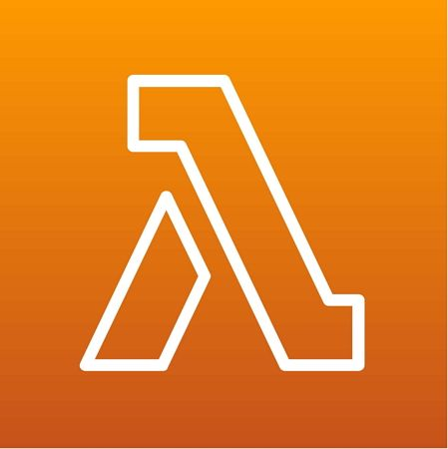
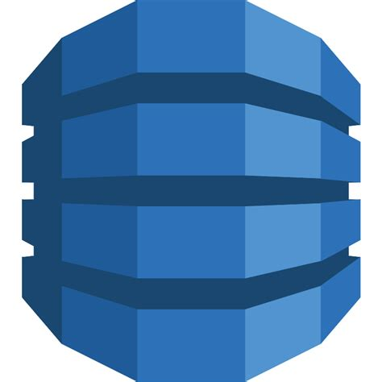





Infrastructure
CRUD
Target URLs
Infrastructure
API Gateway
Streams
Cloudwatch Dashboard
Event Bridge
Monitoring
Metric Alarms
Lambda Alarms
Cloudwatch Metrics
SNS Topic
Email Sub
AlarmLogger
Alarm Logs
Notes:
Process-
- Api call goes into the api gateway
-- api gateway uses the PUT, POST, DELETE, GET request to the CRUD Lambda which handles the functionality
--- CRUD Lambda updates the URL DB
---- URL DB streams the change to trigger the infrastructure lambda
----- Infrastructure lambda uses what’s changed to add/remove alarms and associated dashboard graph variables
------ The alarms are subscribed to the SNS topic which have email subscription and alarm logger lambda, which logs the alarms outputs in the alarm log db
- Event Bridge runs every 5 minutes to trigger the monitoring lambda
-- Monitoring lambda reads the entries in the URL DB to use as the targets to monitor
--- These metrics are then sent to the cloudwatch metrics which are used in the cloudwatch dashboard widgets
---- There are also alarms created on deploy for the monitoring lambda for errors, invokations, memory and duration, which are subscribed to the same sns topic
For code deploy auto rollback, I attempted to do this, but I was having issues with it not letting me do it due to being on the free tier, so I didn’t really have time to find a work around.

Slide 4
Reflection
→ Demonstration

