Slide 1
TNC AI Task B – Deep Learning w/ CNTK
2018/07/17
CNTK Task Team

Slide 2
Task B CNTK – Project Status 2018/03/09
Train the model
TNC_TransferLearning.py
TNC_ResNet18_ImageNet_CNTK.model
Save the network and
learned parameters
to a CNTK model file
TNC Label REST API
Publish the web API
(including the model) to
Azure App Service
ASP.NET Web API
for
TNC_ResNet18_ImageNet_CNTK.model
Local GPUs
CPU-Only
Azure App Service

Slide 3
Task B CNTK – Web API
TNC China CNTK Model Web API URL
http://tncanimallabelwebapi.azurewebsites.net/api/Prediction
Its interface mirrors the Microsoft CustomVision API
1. PredictImageUrl
https://southcentralus.dev.cognitive.microsoft.com/docs/services/57982f59b5964e36841e22dfbfe78fc1/operations/5a3044f608fa5e06b890f163
Test Image URL
https://qqq.blob.core.windows.net/mycontainer/IMAG0005.JPG

Slide 4
Task B CNTK – Web API
The CNTK Web API repurposes the Prediction-key request header to allow the clients to select which CNTK model to evaluate
If the Prediction-key request header is present, the API will use it as the model name, and load the corresponding CNTK model file and its associated class label map file. E.g. if Prediction-key == TNC_ResNet18_ImageNet_CNTK, the API will load these 2 files:
TNC_ResNet18_ImageNet_CNTK.model -- the CNTK model file
TNC_ResNet18_ImageNet_CNTK.csv -- the csv class label mapping file
If the Prediction-key request header is present, but it is an invalid model name, the API will throw an exception.
If the Prediction-key request header is not present, the API will load a default CNTK model and its class label mapping file.

Slide 5
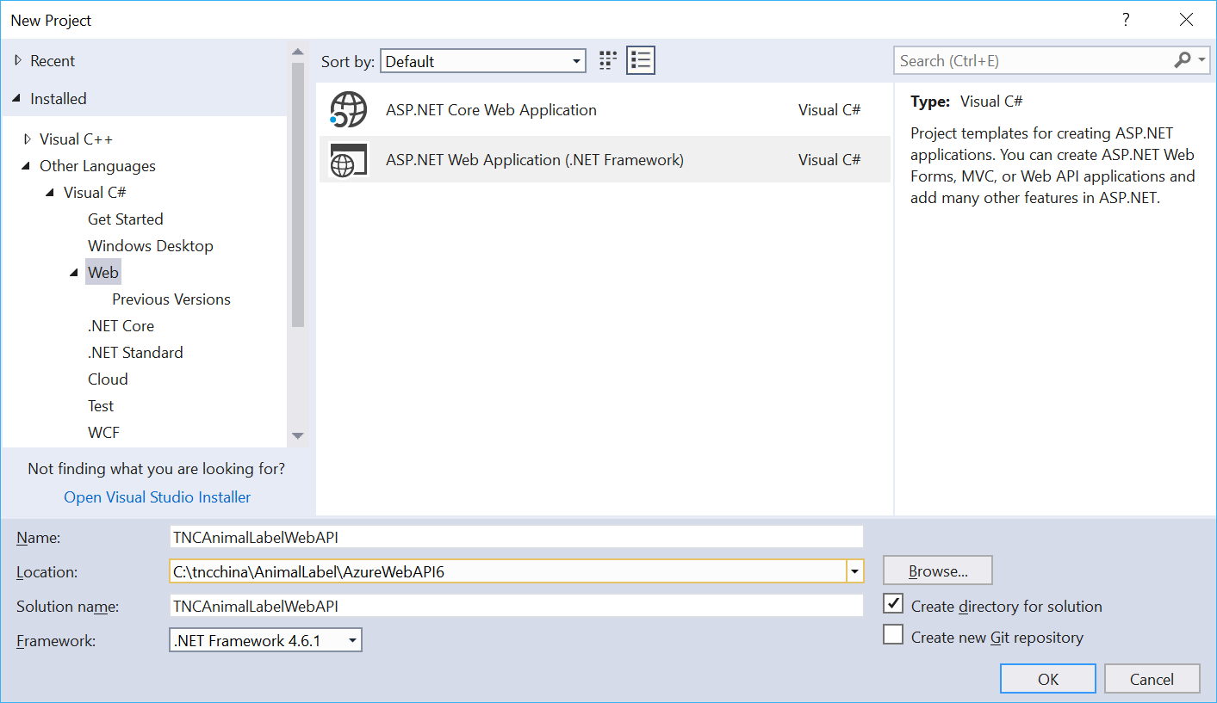
TNCAnimalLabelWebAPI Solution
Follow this tutorial to create a skeleton Web API project with Http Post method
https://docs.microsoft.com/en-us/aspnet/web-api/overview/data/using-web-api-with-entity-framework/part-1

Slide 6
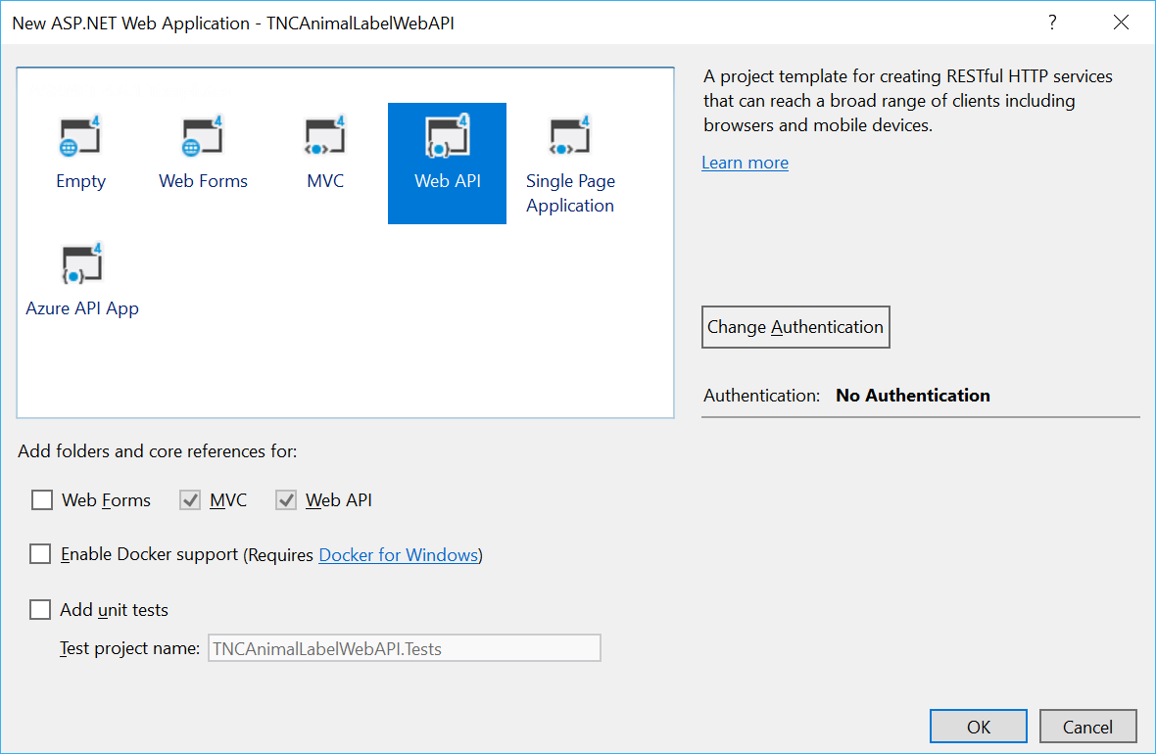
TNCAnimalLabelWebAPI Solution
Follow this tutorial to create a skeleton Web API project with Http Post method
https://docs.microsoft.com/en-us/aspnet/web-api/overview/data/using-web-api-with-entity-framework/part-1

Slide 7
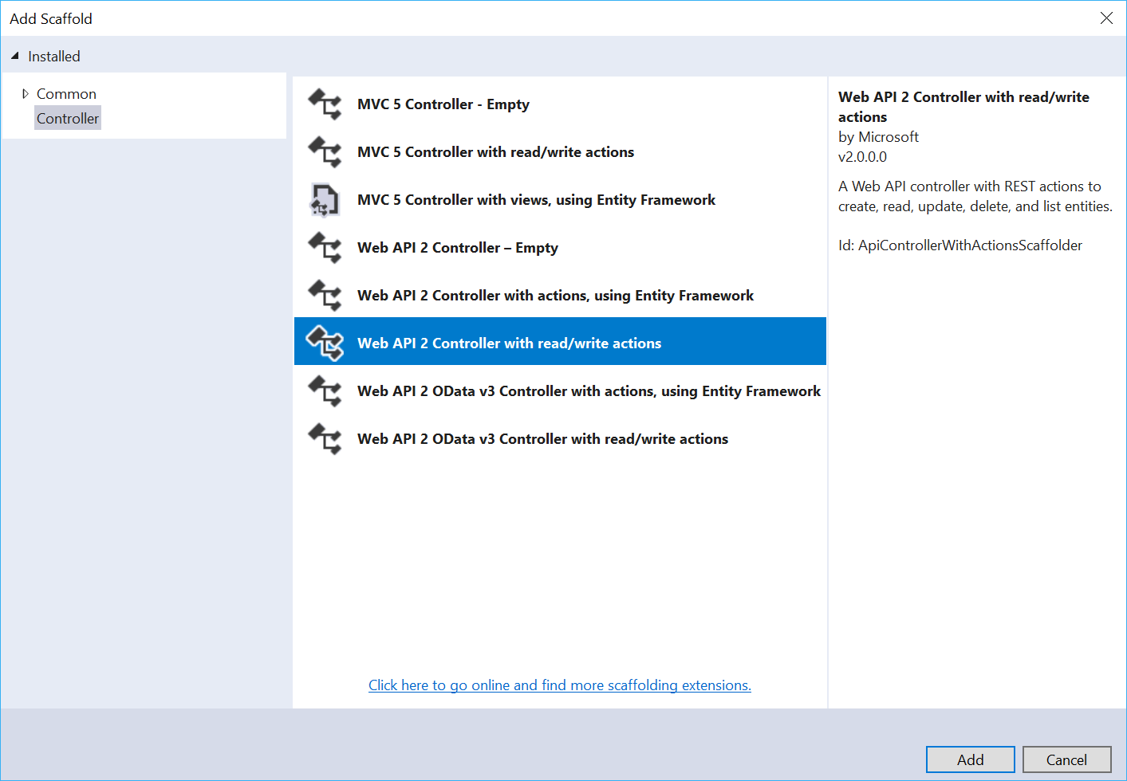
TNCAnimalLabelWebAPI Solution
Follow this tutorial to create a skeleton Web API project with Http Post method
https://docs.microsoft.com/en-us/aspnet/web-api/overview/data/using-web-api-with-entity-framework/part-1

Slide 8
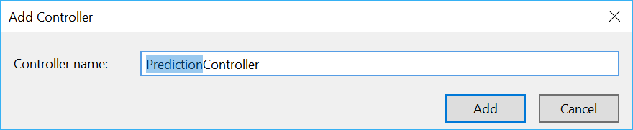
TNCAnimalLabelWebAPI Solution
Follow this tutorial to create a skeleton Web API project with Http Post method
https://docs.microsoft.com/en-us/aspnet/web-api/overview/data/using-web-api-with-entity-framework/part-1

Slide 9
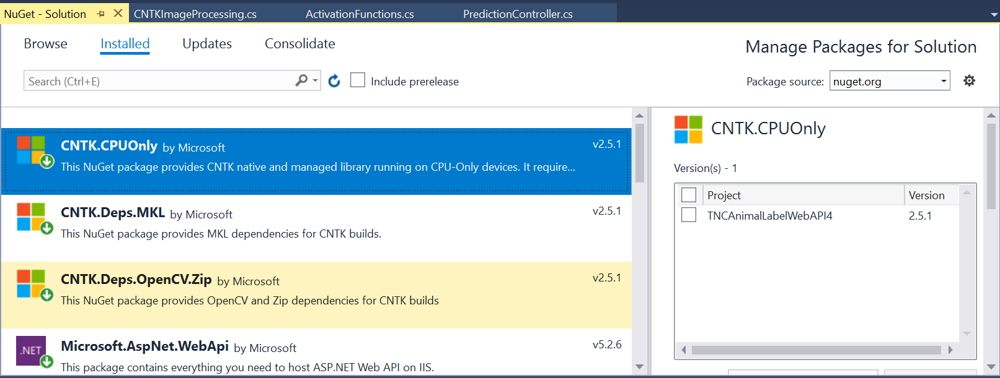
TNCAnimalLabelWebAPI Solution
In Tools -> NuGet Package Manager -> Manage NuGet Packages for Solution…
Install the CNTK.CPUOnly, CNTK.Deps.MKL, CNTK.Deps.OpenCV.Zip packages

Slide 10
TNCAnimalLabelWebAPI Solution
More docs on ASP.Net Web API
https://www.asp.net/web-api/overview/getting-started-with-aspnet-web-api
Then follow this doc to add CNTK evaluation code into the skeleton project.
https://docs.microsoft.com/en-us/cognitive-toolkit/evaluate-a-model-in-an-azure-webapi

Slide 11
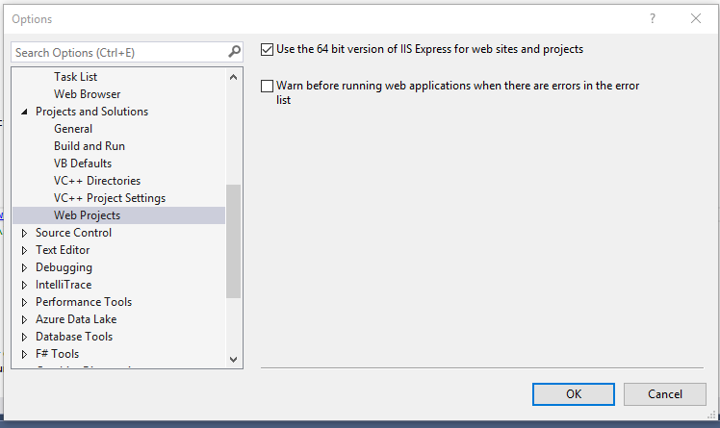
TNCAnimalLabelWebAPI Solution
Ensure to configure the project to use 64-bit IIS Express for local debugging
https://docs.microsoft.com/en-us/cognitive-toolkit/evaluate-a-model-in-an-azure-webapi
CNTK requires a 64-bit runtime environment. Make sure in the Configuration Manager that the project is compiled for the x64 platform. In addition, the WebApi we are creating has to be hosted in a 64-bit instance of IIS. You can enforce this by selecting "Use 64 bit version of IIS Express for web sites and projects" Tools -> Options -> Project and Solutions -> WebProjects

Slide 12
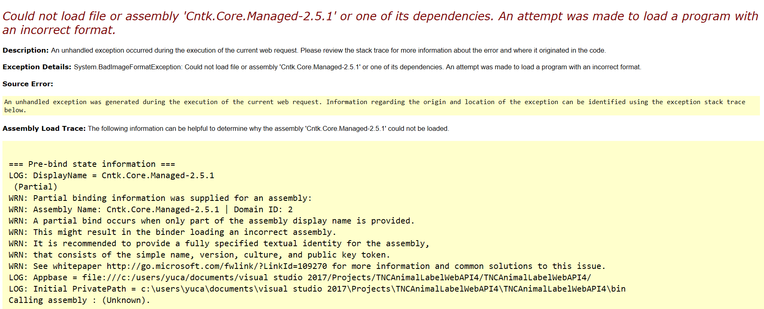
TNCAnimalLabelWebAPI Solution
You will get this error if the project is not compiled for x64 platform

Slide 13
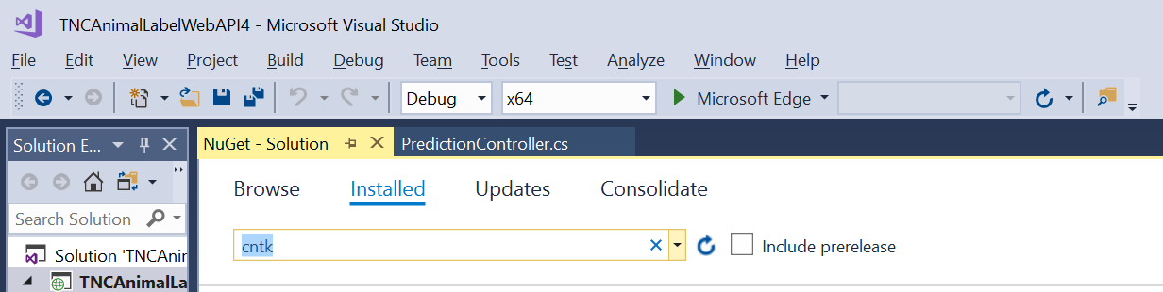
TNCAnimalLabelWebAPI Solution
Also ensure to configure the project to build for x64 platform
https://docs.microsoft.com/en-us/cognitive-toolkit/cntk-eval-examples
https://docs.microsoft.com/en-us/cognitive-toolkit/troubleshoot-cntk

Slide 14
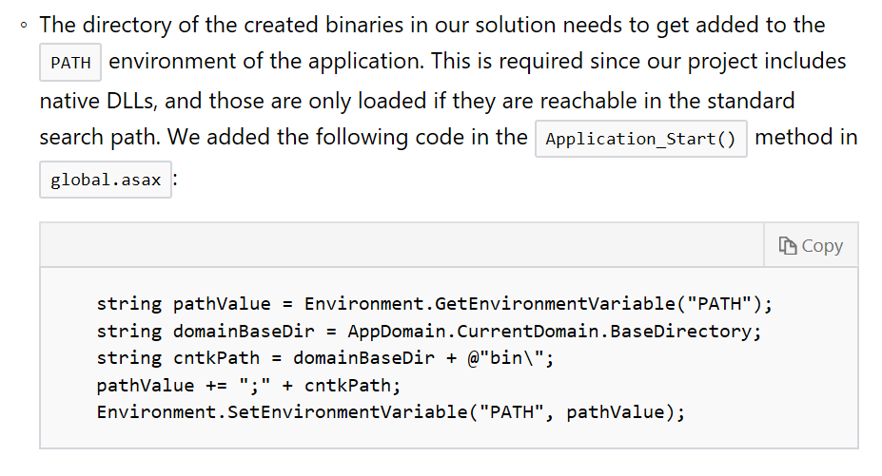
TNCAnimalLabelWebAPI Solution
Ensure to add path in global.aspx

Slide 15
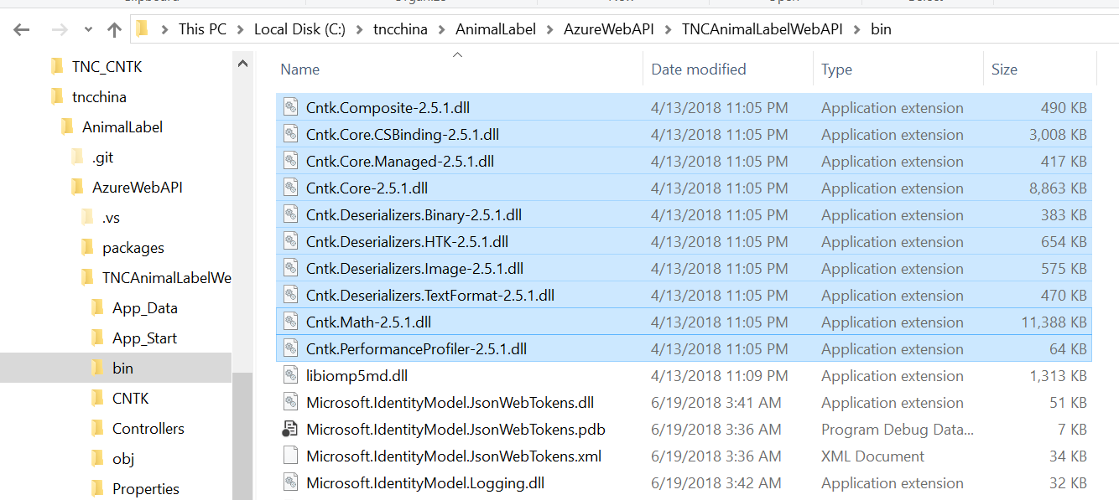
TNCAnimalLabelWebAPI Solution
In Tools -> NuGet Package Manager -> Manage NuGet Packages for Solution…
Install the CNTK.CPUOnly, CNTK.Deps.MKL, CNTK.Deps.OpenCV.Zip packages
Make sure you have these DLLs in the solution folder

Slide 16
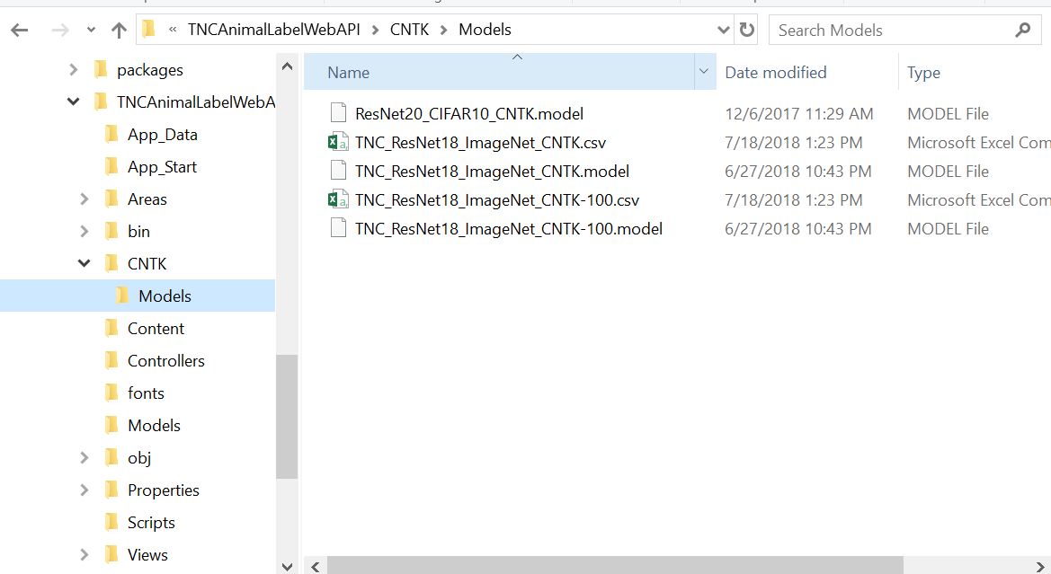
TNCAnimalLabelWebAPI Solution
In VisualStudio, under the solution, create CNTK/Models folder
In File Explorer, copy the 2 CNTK models + 1 class label map file in the folder .

Slide 17
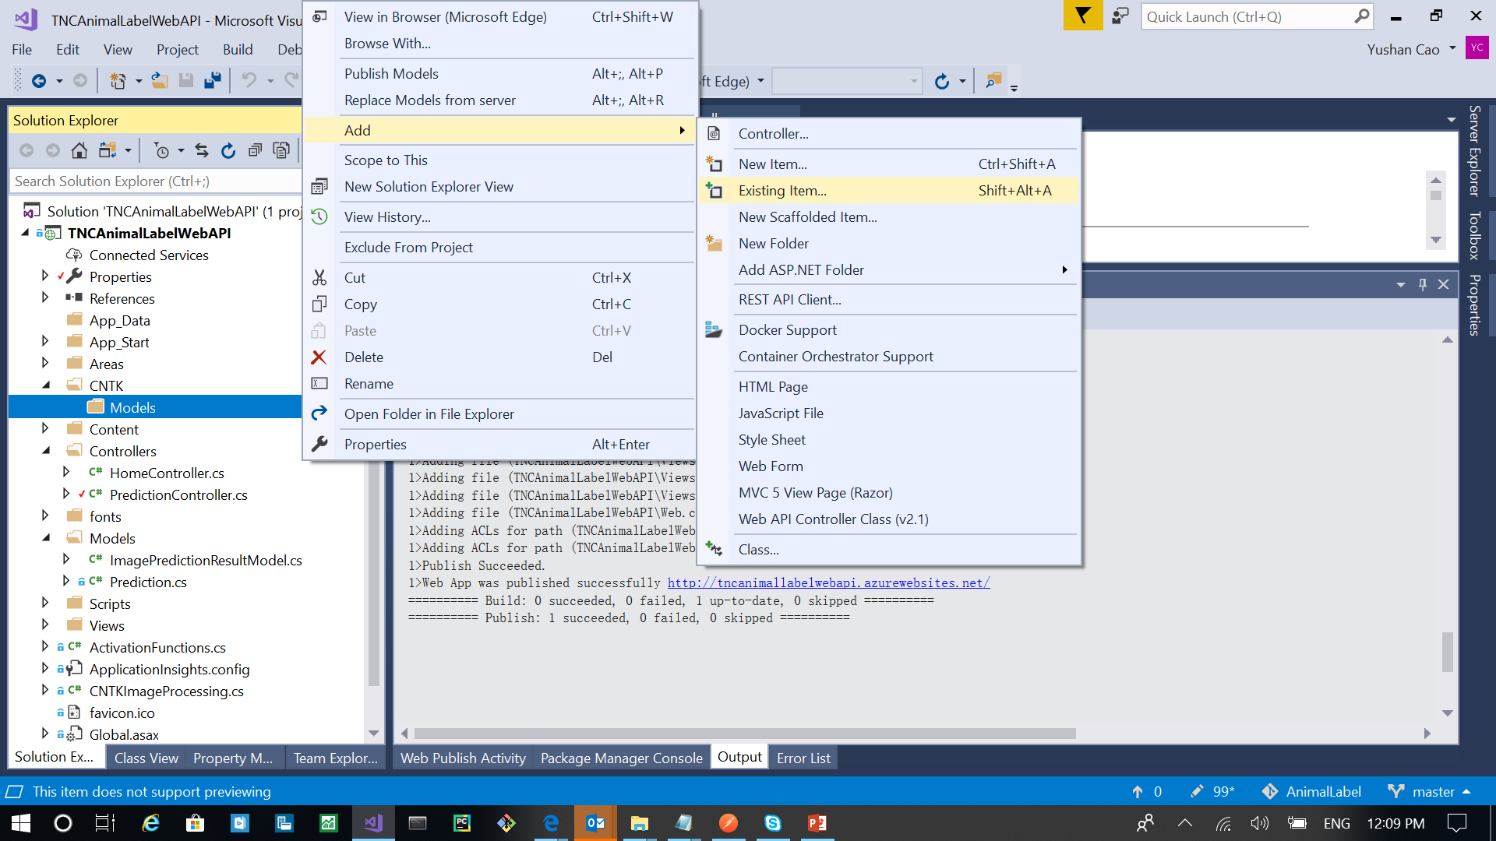
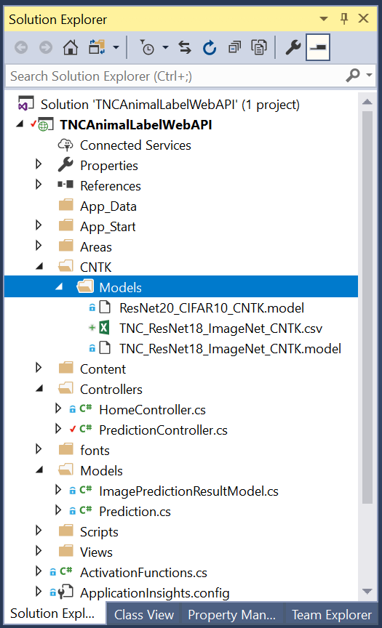
TNCAnimalLabelWebAPI Solution
In VisualStudio, add the 3 files under the CNTK/Models folder.
If you miss this step, these files won’t get published to Azure.

Slide 18
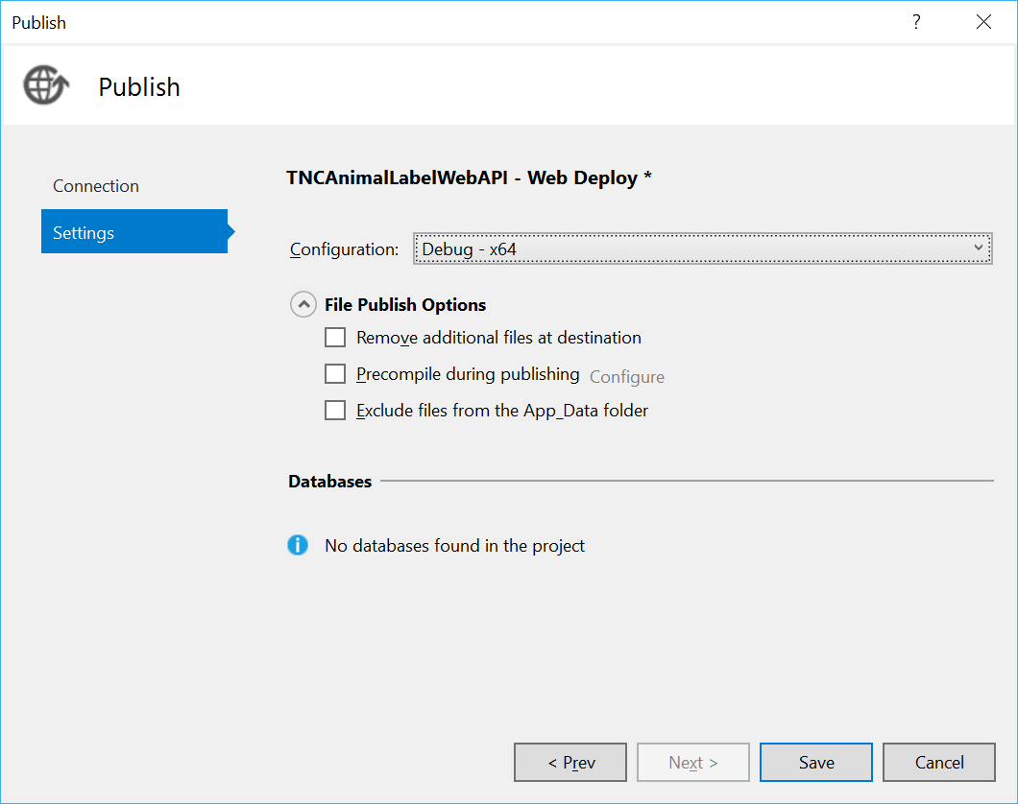
TNCAnimalLabelWebAPI Solution
Publish to Azure -
https://docs.microsoft.com/en-us/cognitive-toolkit/Evaluate-a-model-in-an-Azure-WebApi
Very Important, when Publishing, ensure to choose a x64 configuration.

Slide 19
TNCAnimalLabelWebAPI Solution
Publish to Azure -
A successful publish should include these files -- WebAPI_Files_Needed_to_published_to_Azure_Web_App.txt

Slide 20
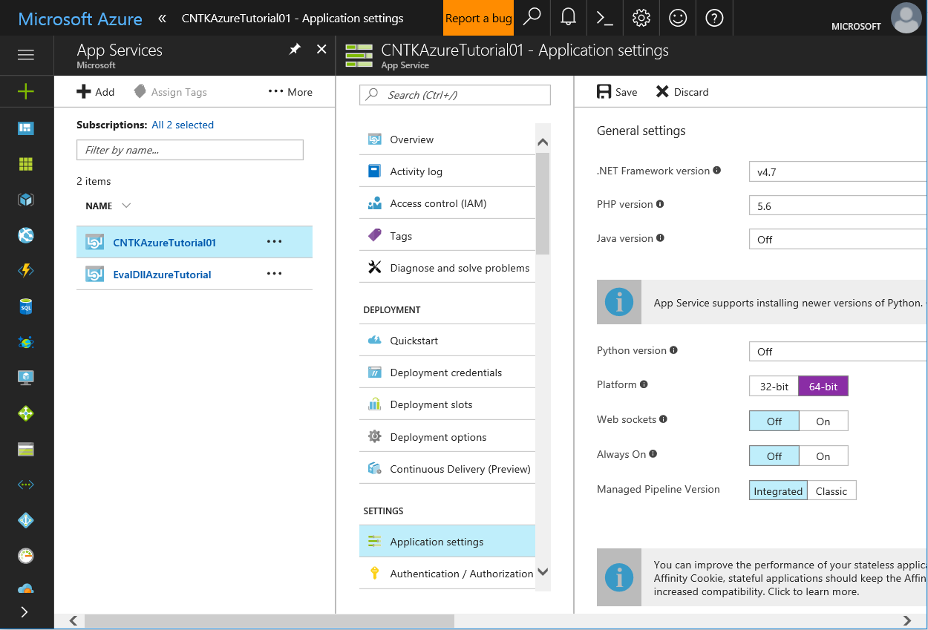
TNCAnimalLabelWebAPI Solution
Publish to Azure -
After publishing, need to go in Azure portal to set the platform to 64-bit

Slide 21
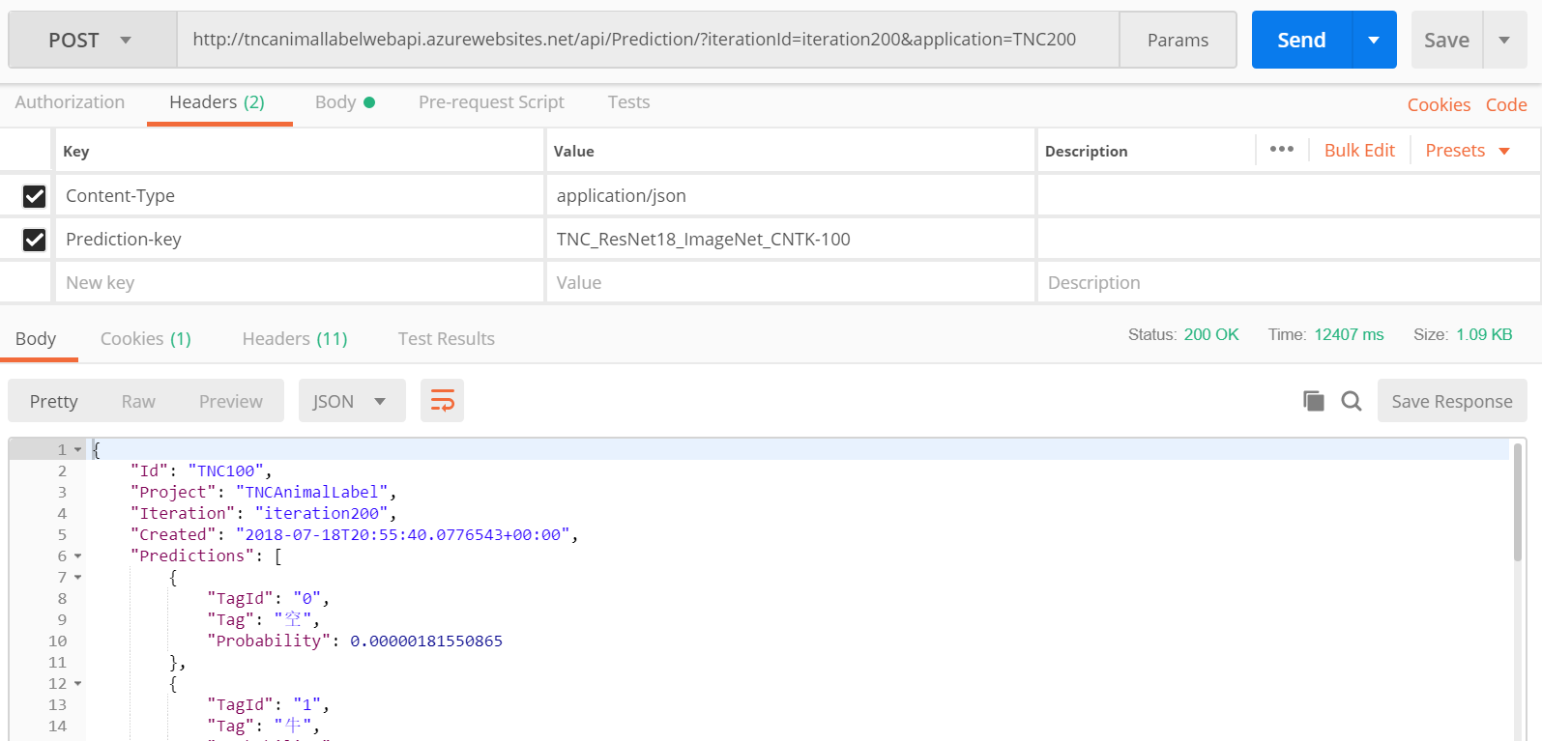
TNCAnimalLabelWebAPI Solution - Postman

Slide 22
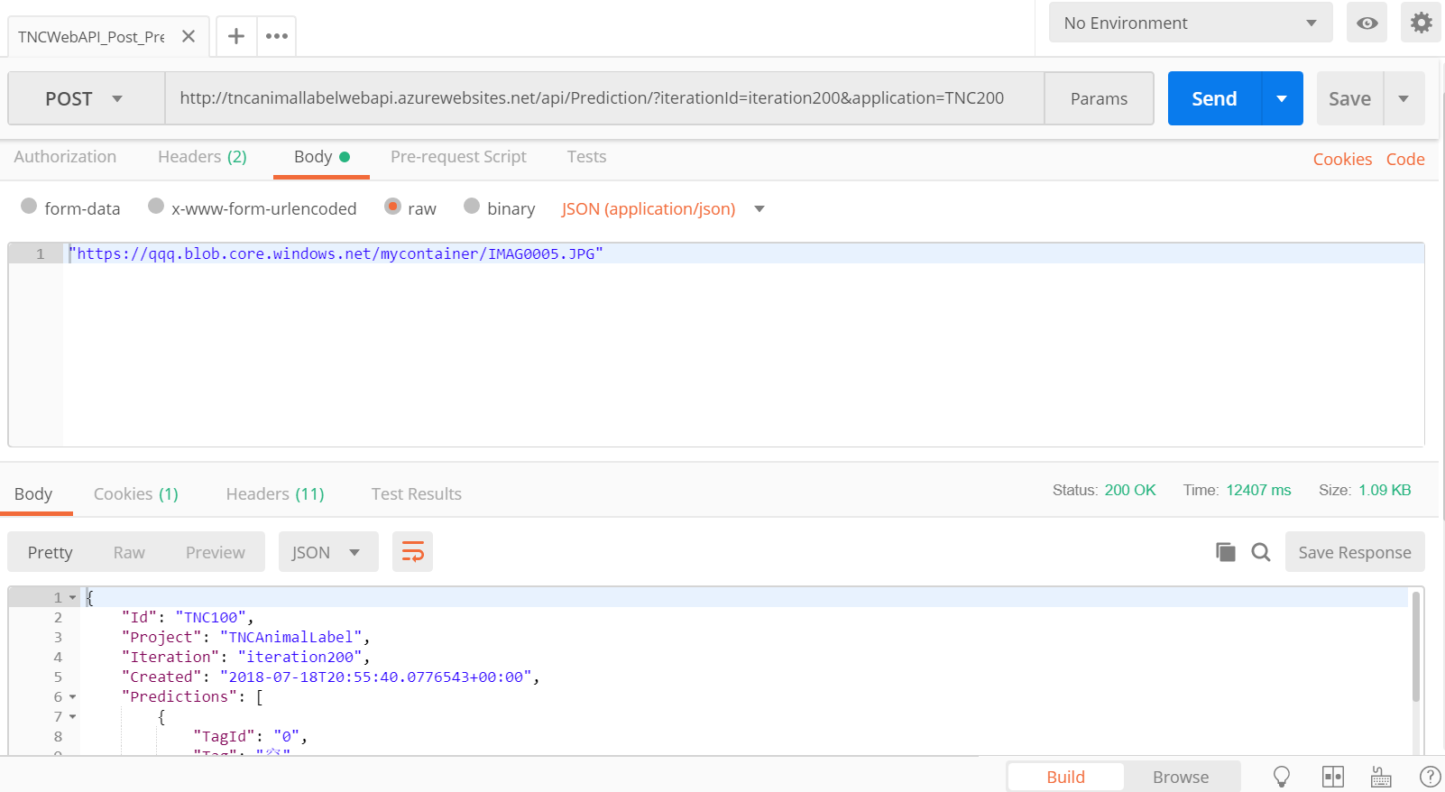
TNCAnimalLabelWebAPI Solution - Postman

Slide 23
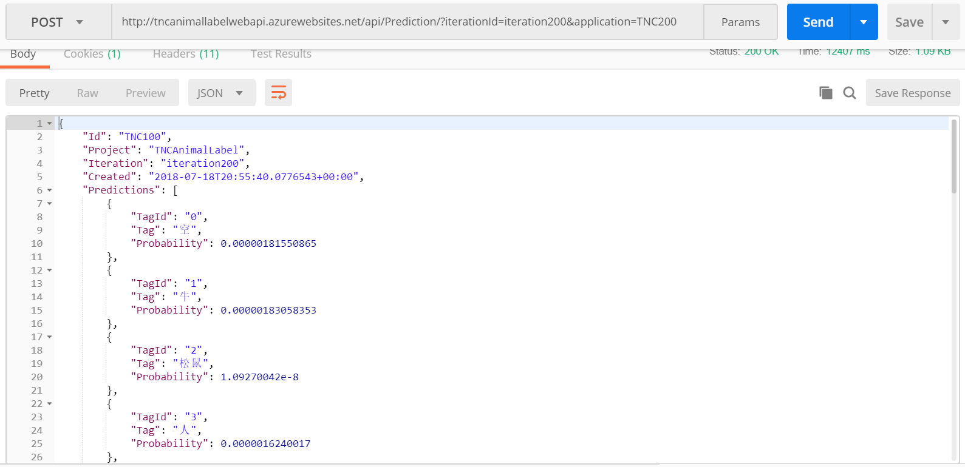
TNCAnimalLabelWebAPI Solution - Postman

