Slide 1
First Machine Learning Program
Shu Peng
11/10/2017

Slide 2
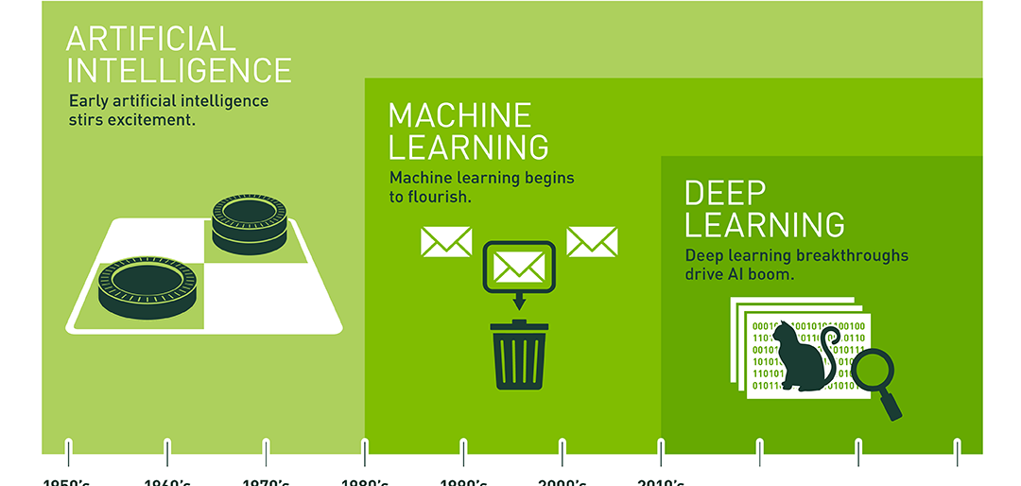
What is Machine Learning?
Type of artificial intelligence (AI)
Predicting outcomes without being explicitly programmed

Slide 3
Supervised learning :
Classification
Train our model how to classify something into some class
Support vector machines (SVM)
Naïve Bayes classifier.
Decision trees
Nearest neighbors (KNN)
Neural Networks
……
Regression
Need to deal with data that the output value is real value such as “Age” , “Weight” , “House Price “ etc …
Linear regression
Nonlinear regression
Generalized linear models
Support Vector Regression (SVR)
Back-Propagation Neural Network (BPNN)
Partial Least Squares (PLS)
Multiple Linear Regression (MLR)
Notes:
The process to learn by examples , uses known data called “Training data set” , to make predictions , after training our model , we will generate a function that maps the input to desired output
There is 3 steps for Creating Supervised Learning Model :
Build the Model
Train the Model
Test the Model

Slide 4
Unsupervised Learning :
Clustering
A type of unsupervised learning that refers to segmentation and learning about characteristics in the data through algorithms
K-Means Clustering
Hierarchical Clustering
Density based Clustering
Association
The process to train our machine to discover rules that describe large points of data “

Slide 5
Setup environment
ML Tool
Anaconda
CNTK
(Tensorflow
Optional
pyCharm
https://www.anaconda.com/download
https://docs.microsoft.com/en-us/cognitive-toolkit/setup-windows-python?tabs=cntkpy22
pip install tensorflow)
https://www.jetbrains.com/pycharm
Notes:
scikit-learn
Machine Learning in Python
Simple and efficient tools for data mining and data analysis
Accessible to everybody, and reusable in various contexts
Built on NumPy, SciPy, and matplotlib
Open source, commercially usable - BSD license

Slide 6

Hands On

Slide 7


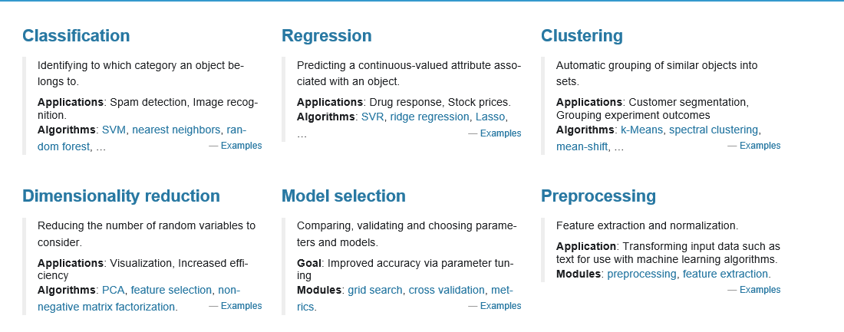
Hands-on with scikit-learn
Machine leaning library
Learning the basic concepts / process
Simple
Simple and efficient tools for data mining and data analysis
Accessible to everybody, and reusable in various contexts
Built on NumPy, SciPy, and matplotlib
Open source, commercially usable - BSD license

Slide 8
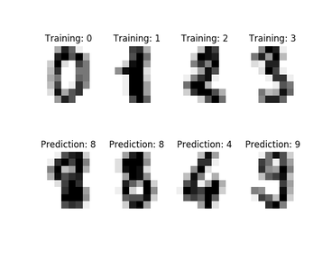
Hands-on Sample Problem
Create a program that can predict an image which digit it represents

Slide 9
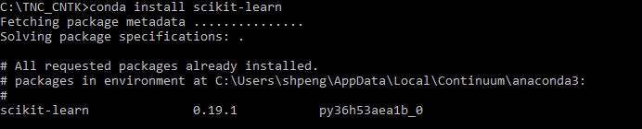
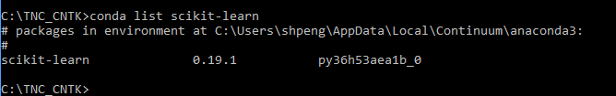
Step 0: Package installation
Check

Slide 10
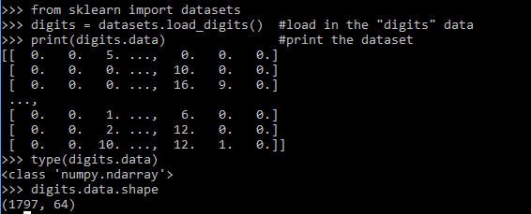
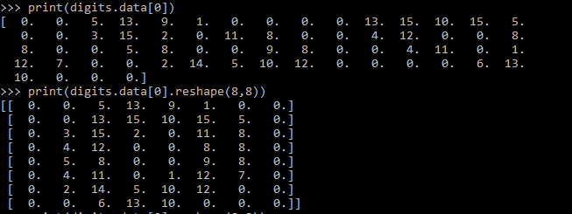
Step 1: Loading our Dataset
“ dataset is a dictionary-like object that holds all the data and some metadata about the data”
Looking into the dataset

Slide 11
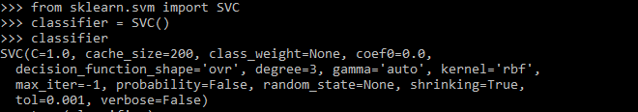
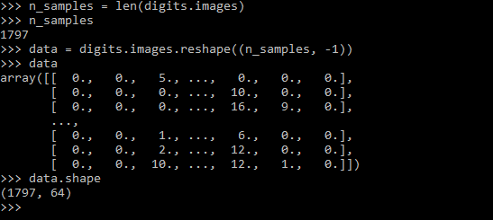
Step 2:Creating SVM Classifier
Support Vector Machines
Create SVM classifier
Turn data into 2 dimension matrix

Slide 12

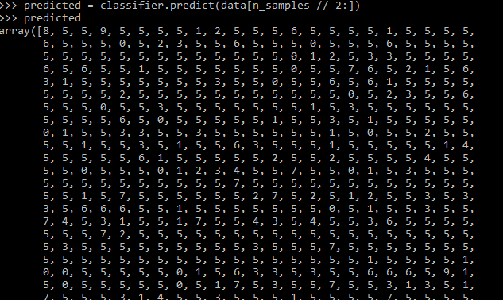
Step 3: Training and Predicting
Calling fit() with first half of the data, and the standard answers to train the model
Using the 2nd half of the data to get prediction

Slide 13
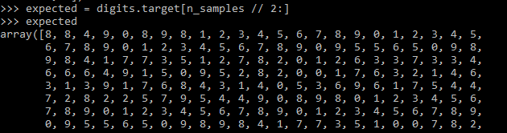
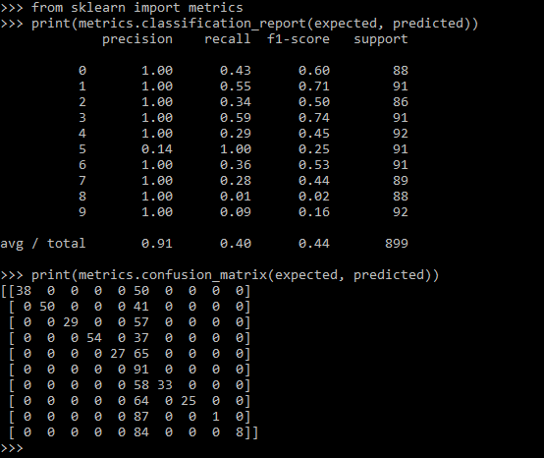
Step 4: Evaluation
Print out the standard answer.
Using the reporting function

Slide 14
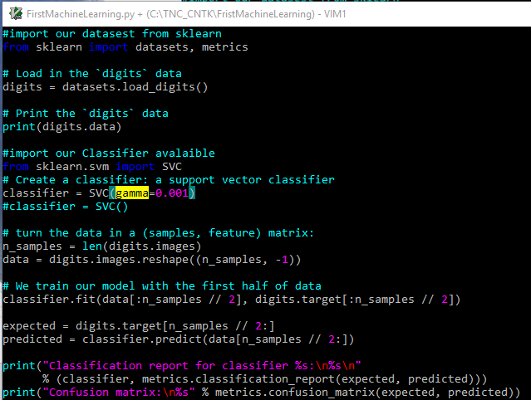
Full Script
By changing gamma parameter in the line 13, you will get a better model.
☺

Slide 15

Backup

Slide 16
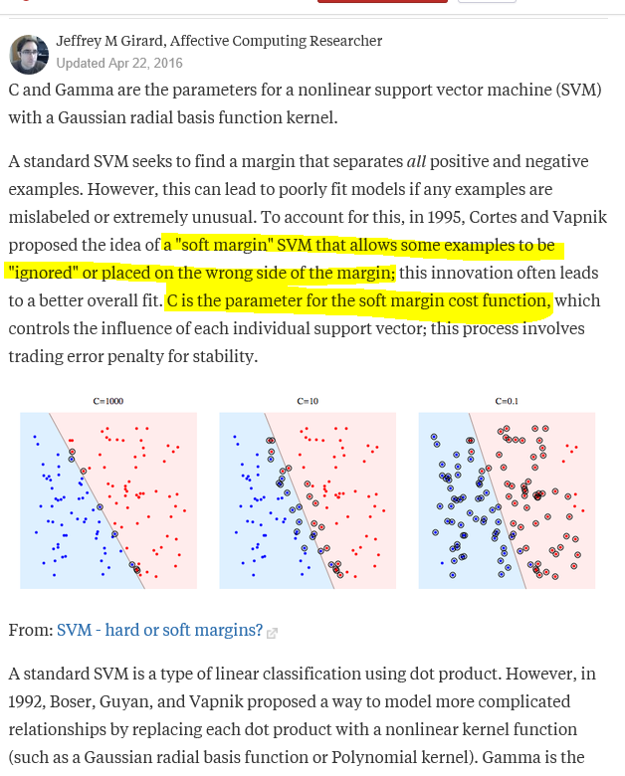
“C” and “Gamma”
A standard SVM is a type of linear classification using dot product. However, in 1992, Boser, Guyan, and Vapnik proposed a way to model more complicated relationships by replacing each dot product with a nonlinear kernel function (such as a Gaussian radial basis function or Polynomial kernel). Gamma is the free parameter of the Gaussian radial basis function.
If gamma is large, then variance is small implying the support vector does not have wide-spread influence. Technically speaking, large gamma leads to high bias and low variance models, and vice-versa.

Slide 17
Support vector machines (SVM)

Slide 18
Q&A

Slide 19
Learning Python and Tools
Python language itself
Introduction - http://tdc-www.harvard.edu/Python.pdf
Tutorial - http://marvin.cs.uidaho.edu/Teaching/CS515/pythonTutorial.pdf
Python library/package
NumPy - Fundamental package for scientific computing with Python
https://docs.scipy.org/doc/numpy-dev/user/quickstart.html http://csc.ucdavis.edu/~chaos/courses/nlp/Software/NumPyBook.pdf
Sickit-learn – ML library for python
http://scikit-learn.org/stable
CNTK - Microsoft Cognitive Toolkit
https://cntk.ai/pythondocs/index.html
TensorFlow
Anaconda - The Most Popular Python Data Science Platform
Jupyter notebook
Notes:
https://medium.com/@Ahmedrebai/my-first-machine-learning-program-8647051362b8

