Slide 1
PlotCms PlotS3k Matlab Class
Thomas Smed
Studsvik Scandpower

Slide 2
PlotCms
Graphical interface based on Handle Graphics
Can take many types of files (.cms, .hms, .res, .out, .hdf5)
Can interact with Matlab variables in workspace
Easy to port with another type of file
Its predecessor distplot has been used for many years at Vattenfall (also by people who do not know Matlab)

Slide 3
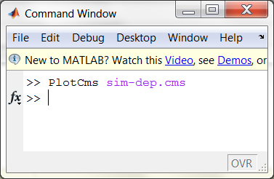
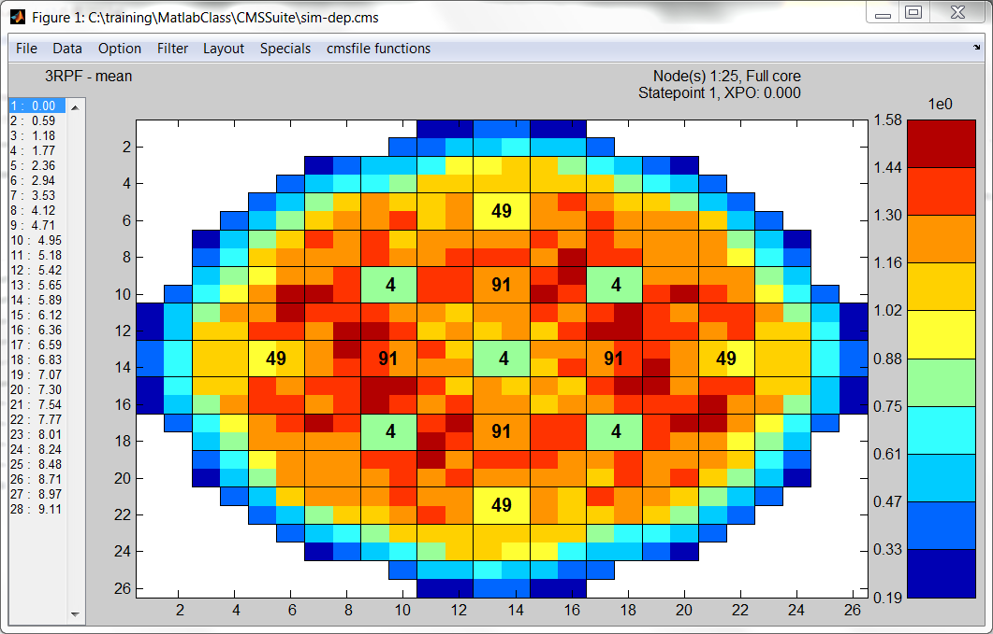

Slide 4
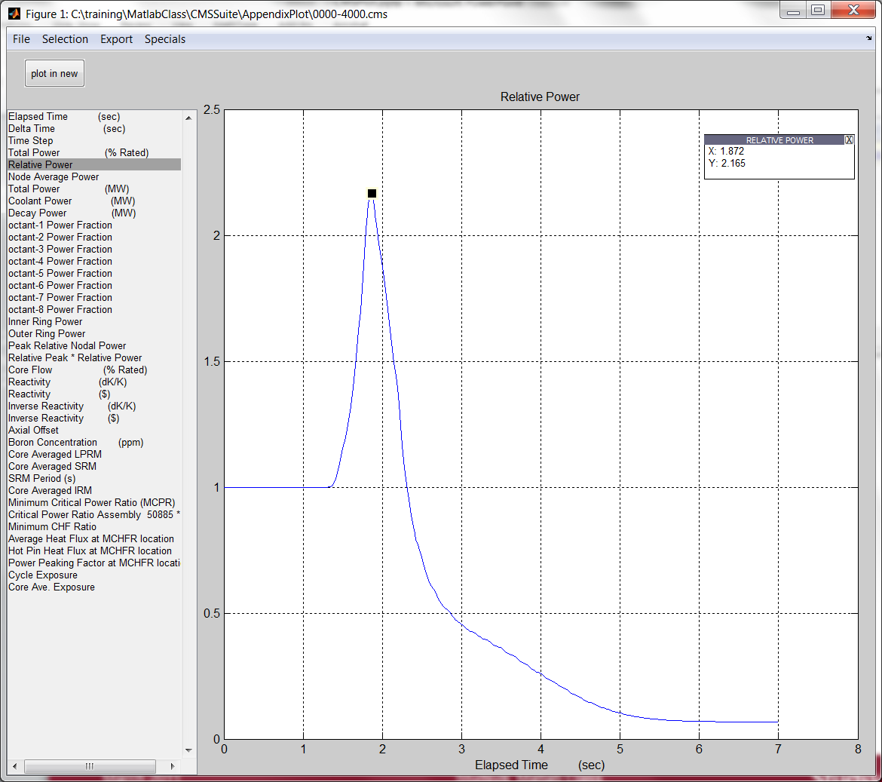
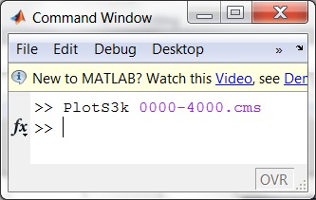
PlotS3k

Slide 5
Exercises PlotS3k, AppendixPlot
Exercise Appendixplot.txt (on CMSSuite/AppendixPlot)

Slide 6
Answers to Exercise CMSSuite
Run AppendixPlotExAppPlot.m
Or click the link below
AppendixPlot\html\ExAppPlot.html

Slide 7


