Slide 1
The MATLAB User Interface
Shaun Tarves
Studsvik Scandpower

Slide 2
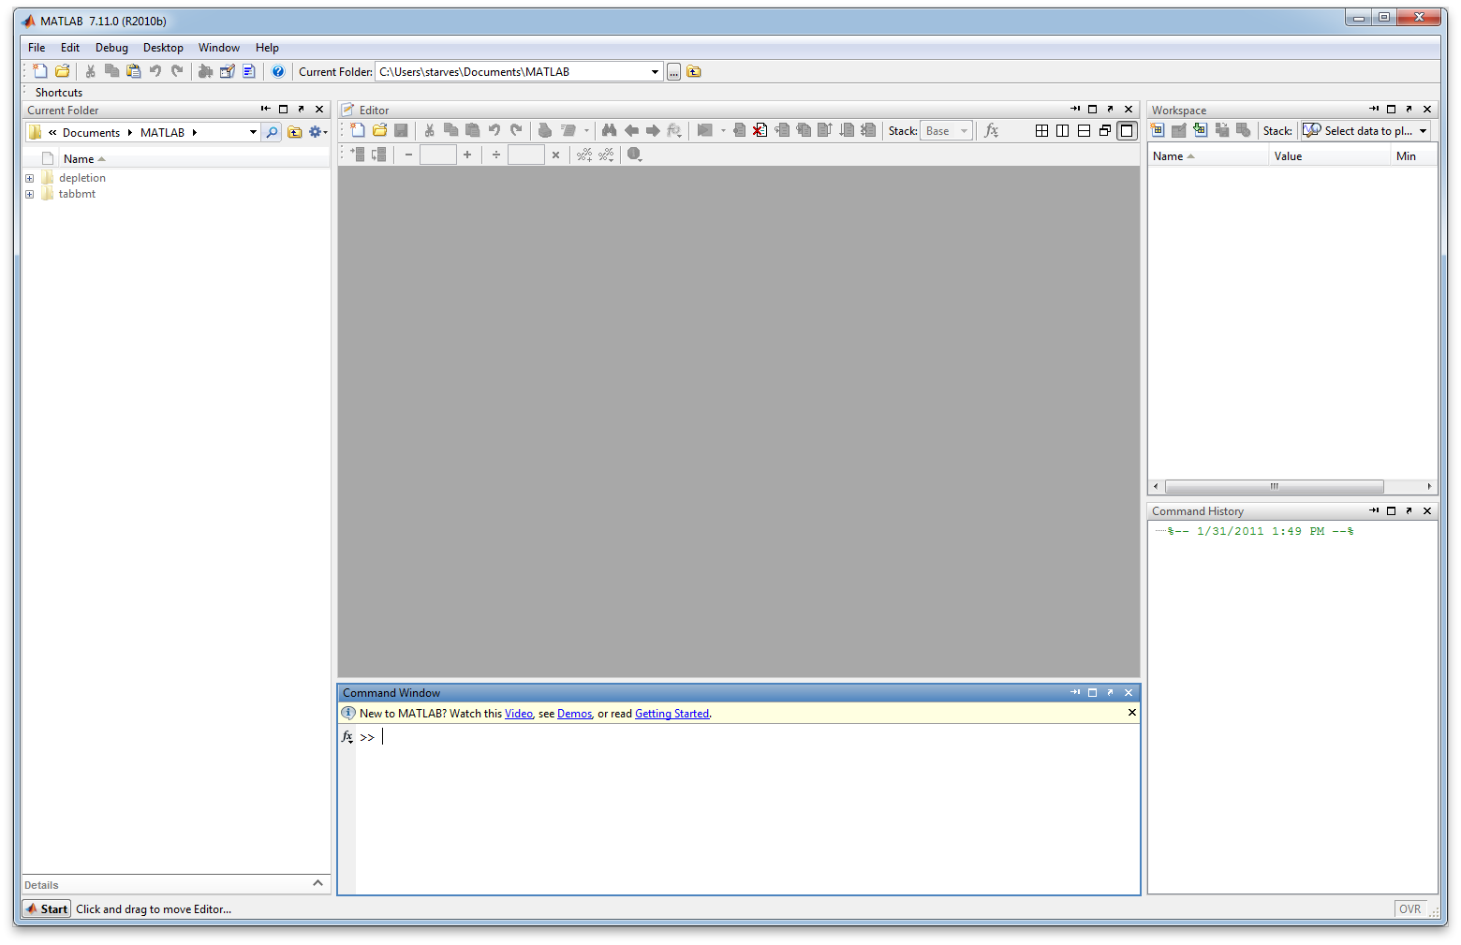
The MATLAB Desktop
Current Folder
Editor
Workspace
Command History
Command Window

Slide 3
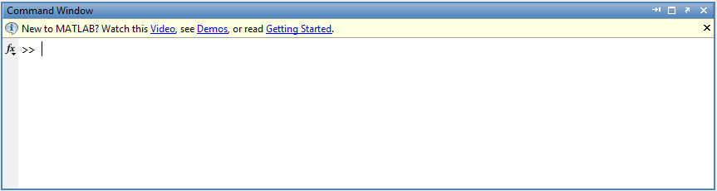
Command Window
Used to enter MATLAB commands

Slide 4
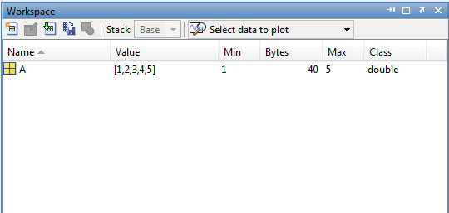
Workspace
Used to display and access MATLAB variables

Slide 5
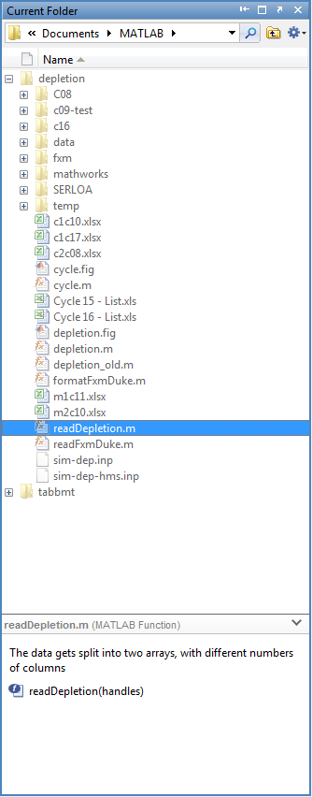
Current Folder Browser
Used to display file and folder lists

Slide 6
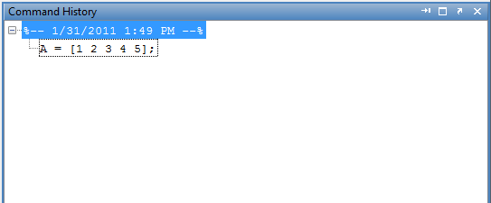
Command History
Used to record your work

Slide 7
Editor
Used to display and edit files
More on this to come

Slide 8
The MATLAB Desktop
Any component can be undocked to a separate window, docked back into the desktop, or closed
The layout can be customized and saved by accessing Desktop➔Save Layout
The Start button allows you to access wizards, help, and other goodies

Slide 9
Example: Gas Price Data (gasprices.csv)
Change your MATLAB current directory to the directory containing the course files
Hint: You can do this several ways, both in the Desktop and from the command line
C:…..\MatlabDesktop\gasprices.csv
Right-click the filename in the Current Folder Browser
Open as Text (in the Editor)
Open outside MATLAB (in the appropriate application)

Slide 10
The Import Wizard
To work with external data, it must be imported into MATLAB and stored in MATLAB “containers” (variables)
To open the Import Wizard:
File➔Import Data
Select the file gasprices.xls
Try: Use the Import Wizard to create MATLAB variables containing the data in the file

Slide 11
MATLAB Data Types
MATLAB has several data container types for various kinds of information
Some are familiar (strings, doubles, etc.), some are not (cell arrays, structs, etc.)
Double (precision) arrays are the default type of variable for numeric data
Cell arrays are versatile, and can store both numeric and character data in the same container

Slide 12
The Variable Editor
You can view and edit the contents of variables in the base workspace using the Variable Editor
Try: Double-click on the data variable and explore its contents
To edit data in a variable, simply select the data and type in new values
Try: Find the NaN in column 2 and change its value to 1.89. Notice the changes to the variable in the Workspace

Slide 13
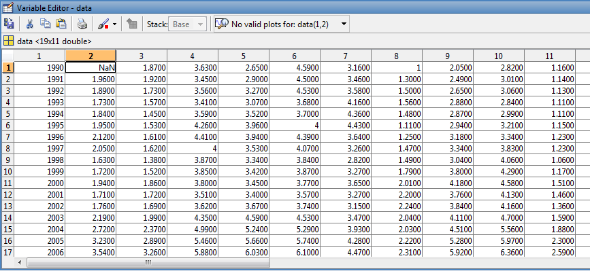
The Variable Editor

Slide 14
Shortcuts
A way to save a series of commands for easy access
For example, to clean up the MATLAB desktop, you will use:
clear: Clears the workspace variables
clc: Clears the Command Window
close: Closes the current figure
To create a shortcut, right-click the Shortcuts bar at the top of the desktop and choose New Shortcut
Enter the previous 3 commands on separate lines and click Save
Try: Click your new shortcut button to clear the Desktop

Slide 15
Quiz
Where does MATLAB display a listing of stored variables and their attributes?
Workspace
What is the default MATLAB variable type
Double
T/F: The MATLAB desktop is customizable
True

